Slide 1
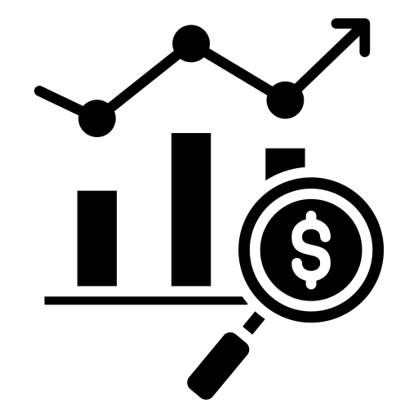
Profit_Analysis
REGRESSION AND VISUALIZATION BASED ANALYSIS
Name :Vinay Kumar Jaiswal
Team ID : PTID-CDA-MAY-25-491
Project ID : PRDA-01

Slide 2

CONTENTS
1.
Objective
Data Collection
Data Preperation
Data Visualization Dashboard
Correlation Analysis
Regression Model
Prediction
Conclusion & Recommendation
2.
3.
4.
5.
6.
7.
8.

Slide 3
OBJECTIVE
To analyze how different type of company expenditures RD Spend, Administration and Marketing Spend impact the Profit of the company.
Perform a regression analysis to quantify the relationship between expenditures and profit.
Use the model to predict profit for new scenarios based on input values.( RD_Spend Administration Marketing Profit )
21892.92 81910.77 164270.7 ?
23940.93 96489.63 137001.1 ?
Visualize the data using Power BI to uncover trends and insights across different states.
Provide data-driven recommendations to guide future spending strategies and maximize profitability.

Slide 4
DATA COLLECTION
You’ve uploaded a file named (project_profit_analy - sis.csv) , which appears to contain the dataset. I’ll begin by examining its contents.
Let me now inspect the file .
The dataset contains the following features:
RD_Spend: Money spent on R&D
Administration: Money spent on administration
Marketing_Spend: Money spent on marketingState: Location of the business unit
Profit: Target variable

Slide 5
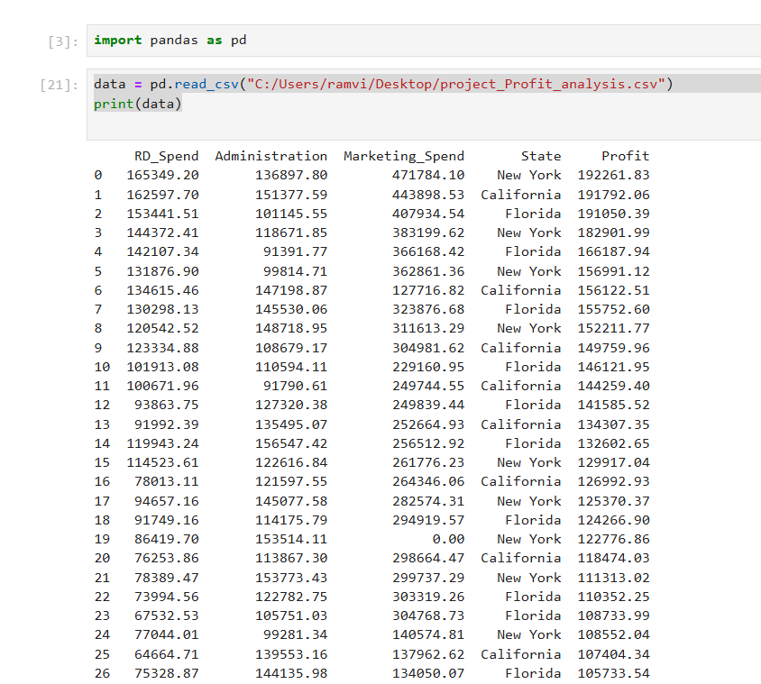
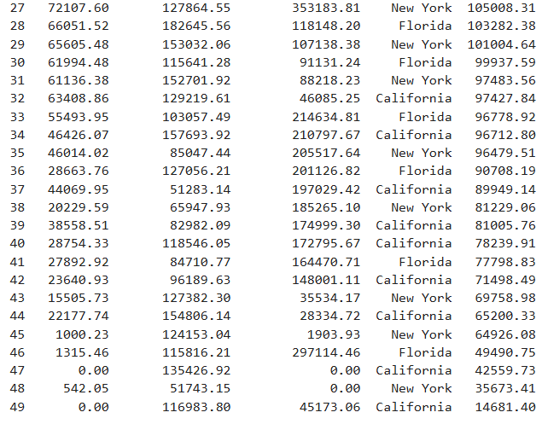
DATA PREPARATION
Import the CSV file using Pandas.

Slide 6
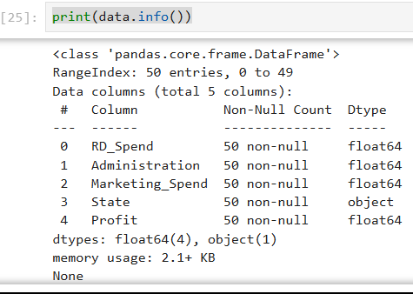
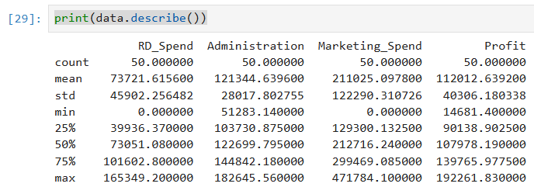
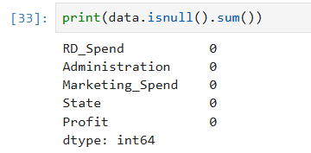
Check Structure
Check For missing values

Slide 7
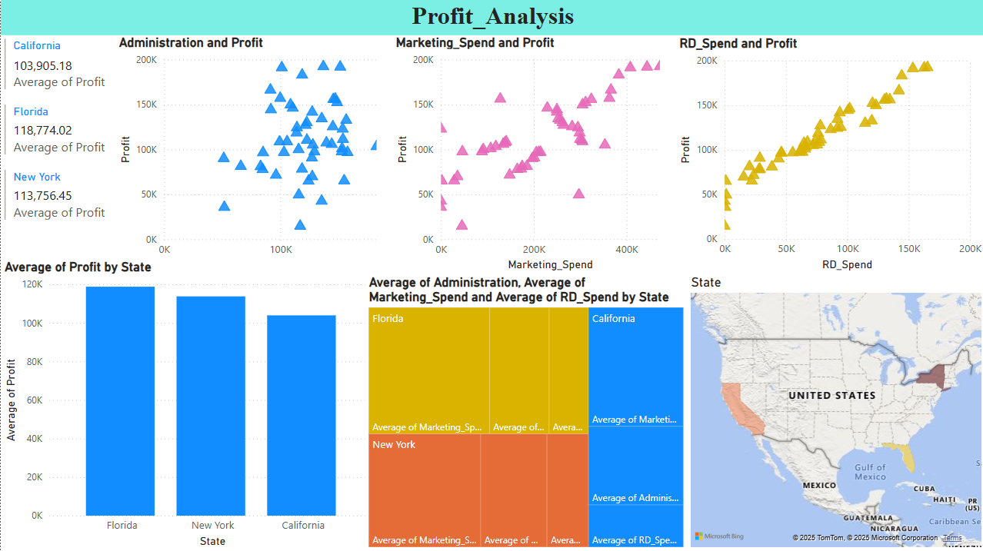
DATA VISUALIZATION DASHBOARD

Slide 8
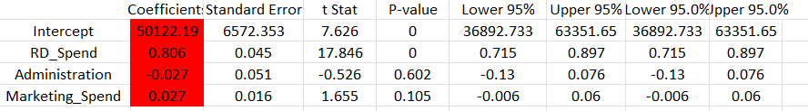
CORRELATION ANALYSIS
Correlation analysis is a statistical method used to measure and evaluate the strength and direction of the relationship between two or more variables.
RD_Spend has strong correlation with Profit.
Administration_Spend has weak/negative.
Marketing_Spend is moderate/weak.

Slide 9
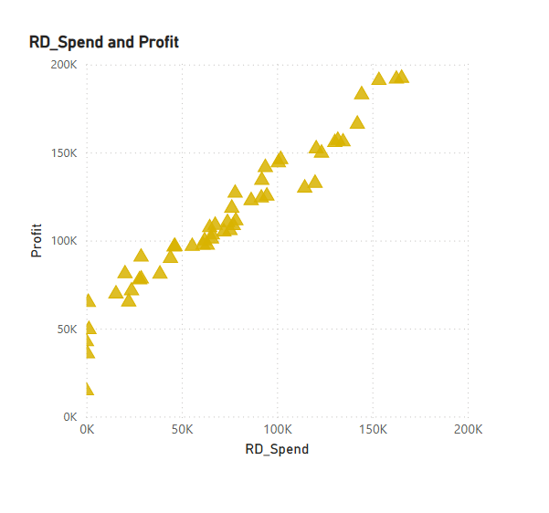
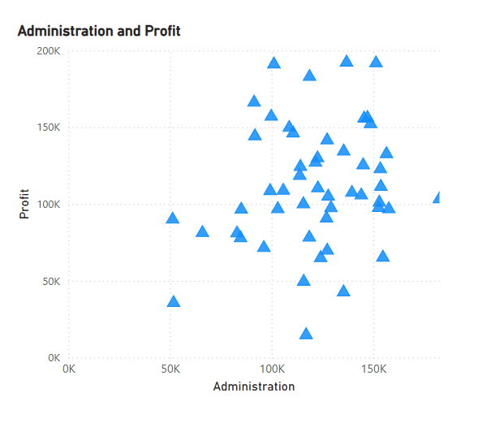
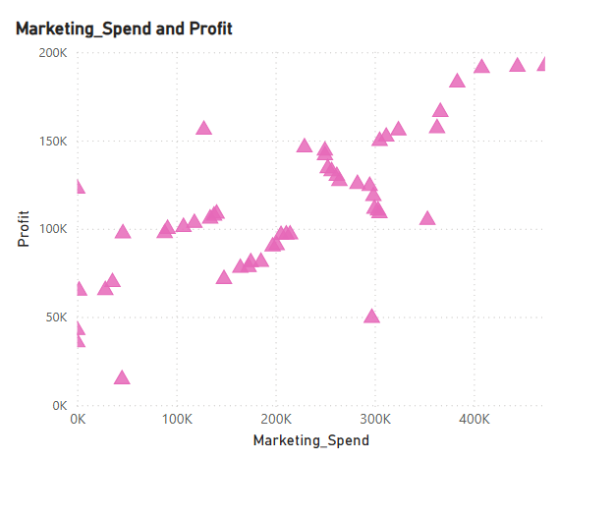
A scatter plot (also known as a scatter chart, scatter graph, or scattergram) is a type of graph that uses dots to represent the values for two different numerical variables.
Direction of Relationship
Positive Correlation: If the dots generally trend upwards from left to right, it suggests that as one variable increases, the other tends to increase.
Negative Correlation: If the dots generally trend downwards from left to right, it suggests that as one variable increases, the other tends to decrease.
No Correlation: If the dots appear randomly scattered with no discernible pattern, it indicates little to no linear relationship between the variables.

Slide 10
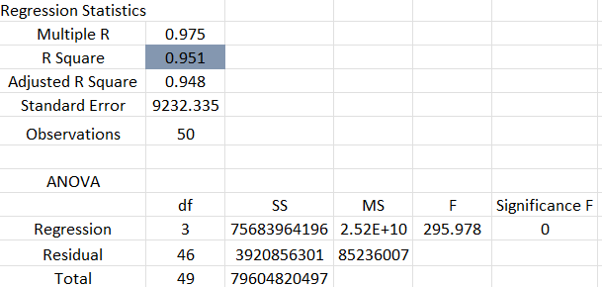
REGRESSION MODEL
Regression analysis is a powerful statistical method used to model and examine the relationship between a dependent variable (also called the outcome, response, or target variable) and one or more independent variables (also called predictor, explanatory, or regressor variables).
Regression Formula
Y = 0.806*RD_Spend +(- 0.027*Administration) + 0.027*Marketing_spend + 50122.193

Slide 11
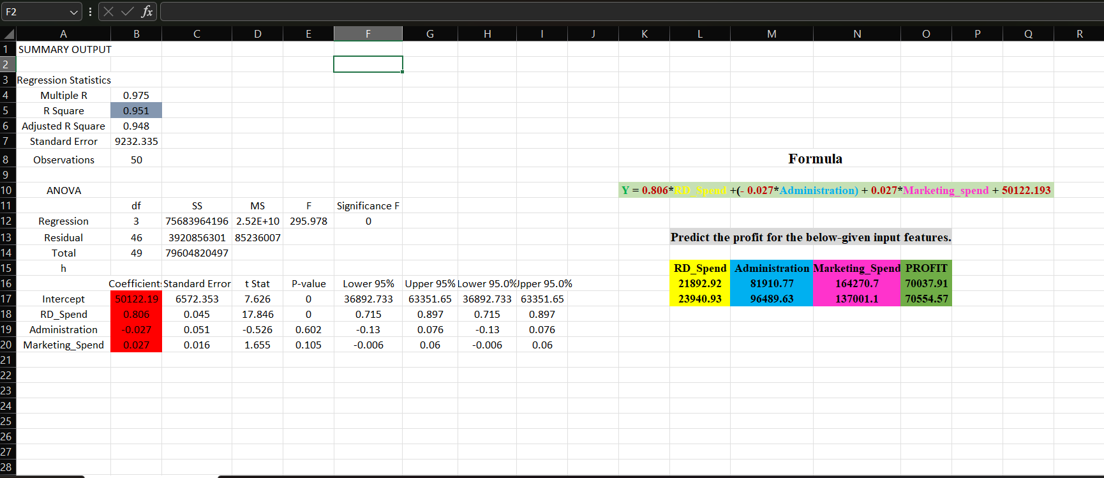
PREDICTION
Predict the profit.
RD_Spend Administration Marketing Profit
21892.92 81910.77 164270.7 70037.91
23940.93 96489.63 137001.1 70554.57

Slide 12
CONCLUSION & RECOMMENDATION
1. RD Spend
Strongest positive impact on profit
Every additional dollar spent increases profit significantly
Highly correlated with business success
2. Marketing Spend
Slight positive impact
Can boost profit, but less effective than R&D
May need better targeting or analysis of ROI
3. Administration Spend
No significant effect on profit
Could be a candidate for cost reduction or optimization
4. State-wise Differences
Minor differences in profit across states
Could be due to operational or market differences

Slide 13


