Slide 1

CertiFlow Workshop Certificate Automation

Slide 2

Tools & Technologies Used
Microsoft Forms → Used for collecting participant details
Excel (Forms for Excel) → Responses stored and managed automatically
Power Automate → Automated the certificate generation and email process
SharePoint → Stored certificate files and participant records
Outlook Email → Sent individual certificate emails to participants

Slide 3


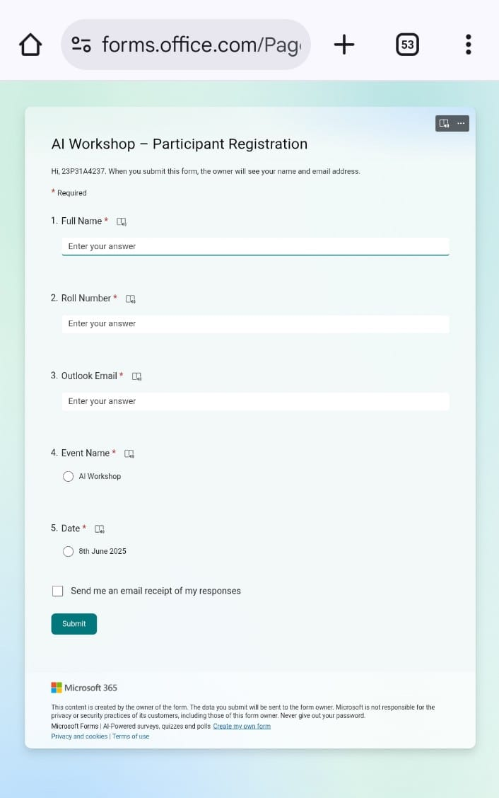
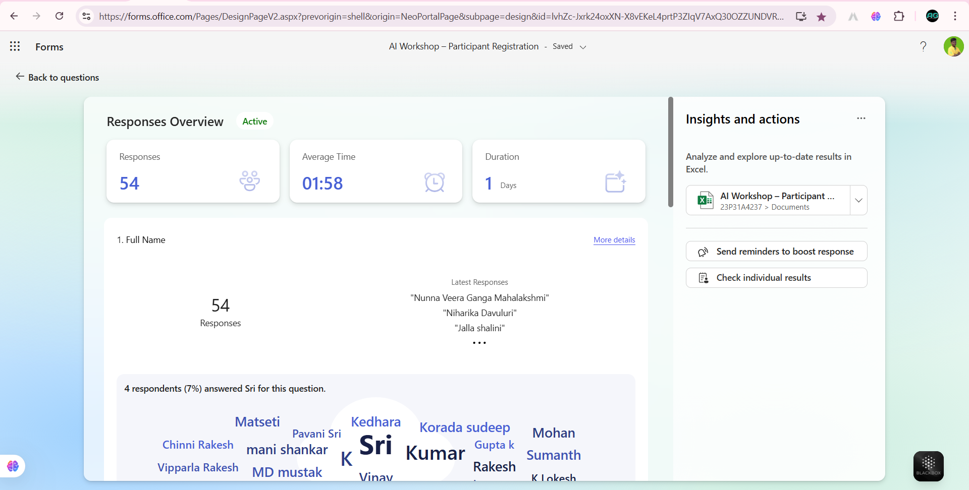
Microsoft Form – Participant Registration
This form collected participant data, which was linked to Excel using 'Forms for Excel’.

Slide 4
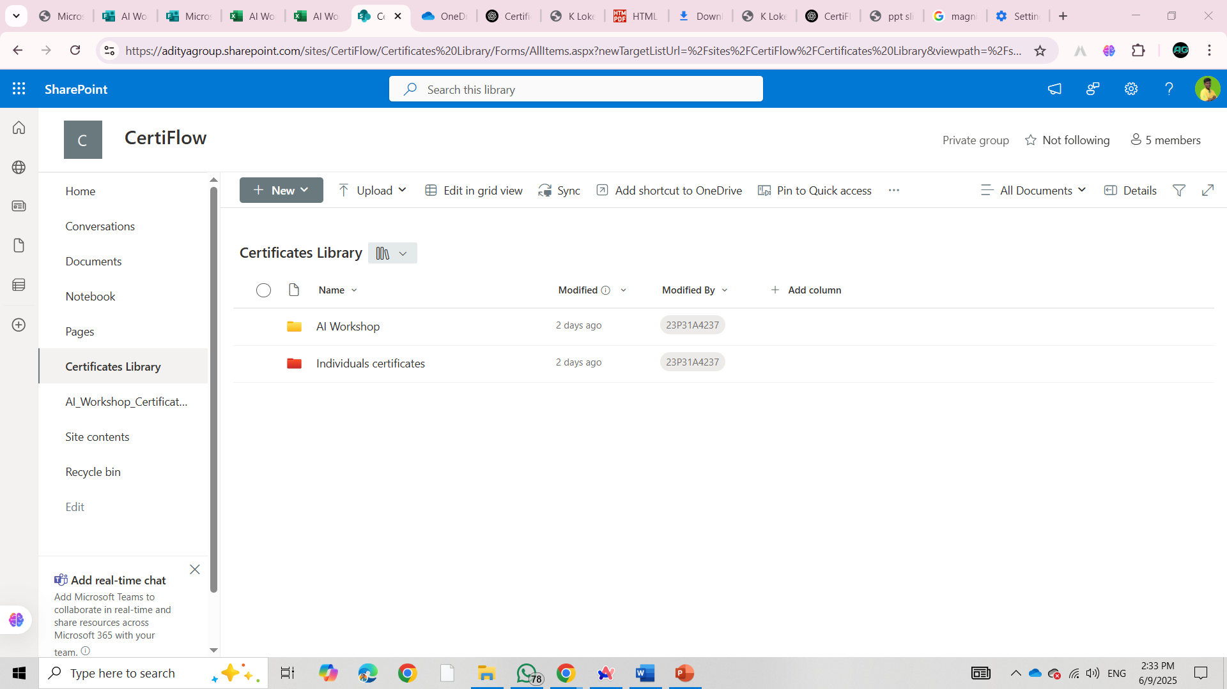
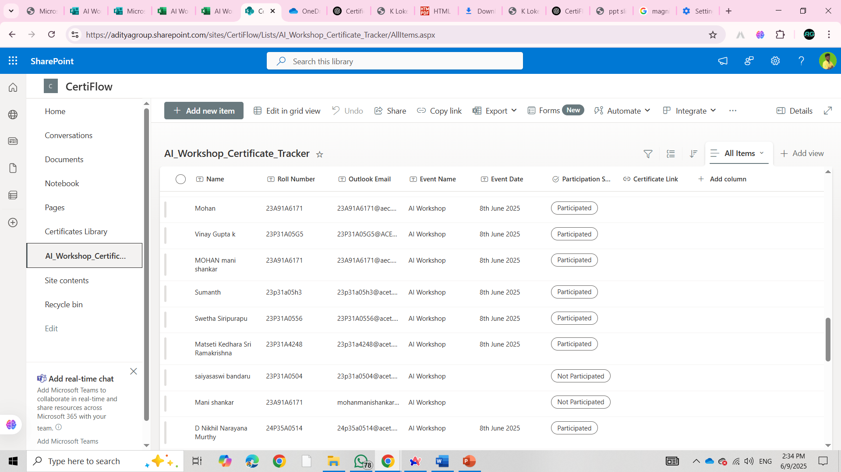
SharePoint Site – List & Certificate Storage
This SharePoint Team Site includes a document library to store certificates and a custom list to track delivery status. Power Automate updates both automatically.

Slide 5
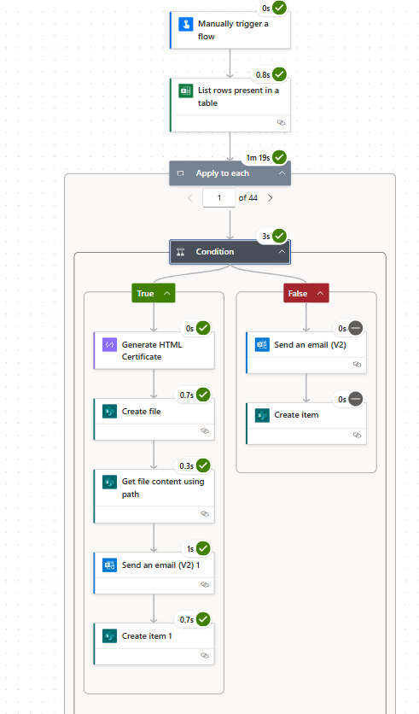
Power Automate Flow – Conditional Logic
This flow checks each response from Excel. If the participant is marked as ‘Participated’, it sends a certificate and stores the data in SharePoint. Otherwise, it sends a non-participation email.

Slide 6
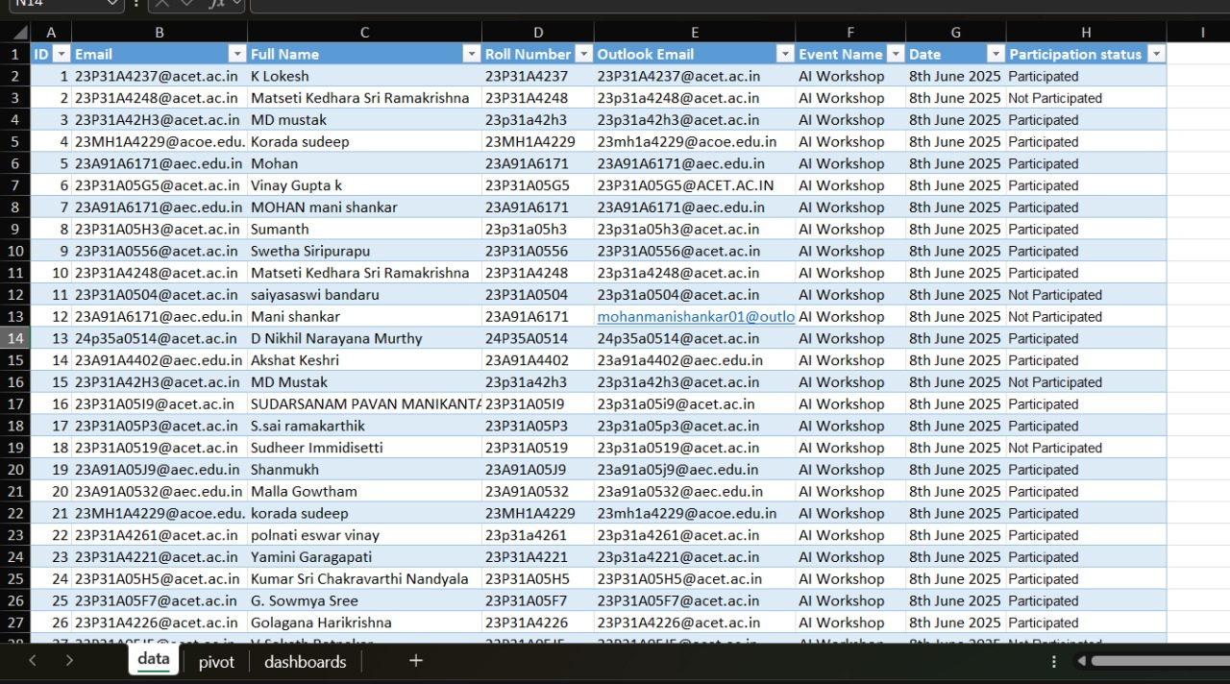
Excel Response & Participation Tracking
Form responses are linked to Excel. A filtered list is used to generate and send certificates only to participants who attended.

Slide 7

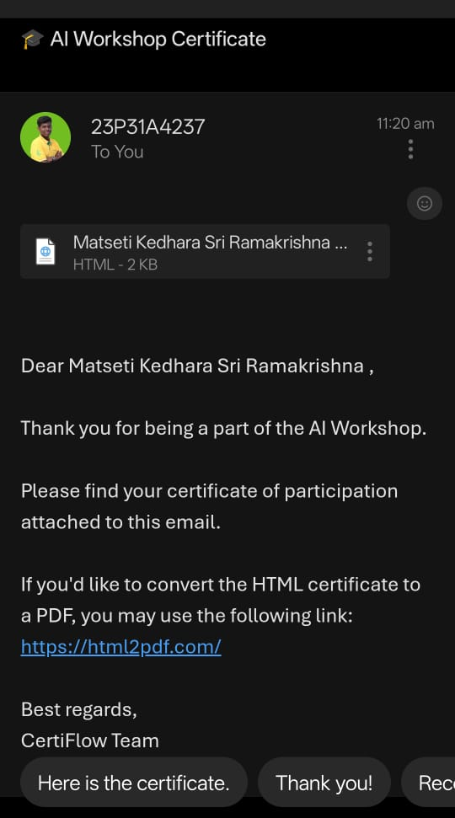
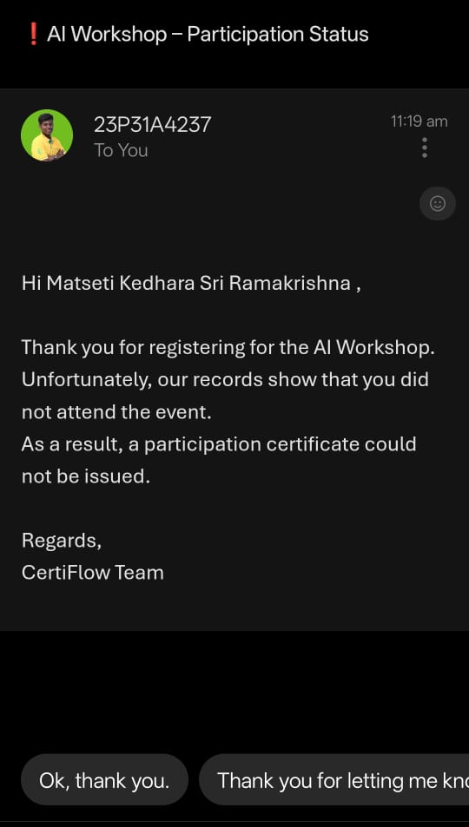
Certificate Email – Participated vs Not Participated
Power Automate sends personalized emails. Participants receive their certificates, while non-attendees are notified without attachments.

Slide 8
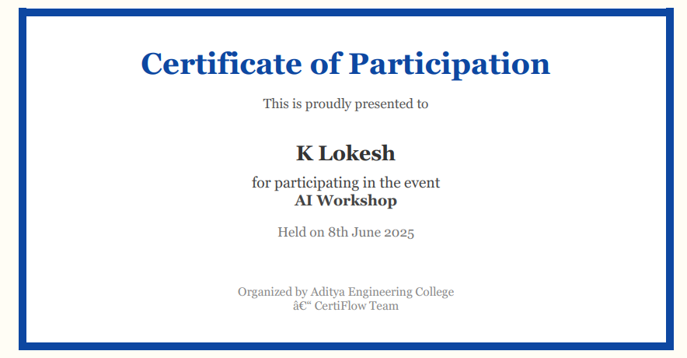
Sample Participation Certificate
This sample shows the auto-generated certificate received by participants via email.

Slide 9
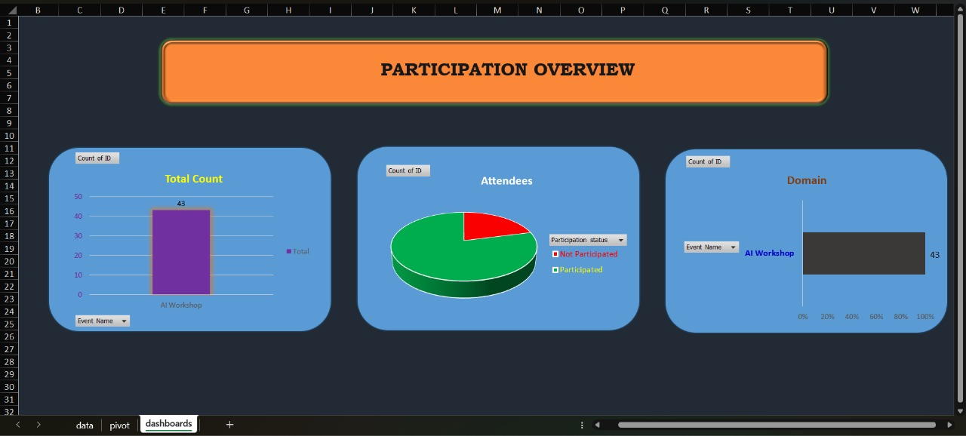

Slide 10

Conclusion
CertiFlow successfully automates certificate distribution using Microsoft tools
Reduces manual effort and ensures accurate tracking
Fully developed using free features of Microsoft 365 A3 student license
Can be reused for future workshops and campus events
“Automation doesn’t just save time — it creates consistency.”

Slide 11
Thank You

