Slide 1
MATHEMATICAL FOUNDATIONS FOR DATA SCIENCE
Dr Y V K RAVI KUMAR

Slide 2
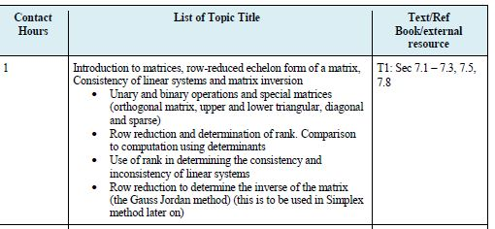

Slide 3
Matrix
A matrix is a rectangular array of numbers enclose in brackets.
These numbers are called entries or elements of the matrix.
In a matrix horizontal lines are called rows and vertical lines are called columns.
Matrices are represented by capital letters A,B,C……

Slide 4
Matrix Notations
Column 4
(second index)
Row 3
(first index)

Slide 5
Matrix having just a single row or column are called vectors. Its entries are called components of the vectors.
Matrix having just one row is called row vector.
Matrix having just one column is called column vector.

Slide 6
Square Matrix
Square matrix, m = n
Particularly important when solving simultaneous equations in engineering applications
a_{ii} – principle or main diagonal

Slide 7
Matrix Operation Rules
Matrix identity
[A] = [B] if and only if a_{ij} = b_{ij} for all i and j
Matrix Addition and Subtraction
[C] = [A] + [B] ⇒ C_{ij} = A_{ij} + B_{ij}
[C] = [A] − [B] ⇒ C_{ij} = A_{ij} − B_{ij}

Slide 9
Addition and Subtraction
Commutative
[A] + [B] = [B] + [A]
[A] − [B] = −[B] + [A]
Associative
( [A] + [B] ) + [C] = [A] + ( [B] + [C] )
( [A] + [B] ) − [C] = [A] + ( [B] − [C] )
( [A] − [B] ) + [C] = [A] + (−[B] + [C] )

Slide 10
Multiplication of Matrix by a Scalar
g = 5

Slide 11
Problems
Find 1. 2(A+B)
2. 12u+10v
3. u-v

Slide 12
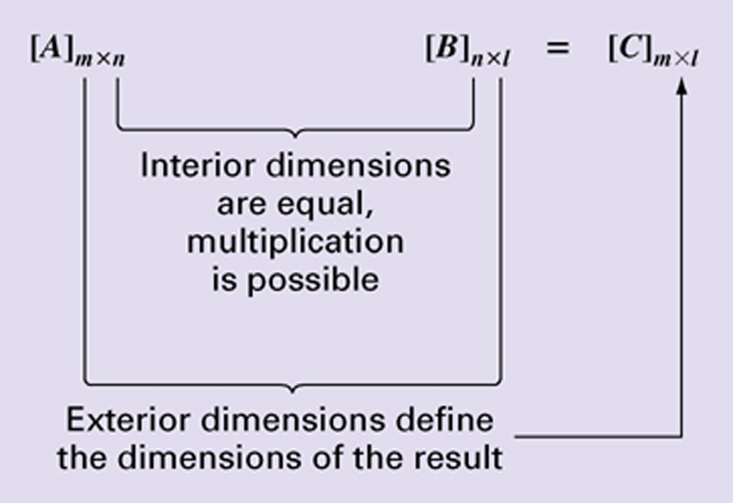
Matrix Multiplication
Matrix multiplication can be performed only if the inner dimensions are equal

Slide 13
Matrix Multiplications
Recall how matrix multiplication works
[A]*[B] ≠ [B]*[A]

Slide 14
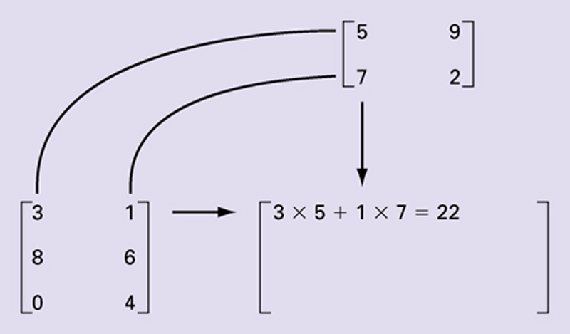
Matrix Multiplication
Visual depiction of how the rows and columns line up in matrix multiplication

Slide 15
Matrix Multiplication
Interior dimensions have to be equal
For a vector
We will be using square matrices

Slide 18
Matrix Multiplication
Associative
( [A] [B] ) [C] = [A] ( [B] [C] )
Distributive
[A] ( [B] + [C] ) = [A] [B] + [A] [C]
([A] + [B] ) [C] = [A] [C] + [B] [C]
Not generally commutative
[A] [B] ≠ [B] [A]

Slide 19
Matrix Multiplication
In general [A] [B] ≠ [B] [A]
AB=0, does not necessarily imply A=0 or B=0 or BA=0.
AC=AD does not necessarily imply C=D

Slide 20
Special Matrices
Diagonal matrix
Identity matrix
[A][I] = [I][A] = [A]

Slide 21
Special Matrices
lower triangular
upper triangular

Slide 22
Matrix Operations
Transpose
Trace is sum of diagonal elements

Slide 23
Matrix Transpose

Slide 24
Special Matrices
symmetric matrices
a_{ij} = a_{ji}
_{[A]}^{T} _{= [A]}
skew-symmetric matrices
a_{ij} = - a_{ji} hence a_{jj} =0
_{[A]}^{T} _{=- [A]}

Slide 25
Symmetric Matrix:
(OR)

Slide 26
Example:
then

Slide 27
Skew – Symmetric Matrix:
(OR)

Slide 28
Example:
then we have

Slide 29
Rank of the Matrix

Slide 30
Alternate Definition:

Slide 31
Important results of the Rank of the Matrix:

Slide 33
Note:

Slide 34
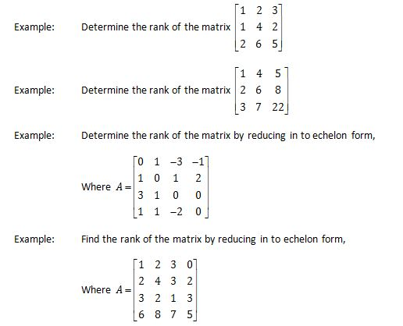

Slide 35
System of Linear Equations
Linear equations are two types
1. Non-Homogeneous Linear equations
2. Homogeneous Linear equations

Slide 36
Non Homogeneous Linear Systems
Linear equations and constant coefficients
____(1)
a_{ij} and b_{i} are constants

Slide 37
Mathematical background
It is convenient to write system of equations in matrix-vector form

Slide 38
Solution of Linear equations
The matrix form of system of equations is
(------(1)
If (1) has a solution, then the linear system is said to be consistent otherwise the linear system is said to be inconsistent.
If b’s are all zero in equation (1) then,
(1) is called homogeneous linear system otherwise (1) is called non-homogeneous system.

Slide 39
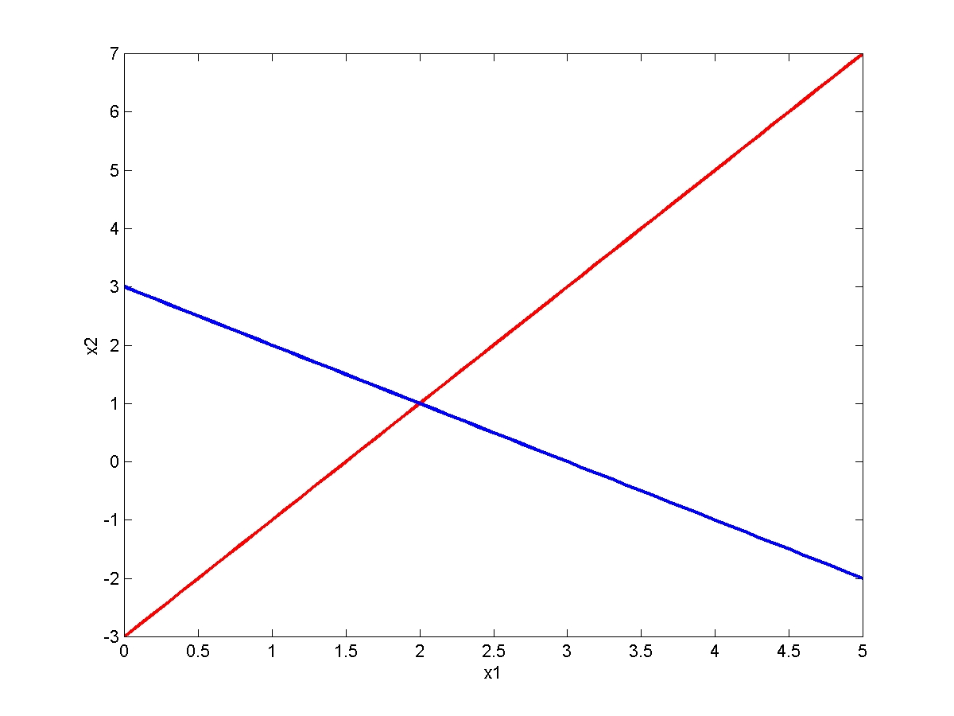
Graphical Method
x₁ + x₂ = 3
2x₁ – x₂ = 3
One solution

Slide 40
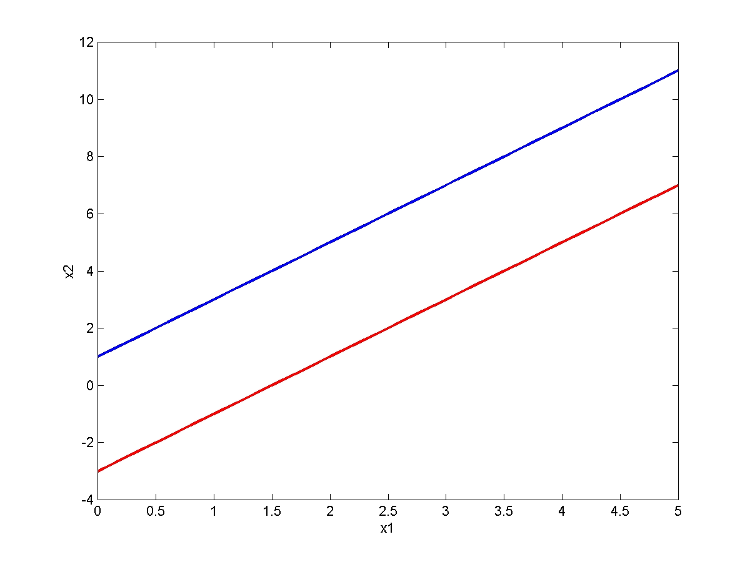
Graphical Method
No solution
2x₁ – x₂ = – 1
2x₁ – x₂ = 3

Slide 41
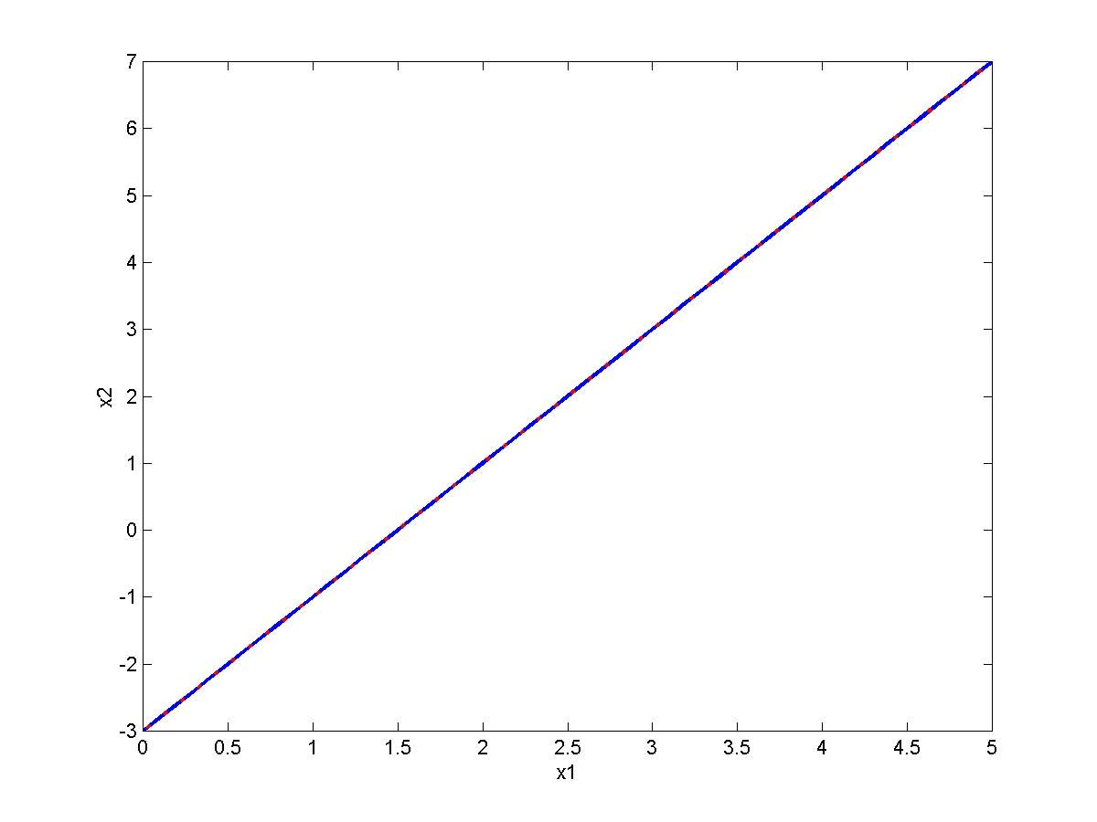
Graphical Method
Infinite many solution
2x₁ – x₂ = 3
6x₁ – 3x₂ = 9

Slide 42
Non-Homogeneous Linear equations

Slide 43
Elimination of first column

Slide 44
Elimination of second column

Slide 45
Elimination of third column
Upper triangular matrix

Slide 46
Back-Substitution
Upper triangular matrix

Slide 47
|
|
|
|
The matrix in the above form is called echelon form.
No. of non-zero rows in echelon form is called rank of the matrix.

Slide 48
n=no. of unknowns in the linear system
If rank of A=rank of [A/b]=n ,then the system has unique solution.
If rank of A=rank of [A/b]<n ,then the system has infinite no. of solutions.
If rank of A ≠ rank of [A/b] , then the system has no solution.

Slide 49
Solve the following system of equations
3. x +y+ z+ t= 0
x+ y+ z- t= 4
x+ y-z + t= -4
x- y +z + t= 2
4. x+2y -z =3
3x-y+2z=-1
2x-2y+3z=2
x- y + z= -1
1.x+ y +z =6
2x+3y-2z=2
5x+y+2z=13.
2. x+ y +z =9
2x+5y+7z=52
2x+y-z =0.

Slide 50
EXERCISE
Solve the linear system
(i) (ii)
(iii)

Slide 51
Homogeneous Linear equations

Slide 52
Solve the following system of equations
1.x+3y-2z = 0
2x-y+4z=0
x-11y+14z=0.
2. 4x+ 2y +z+3w =0
6x+3y+4z+7w=0
2x+y+w =0.

Slide 53
Matrix Inverse
Matrix division is undefined
However, there is a matrix inverse for non singular square matrices
[A]⁻¹ [A] = [A] [A]⁻¹ = [I]
Multiplication of a matrix by the inverse is analogous to division

Slide 54
If A has an inverse, then A is called a non-singular matrix. (|A|≠0)
If A has no inverse, the A is called a singular matrix. (|A|=0)
If A has an inverse then it is unique.

Slide 55
Gauss-Jordan Elimination
To find the inverse of a Matrix A using
Gauss-Jordan Method where A is,

Slide 56
We write
Whatever you do to left-hand-side, do to the right-hand side (useful when solving system of equations)

Slide 57
Exercise
(i) (ii) (iii)

Slide 58
Thank you

