Slide 1
MATHEMATICAL FOUNDATIONS FOR DATA SCIENCE
Dr Y V K RAVI KUMAR

Slide 2
Rank of the Matrix

Slide 3
Alternate Definition:

Slide 4
Important results of the Rank of the Matrix:

Slide 6
Note:

Slide 7
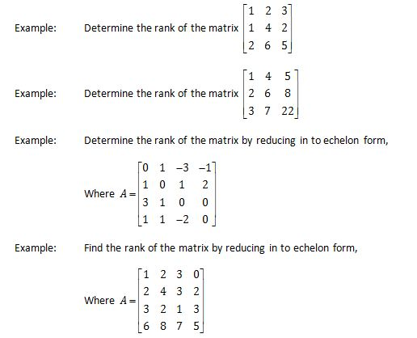

Slide 8
System of Linear Equations
Linear equations are two types
1. Non-Homogeneous Linear equations
2. Homogeneous Linear equations

Slide 9
Non Homogeneous Linear Systems
Linear equations and constant coefficients
____(1)
a_{ij} and b_{i} are constants

Slide 10
Mathematical background
It is convenient to write system of equations in matrix-vector form

Slide 11
Solution of Linear equations
The matrix form of system of equations is
(------(1)
If (1) has a solution, then the linear system is said to be consistent otherwise the linear system is said to be inconsistent.
If b’s are all zero in equation (1) then,
(1) is called homogeneous linear system otherwise (1) is called non-homogeneous system.

Slide 12
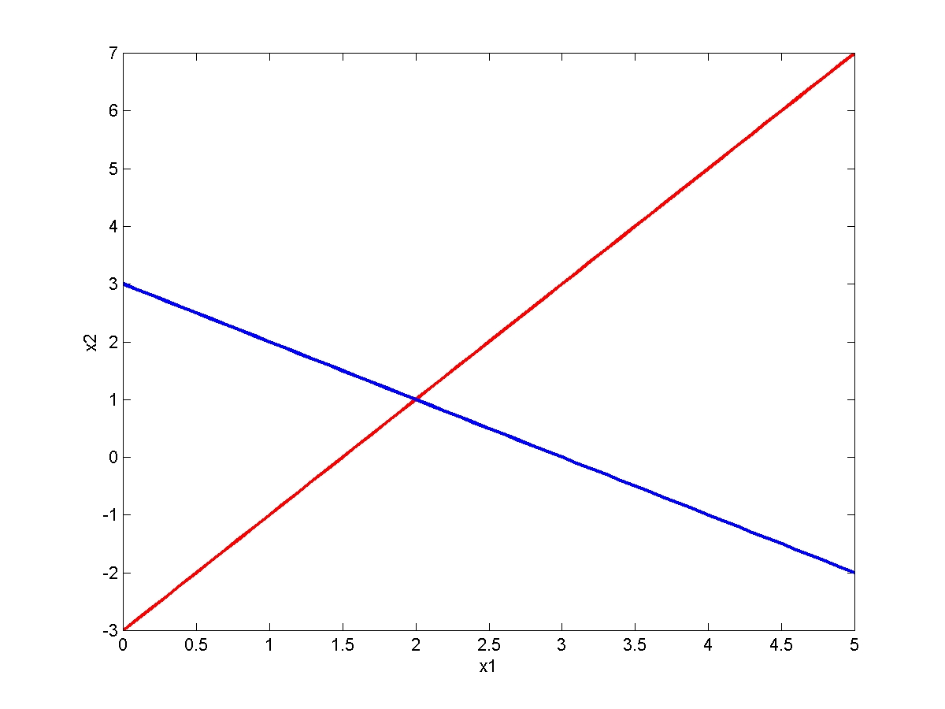
Graphical Method
x₁ + x₂ = 3
2x₁ – x₂ = 3
One solution

Slide 13
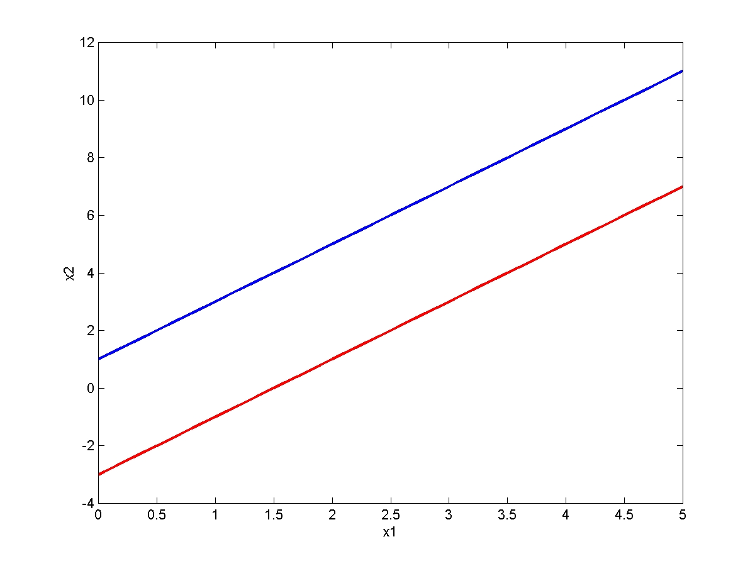
Graphical Method
No solution
2x₁ – x₂ = – 1
2x₁ – x₂ = 3

Slide 14
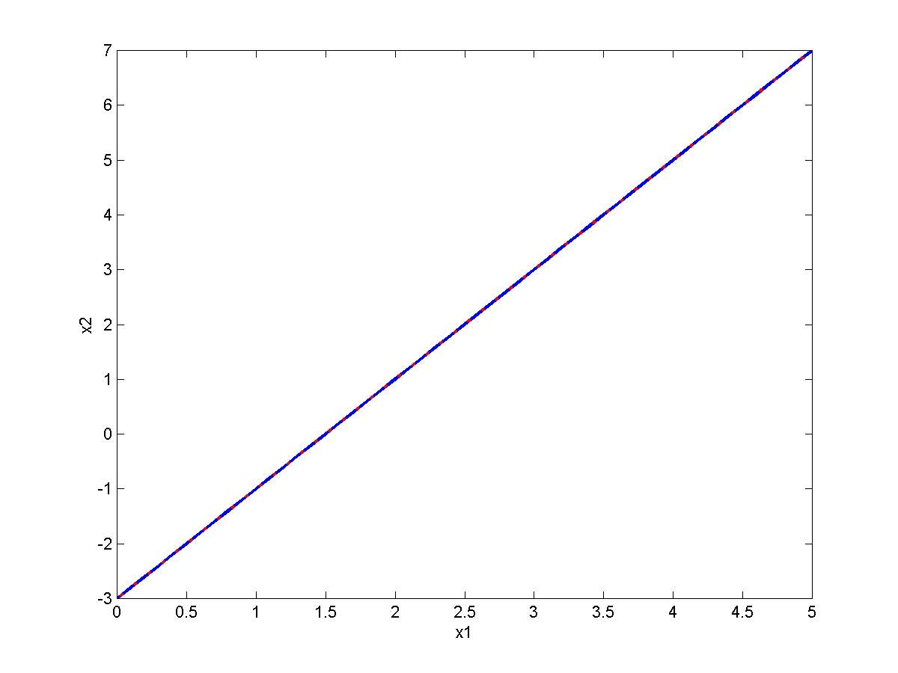
Graphical Method
Infinite many solution
2x₁ – x₂ = 3
6x₁ – 3x₂ = 9

Slide 15
Non-Homogeneous Linear equations

Slide 16
Elimination of first column

Slide 17
Elimination of second column

Slide 18
Elimination of third column
Upper triangular matrix

Slide 19
Back-Substitution
Upper triangular matrix

Slide 20
|
|
|
|
The matrix in the above form is called echelon form.
No. of non-zero rows in echelon form is called rank of the matrix.

Slide 21
n=no. of unknowns in the linear system
If rank of A=rank of [A/b]=n ,then the system has unique solution.
If rank of A=rank of [A/b]<n ,then the system has infinite no. of solutions.
If rank of A ≠ rank of [A/b] , then the system has no solution.

Slide 22
Solve the following system of equations
3. x +y+ z+ t= 0
x+ y+ z- t= 4
x+ y-z + t= -4
x- y +z + t= 2
4. x+2y -z =3
3x-y+2z=-1
2x-2y+3z=2
x- y + z= -1
1.x+ y +z =6
2x+3y-2z=2
5x+y+2z=13.
2. x+ y +z =9
2x+5y+7z=52
2x+y-z =0.

Slide 23
EXERCISE
Solve the linear system
(i) (ii)
(iii)

Slide 24
Homogeneous Linear equations

Slide 25
Solve the following system of equations
1.x+3y-2z = 0
2x-y+4z=0
x-11y+14z=0.
2. 4x+ 2y +z+3w =0
6x+3y+4z+7w=0
2x+y+w =0.

Slide 26
Matrix Inverse
Matrix division is undefined
However, there is a matrix inverse for non singular square matrices
[A]⁻¹ [A] = [A] [A]⁻¹ = [I]
Multiplication of a matrix by the inverse is analogous to division

Slide 27
If A has an inverse, then A is called a non-singular matrix. (|A|≠0)
If A has no inverse, the A is called a singular matrix. (|A|=0)
If A has an inverse then it is unique.

Slide 28
Gauss-Jordan Elimination
To find the inverse of a Matrix A using
Gauss-Jordan Method where A is,

Slide 29
We write
Whatever you do to left-hand-side, do to the right-hand side (useful when solving system of equations)

Slide 30
Exercise
(i) (ii) (iii)

Slide 31
Thank you

