Slide 1
MALLARD CONNECT
Lead Nurturing & Follow-up System
A lightweight pre-CRM that ensures no prospect falls through the cracks. Works alongside the Mortgage Advice Bureau Platform system.
Mallard Mortgages, Sheffield UK
Built by Storyboard Digital

Slide 2
The Problem
Prospects who enquire but aren't ready to proceed are falling through the cracks.
The Solution: Mallard Connect
Structured follow-up reminders with email notifications to up to 3 recipients
Visual pipeline board showing every prospect's status at a glance
Daily 7am reminder emails so no lead is ever forgotten
MAB Platform CSV import with automatic deduplication
Mobile-optimized for salespeople in the field
Real-time team dashboard for Della
No structured follow-up
Advisers note "contact in January" but there's no system to make it happen.
No pipeline visibility
Della can't see at a glance where each prospect sits or what the next action should be.
CRM is overkill (for now)
A full CRM is too expensive and complex. They need something that works with what they have.

Slide 3
Three Personas, One System
D
O
F
Della Mallard
Office Salespeople
Field Salespeople
Owner / Manager
Desktop / Laptop
Mobile / On the Go
Sees everything at a glance
Pipeline health & team performance
Assigns and rebalances leads
Imports from MAB Platform
Reports and KPIs
Structured daily follow-up list
Fast lead capture (<60 seconds)
Qualification workflow
Activity logging with reminders
Prospect detail with full timeline
15-second Quick Capture
Pre-meeting client review
Pipeline check between appointments
Tap-to-call from follow-up cards
Push notifications with quick actions

Slide 4
Pipeline Stages
UK mortgage nurture process, designed around Mallard's specific pain points
New Enquiry
Initial Contact
Not Ready Yet
Nurturing
Ready to Proceed
Referred to MAB
Won / Completed
Lost / Gone Cold
→
→
→
→
→
→
→
5
3
12
8
4
6
3
9
"Not Ready Yet" is a first-class stage — not an afterthought.
This is where Mallard's leads currently fall through cracks. The system highlights it with amber borders, prominent follow-up scheduling, and supports 6-12 month reminder cycles.

Slide 5
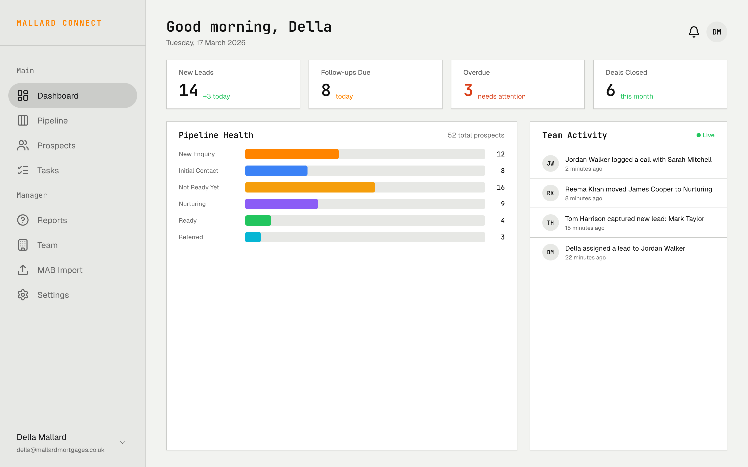
Manager Dashboard
Della
Desktop
Della sees everything at a glance — pipeline health, team performance, and which leads need attention.
Key Features
4 KPI cards: New Leads, Follow-ups Due, Overdue, Deals Closed
Pipeline Health horizontal bar chart across all active stages
Team Activity live feed — calls logged, stages changed, leads created
Real-time updates via Firestore onSnapshot
Full sidebar navigation with manager-level sections
In control within 30 seconds of opening the app
Screen: 00PCT
Design: pencil-welcome-desktop.pen | Node: 00PCT

Slide 6
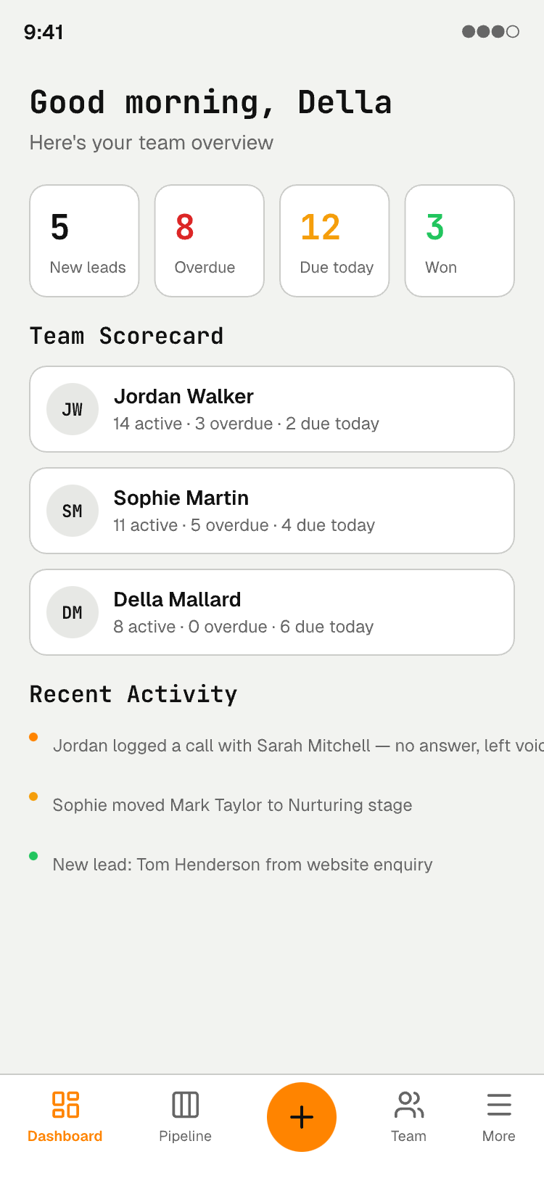
Manager Dashboard — Mobile
Della
Mobile
9:41
Same data optimized for Della's phone. Check team status on the go.
Key Features
Compact KPI pills: New leads, Overdue, Due today, Won
Team Scorecard — avatar + stats per salesperson
Condensed activity feed with color-coded dots
Bottom tab nav with Dashboard active
FAB button for quick actions
Design: pencil-welcome-desktop.pen | Node: bO6Pj
Screen: bO6Pj

Slide 7
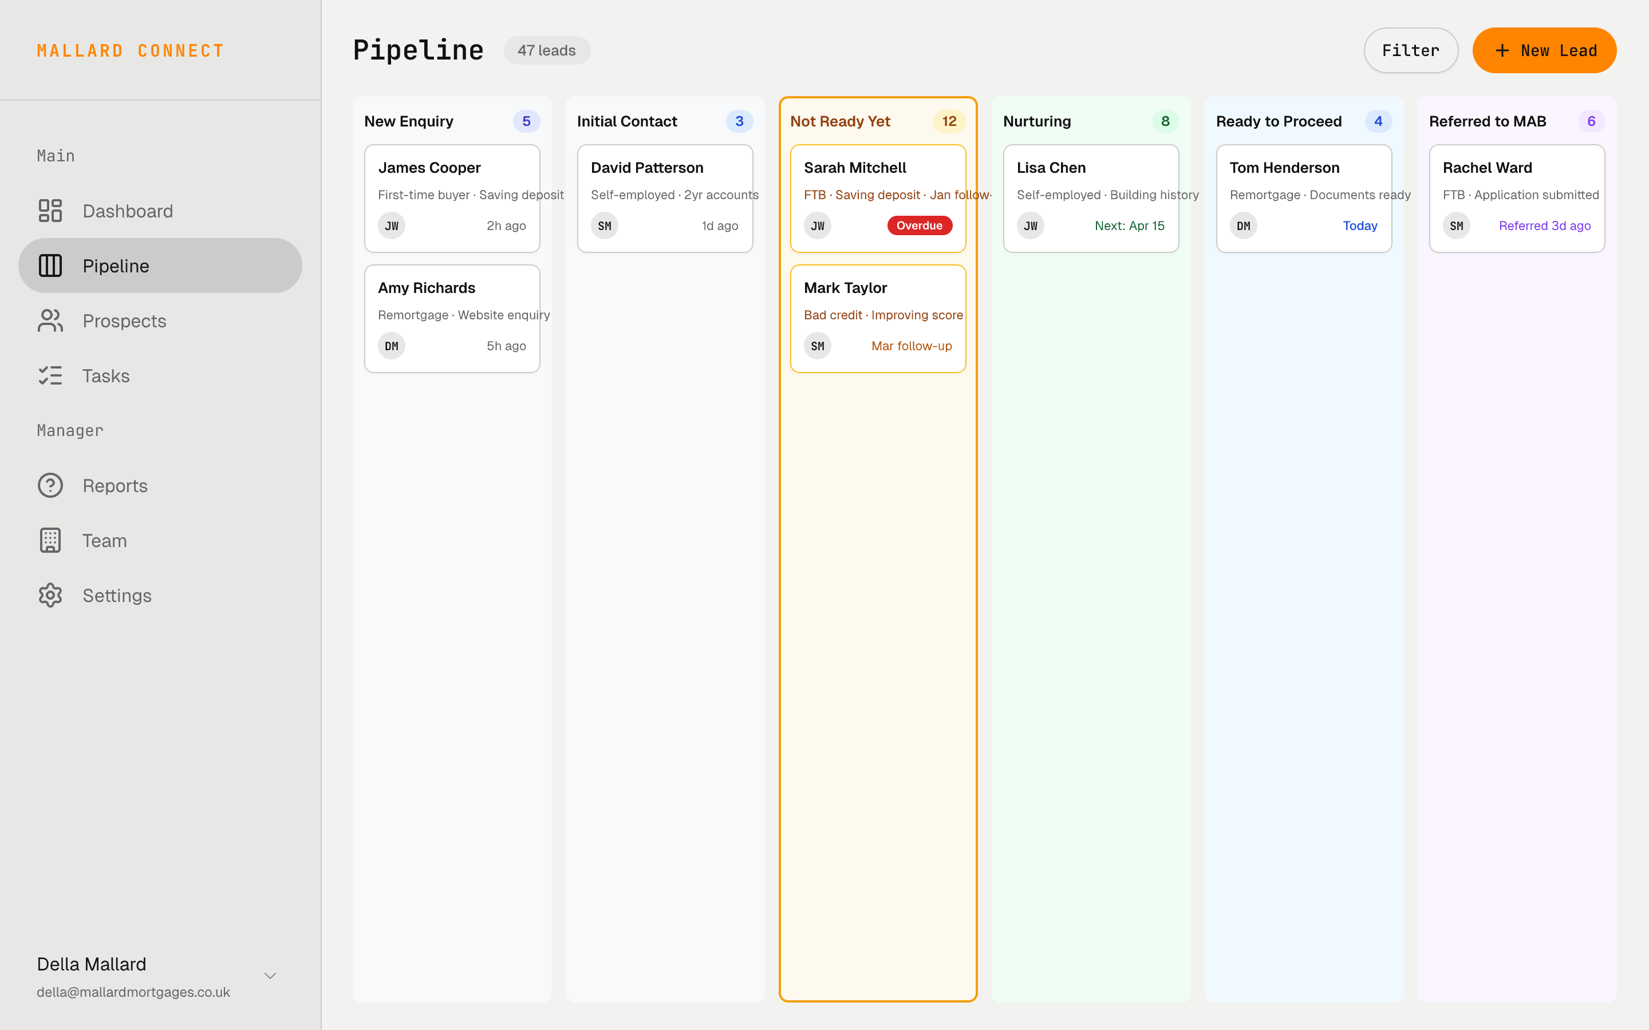
Pipeline Board — Kanban
Della
Desktop
Drag-and-drop Kanban board with 6 visible stage columns. Bird's-eye view of all prospects.
Key Features
6 color-coded stage columns: New Enquiry → Referred to MAB
"Not Ready Yet" column highlighted with amber border — the key stage
Prospect cards show: name, type, assigned avatar, time context
Overdue badges in red on cards that need attention
Filter and search in the toolbar
47 total leads with per-stage count badges
Screen: yuS5D
Design: pencil-welcome-desktop.pen | Node: yuS5D

Slide 8
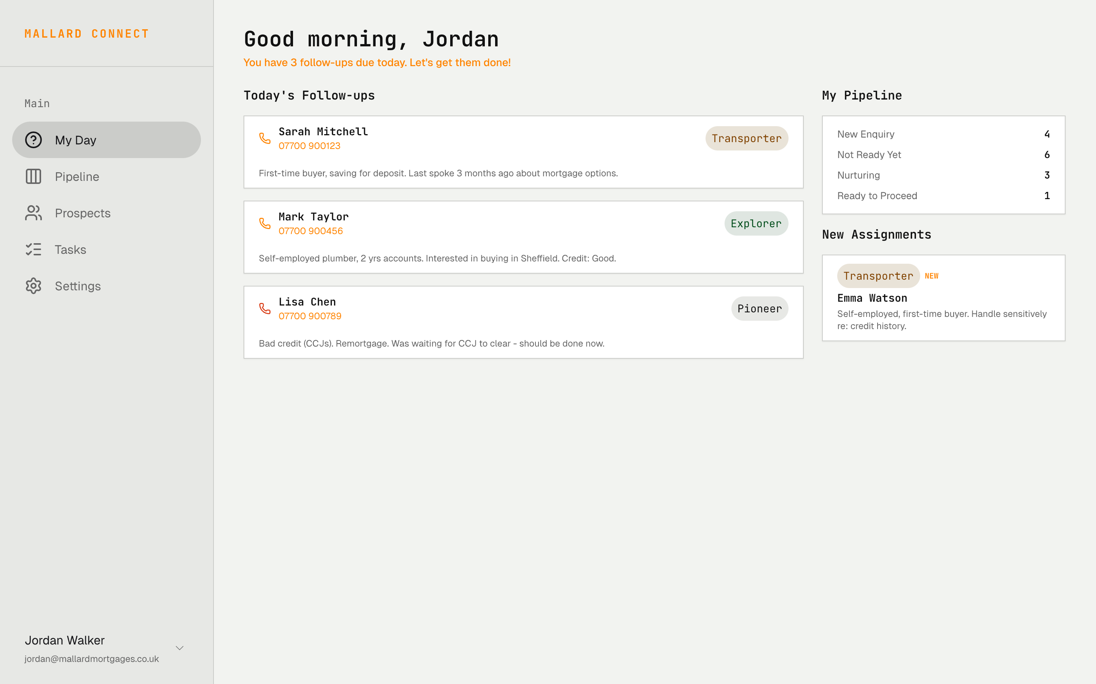
"My Day" Dashboard
Salesperson
Desktop
The salesperson's home screen. Clear daily priorities with no ambiguity.
Key Features
Personalised greeting with motivational nudge
Today's Follow-ups — cards with name, phone, context blurb, status badges
Status badges: Overdue (red), Due today (amber), Planned (blue)
My Pipeline summary — stage counts at a glance
New Assignments — leads Della has assigned with context
Focused on what to do right now
Screen: xLorR
Design: pencil-welcome-desktop.pen | Node: xLorR

Slide 9
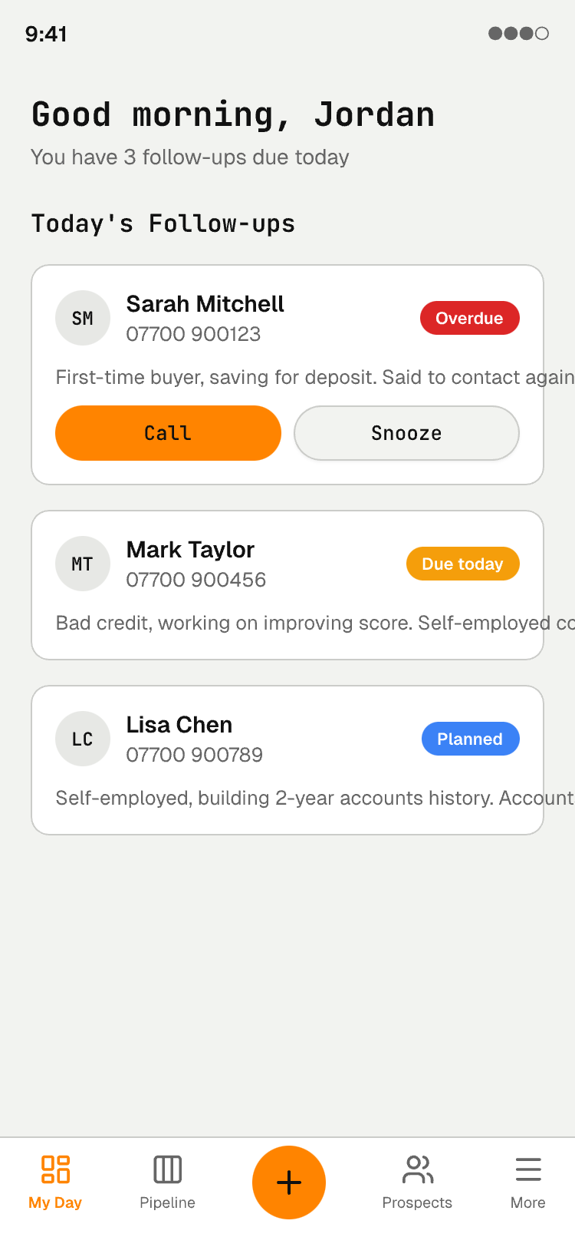
"My Day" — Mobile
Salesperson
Mobile
9:41
Single-column, follow-up focused. Everything works with one hand between appointments.
Key Features
3 follow-up cards with avatar, name, phone number
Status badges: Overdue, Due today, Planned
Context blurb for each prospect
Call and Snooze action buttons on overdue cards
Bottom tab nav: My Day, Pipeline, +, Prospects, More
FAB button for instant new lead capture
Design: pencil-welcome-desktop.pen | Node: S14Wd
Screen: S14Wd

Slide 10
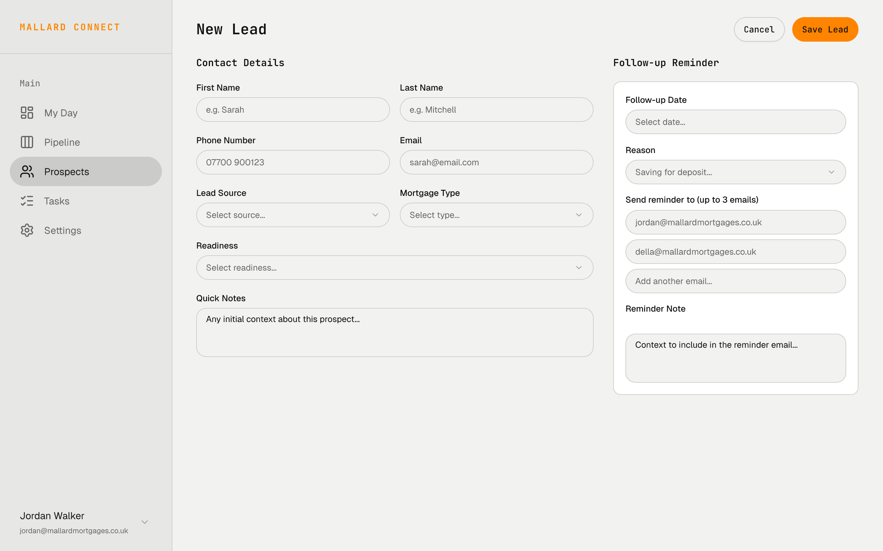
New Lead Form
Salesperson
Desktop
Two-column layout for capturing leads in under 60 seconds. The core data entry screen.
Key Features
Left: Contact details — name, phone, email, source, mortgage type, readiness, notes
Right: Follow-up Reminder config — date, reason, up to 3 email recipients
Up to 3 email recipients — ensures the right people get the reminder
Reminder note — context to include in the email
Smart defaults for follow-up dates based on readiness
Save Lead button creates the lead + schedules the reminder in one action
Screen: oluoT
Design: pencil-welcome-desktop.pen | Node: oluoT

Slide 11
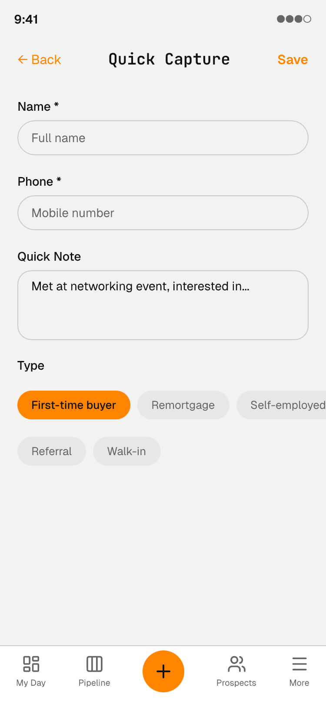
Quick Capture
Field Sales
Mobile
9:41
15-second lead capture for networking events and in-person referrals. Minimal friction.
Key Features
Only 2 required fields: Name and Phone
Quick Note textarea for context
Type tags — tap to select: First-time buyer, Remortgage, Self-employed, etc.
Save button in header for one-tap completion
Designed for capture while the conversation is still fresh
Full details can be added later on desktop
Design: pencil-welcome-desktop.pen | Node: gJmkX
Screen: gJmkX

Slide 12
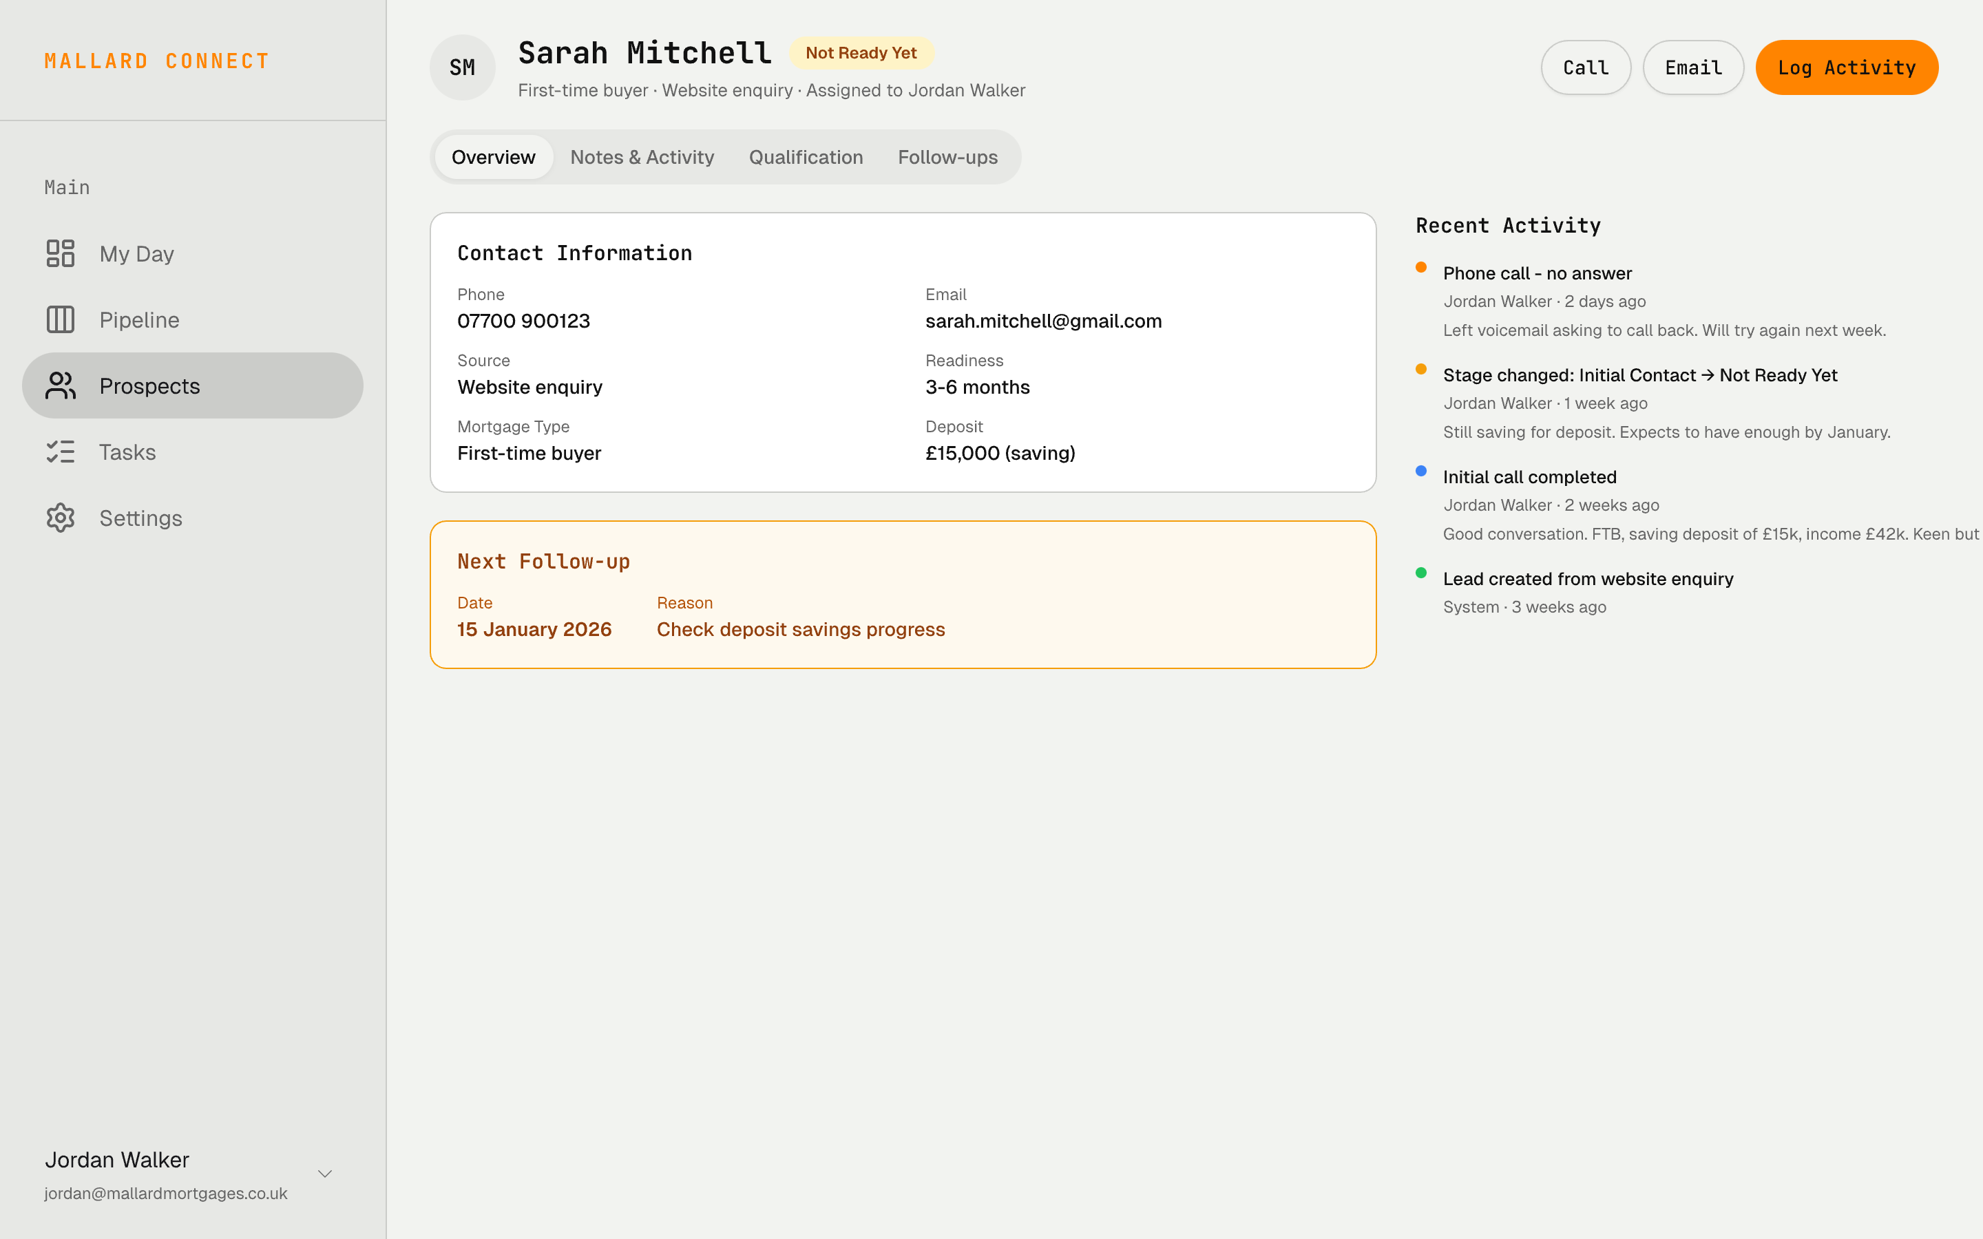
Prospect Detail
Salesperson
Desktop
Full prospect view with contact info, follow-up schedule, and activity timeline.
Key Features
Header: avatar, name, tappable stage badge, meta info
Action buttons: Call, Email, Log Activity
Tabs: Overview, Notes & Activity, Qualification, Follow-ups
Contact Information card with all key fields
Next Follow-up card highlighted in amber — never missed
Activity Timeline with color-coded dots and full context notes
Screen: CHnFT
Design: pencil-welcome-desktop.pen | Node: CHnFT

Slide 13
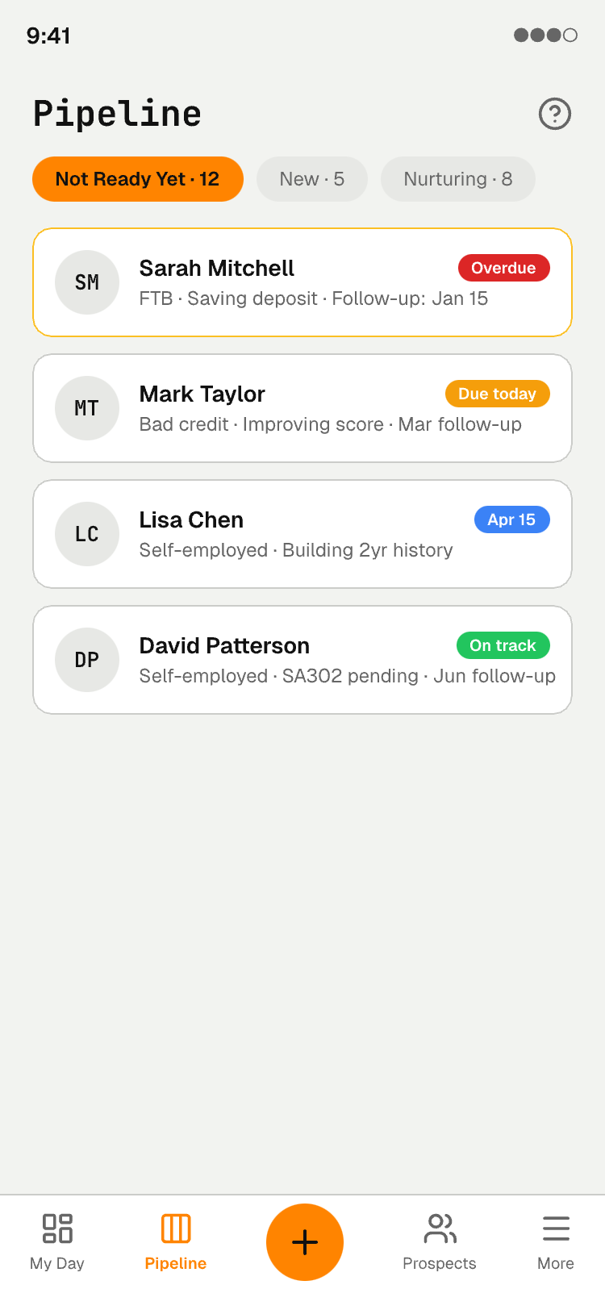
Pipeline List — Mobile
Field Sales
Mobile
9:41
Mobile-optimized pipeline view. Horizontal stage pills for quick filtering.
Key Features
Horizontal stage pills — tap to filter by stage
"Not Ready Yet" selected, showing 12 leads
Prospect cards with avatar, name, type summary
Color-coded badges: Overdue, Due today, scheduled date, On track
Bottom nav with Pipeline tab active
Quick access to prospect detail via card tap
Design: pencil-welcome-desktop.pen | Node: xNuto
Screen: xNuto

Slide 14
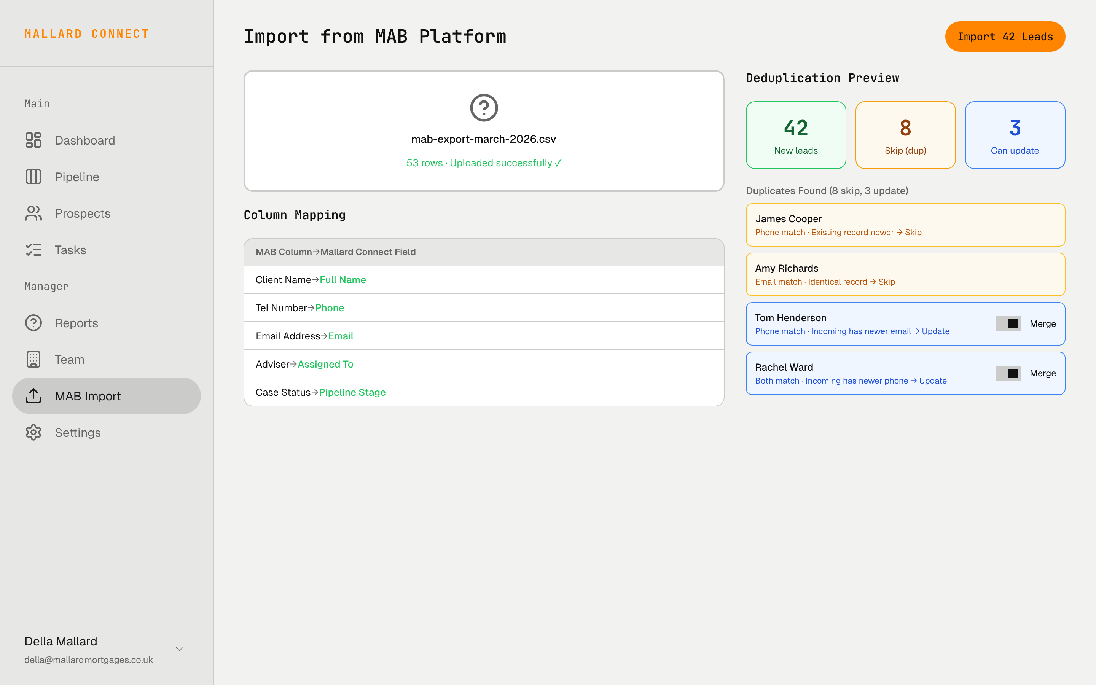
MAB Platform Import
Della
Desktop
Bridge to the existing system. CSV/XLS upload with automatic column mapping and deduplication.
Key Features
Drag-and-drop upload area with file confirmation
Auto column mapping: MAB columns → Mallard Connect fields
Deduplication preview with 3 color-coded buckets:
Green (42) — New leads, will be created
Amber (8) — Duplicates, will be skipped
Blue (3) — Duplicates with newer data, merge toggles
Column mapper remembers last mapping
Phone normalization handles +44 prefix and spacing
Screen: oaR0H
Design: pencil-welcome-desktop.pen | Node: oaR0H

Slide 15
Core Feature: Follow-up Reminders
The single most important feature. This is what Mallard Connect exists to do.
1
→
2
→
3
→
4
→
5
Set Date
Add Recipients
Write Context
7am Daily Cron
Act on Reminder
Smart defaults based on readiness level
Up to 3 email addresses who should be notified
Client situation blurb included in the email
Vercel Cron + Resend sends reminders
Email with client details + deep link to app
Why this matters:
The reminder email includes enough context that the salesperson can act without opening the app — client name, phone, situation summary, and a deep link to the prospect detail. Long nurture cycles (6-12 months) are normal in UK mortgage — the system handles them gracefully.

Slide 16
Tech Stack & Architecture
Framework
UI
Next.js 14+ (App Router, TypeScript)
Tailwind CSS + shadcn/ui + KokonutUI
Database
Hosting
Firebase Firestore (NoSQL, real-time sync)
Vercel (Next.js optimized, preview deploys)
Auth
Validation
Firebase Auth (email/password, magic link)
Zod (shared client/server schemas)
Email
Real-time
Resend (transactional reminders, invites)
Firestore onSnapshot (no extra WebSocket infra)
Cron
Import
Vercel Cron (daily 7am UK reminder job)
SheetJS/xlsx (CSV/XLS parsing)
Migration path: Firebase → Supabase/Postgres when Mallard is ready for a full CRM

Slide 17
Phased Delivery Plan
Phase 1
Phase 2
Phase 3
Phase 4
Foundation + Core
Pipeline + Visibility
Team + Qualification
Reports + Polish
Lead intake, follow-up scheduler (3 email recipients), daily 7am cron job, basic dashboard, MAB CSV import, PWA
Kanban board, stage change flow, manager dashboard, real-time activity feed, notification system
Team management, lead assignment, qualification fields, quick capture, meeting prep
KPI reports, leaderboard, export, onboarding wizard, edge cases, audit log
Future: CRM Graduation → Supabase/Postgres, email integration, calendar sync, automated workflows

Slide 18
MALLARD CONNECT
No prospect falls through the cracks.
Designed for Mallard Mortgages | Built by Storyboard Digital | Sheffield, UK
UI Mockups: pencil-welcome-desktop.pen | 10 screens across desktop & mobile

