Slide 1
Full-Stack Web Development Project
“Notes” - Built with Node.js, MongoDB, Express
Presented By:
Date: 21 May 2025

Slide 2
Notes
Type: Notes-Taking Web Application
Tech Stack:
Backend: Node.js, Express.js
Database: MongoDB, Mongoose
Frontend: EJS templating
Architecture: MVC Pattern

Slide 3
Tech Stack Breakdown
Node.js: JS runtime for building server-side logic
Express.js: Web framework for Node.js
MongoDB: NoSQL database for flexible document storage
Mongoose: ODM (Object Data Modeling) library for MongoDB
EJS(Embedded JS): Templating engine to generate HTML
MVC Architecture: Separate application logic (Model), UI (View), and control flow (Controller)

Slide 4
MVC Architecture
Model - Handles database schema & interaction (via Mongoose)
View - EJS templates to render HTML dynamically
Controller - Business logic and route handlers
Benefit - Separation of concerns, cleaner code structure

Slide 5
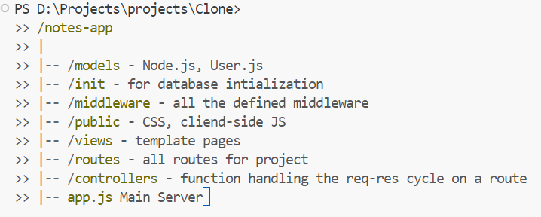
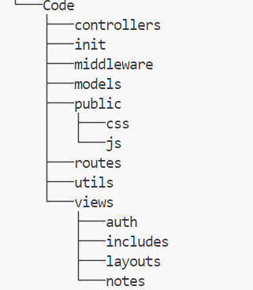
Project Structure

Slide 6
Authentication & Authorization
Authentication:
JWT & Cookies are used for signup and login
Salting & Hashing
Authorization:
Using MongoDB & mongoose functionalities are used for the authorization checking if the user has a valid JWT Token

Slide 7
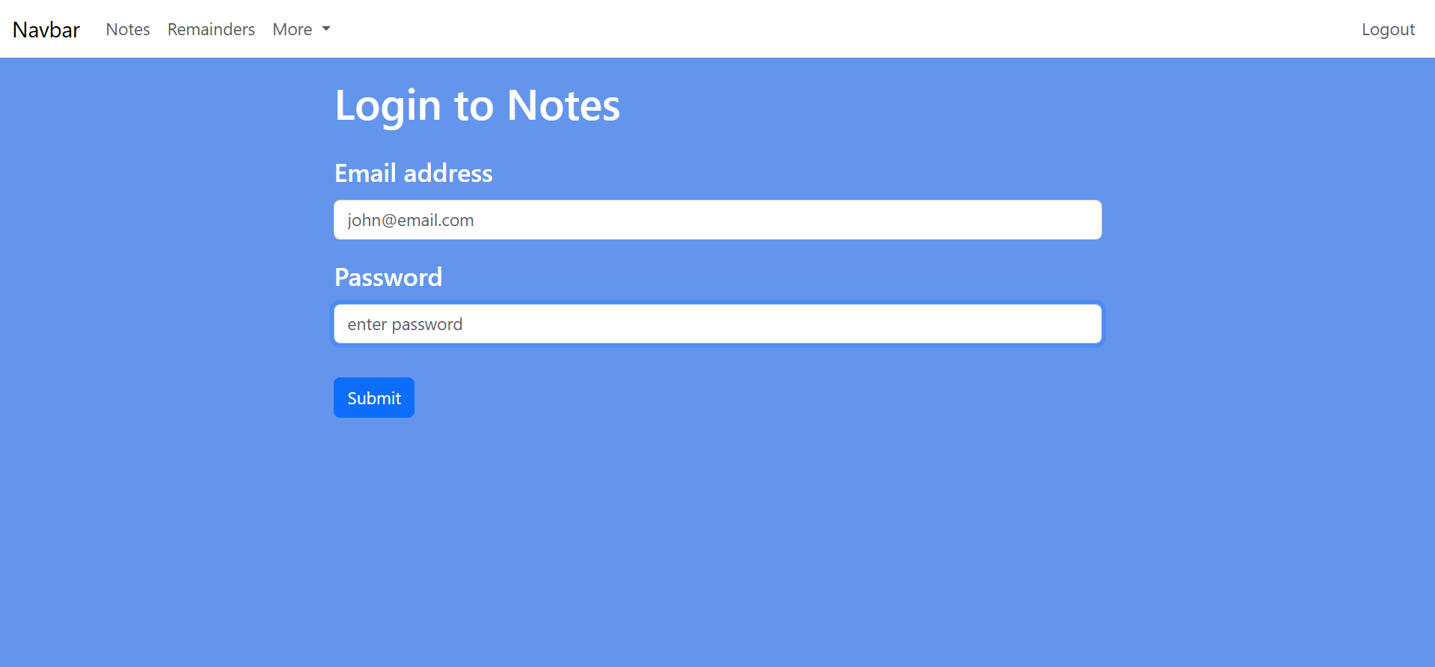
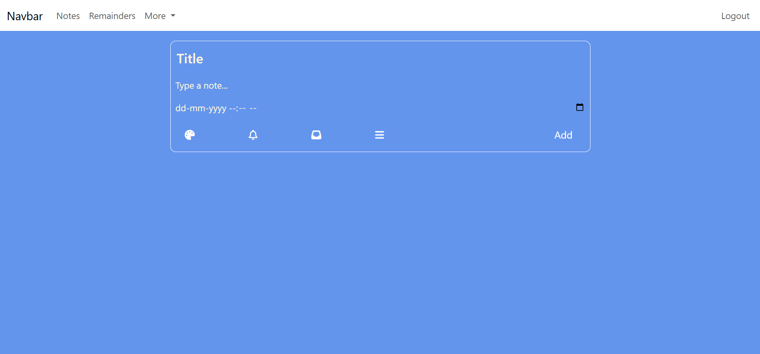
Implementation

