Slide 1
BTech CE 3rd Year Team
Member 1:
Yug Patel
Problem Statement Title:
Member 2:
Smit Patel
Online Examination System
Member 3:
Vinay Patel
Institute Name:
LDRP – Institute of Research and Technology
Member 4:
Kartik Modi
Mentor :
Pinkal Chauhan

Slide 2
Introduction
Online examinations contents providers to focus on creating effective assessment questions and focusing on exam’s feedback delivery to students. In the paper we present techniques that are pertinent to the elements of assessment process: answers submission, computerized grading, and feedback after submission.
The administrators, instructor, Students who are attending for online examination can communicate with the system through this projects, thus facilitating effective implementation and monitoring of various activities of Online Examinations like conducting Exams as per scheduled basis and delivering result to that particular use or student. And the details of students who attempted Online Examination are maintained at administrator.

Slide 3
Purpose of Online examination system
The purpose of online examination system is creating effective assessment questions and focusing on exam’s feedback delivery to students.
Online examination is fast developing method
It is also needed less manpower handle examination
Organizations can also easily monitor
Requirement is significantly
Saving the time and effort
Prepare the results report

Slide 4

OBJECTIVES
Result calculated in less time
Time Saving
Clarity
Instantly
Access to new-data
User –friendly

Slide 5
MAIN INTENTION
To provide an interface through which student can appear for examination online for objective type questions.
To provide registration for students done by themselves.
When the student starts the exam the timer will start automatically and show the student how much time is left
To provided user name and password facility.

Slide 6
FUTURE ASPECTS
Random Selection of Question
Admin can monitor through webcam
Schedule examination
Result output with answers
Validating Student through Face Recognition System

Slide 7
How this web works ?
ADMINSTRATOR ASPECT
Editing/deleting/creating the database
Accepting registration of candidates
Changing the password
Logging into the system
Time limit of the test if any
Marking correct answer with in the given option
Set negative marks for wrong response
STUDENT ASPECT
Requesting registration
Logging into the system
Selecting the test
Appearing for the examination
Printing the result at the end of examination
Reviewing the given response

Slide 8
Software/Tools Requirements
Designing Tool :HTML, CSS, php, javascript
Front End Tool :XAMPP Server
Database Tool :SQL Server
Documenting Tool : MS-Word

Slide 9
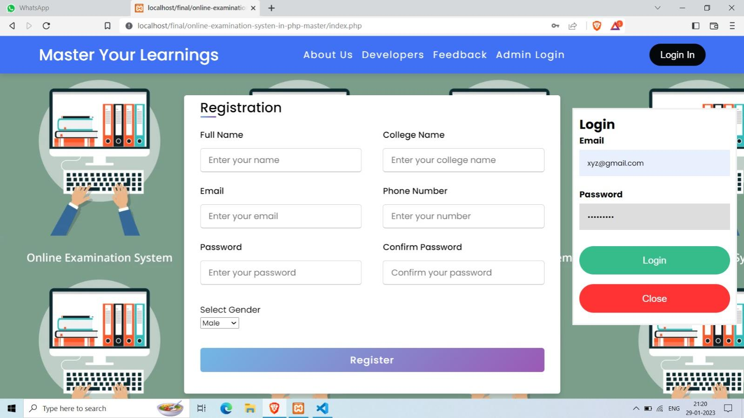
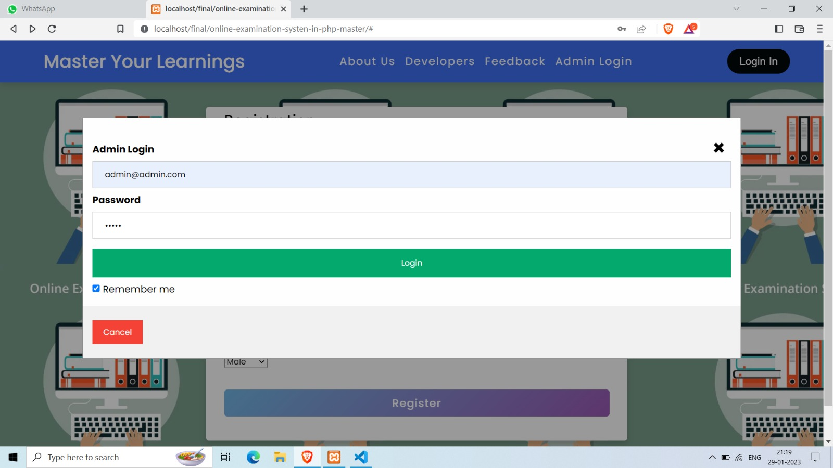
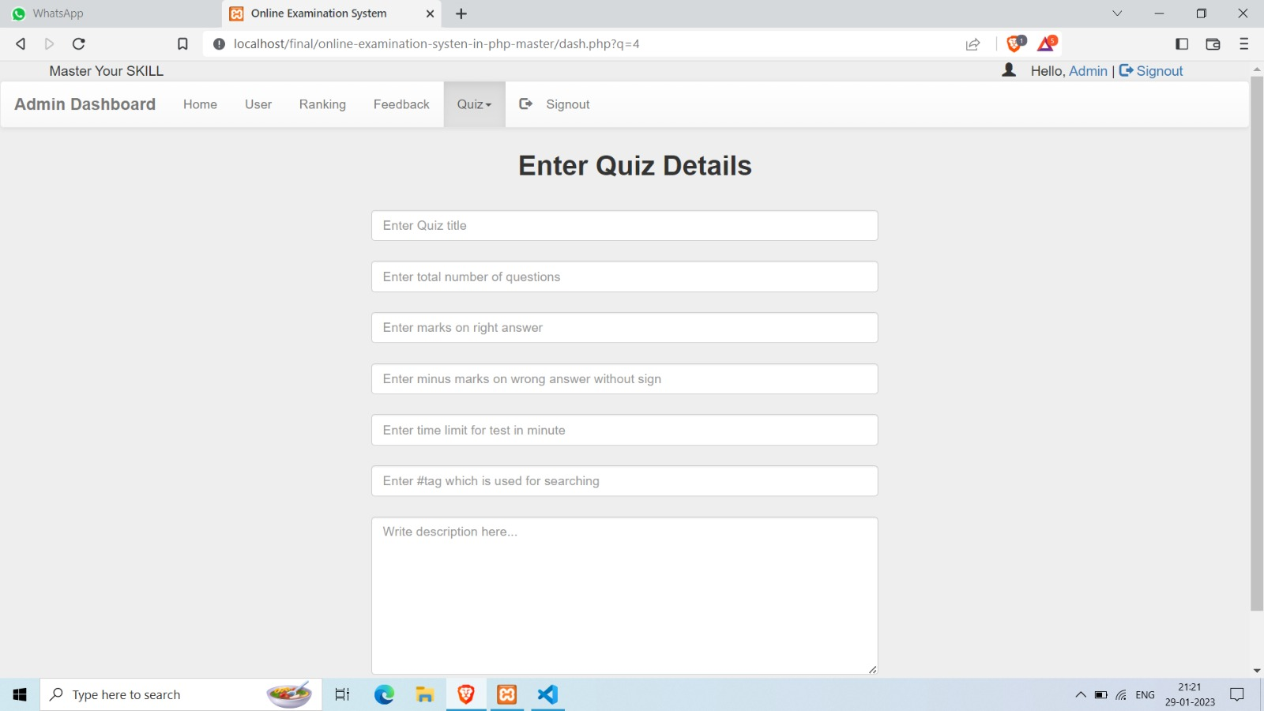
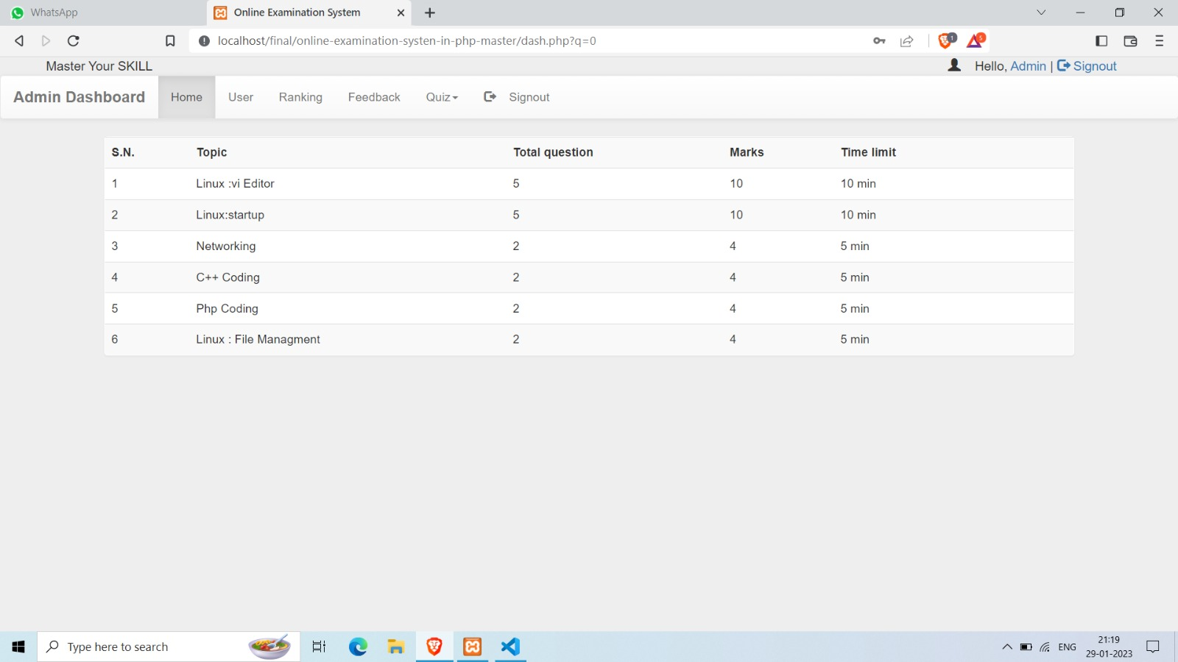
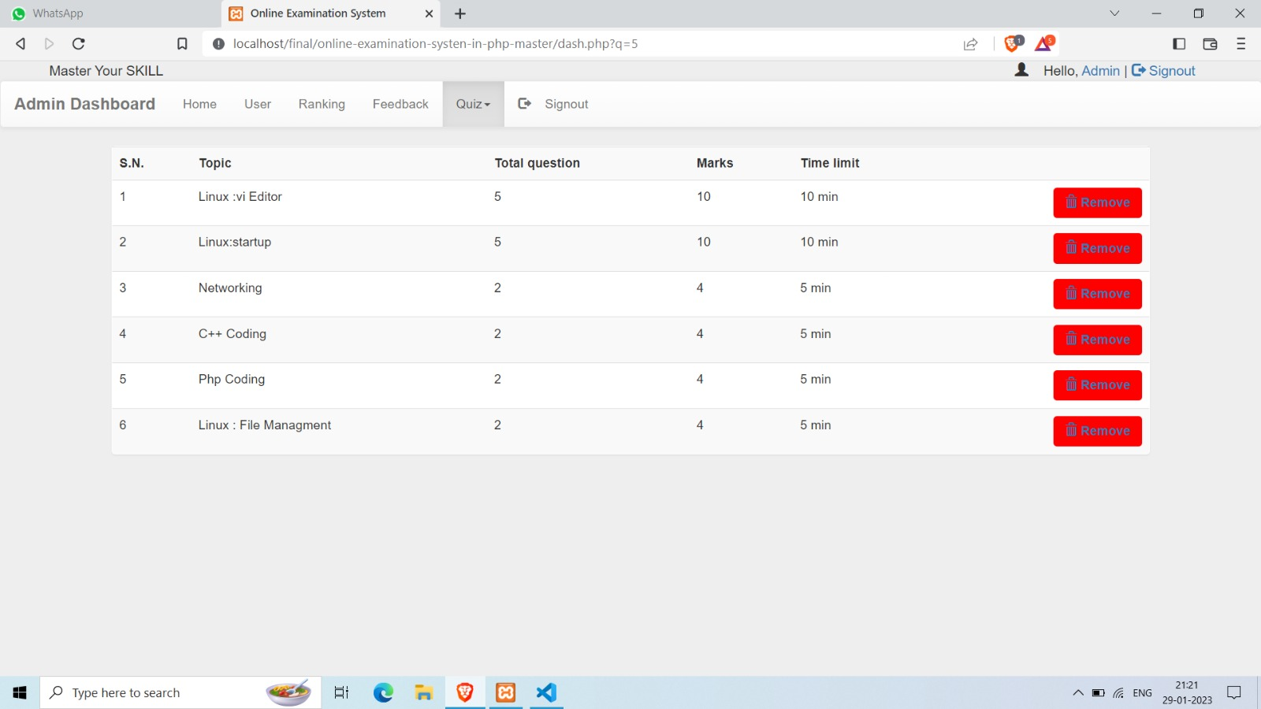
USER INTERFACE

Slide 10
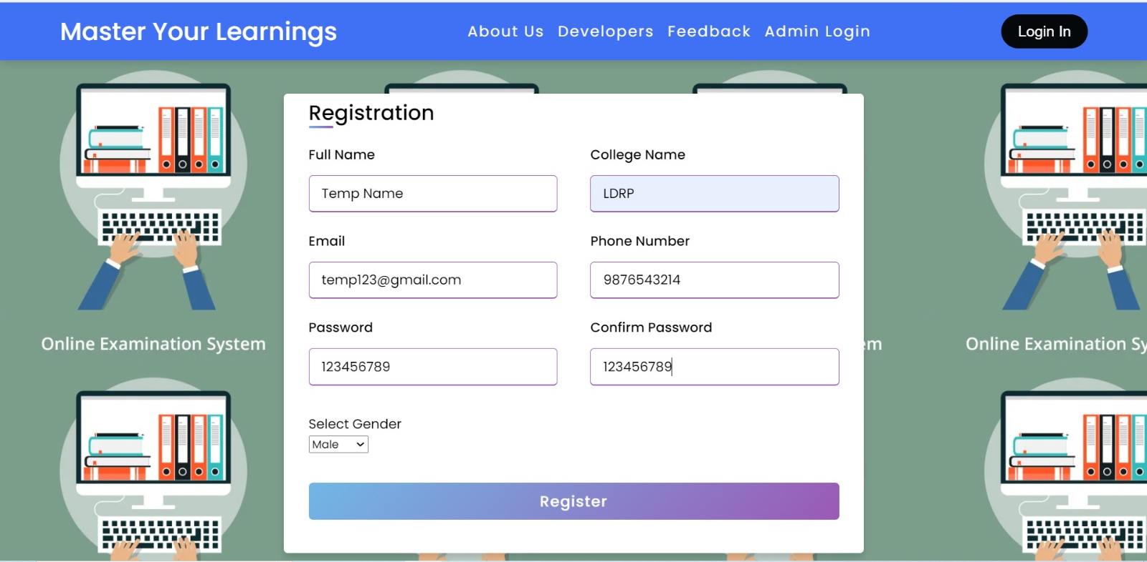

Slide 11


Slide 12
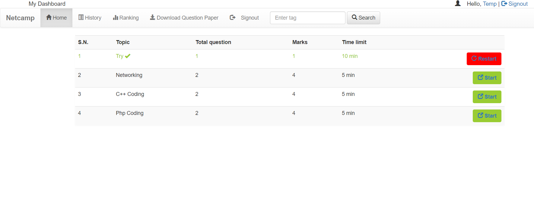

Slide 13


Slide 14
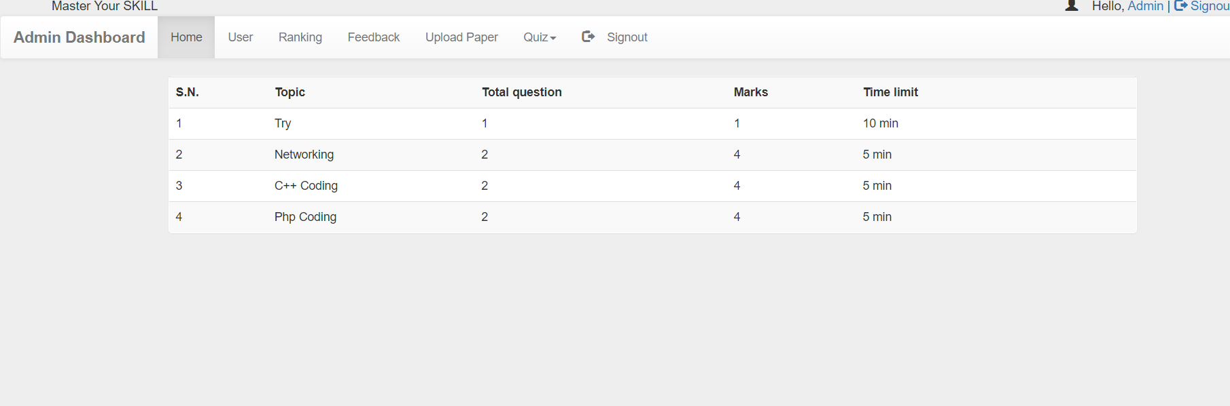

Slide 15
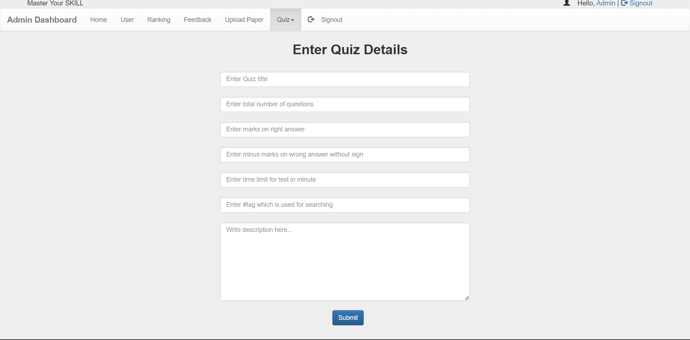

Slide 16
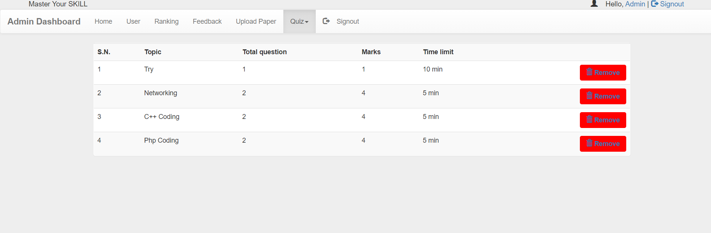

Slide 17
Conclusion
The following conclusions can be deduced from the development of the project.
Automation of the entire system improves the efficiency
It provides a friendly graphical user interface which proves to be better when compared to the existing system.
It gives appropriate access to the authorized users depending on their permissions.
It effectively overcomes the delay in communications.
Updating of information becomes so easier.
System security, data security and reliability are the striking features.
The System has adequate scope for modification in future if it is necessary.

Slide 18
Reference
Project report : Online Examination System

Slide 19
THANK YOU

