Slide 1

British Airways Booking Prediction
summary of the Random Forest model analysis

Slide 2
Project Summary
Objective: Predict whether a customer will complete a flight booking using Random Forest.
Loaded and explored customer booking data
Analyzed data types and statistical summaries
Trained a Random Forest Classifier
Split data into training and testing sets
Evaluated the model's accuracy
Identified top features influencing booking decisions

Slide 3
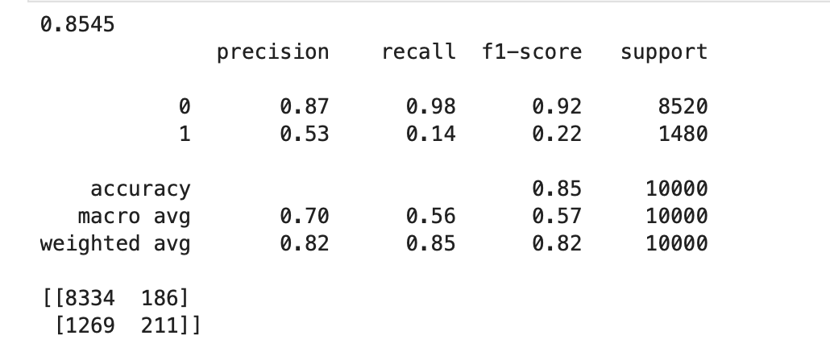
Booking Prediction Model Overview
We developed a Random Forest model to predict customer booking decisions based on features like flight time, lead time, and preferences.
Overall model accuracy reached **85.4%**, driven mainly by high precision for non-bookers. However, the recall for bookers (positive class) was lower, indicating room for improvement.
Key classification metrics:
• Precision: 0.53 (positive class)
• Recall: 0.14 (positive class)
• F1-score: 0.22 (positive class)

Slide 4
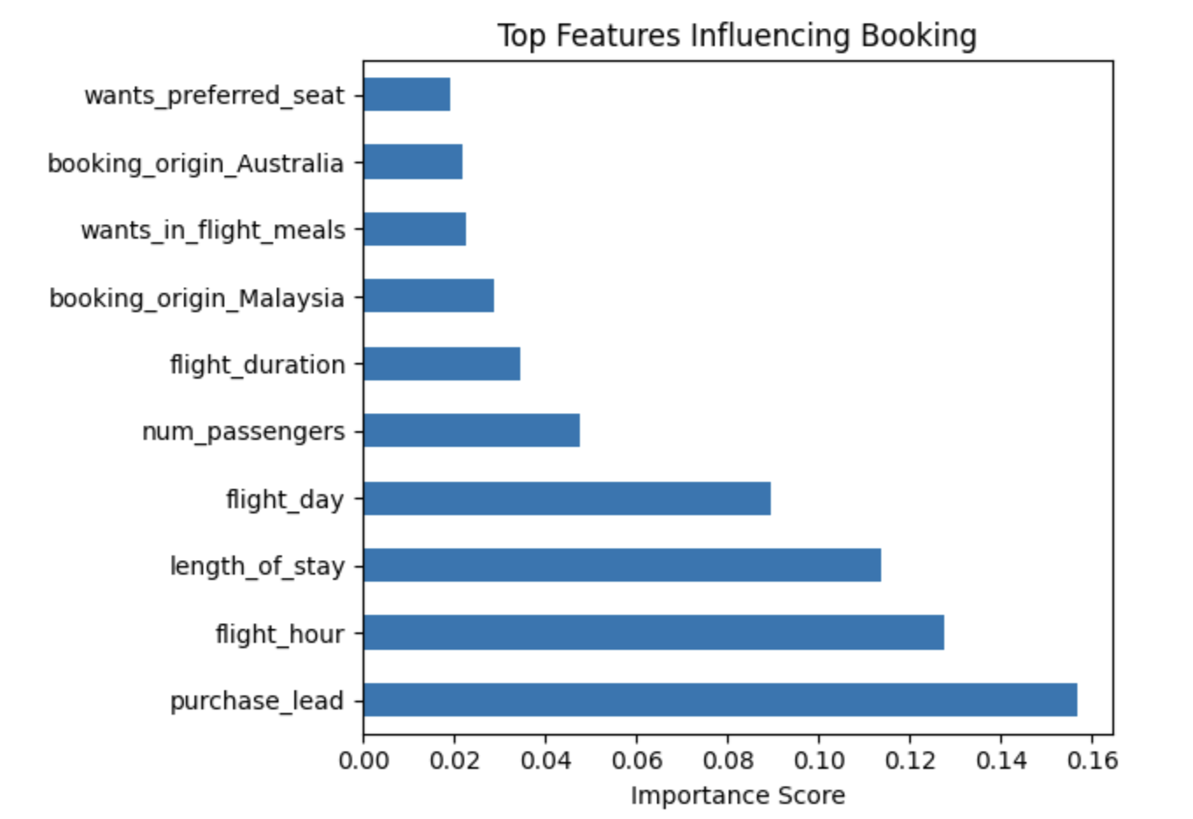
What Influences Bookings?
The most influential factors driving booking behavior were:
These insights help us identify booking patterns and can guide marketing strategies, pricing, and lounge resource planning.
Purchase Lead Time
Flight Hour & Day
Length of Stay
Number of Passengers

Slide 5
Key Insights from the Model
The model revealed that the following customer behaviors strongly influence bookings:
Booking lead time (how early they book)
Trip type (round-trip vs one-way)
Flight duration
Preferences for baggage, meals, and seating

Slide 6
Business Value
Why this matters for British Airways:
Personalize offers to boost conversions
Optimize pricing and service strategies
Enhance customer experience through insights
Support data-driven operational decisions

