Slide 1
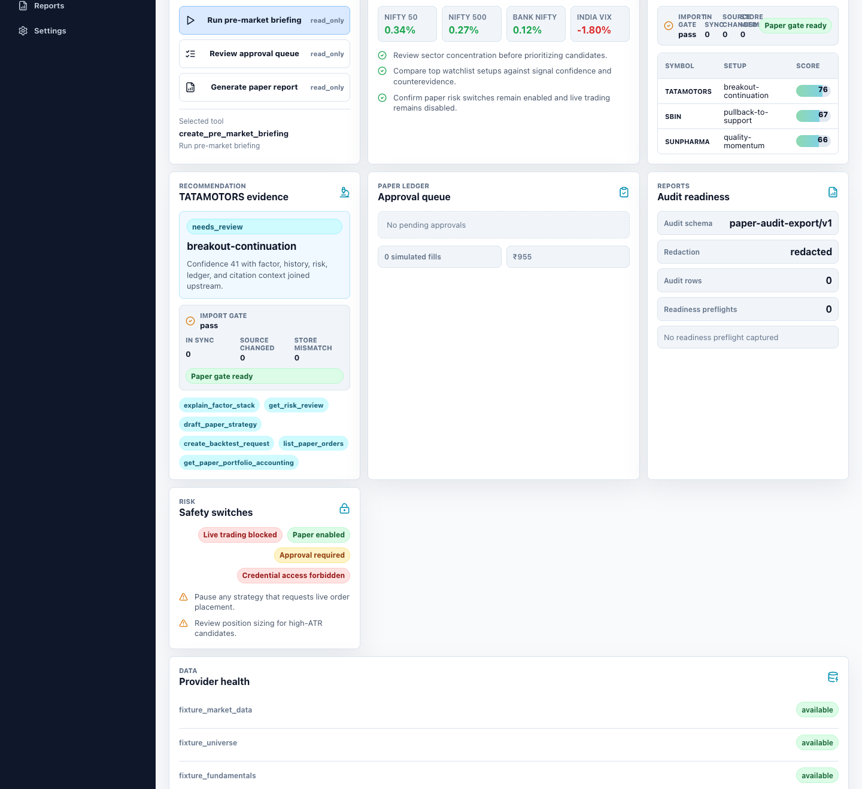
KAGGLE AI AGENTS CAPSTONE
TradePilot
Sentinel
Agentic trading workflows with evidence, policy, and human control.
ADK AGENT
MCP TOOLS
APPROVAL-GATED
Concierge Agents
Capstone evidence uses paper simulation; the platform architecture is built for governed trading workflows.
TRADEPILOT SENTINEL
01
Notes:
Introduce TradePilot Sentinel as a governed agentic trading workflow platform. The capstone uses paper simulation as a safe proof path, while the architecture separates future execution from the current release boundary.

Slide 2
WHY THIS MATTERS
A trading assistant must explain and govern every action
Most systems optimize one step. Real decisions fail across the handoffs.
01
02
03
Fragmented signals
Opaque recommendations
Unsafe automation
Technical, fundamental, sentiment, volatility, and macro evidence live in separate workflows.
A score without counterevidence, citations, and readiness checks is not decision support.
A capable model still needs permissions, approvals, audit records, and a hard execution boundary.
TradePilot Sentinel makes evidence, policy, and approval part of the workflow itself.
The result is a traceable recommendation and a bounded action, not a conversational guess.
TRADEPILOT SENTINEL
02
Notes:
Frame the problem as a workflow problem. Signals, reasoning, and execution controls usually live in different systems. TradePilot Sentinel puts them in one governed sequence.

Slide 3
SYSTEM ARCHITECTURE
The agent coordinates; deterministic services decide what is allowed
Web console + API clients
FastAPI + Google ADK
MCP policy boundary
Deterministic domain services
Workflow entry points
Intent routing and synthesis
49 safe tools; forbidden tools unregistered
Screeners, recommendations, backtests, ledger, reports
Model provider adapter
Read-only data adapters
Gemini default; Claude, OpenAI-compatible, and Ollama paths
Fixtures or configured market, universe, fundamentals, sentiment, volatility, macro
Future execution
adapters
Evaluation + delivery
Structured state
Agents CLI evals, deterministic policy metrics, CI, Docker/Podman
SQLite ledger, provider profiles, market snapshots, audit events
Disabled in the capstone release boundary
TRADEPILOT SENTINEL
03
Notes:
The model does not own business rules. ADK coordinates intent and response synthesis, MCP exposes only bounded tools, and deterministic domain services own scores, readiness, ledger state, and audit records. Future execution remains outside the current trust boundary.

Slide 4
DECISION INTELLIGENCE
Six evidence families become one reviewable recommendation
Technical
trend, momentum, ATR
Fundamental
Normalize + validate
Explainable recommendation
quality, value, revisions
Typed provider contracts and freshness checks
Score + counterevidence
Setup, factor stack, citations, allowed next actions
Sentiment
Weighted factors, confidence, uncertainty
news, investors, contradiction
Volatility
Apply hard gates
VIX, regime, risk multiplier
Import reconciliation, liquidity, risk, policy
Strategy + simulated backtest
Macro
Draft-only until readiness is proven
breadth, rates, events, liquidity
Portfolio fit
exposure, concentration, risk
Read-only pattern cards add strategy context and citations; structured facts remain authoritative.
TRADEPILOT SENTINEL
04
Notes:
Walk through the factor stack. Every input is normalized and freshness-checked. Hard gates can block a candidate before scoring. The recommendation includes both supporting evidence and counterevidence, then exposes only allowed next actions.

Slide 5
AGENTIC WORKFLOW
One request becomes a traceable, approval-gated workflow
Natural language starts the flow. Tools, policy, and people determine how far it can go.
1
Prompt
2
Agent routes
3
Gather evidence
4
Explain
5
Draft strategy
Review a candidate
Selects safe tools
Factors + patterns
Counterevidence + citations
No execution
6
Backtest
7
Human approval
8
Simulated fill
9
Report + audit
Simulated evidence
Explicit decision
Paper ledger only
Redacted trace
MODEL-ASSISTED
DETERMINISTIC TOOLS
HUMAN CONTROL
AUDITABLE STATE
No approval, no simulated fill.
TRADEPILOT SENTINEL
05
Notes:
Use this slide before the live demo. The agent selects and sequences tools, but deterministic readiness and policy checks constrain the workflow. A human approval is required before the system can create a simulated fill.

Slide 6
SAFETY MODEL
The policy boundary limits autonomy before the model can act
Tool registration and domain policy enforce the boundary outside the language model.
CURRENT RELEASE BOUNDARY
Forbidden actions are absent from the MCP tool catalog.
APPROVAL REQUIRED
FORBIDDEN
DRAFT ONLY
Paper simulation and selected risk changes
Live orders
Broker trading tokens
Credential disclosure
Approval bypass
READ ONLY
Strategies, backtest requests, order proposals
Portfolio, screener, factors, reports
Agent may proceed
Agent may proceed
Human must decide
Tool is not exposed
LIVE TRADING BLOCKED
A weaker or compromised model still cannot invoke a capability that was never registered.
TRADEPILOT SENTINEL
06
Notes:
Safety is not a prompt-only instruction. The MCP server exposes a least-privilege tool catalog, policy tests assert forbidden tools remain absent, and approval state is persisted before a simulated fill can occur.

Slide 7
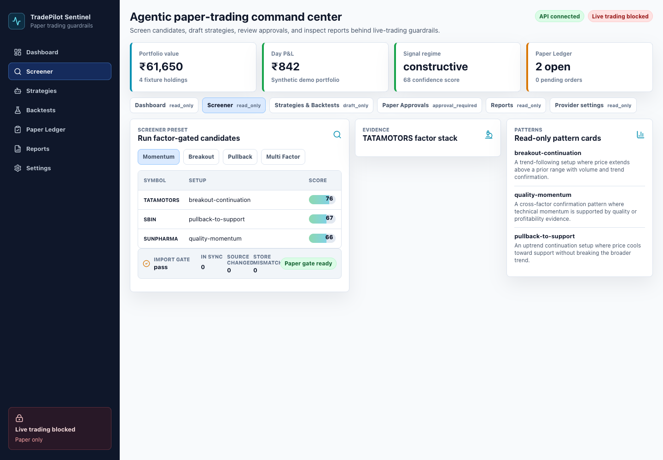
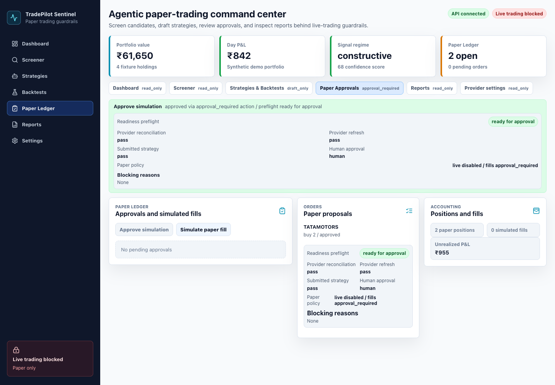
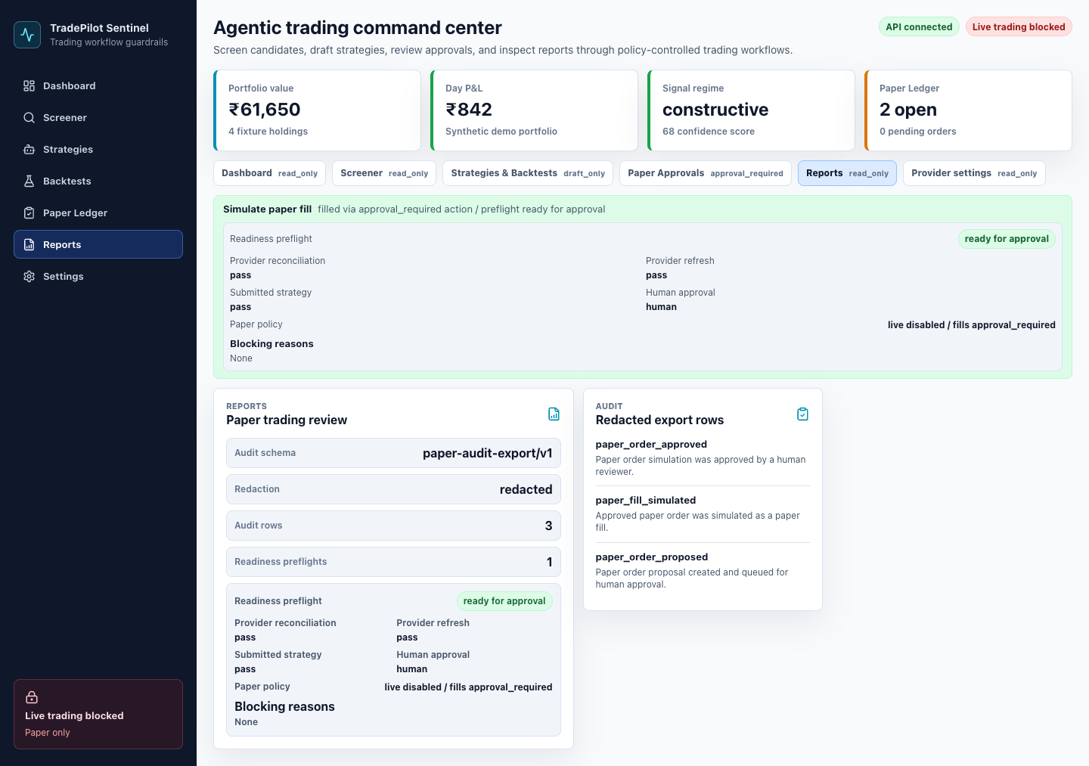
WORKING PRODUCT EVIDENCE
The governed workflow is implemented end to end
Evidence-backed candidate
Approval gate
Auditable result
Deterministic ranking + pattern context
Readiness checks + explicit human action
Simulated fill + redacted audit rows
Screener → strategy/backtest → paper proposal → human approval → simulated fill → report and audit
TRADEPILOT SENTINEL
07
Notes:
Show that this is a functioning workflow, not a static concept. The screen captures come from the local Docker or Podman Compose stack using safe fixture data. The result includes an approval record, a simulated fill, and a redacted audit trail.

Slide 8
EVALUATION AND DEPLOYABILITY
The system is tested as behavior, not only code
4.92
Eval datasets
Portable runtime
/ 5 response quality
Positive workflows + forbidden cases
Web console
3000
Docker or Podman Compose
1.00
ADK traces
FastAPI + ADK
8000
Optional Ollama profile
Tool calls and ordering
forbidden-action policy
MCP server
8081
GitHub Actions
contracts • web • containers
0.80
Hybrid grading
LLM judge + deterministic metrics
workflow trajectory
Deterministic triage
15 / 15 INFERENCE CASES COMPLETED
Credential-free deterministic tests still run without cloud access.
0 failures; 0 critical failures
TRADEPILOT SENTINEL
08
Notes:
The eval suite measures response quality, forbidden-action safety, and expected tool trajectories. Fifteen inference cases completed. Deterministic triage passed with zero failures and zero critical failures. The same stack runs through Docker or Podman Compose and CI exercises contracts, the web build, containers, and the MCP tool catalog.

Slide 9
CAPSTONE CONCLUSION
A governed trading workflow, proven through safe simulation
TradePilot Sentinel combines agent reasoning with deterministic evidence, explicit permissions, and durable audit state.
Implemented now
Course concepts proven
Future release boundary
Read-only provider adapters
Multi-factor screeners
Pattern citations
Strategy + backtest drafts
Approval-gated paper ledger
Reports + redacted audit
Google ADK agent
MCP tool server
Security boundaries
Docker/Podman deployability
Agents CLI evals and skills
Configured execution adapters may be added only after broker isolation, stronger approvals, audit review, production observability, and release controls are implemented.
The model can recommend. The system decides what is permitted. A human controls the consequential step.
TRADEPILOT SENTINEL
09
Notes:
Close on the product principle. TradePilot Sentinel is broader than paper trading, but the capstone release proves the architecture through a safe simulation boundary. Future execution requires explicit production controls and is not represented as implemented today.

