Slide 1

Card Content Microservice
ID Card Content Extractor (Offline AI OCR + Entity Mapping Microservice)
Summer Internship Project @ Turtil
ARUKALA VINAY TEJA• May–June 2025

Slide 2
Agenda
Introduction & Problem Statement
Objectives
System Architecture
Tech Stack
Key Features & Enhancements
Model Training & Evaluation
Deployment Overview
Results, Challenges & Future Scope

Slide 3
Problem Statement
Manual data entry from student ID cards is error-prone and time-consuming.
ID card formats vary significantly across universities.
A robust, automated solution is needed to extract structured data from these cards.

Slide 4
Project Objective
Build a microservice that extracts structured data from a student-uploaded college ID card image
Run offline OCR on the image
Extract key fields (Name, College, Roll Number, Branch, Validity)
Use OCR + Regex + NER + Fallback logic.
Use local AI models to parse and map the fields accurately
Be built with FastAPI, configurable via config.json, and deployable via Docker
Accept base64 image input and return JSON output

Slide 5
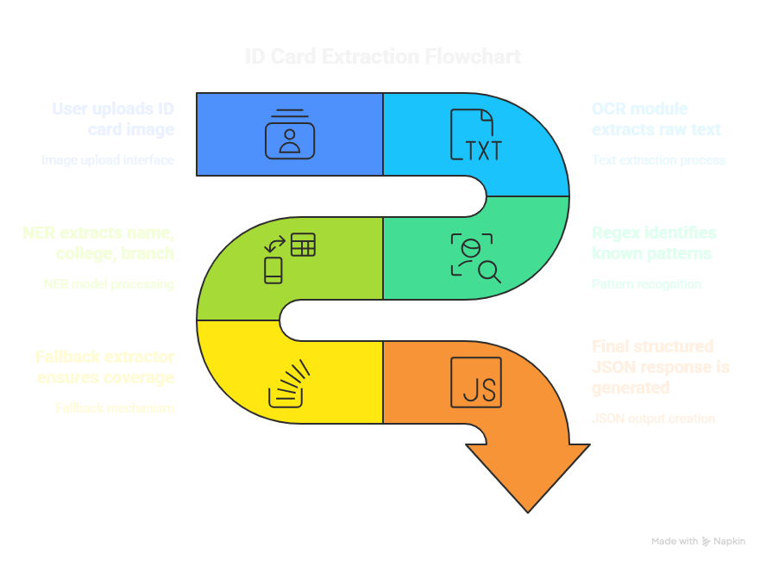
System Architecture

Slide 6
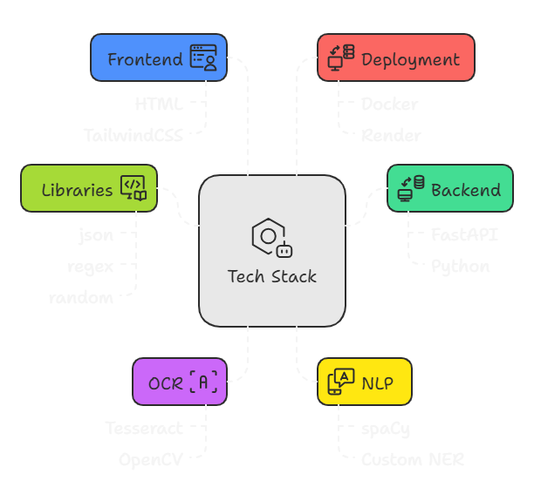
Tech Stack

Slide 7
Key Features
✅ Upload Image UI with Live Preview
✅ Base64 image handling using FastAPI
✅ OCR output parsing with Tesseract
✅ Field extraction using Regex + spaCy NER
✅ Fallback system to fill missing fields
✅ JSON response with
user_id,
extracted_fields,
confidence_score,
missing_fields,
and status

Slide 8

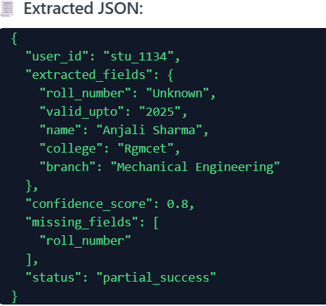
Sample API JSON Response

Slide 9
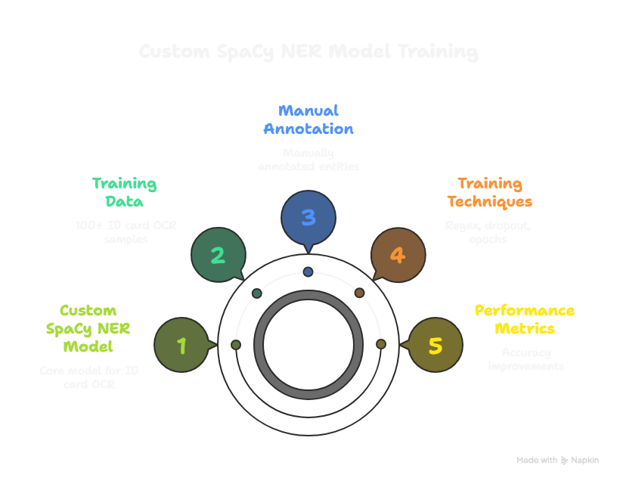
Training Strategy
Custom dataset of 100+ images with JSON annotations.
Used regex + OCR to bootstrap entity alignment.
Added variants like 'HTNO', 'Card No' → roll_number
Used Normalization
Intial accuracy: 80%, Final: 91%

Slide 10
📈 Accuracy Improvement Summary
Field | Initial Accuracy | After Regex + NER | Final (Post Normalization)
Name | ~76% | 85% | 86%
College | ~75% | 81% | 84%
Branch | ~78% | 88% | 95%
Roll Number | ~60% | 71% | 88%
Valid_upto | ~80% | 91% | 97%
Overall | ~80% | 85% | 91.18% ✅

Slide 11
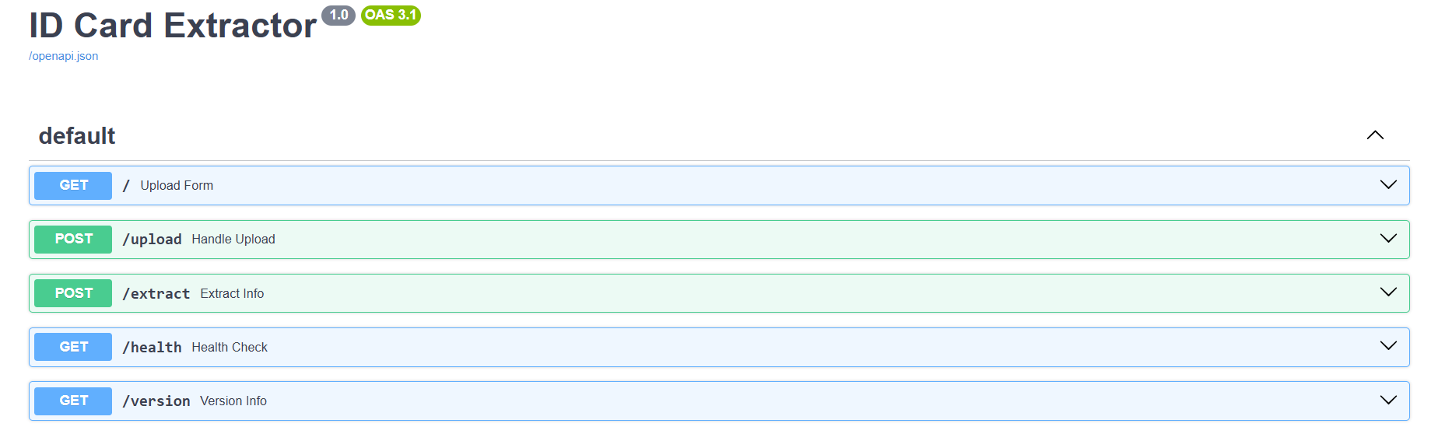
Deployment Overview
Created Docker image with Tesseract, spaCy, FastAPI.
Container hosted on Render free tier.
Upload UI served at / route, /upload API receives file.
Endpoint /extract handles full extraction pipeline.

Slide 12
Challenges Faced
Entity misalignment in spaCy training
OCR errors (blurry images, unusual fonts)
Similar field values (name vs college)

Slide 13
Achievements & Future Scope
Achieved 91% field-level accuracy
Real-time extraction in <5s per card
Future: To get better Output we can use pretrained models, and ONXX for reponse in <1 Second
Expand NER training with synthetic data
Integrate dashboard for user correction
Link:
Idcard-Content-Microservice

Slide 14
Thank You
Thank you Turtil for giving me a great Experience and being such an integral part of this chapter in my life. I hope to carry this learnings, mentorship and culture forward in every step I take.

