Slide 1
Hate Intensity Prediction
Team 14 Satya Swaroop Gudipudi
Vinay S
Aman G

Slide 2
Problem Statement & Challenges
Predict the intensity of hate speech in given textual data, from benign to extremely hateful.Understanding the nuanced spectrum of hate to better address it on digital platforms like social media.
Language is inherently ambiguous. A phrase that seems hateful in one context might be harmless in another.

Slide 3
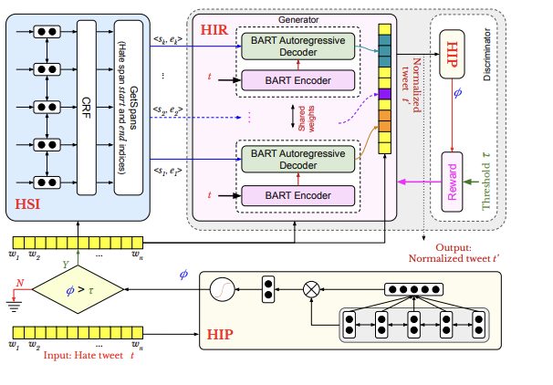
Baseline
HIP Module:
The current baseline model architecture is a combination of Bert and BiLSTM. Bert to handle token representations while BiLSTM capture sequential information

Slide 4
Experiment approaches

Slide 5
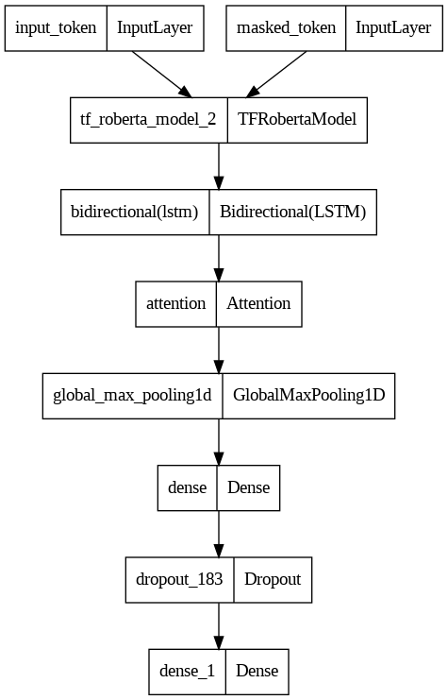
Fusion architectures & Fine Tuning
We referred to similar problem statements like hate-intensity prediction(regression) from this paper and have modified it to train with classification objective.
The results are not significantly different from finetuning foundation models.
We also attempted transfer learning approach by finetuning on tweeter pretrained model “BerTweet” for irony detection but performance is suboptimal

Slide 6
Task Specific Positional Encoding
Decaying Exponential Positional Encoding
The positional encoding designed such that later positions in a sequence get a higher weight, and this weight decays exponentially towards the beginning of the sequence. This could be treated as a task-specific design choice for the problem of detecting irony, where the end of the sentence might hold more importance.
Remarks:
The Bert model is finetuned to detect hate or not using the custom exponential positional encoding. During this fine-tuning, the weights of all layers in the BERT model can be updated based on the new task-specific objective(irony detection) for the new dataset.
This finetuned bert performs relatively fine with the bert variant recorded in the paper.
But this finetuning approach is poorly performing or other transformer architectures like Roberta, Deberta etc.

Slide 7
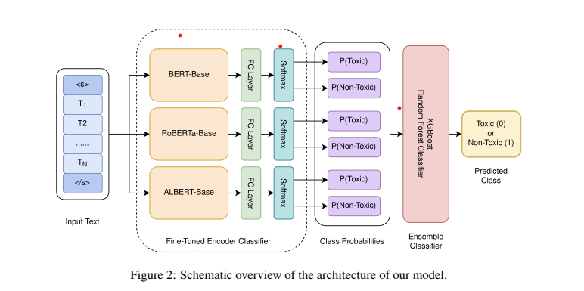
Stacked Meta ensemble training
Reference architecture for ensemble modelling on similar task

Slide 8
Results Revisited

Slide 9
Model Experiments revisited – Hate Intensity
Exp #No | Model architecture | Pearson | Cosine Sim | RMSE
1 | BERT + BiLSTM[1] | 0.787 | 0.975 | 1.3947
2 | ROBERTA + BiLSTM | 0.818 | 0.98 | 1.1846
3 | Roberta + RCNN | 0.830 | 0.9799 | 1.1892
4 | Roberta BiLstm CNN | 0.844 | 0.981 | 1.1517
5 | XLNet + BiLSTM | 0.47 | 0.948 | 2.19
6 | CustomBert Postional Enc | 0.345 | 0.94 | 2.01
7 | Stacked Ensemble | 0.853 | 0.983 | 1.08
8 | Bert+Exp_dec+BiLSTM | 0.02 | 0.937 | 2.09
9 | Bert+Exp_inc+BiLSTM | 0.3 | 0.938 | 2.06

Slide 10
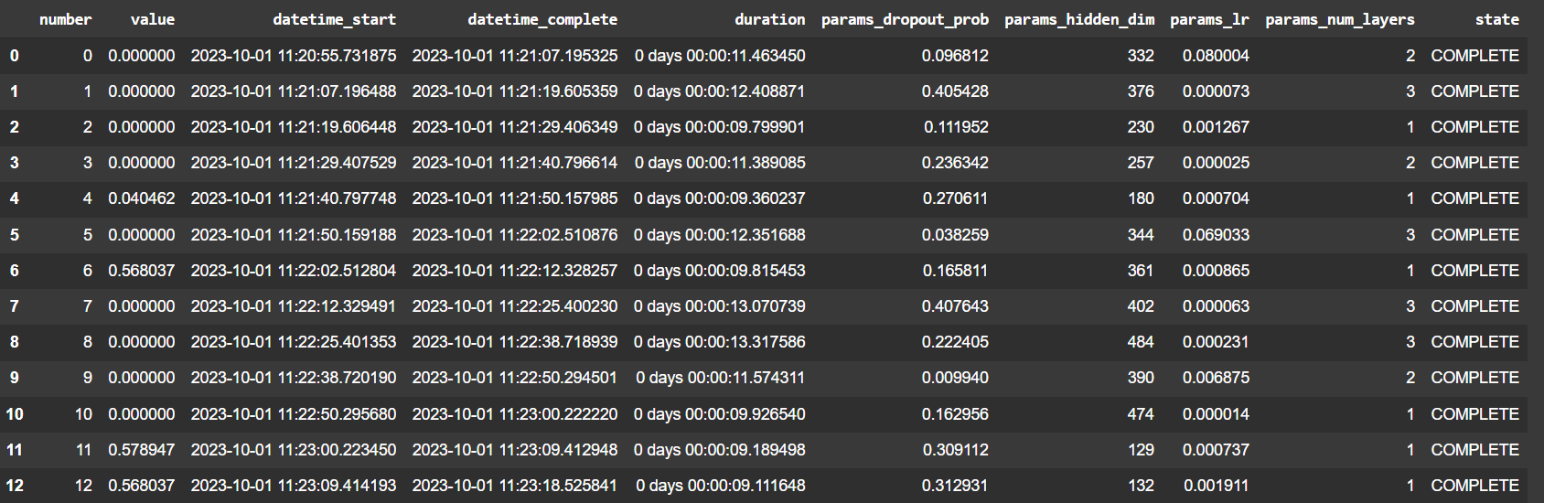
Hyper parameter trials with optuna and ray

Slide 11
Achievements and Learnings
We are able to significantly improve the baseline performance by changing the embedding from Bert to Roberta representations.
We have referred to a similar problem that is “Sarcasm detection”[2] and have implemented similar architecture that is Roberta + RCNN for the current problem statement “Hate Intensity prediction” and results are improving by small fractions.
Our Bert variant finetuning with novel exponential task specific encoding is relatively performing Bert variant mentioned in the reference paper.

Slide 12
Further improvements
"After closely studying the problem, we identified some potential improvements worth exploring:
1D Convolutional Layers: While these aren't technically positional encodings, introducing a few 1D convolutional layers before inputting data into the Transformer could help the model capture local patterns. This is because convolutions inherently consider the relative positions of adjacent tokens.
Data Cleaning: Clean the label errors with state of the art confident learning algorithms that estimate label noises.
Decoding with LLM-based Models: It might be intriguing to explore how LLM-based models perform in decoding for regression tasks.
Hyperparameter Tuning: We also recommend further tuning of hyperparameters, especially when experimenting with different model embeddings.“

Slide 13
Conclusion
We started with baseline architecture and successfully implemented using the configurations mentioned in the paper. We improved the baseline with different fusion architectures. We also explored some novel positional encoding techniques that may not improved over the baseline but atleast performed decently.
References:
1. SemEval-2018 Results
2. Reddit Politics Dataset results
3. Hate intensity prediction

