Slide 1
NIRMA UNIVERSITY | INSTITUTE OF TECHNOLOGY
PROJECT
BlockStruct
Data Structure
Innovative Assignment 1
Interactive tool for blocks, Merkle trees, tamper detection and network propagation
Course Code: 6CS102CC26
BUILT WITH
HTML, CSS (Tailwind), JavaScript and SVG graphics, with a hand-written SHA-256
Student Vinay Thakor | 26MCA061
Yuvraj Kanaya | 26MCA024
Faculty Prof. Nirav Patel
Notes:
Introduce the project: a browser-based tool that lets you mine blocks, build Merkle trees, tamper with a chain and watch a block spread across a peer-to-peer network.

Slide 2
Blockchain made visible
1
The idea
2
The tool
An append-only list of blocks; each block stores the hash of the one before it, so any edit can be found by recomputing hashes.
Mine blocks, queue transactions, search, verify proofs, tamper and broadcast. A hand-written SHA-256 runs in the browser.
A Merkle root summarises all transactions in one hash
Proof of work: find a nonce so the block hash starts with 00
Editing an old block breaks every later link
Block strip, explorer, pool and search sections
Merkle proof view, tamper detection and re-mining
Six-node network with an animated broadcast
Notes:
A blockchain is an append-only list of blocks, each storing the hash of the previous one. A Merkle root commits to all transactions and proof of work makes blocks costly to forge. SHA-256 is implemented by hand and runs in the browser.

Slide 3
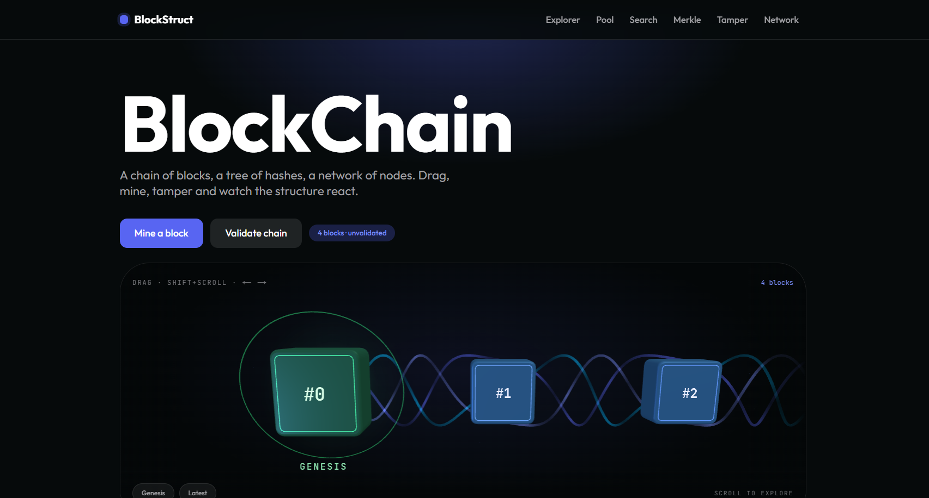
Data structures behind BlockStruct
tx
One transaction: sender → receiver : amount
pool
Transactions waiting to be mined into one block
block
Index, time, prev hash, Merkle root, nonce, txs, hash
chain
Ordered blocks; chain[0] is genesis, prev = 64 zeros
merkle(txs)
Levels of hashes, from m leaves up to one root
bad
Maps a block index to its validation errors
Main window: title, action buttons and the strip of linked blocks
nodes, edges
Peer graph; each node stores its chain height h
Difficulty: a hash needs two leading hex zeros, so a block takes about 256 attempts on average
sha(m) → merkle(txs) → mine(txs, prev, i)
Notes:
tx and pool hold transactions; each block stores index, timestamp, previous hash, Merkle root, nonce, transactions and its own hash. The chain is an array of blocks; the nodes and edges arrays describe the peer-to-peer graph. sha(m), merkle(txs) and mine(txs, prev, i) are the core functions.

Slide 4
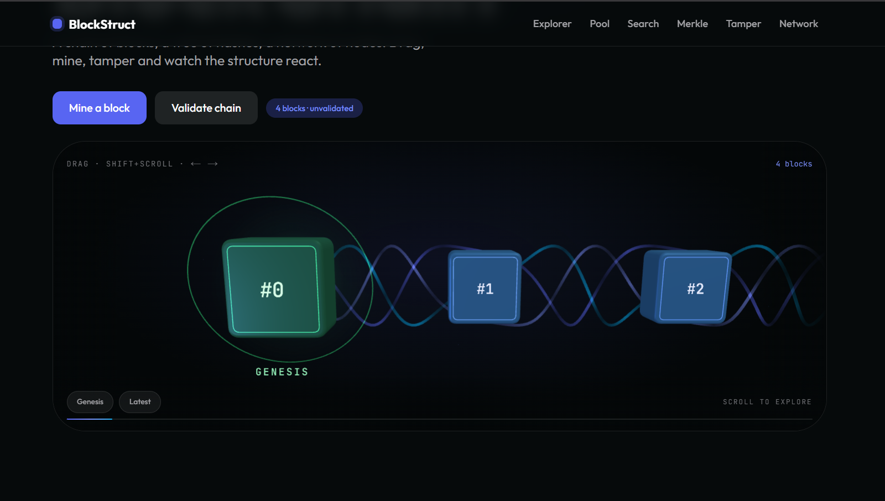
Block, Merkle tree and mining algorithms
Hash
1
SHA-256 of each transaction gives the leaves; an empty block hashes the empty string.
Build the tree
2
Pair neighbours level by level; an odd last hash is paired with itself, until one root.
Mine
3
Raise the nonce until the hash of i|ts|prev|root|nonce starts with 00.
Validate
Block strip: linked cards with the hash, previous hash and nonce of each block
4
For every block, recompute the root and hash, and check the prev link.
Why it is tamper-evident: one changed character alters the Merkle root, the block hash and every later prev link.
Expected attempts 16^d (256 at d = 2)
Notes:
Hash every transaction, pair hashes level by level (odd last hash pairs with itself) until one root remains, mine by raising the nonce until the header hash starts with 00, then validate each block for root, hash and prev link. Expected attempts at d leading hex zeros are 16 to the power d.

Slide 5
Visualising and explaining the result
1
Block strip
Cards joined by connectors; leading zeros show in green and invalid blocks turn red.
2
Explorer and search
Click a block for its header and transactions; search by index, hash or text.
3
Tamper and network
A tick or cross per block with reasons; green packets show a block spreading.
Expected attempts per block: 16^d
Notes:
The block strip draws cards joined by connectors with leading zeros in green. The explorer, pool and search sections inspect and change data. Tamper detection marks each block with a tick or cross and the network view animates packets. The chart compares measured mining attempts with the 16 to the power d theory.

Slide 6
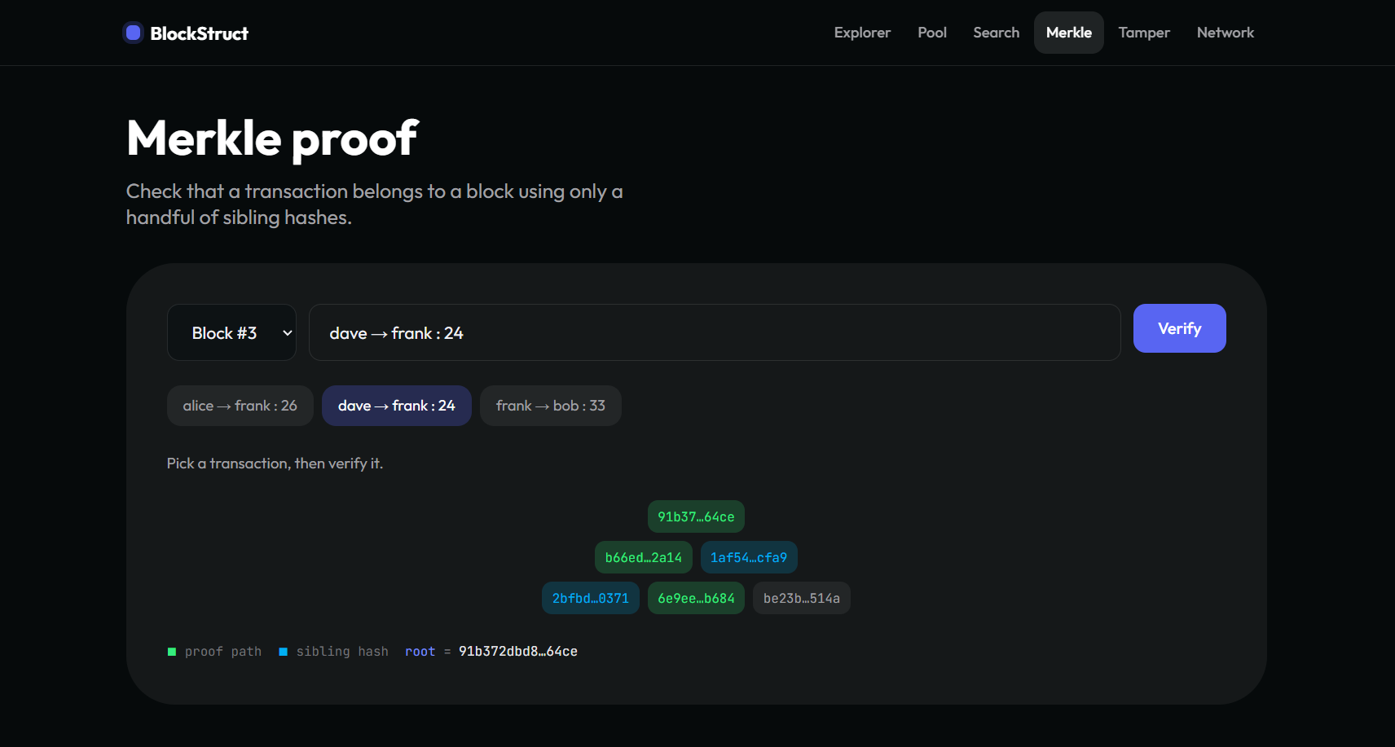
Merkle proof on the same tree
1
Hash the leaf
Hash the chosen transaction; no proof exists if the text is not in the block.
2
Climb with siblings
At each level combine with the sibling; an odd last leaf uses itself.
3
Compare roots
The proof is valid if the rebuilt value equals the block root.
Merkle section: path in green, sibling hashes in blue
m = 8 3 sibling hashes instead of 7 transactions
Controls: pick a block, click a transaction, press Verify
Notes:
verify() hashes the chosen transaction, then at each level picks the sibling (index XOR 1, or itself when there is no right neighbour), combines the pair and moves to the parent index. The proof is valid when the rebuilt value equals the block root. Eight transactions need only three sibling hashes.

Slide 7
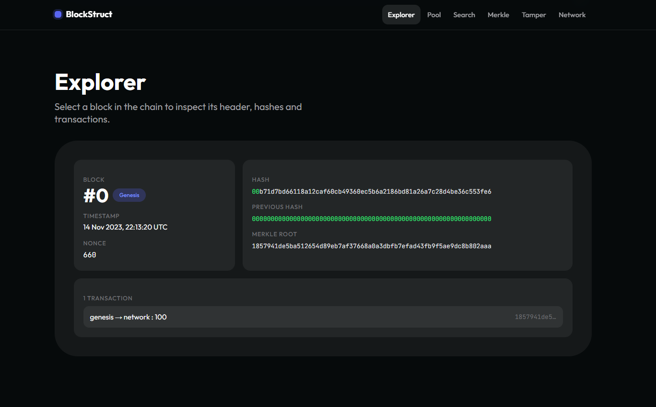
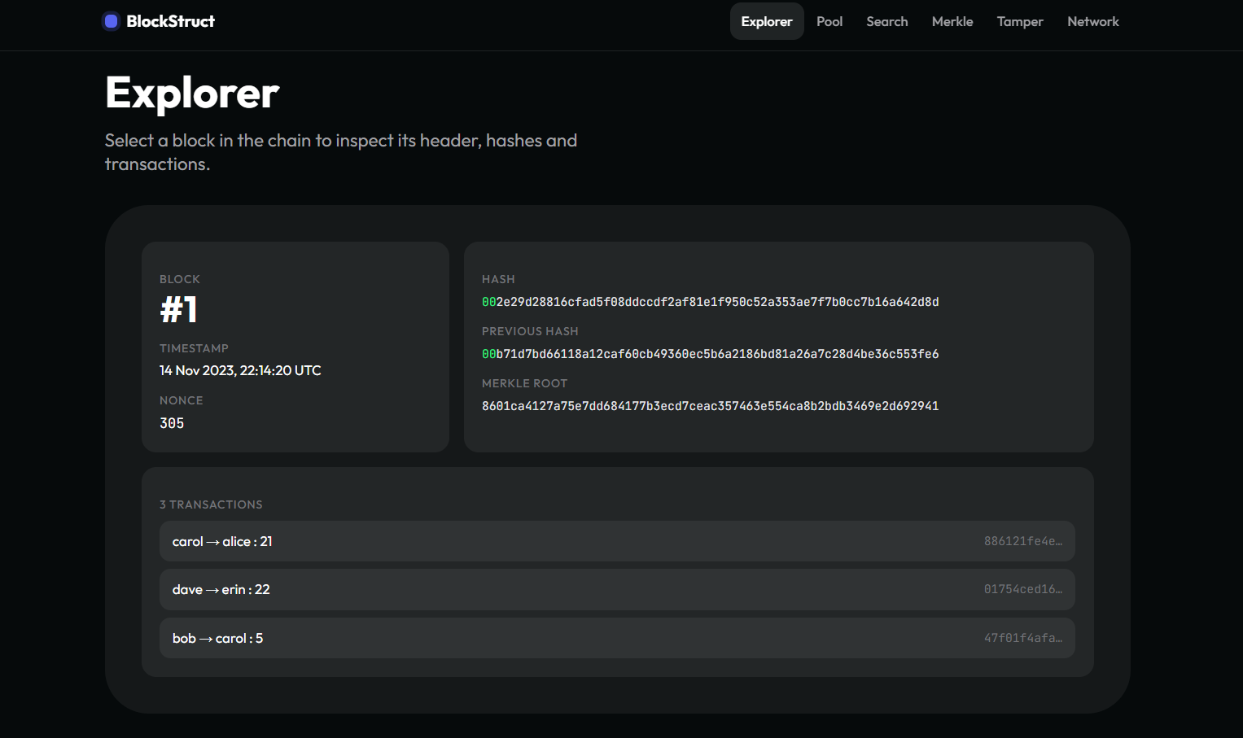
Test cases 1 and 2: genesis and three transactions
Test case 1: genesis block, m = 1
Test case 2: three transactions
Root equals the transaction hash, so the proof needs 0 siblings. Nonce 68 after 69 attempts.
The third leaf is paired with itself: 6 hashes in 3 levels, 2 siblings per proof. Nonce 41 after 42 attempts.
Notes:
Test case 1: the genesis block holds one transaction, so the Merkle root equals the transaction hash and the proof needs no siblings. Test case 2: three transactions, the third paired with itself, six hashes in three levels, every proof needs two siblings.

Slide 8
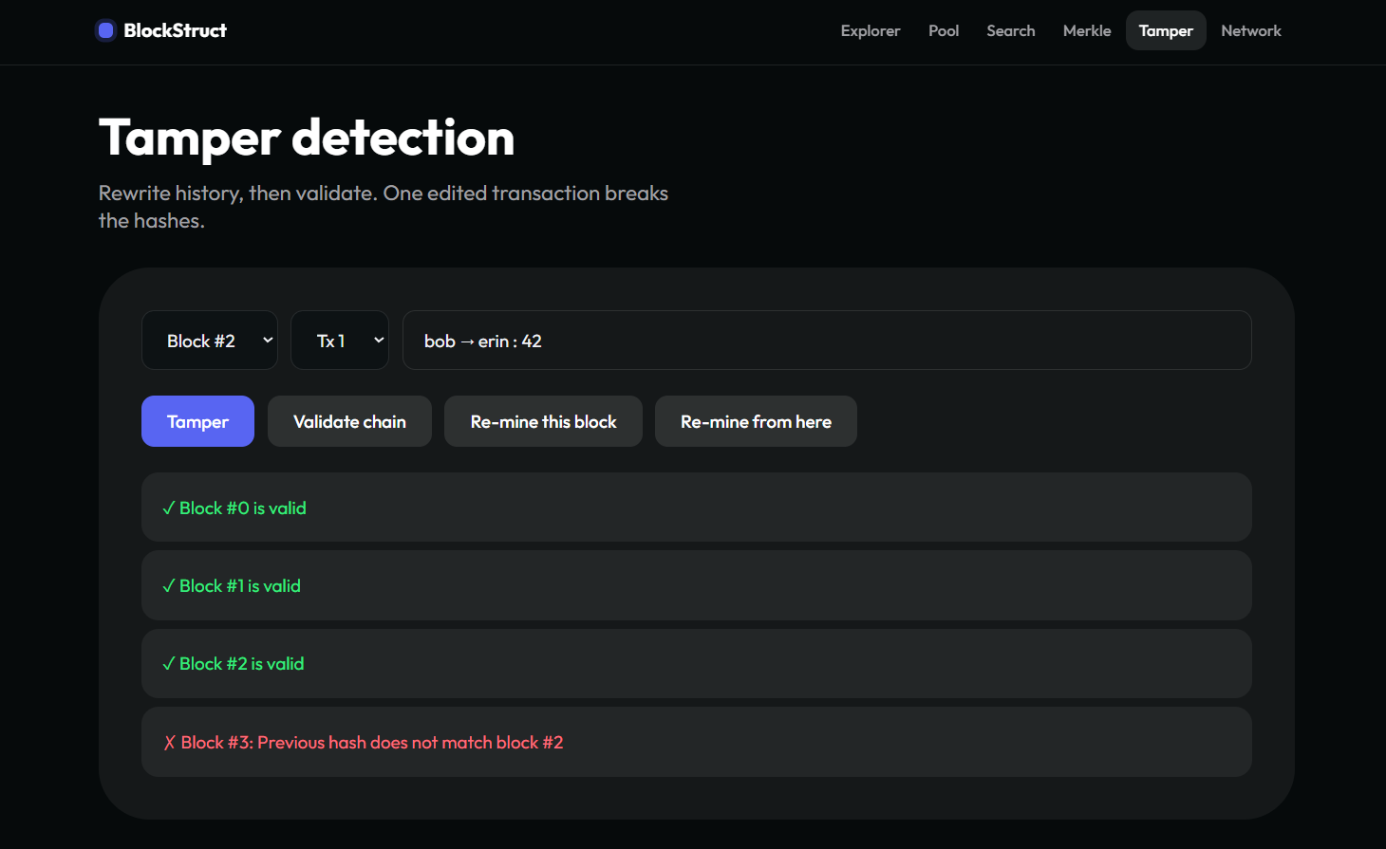
Test case 4 and the proof-size comparison
Test case 4: tamper and re-mine. The edit is caught by the Merkle root. Re-mining one block moves the break to the next; re-mining from here repairs the chain.
Notes:
Test case 4: editing a transaction in block 1 breaks the Merkle root check. Re-mining block 1 needed 125 attempts and moved the failure to block 2. Only re-mining from block 1 to the end repaired the chain. The chart compares the sibling hashes in a proof with the other transactions a verifier would otherwise need.

Slide 9
Further test cases: proofs, mining and network
3
253
5
sibling hashes
mean attempts
messages
Eight transactions
Mining effort
Network broadcast
Test case 3: 15 hashes
Test case 5: expected 256
Test case 6: 2 to 3 rounds
A proof needs 3 siblings instead of 7 other transactions. All eight proofs are valid and unknown text is rejected.
Averages follow 16^d: 17.5, 253.0 and 3917.3 for one, two and three zeros. Single blocks ranged from 1 to 1819 attempts.
All six nodes are reached from every start node. N3 and N6 have only two links, so they need three rounds.
Notes:
Test case 3: eight transactions, 15 hashes, a proof of three siblings; unknown text is rejected. Test case 5: mean 253 attempts at two zeros against 256 expected. Test case 6: a block reaches all six nodes with five messages in two or three rounds.

Slide 10
Comparison of the six test cases
Test case | Input | Key figure | Outcome
1. Genesis block | m = 1 | 0 siblings | Root equals the transaction hash
2. Three transactions | m = 3 | 2 siblings, 6 hashes | Odd leaf paired with itself
3. Eight transactions | m = 8 | 3 siblings, 15 hashes | All eight proofs valid
4. Tamper and re-mine | block #1 edited | 1 to 2 blocks flagged | Only re-mining onwards repairs it
5. Mining effort | d = 2 zeros | mean 253 attempts | Matches 16^d = 256
6. Network broadcast | 6 nodes, 8 links | 5 messages, 2-3 rounds | All nodes reached
Proofs grow slowly
One edit is always visible
Work grows 16-fold
Siblings rose 0, 2, 3 while the block grew from 1 to 8 transactions.
A changed character alters the root, the hash and every later link.
Each extra leading zero multiplies the mining attempts by 16.
Notes:
The six cases show proofs growing slowly with block size, every edit being detected, and the mining cost growing sixteen-fold per extra leading zero.

Slide 11
Conclusion and key takeaways
log₂ m
sibling hashes per Merkle proof, rounded up
Key takeaways
One changed character alters the Merkle root, the block hash and every later link.
Hiding an edit means re-mining the block and every block after it.
The tool is a teaching aid: fixed difficulty, no signatures and no forks.
16×
more mining work per extra leading zero
6 of 6
nodes reached from every start node
Notes:
Close by restating that BlockStruct turns hash-linked blocks, Merkle proofs, proof of work and propagation into something visible that can be checked by hand. It is a teaching aid with fixed difficulty, no signatures and no forks.

