Slide 1
NIRMA UNIVERSITY | INSTITUTE OF TECHNOLOGY
PROJECT
Huffman Coding Visualization
Data Structure
Innovative Assignment 2
Interactive encoding, decoding and visualisation tool for Huffman codes
Course Code: 6CS102CC26
BUILT WITH
HTML, CSS (Tailwind), JavaScript and SVG graphics
Student Vinay Thakor | 26MCA061
Faculty Prof. Nirav Patel
Notes:
Introduce the project: a browser-based tool that animates every stage of Huffman coding.

Slide 2
Huffman coding made visible
1
The idea
2
The tool
Lossless compression with variable-length binary codes built from symbol frequencies.
Type up to 64 characters (16 distinct) or pick one of six test cases, then press Visualize.
Repeatedly merge the two lightest nodes under a new parent
Left edge = 0, right edge = 1; the path to a leaf is its code
Prefix-free codes decode without separators
Animated counting, sorting, merging, code assignment, encoding
Code table, bit stream, compression and entropy
Bit-by-bit decoding replayed on the tree
Notes:
Huffman coding is lossless compression: frequent symbols get short codes, rare symbols get long codes. Symbols sit only on leaves, so no code is a prefix of another.

Slide 3
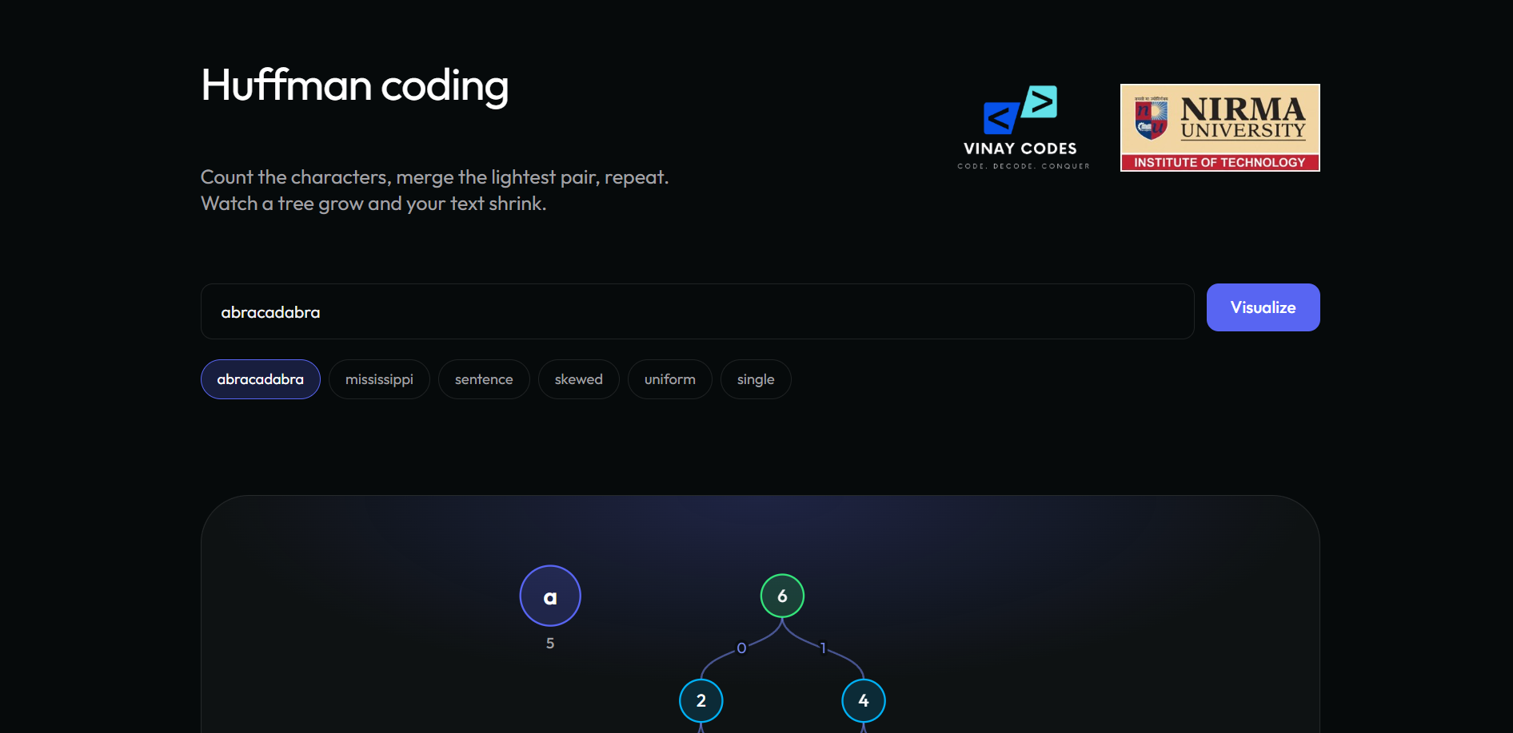
Data structures behind the visualiser
text
Input string, up to 64 characters
freq
Count per character, first-appearance order
Node
Weight, plus char (leaf) or left/right children
forest
Sorted tree roots; acts as priority queue
Main window: title, text input, test-case chips and the Visualize button
steps
One snapshot per stage: Count to Encode
Limits: at most 64 characters and 16 distinct symbols, so the tree stays readable
codes, paths
Bit string and root-to-leaf node ids
build(t) → layout(forest) → go(i)
Notes:
build(t) counts, creates leaves, merges, and derives codes and paths. layout(forest) positions nodes; go(i) switches step; a requestAnimationFrame loop animates movement.

Slide 4
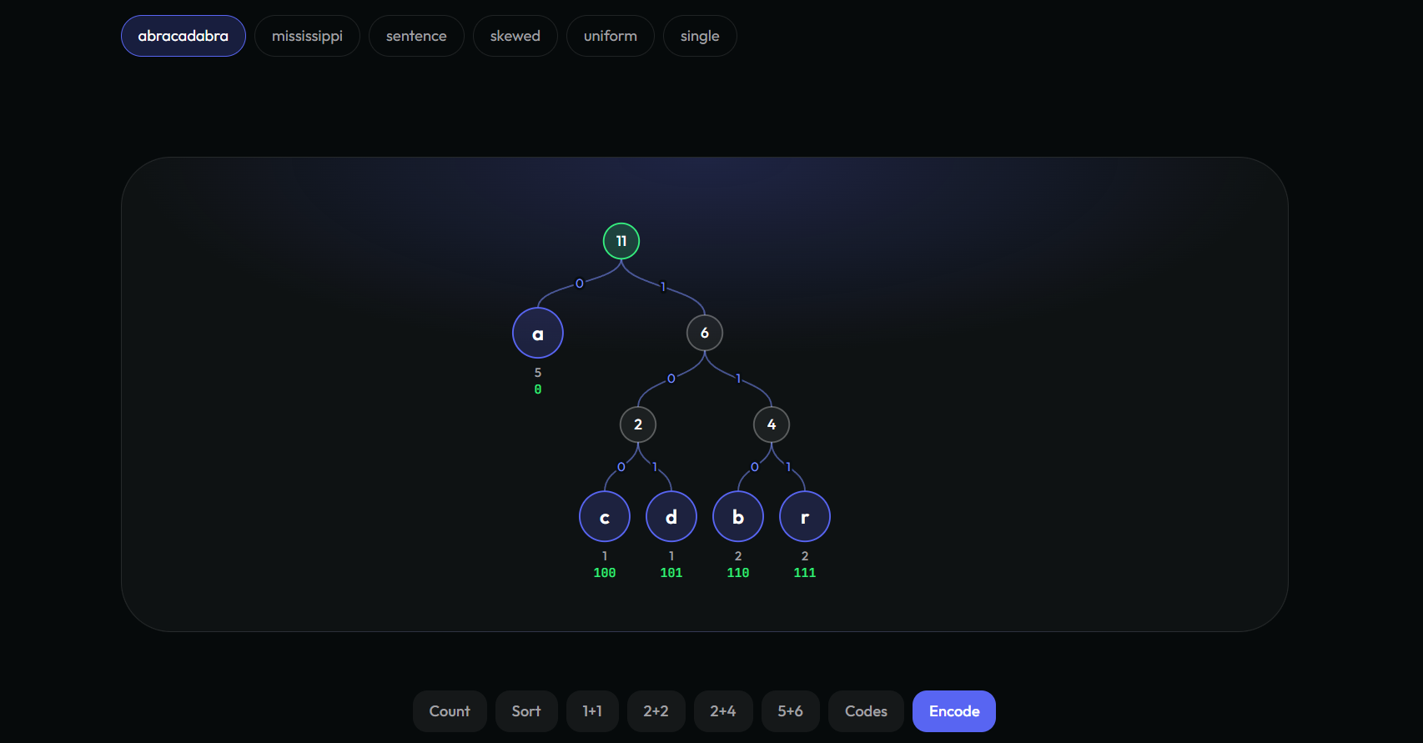
The greedy Huffman construction
Initialise
1
Count characters; each becomes a leaf weighted by its frequency, sorted.
Merge
2
Join the two lightest trees under a parent of summed weight. Repeat until one root.
Assign codes
3
Walk root to leaf: left appends 0, right appends 1.
Tree during construction: merged nodes highlighted, edges labelled 0 and 1
Encode
4
Why greedy works: the two rarest symbols can always be the deepest sibling leaves of an optimal tree.
Replace each character by its code; compare with 8n bits.
Running time O(n + k log k)
Notes:
Ties are broken by first appearance so the same input always gives the same tree. With a binary heap the cost is O(n + k log k); the visualiser uses a sorted array, O(k^2), negligible for k up to 16.

Slide 5
Visualising and explaining the result
1
Step bar and hover
One button per stage; hover shows the actual numbers being merged.
2
Animated tree
Nodes glide to new positions; merged pair in cyan, parent in green.
3
Statistics
Colour-coded bit stream, ASCII vs Huffman bars, average length and entropy.
Rule checked in every case: H ≤ L < H + 1
Notes:
Every stage can be replayed. After Encode, the tool reports saved percentage, average bits per character and entropy. For a Huffman code H <= L < H + 1.

Slide 6
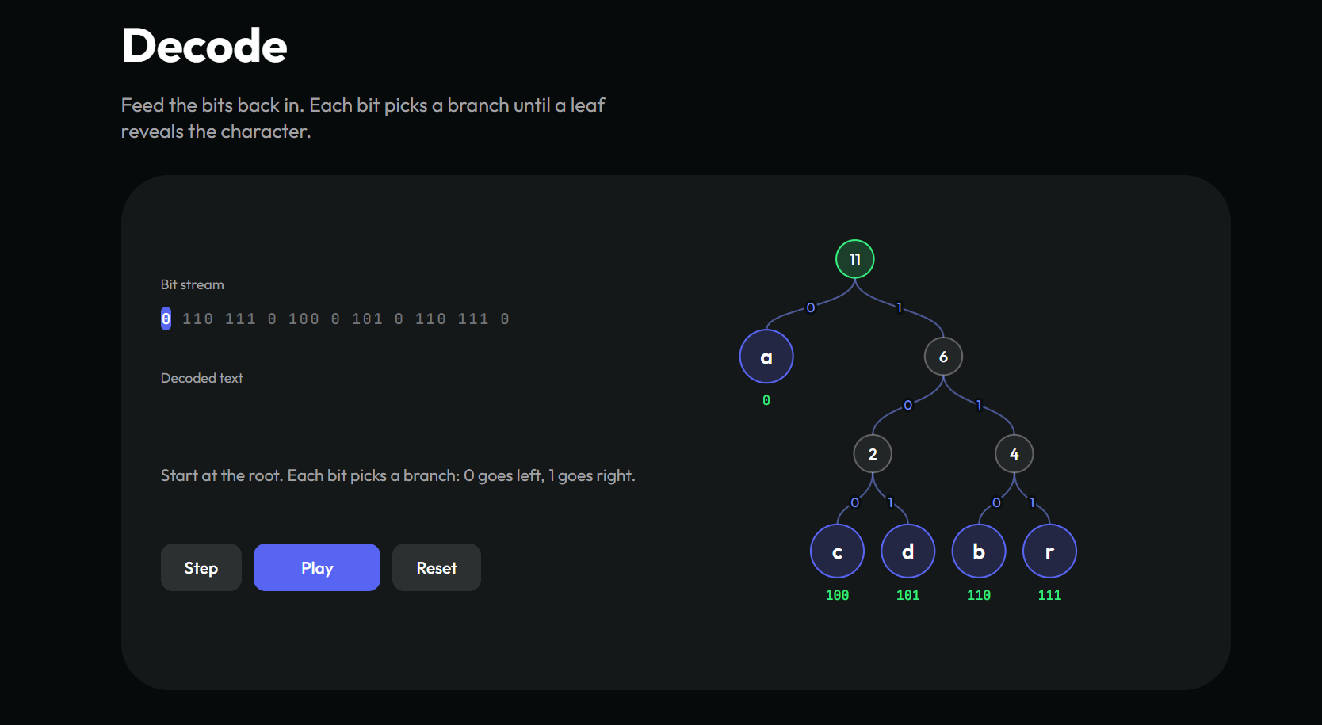
Decoding on the same tree
1
Read a bit
0 moves to the left child, 1 to the right child.
2
Reach a leaf
Write its character, then return to the root.
3
Verify
The decoded text must equal the original input.
Decode section: bit stream, decoded text so far and the path on the tree
abracadabra bits: 0 110 111 0 100 0 101 0 110 111 0
Controls: Step, Play, Reset
Notes:
dstep() consumes one bit per call: 0 goes left, 1 goes right; a leaf outputs its character and returns to the root. At the end the tool confirms decoded text equals the original.

Slide 7
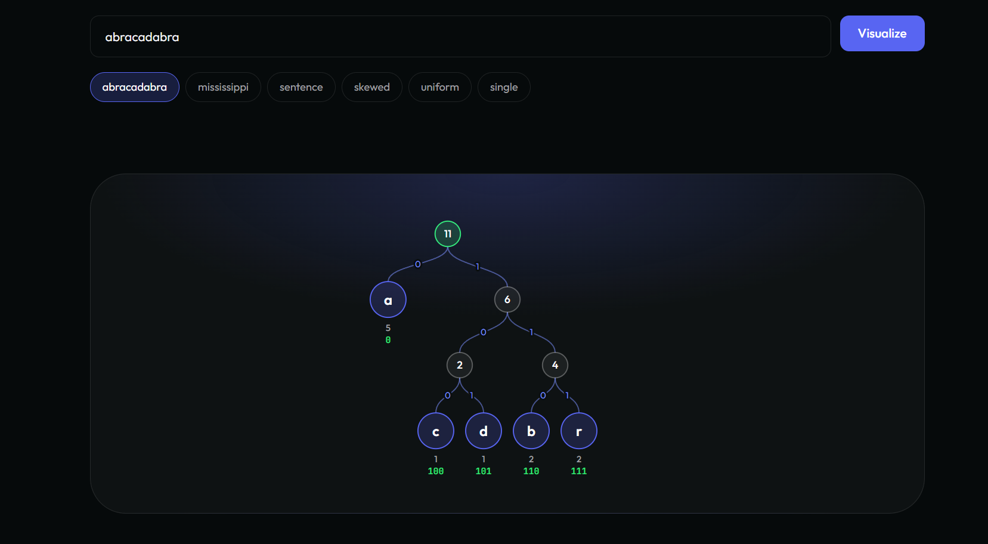
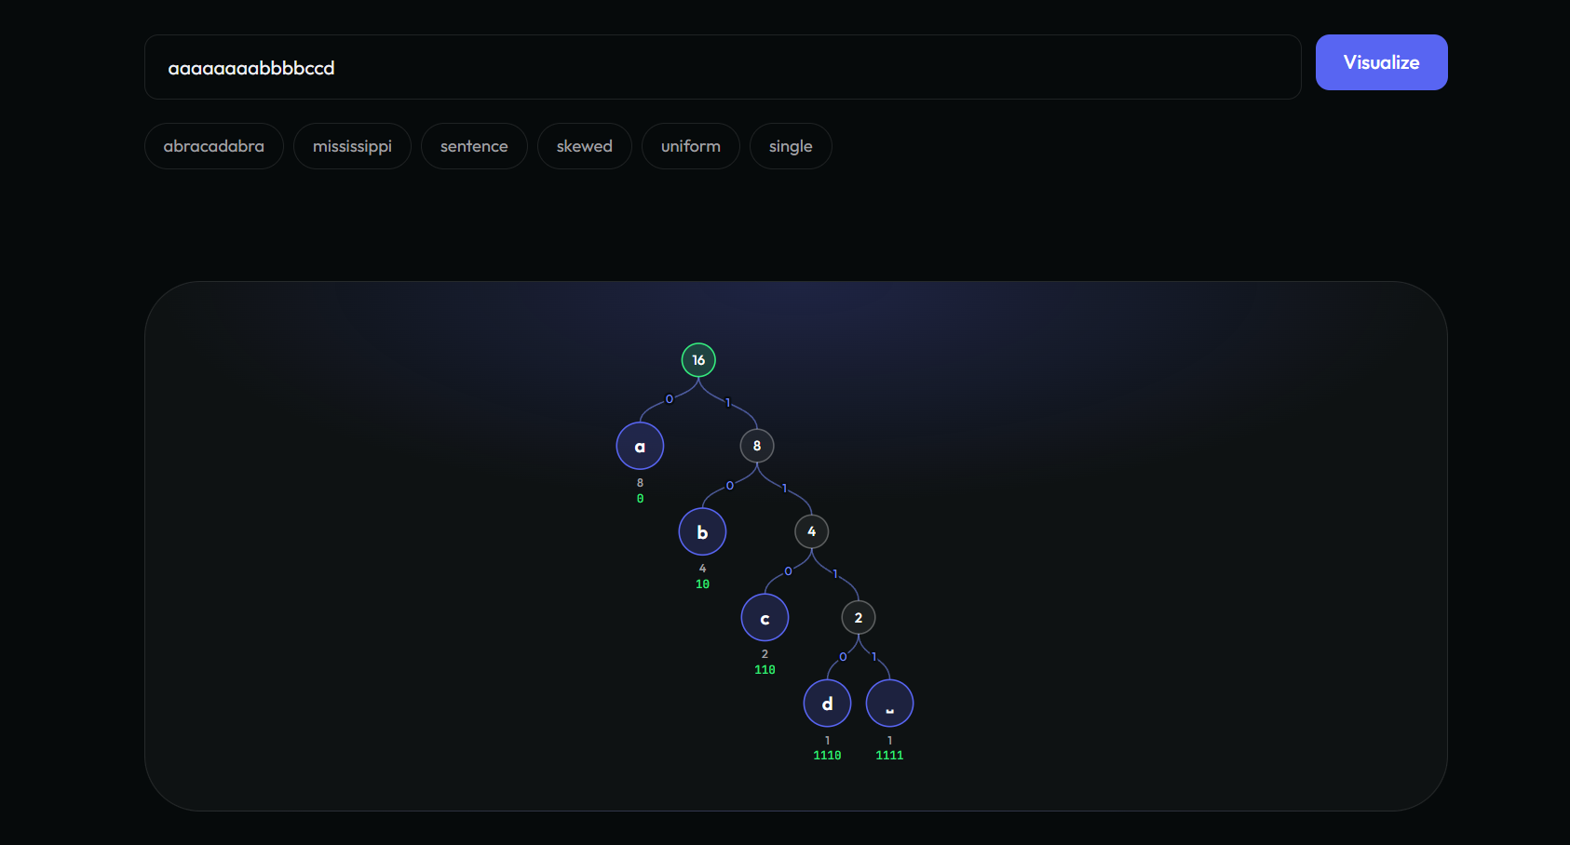
Test cases 1 and 2: small and skewed text
Test case 1: abracadabra
23 bits instead of 88, 74% saved. a = 0, b = 110, r = 111, c = 100, d = 101.
Test case 2: skewed (aaaaaaaabbbbccd)
25 bits instead of 120, 79% saved. The dominant letter a costs one bit.
Notes:
TC1: abracadabra, 11 chars, 5 symbols, 23 bits vs 88. TC2: aaaaaaaabbbbccd, chain-shaped tree, 25 bits vs 120, the best saving among the three detailed cases.

Slide 8
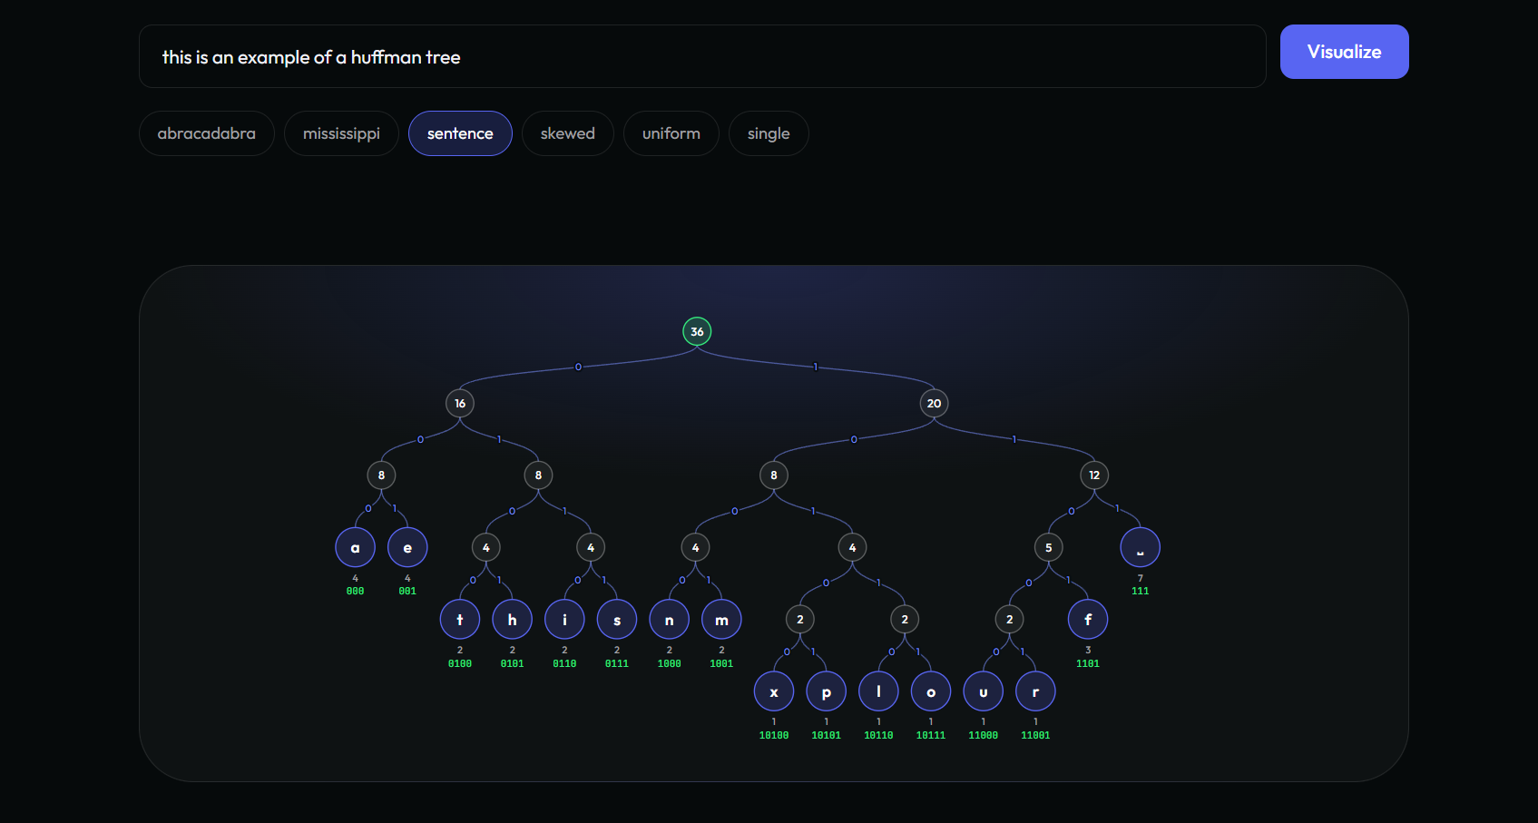
Test case 3 and the compression comparison
Test case 3: 16-symbol sentence
135 bits instead of 288, 53% saved, after 15 merges. Average 3.75 bits per character vs entropy 3.71.
Notes:
The 36-character sentence has 16 symbols and needs 15 merges. Saving is smaller (53%) because frequencies are spread over many symbols.

Slide 9
Further test cases: typical and degenerate input
76%
63%
88%
saved
saved
saved
mississippi
abcdefgh
zzzzzz
21 bits vs 88
24 bits vs 64
6 bits vs 48
s = 0, i = 11, p = 101, m = 100. The two most common letters get the shortest codes.
All frequencies equal: a balanced tree, every code 3 bits, same as fixed-length coding.
A single leaf with code 0. Entropy is zero, yet one bit per character is still spent.
Notes:
These three presets test typical and degenerate inputs. Tree or code-table overhead is not included in the bit counts.

Slide 10
Comparison of the six test cases
Test case | n × k | ASCII bits | Huffman bits | Saved | Avg bits/char | Entropy
1. abracadabra | 11 × 5 | 88 | 23 | 74% | 2.09 | 2.04
2. Skewed | 15 × 4 | 120 | 25 | 79% | 1.67 | 1.64
3. Sentence | 36 × 16 | 288 | 135 | 53% | 3.75 | 3.71
4. mississippi | 11 × 4 | 88 | 21 | 76% | 1.91 | 1.82
5. Uniform | 8 × 8 | 64 | 24 | 63% | 3.00 | 3.00
6. Single | 6 × 1 | 48 | 6 | 88% | 1.00 | 0.00
Skewed compresses best
Uniform gains nothing
Close to entropy
Test case 2 saves 79% with four symbols; case 3 saves 53% over 16.
Eight equal symbols still need 3 bits each, like a plain 3-bit code.
Average length is above entropy but under one bit above it.
Notes:
Skewed input compresses best, uniform input gains nothing over fixed-length codes, and the average length always stays within one bit of the entropy.

Slide 11
Conclusion and key takeaways
53–88%
saved vs 8-bit ASCII
Key takeaways
Greedy merging yields prefix-free codes that decode without separators.
Skewed text compresses most; uniform text gains nothing over fixed-length codes.
The stored tree is not counted, so savings describe the encoded data only.
< 1 bit
average length above entropy
6
test cases, 1 to 16 symbols
Notes:
Close by restating that the tool turns the greedy algorithm into something visible and verifiable by hand.

