Slide 1

MANUAL TESTING PROJECT
“IN-FLOW INVENTORY APPLICATION”
GUIDED BY:-
Miss. Pratiksha Mam
GROUP MEMBER:-
Vinayak .N. Rathod(TL)
Prathamesh Jadhav(TM)

Slide 2
EXPLANATION OF PROJECT
INFLOW INVENTORY APPLICATION:-
Inflow Inventory is an inventory management software that can also play a role in software testing or application that mange inventory data.
Inflow Inventory can be valuable tool for testing inventory management software, providing a robust framework to validate functionality, performance and usability.
Features:
Creation of new purchase orders with predefined templates.
Vendor management and approval workflows.
Automatic inventory updates upon order receipt.
Real-time status tracking of orders.
Benefits:
Simplified procurement process.
Enhanced visibility into vendor performance.
Reduction in processing time and errors.

Slide 3
ROLE AND RESPONSIBILTY
RESPONSIBILITIES:-Performing all the Test cases & Create Defect Report
List of Function:- This Function done by Vinayak Rathod(TL)
Vendor 9.Search
Contact 10.Vendor Product Code
Phone 11.Quantity
Vendor address 12.Unit Price
ADD Shipping 13.Discount
Order # 14.Sub-total
Item Dialog Box-ADD NEW 15.Taxing Scheme
Item Dialog Box-ADD Button 16.Currency

Slide 4
This function done by Prathamesh.T.Jadhav(TM)
List of function:-
1)New Button
2)Save Button
3)Preview Button
4)Attachment Button
5)Sticky
6)Close Button

Slide 5
EXPLANATION OF PURCHASE MODULE
Purchase Order A purchase order in Inflow Inventory includes Importance details like supplier info, order specifics, product info, Shipping and payment details, discounts and notes. This comprehensive data helps businesses process order smoothly, communicate effectively with suppliers, and ensure accurate delivery. Overall, It makes managing purchase easier and enhance supplier relationship.
Creating order : You can easily create purchase orders for suppliers. This includes selecting items you want to buy, entering quantities, discounts, and unit prices.
Tracking Orders: Once an order is created, you can track its status. ​ You’ll know if it’s completed or shipped
Payment Management: The payment method is highly secured and all types of currency are included in the module.
Supplier Management: You can keep track of supplier information, like contact details and order history, which helps in providing better service.
Button: The module provides all types of buttons like save, new, attachment, sticky note, and copy, which may help in providing better service. ​ Overall, it streamlines the purchase process, making it easier to manage orders and keep track of inventory.

Slide 6
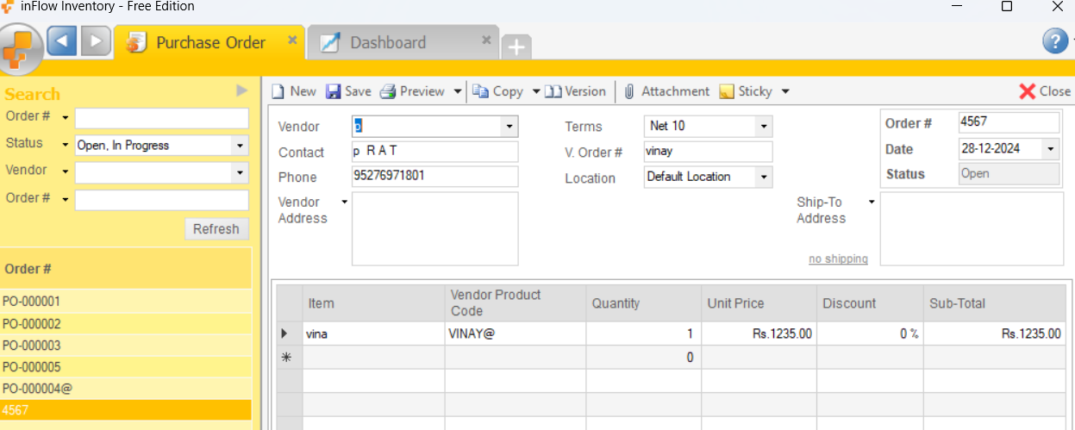
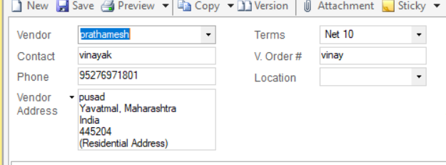


DEFECT FOUND
DEF- ID | DEFECT NAME | DEFECT DESCRIP-TION | PRECONDITION | TEST DATA | TEST STEPS | EXPECTED RESULT | ACTUAL RESULT | PRIORITY | SEVERITY
D5 | Phone (Valid) | To verify Maximum number of character can not exceed | 1)In-Flow inventory Application 2) Purchase Order 3) Phone Field Should be Visible | 95276971801 | 1) Open the Application 2) Click on the Purchase order 3) Click on Phone Number field 4)type on the phone label | The maximum number of digit should not exceed and show a proper message | It is accepting maximum number and not showing proper message | HIGH | MEDIUM

Slide 7
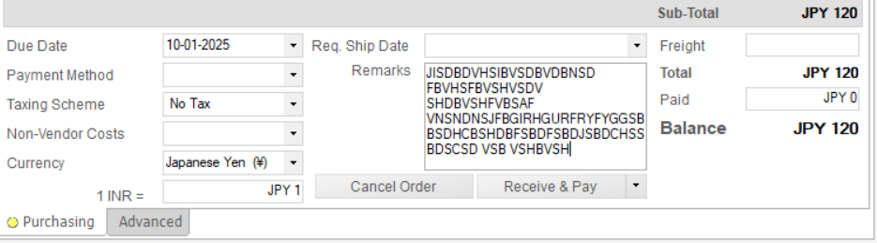




DEF ID | DEFECT NAME | DEFECT DESCRIPTION | PRECONDITION | TEST DATA | TEST STEPS | EXPECTED RESULT | ACTUAL RESULT | PRIORITY | SEVERITY
TC_154 | Remark (Invalid) | To verify the remark field cannot be exceed from the given range | 1)In-Flow inventory Application 2) Purchase Order 3) remark module can be visible 4) type something | 0 to 101 | 1) Open the Application 2) Click on the Purchase order 3) Click on Remark module | The remark field should not exceed from the given range and show a proper error msg | The Remark field is accepting more number | LOW | MEDIUM

Slide 8
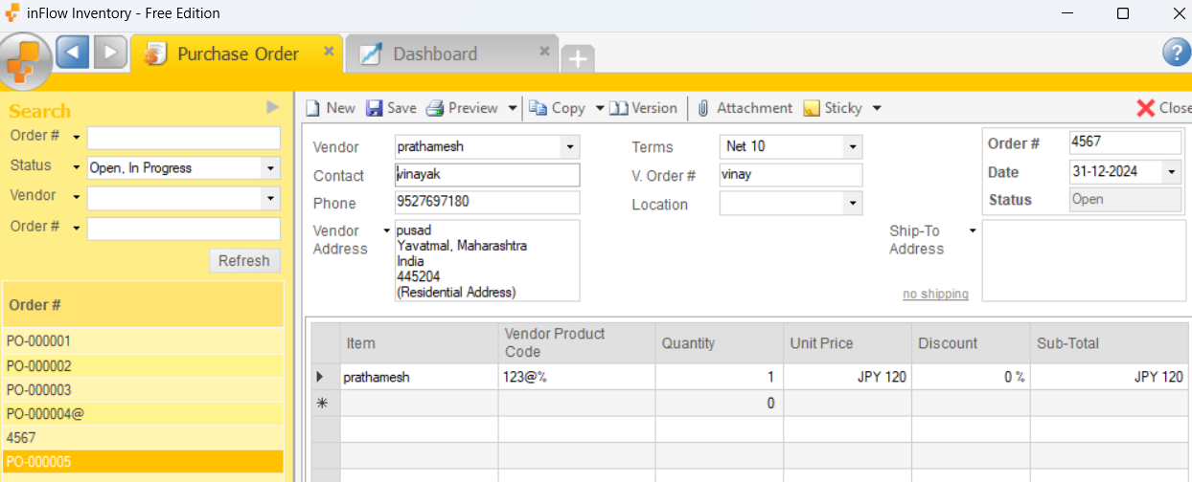
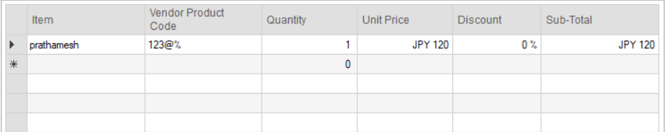



DEF ID | DEFECT NAME | DEFECT DESCRIPTION | PRECONDITION | TEST DATA | TEST STEPS | EXPECTED RESULT | ACTUAL RESULT | PRIORITY | SEVERITY
D16 | Product code (Valid) | To verify it Can not accept special character or alphabet | 1)In-Flow inventory Application 2) Purchase Order 3) Product code should be visible | 1234@vi nay | 1) Open the Application 2) Click on the Purchase order 3) Click on product code 4) enter the code | It should not accept special character or alphabet | It is accepting special character or alphabet | MEDIUM | HIGH

Slide 9
CHALLENGES
• Complex Rules(For Installation): The app has many rules about how inventory works, which can make it tricky to test everything correctly. ​
​
• Time Constraints: Testers often have limited time to do their work, making it hard to test everything thoroughly. ​
• Inadequate testing​ : This can happen when the software is not tested thoroughly enough before it is released. It is important to make sure that the software is sufficiently tested before it is released. This can help to avoid software defects and improve the quality of the software.
• Difficulty in understanding scenarios and test case.

Slide 10
Experience
Gained in-depth knowledge of inventory management systems.
Improved problem-solving and debugging skills.
Improved communication in Group Discussion.
Ability to develop the Text Case from give Test Scenario.
In this we learn how the Application is tested without using any Tools or Test Scripts.
We Learn how to manage Time / how to complete the project in given Deadline.

Slide 11
VOTE OF THANKS
Thank you so much mam for your guidance and support on our project. ​ Your help has made a big difference, and we really appreciate it.
Thank to my Team Member and all of you for your Support.
Thank You for believing in us and for being such an inspring mentor.
Regards:- Vinayak & Prathamesh

Slide 12


