Slide 1


Slide 2
Presentation Outline
Introduction
Embedded Sytems overview
ARM Architecture and LPC2138 Micro controller
Micro Kernel Functions Implemented
Task Related functions
Pre-emptive Priority Scheduler
Context Switching Implementation
Semaphore implementation for Intertask Communication
Circuit Schematics of the board used
Results
Tools and Applications
Notes:
INTRODUCTION

Slide 3
Introduction
In this project a Real Time microkernel that performs multi tasking on ARM7TDMI
platform is developed
A real-time microkernel is the near-minimum amount of software that can provide
the mechanisms needed to implement a real-time operating system
The micro kernel includes a preemptive priority scheduler and context switching
modules for carrying out multi-tasking
Scheduler is for choosing the highest priority task for execution
Context switching is for saving the current task registers and restoring the next task
registers from the stack or task control block
ARM7TDMI used in this project is part of LPC2138 micro controller. The details of
the architecture needed to implement a microkernel are explained in this
presentation

Slide 4
Real Time vs Non-Real Time
Real Time Systems are those systems whose response is deterministic in time. The Real Time operations must be completed within deadlines.
The Real Time deadlines are classified into two types
Hard Real Time Deadline: Failure to meet the deadline leads to system failure .
Eg .Atomic Reactor Control, Aircraft On board controller.
Soft Real Time Deadline: Failure to meet deadline leads to degradation of system performance.
Eg. Playing a video on a laptop.

Slide 5
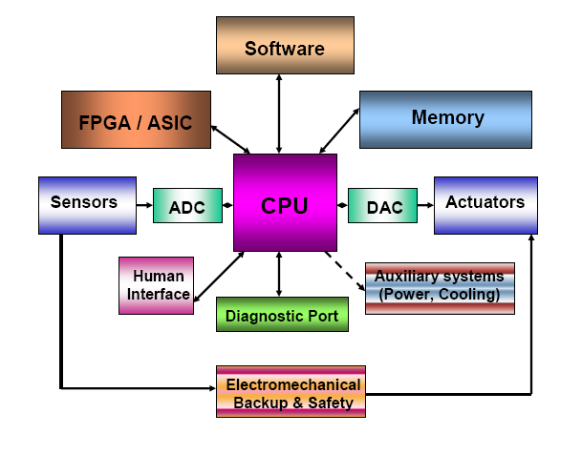
Embedded System
An EMBEDDED SYSTEM is any device that includes a computer but is not itself
a general purpose computer.
It is a combination of hardware and software which can perform a specific task and
is expected to function without human intervention.
It can respond, monitor and control external environment using sensors and actuators.
Examples: car electronics, cell phone, printer, television, house hold appliances etc.
General purpose Embedded system block diagram
Notes:
An EMBEDDED SYSTEM

Slide 6
ARM7TDMI (Processor used in the project)
ARM is short for Advanced RISC Machines
ARM is one of the most licensed and thus widespread processor cores in the world
32-bit RISC-processor core (32-bit instructions)
32-bit integer registers (16 available)
Pipelined (ARM7: 3 stages)
TDMI
T - Thumb instruction set
D- Debug-interface (JTAG)
M- Multiplier (hardware)
I – ICE (In Circuit Emulation)
ARM7TDMI is the most used ARM-version

Slide 7
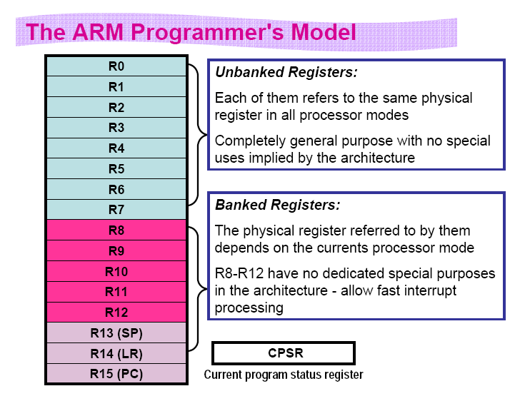
In user mode total 16 GPRs , CPSR & SPSR are present
Special registers in other 5 modes
R13 acts as SP, R14 acts as LR, R15 acts as PC

Slide 8
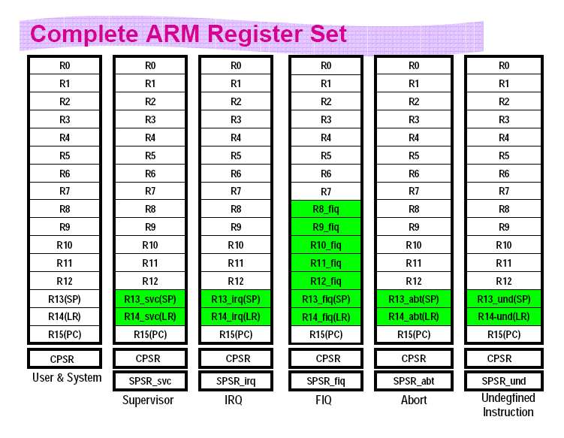
These registers have to be manipulated for context switching

Slide 9
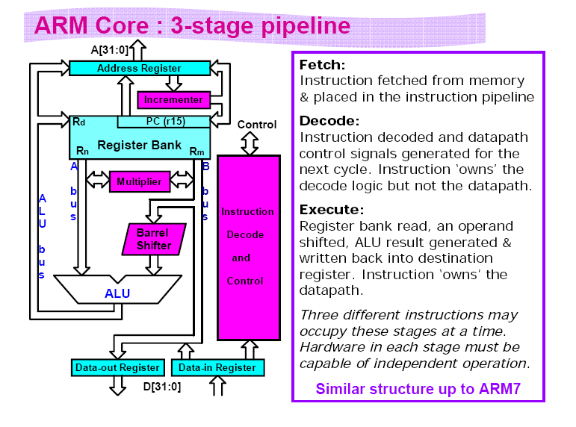

Slide 10
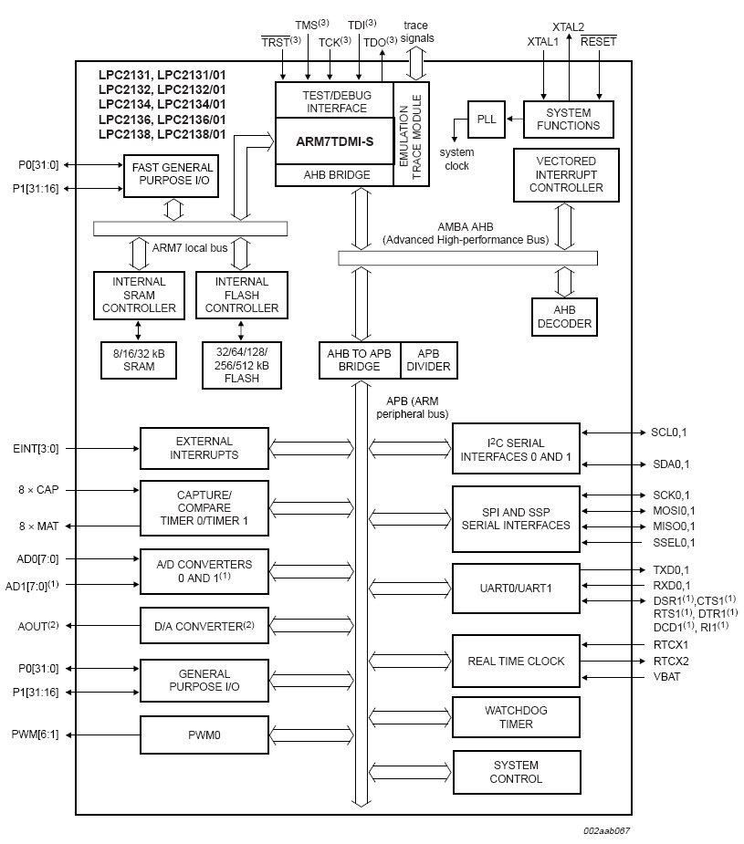
LPC2138 Micro Controller based on ARM7TDMI

Slide 11
Microkernel functions Implemented in the project
All the functions implemented in this project are classified as follows
Task related functions for task creation, priority changing, deletion etc..
Scheduler for scheduling using priority pre-emptive feature
Context switch to swap two tasks
Semaphore related functions for intertask communication

Slide 12
Task or Thread in Operating Systems
Task or thread of execution is the smallest unit of processing that can be scheduled by an operating system.
Task properties:
A Task must be created by the OS before it can be scheduled for execution
Each task has a priority, and an entry in the TCB (Task Control Block)
Each task has its own stack area where it stores local variables
Task will be always in one the three states namely READY, WAIT, RUN
Two different tasks can have same priority, then round robin scheduling happens
User program can change priority of task
Always highest priority ready task runs
Task switching happens due to scheduler and context switching function execution by the operating system.

Slide 13
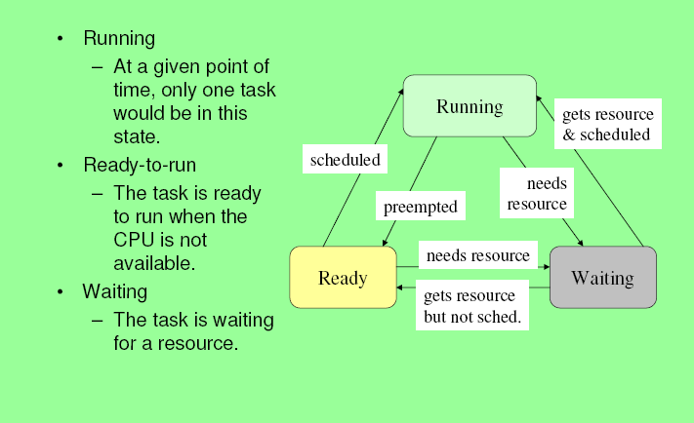
Task States

Slide 14
Task related functions
osrc_t thread_create (int 32*ptid, int32 pri, void (*pfunc)(void))
Creates a thread with the entry point pointed to by pfunc, and makes it ready to run. If the priority is higher than the current thread’s priority, it schedules the created thread. Returns OK if successful, or ERR on error.
void thread_suspend (int32 tid)
Suspends the specified task (puts it in the wait state).
void thread_resume (int32 tid)
Resumes the specified task (puts it in the ready/running state depending on the priority).
int32 thread_self (void)
Returns the id of the current task.
int32 thread_getpri (int32 tid)
Returns the priority of the specified task.
myrc_t thread_setpri (int32 tid, int32 pri)
Sets the priority of the specified task. Additionally, performs scheduling if required due to the change in the task priority.
typedef enum {OK, ERR} osrc_t;

Slide 15
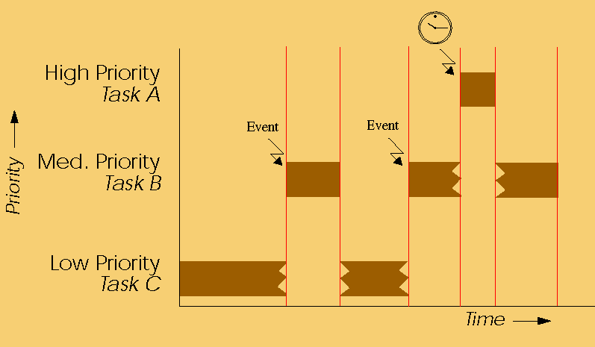
Microkernel & Scheduler
A MICRO KERNEL is a minimum operating system that includes mechanisms such
as Scheduling and Context Switching.
Scheduling is a key concept in multi processing operating system and real time operating system designs. Scheduling refers to the way processes are assigned to run on the available CPUs, since there are typically many more processes running than there are available CPUs.
Priority based scheduling
Notes:
MICRO KERNEL

Slide 16
Scheduler
void thread_schedule (void)
Runs the thread scheduler.
The job of the scheduler is:
1. Scan entire TCB and compare the status and priority of all the tasks with the
current task running2
2. If there is any other task which is ready to run and has higher priority than the
current task, make the current task ready and new task as running
3. Call the context switch routine to swap the register contents.
In summary the job of the scheduler is to run the Highest priority ready task.

Slide 17

Context Switching
A context switch is the computing process of storing and restoring of a CPU so that execution can be resumed from the same point at a later time. This enables multiple processes to share a single CPU. The context switch is an essential feature of a multitasking operating system.
Human being doing multiple tasks
with brain context switching

Slide 18
Context Switching
void thread_switch_context (int32 *pcurcxt, int32 *pnxtcxt) (Assembly code)
This function Takes in the pointers to the arrays containing contexts of the current and new task. Swaps these contexts and returns to new task.
;* Restore all the second task register values from the TCB to Processor
LDR R2,[R1,#0X0]
LDR R3,[R1,#0X4]
LDR R4,[R1,#0X8]
LDR R5,[R1,#0XC]
LDR R6,[R1,#0X10]
LDR R7,[R1,#0X14]
LDR R8,[R1,#0X18]
LDR R9,[R1,#0X1C]
LDR R10,[R1,#0X20]
LDR R11,[R1,#0X24]
LDR R12,[R1,#0X2C]
LDR R12,[R1,#0X28]
LDR R0,[R1,#0X4C]
ADD R0,R0,#04
MOV R13,R0
LDR R14,[R13]
BX R14
END
; //save all the registers of current task
STR R2,[R0,#0X0]
STR R3,[R0,#0X4]
STR R4,[R0,#0X8]
STR R5,[R0,#0XC]
STR R6,[R0,#0X10]
STR R7,[R0,#0X14]
STR R8,[R0,#0X18]
STR R9,[R0,#0X1C]
STR R10,[R0,#0X20
STR R11,[R0,#0X24]
STR R12,[R0,#0X28]
STR R12,[R0,#0X2C]
STR R14,[R13]
SUB R13,R13,#04
STR R13,[R0,#0X4C]

Slide 19
Semaphore
osrc_t ossem_create (int32 count, int32 *psid)
Creates a semaphore with the specified initial count and returns the id in *psid. Returns OK if successful, or ERR on error.
void sem_post (int32 sid)
Posts the specified semaphore. Reschedules the tasks if posting the semaphore could cause a task switch.
void sem_wait (int32 sid)
Waits for a semaphore. If the semaphore is unavailable, puts the current task in waiting state and schedules another task.

Slide 20
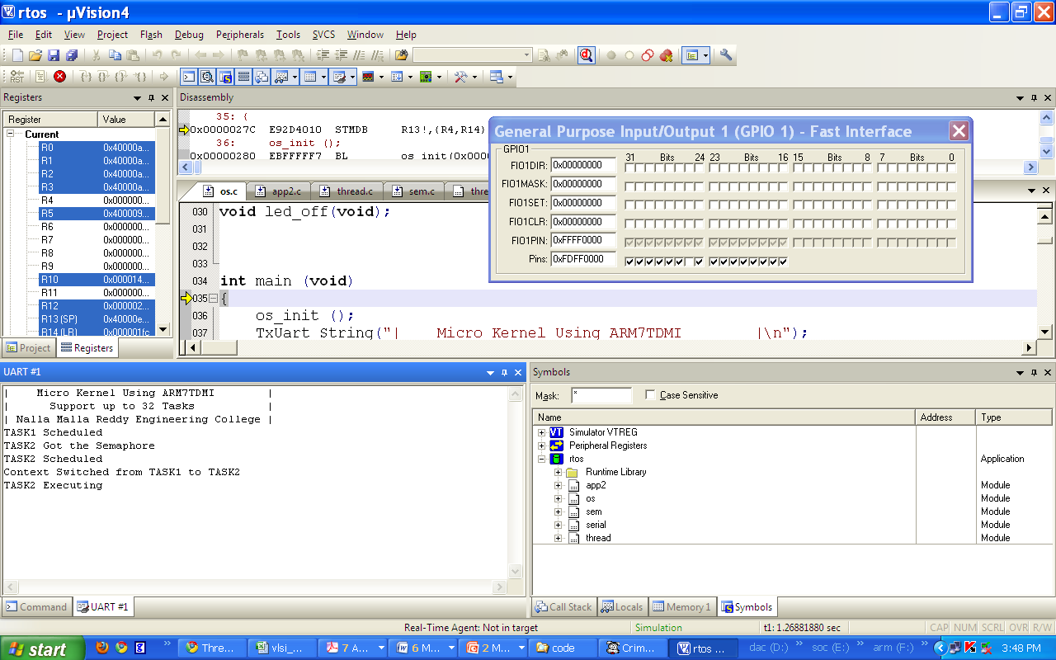
Simulation Results 1

Slide 21
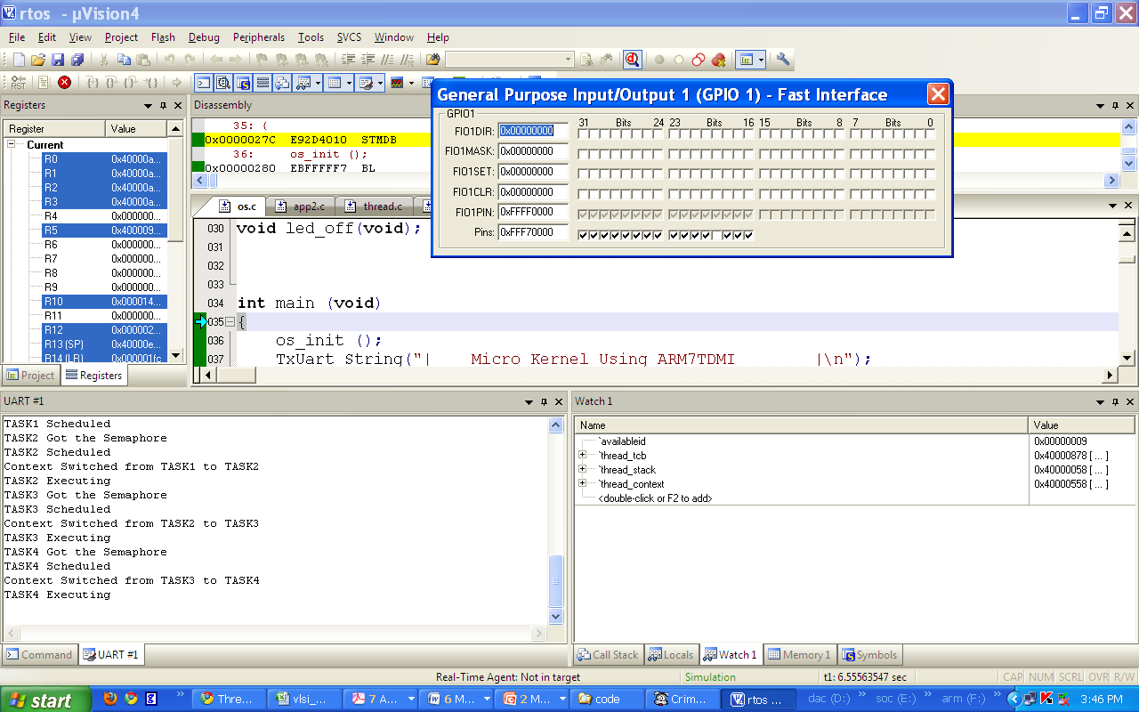
Simulation Results 2

Slide 22
Tools and Hardware used
LPC2138/48 ARM Microcontroller
Keil C compiler
Flash Magic Programmer
Languages: Embedded C
Applications
This Micro Kernel can be used in air-craft control, Industry process automation, smart elevators, car electronics in dash board etc…
Notes:
APPLICATIONS

Slide 23
Thank You

