Slide 1
PROBLEM
Habit building breaks when consistency takes too much effort.
Most people know what habits they want, but daily tracking, reminders, and motivation are still fragmented.
Habit apps often feel like forms instead of a fast daily companion.
Users drop off when logging, reminders, and progress review live in separate steps.
Text-heavy flows create friction when the real need is a quick, low-effort action.
Pain Point Snapshot
Too many taps
Low daily recall
Weak motivation loop
People don’t fail because habits are unimportant. They fail because the support system is too easy to ignore.
That leaves a gap for a habit companion that is immediate, mobile-first, and easier to use than to avoid.
HabitAI | Pitch Deck | 1/4

Slide 2
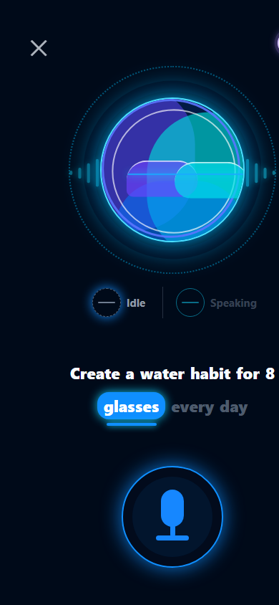
SOLUTION
HabitAI makes daily consistency feel lightweight, guided, and mobile-native.
The app combines manual tracking, reminders, progress feedback, and an assistant-first interaction model.
1
Onboard quickly
What stands out
Choose or create habits with a guided, card-based flow.
Local-first habit storage for reliable offline use
Today, Calendar, Analytics, Assistant, and Settings tabs
Voice capture with preview-first execution for safer actions
2
Track from Today
Complete, skip, or update measurable habits in one place.
3
Stay on schedule
Use local reminders and streak feedback to maintain momentum.
4
Ask the assistant
Speak or type natural commands for faster habit actions.
HabitAI | Pitch Deck | 2/4

Slide 3
TOOLS / STACK
Built with a pragmatic mobile stack designed for fast iteration and future scale.
The current build is intentionally local-first, with cloud and monetization seams already prepared.
Frontend
State & UX
Core Features
Expo, React Native, Expo Router, TypeScript
Zustand, Async persistence, native-feeling card-based flows
expo-notifications, expo-speech-recognition, expo-speech
Backend Ready
Observability
Monetization Path
Firebase Auth already wired; Firestore and Cloud Functions planned next
Sentry integration, privacy-safe telemetry seam
RevenueCat planned for premium features like advanced reminders and exports
HabitAI | Pitch Deck | 3/4

Slide 4
TARGET USERS
HabitAI is built for people who want consistency without heavy setup or daily friction.
The strongest initial audience is mobile-first users trying to build routines that survive real life.
Students & early professionals
Need structure for study, fitness, sleep, and personal routines.
Why this audience fits now
They already use phones as their daily command center.
They need low-friction habit support, not a complex planning system.
They are likely to value future premium features once consistency becomes part of their routine.
Busy self-improvers
Want simple tracking, reminders, and visible progress without spreadsheet overhead.
Users who prefer voice-first convenience
Benefit from speaking quick habit actions instead of navigating multiple screens.
HabitAI’s pitch: turn self-discipline into a smoother daily interaction.
HabitAI | Pitch Deck | 4/4

