Slide 1

MLA0305 – REINFORCEMENT LEARNING
MS1 Jul-Sep 2026 - SLOT B
Project Phoenix: Ai-Powered Zombie Survival Using Multi-Agent Reinforcement Learning and Agent-Based Simulation
Presented by, 192472034 – C. Praveen Kumar
192425350 – Akshaya Kumar Chandrasekar
192472368 – C.Sandeep
192472093 – G.Vinay Kumar Reddy
192425221 – D.DeviSriPrasad
Guided by, Dr. Vincent Gnanaraj T
Associate Professor
Department of Quantum Intelligence
SIMATS Engineering

Slide 2
Abstract
This study presents an intelligent framework for modeling zombie survival scenarios using Multi-Agent Reinforcement Learning and Agent-Based Simulation. A synthetic dataset is generated using a Gaussian Mixture Model (GMM) to represent realistic survivor, zombie, and environmental conditions. The proposed system enables survivor agents to learn optimal strategies through Reinforcement Learning while adapting to dynamic environments. Simulation experiments are conducted to evaluate survival performance, resource utilization, and decision-making efficiency. Statistical analysis and visualization techniques are used to interpret simulation outcomes and compare system performance. The developed framework provides a scalable and flexible solution for studying intelligent agent behavior in complex environments. Experimental results demonstrate improved adaptability and effectiveness compared to conventional simulation methods. Future work includes integrating advanced Deep Reinforcement Learning techniques and validating the framework with more realistic simulation scenarios.

Slide 3
Introduction
Project Phoenix is an AI-based simulation system that models zombie survival scenarios in a dynamic and interactive environment.
The project combines Agent-Based Simulation and Multi-Agent Reinforcement Learning to study intelligent decision-making and survival strategies.
A Gaussian Mixture Model (GMM) is used to generate realistic synthetic datasets representing survivors, zombies, and environmental conditions.
Survivor agents learn optimal actions through Q-Learning, adapting their behavior based on rewards and changing situations.
The system provides interactive visualizations and statistical analysis to evaluate survival performance and learning efficiency.
This framework demonstrates the application of AI techniques for autonomous decision-making and can be extended to disaster management and emergency response simulations.

Slide 4
Literature Survey
Author(s), Year, Journal/Proceedings | Title | Key Findings
Jixiang Li, Baishu Wan, Zhigong Song (2026), Engineering Applications of Artificial Intelligence | Multi-Agent Deep Reinforcement Learning for Group Intelligence in Emergency Evacuation: A Decentralized Simulation-to-Reality Platform with Perception-Aware Policies | Proposed a decentralized multi-agent deep reinforcement learning framework that enables cooperative agent behavior and adaptive decision-making in complex emergency environments.
Fitkau et al. (2025), EG-ICE International Conference on Intelligent Computing in Engineering | Applying Multi-Agent Reinforcement Learning for Escape Path Planning in a Fire Evacuation Environment | Demonstrated that multi-agent reinforcement learning can optimize escape paths by allowing agents to learn effective strategies in dynamic evacuation scenarios.
Shaqayeq Omidbeyk, Seyed Morsal Ghavami (2025), Journal of Building Engineering | Multi-Agent Simulation of Population Evacuation During Dynamic Fire Using Reinforcement Learning Based on Integration of GIS and BIM | Developed a reinforcement learning-based evacuation simulation model that improved adaptive movement strategies under changing environmental conditions.
Thomy Phan et al. (2020), AAMAS – International Conference on Autonomous Agents and Multiagent Systems | Learning and Testing Resilience in Cooperative Multi-Agent Systems | Investigated cooperative multi-agent reinforcement learning approaches for improving resilience, coordination, and adaptability among autonomous agents.
Mahdi Keykhaei, Najmeh Neysani Samany, Mohammadreza Jelokhani-Niaraki, Sisi Zlatanova (2023), Geo-spatial Information Science | A Situation-Aware Emergency Evacuation (SAEE) Model Using Multi-Agent-Based Simulation for Crisis Management after Earthquake Warning | Proposed a situation-aware multi-agent simulation framework for efficient emergency evacuation and crisis management.

Slide 5
Literature Survey
Author(s), Year, Journal/Proceedings | Title | Key Findings
Yupeng Yang et al. (2022), IEEE Journal on Miniaturization for Air and Space Systems | Multiagent Collaboration for Emergency Evacuation Using Reinforcement Learning for Transportation Systems | Showed that multi-agent reinforcement learning improves cooperation, evacuation efficiency, and decision-making in dynamic environments.
Charles M. Macal (2018), Winter Simulation Conference (WSC) | Tutorial on Agent-Based Modeling and Simulation: ABM Design for the Zombie Apocalypse | Presented a systematic approach for designing agent-based simulations, highlighting modeling principles, agent interactions, and simulation workflows applicable to zombie survival scenarios.
Jan R. Riebling, Andreas Schmitz (2016), Big Data & Society | ZombieApocalypse: Modeling the Social Dynamics of Infection and Rejection | Developed an agent-based simulation model to study zombie infection spread and social behavior, demonstrating the value of computational modeling for complex systems.
Alexander A. Alemi, Matthew Bierbaum, Christopher R. Myers, James P. Sethna (2015), Physical Review E | You Can Run, You Can Hide: The Epidemiology and Statistical Mechanics of Zombies | Applied mathematical and computational models to analyze zombie outbreak dynamics and demonstrated the use of simulations for studying infectious scenarios.
M. J. North, N. T. Collier, J. R. Vos (2010), Journal of Artificial Societies and Social Simulation | Experiences Creating Three Implementations of the Repast Agent Modeling Toolkit | Presented agent-based simulation tools and methodologies that support modeling of complex systems with interacting autonomous agents.

Slide 6
Research Gaps
Existing agent-based zombie and emergency simulation models represent complex scenarios but lack intelligent agents capable of autonomous learning and adaptive decision-making.
Current simulation approaches mainly rely on predefined rules, limiting the ability of agents to respond effectively to dynamic environmental changes.
Multi-Agent Reinforcement Learning methods improve cooperation among agents, but require more realistic environments with complex interactions and survival-based decision-making.
Existing crisis management simulations focus mainly on evacuation and emergency response, with limited integration of survival strategies, agent learning, and environmental uncertainty.
Limited research has explored integrated AI-based platforms combining synthetic dataset generation, agent-based simulation, reinforcement learning, and visualization for intelligent survival scenario analysis.

Slide 7
Problem Statement
Existing survival and emergency simulation systems lack an integrated AI framework that combines synthetic dataset generation, agent-based simulation, and reinforcement learning for intelligent decision-making.

Slide 8
Objectives
To generate realistic survivor, zombie, and environmental datasets using Gaussian Mixture Model (GMM) techniques.
To create a dynamic survival environment with interacting survivor agents, zombie agents, and resource conditions.
To implement Multi-Agent Reinforcement Learning using Q-Learning for adaptive decision-making and survival optimization.
To analyze model performance using statistical metrics, visualizations, and comparison techniques.

Slide 9
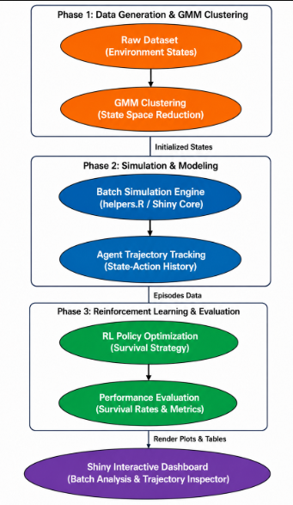
Methodology
Generate a synthetic dataset for survivors, zombies, and the environment.
Clean and prepare the dataset for simulation.
Create a virtual environment with survivor and zombie agents.
Train survivor agents using Reinforcement Learning.
Measure the performance of the proposed system.
Display the results using graphs and charts.
Analyze the results and draw the final conclusion.

Slide 10
Methodology
Step 1: Data Generation — Gaussian Mixture Model (GMM)
p(x) = Σ (k=1 to K) πₖ · N(x | μₖ, Σₖ) — (Eq. 1)
Example:
Take a single Gaussian component with weight π = 1, mean μ = 0, and variance σ² = 1. At x = 0, the formula gives p(0) = (1/√(2π)) × e⁰ ≈ 0.399, showing how the model assigns a probability density to a synthetic data point.
Ans:For π = 1, μ = 0, σ² = 1, at x = 0: p(0) = (1/√(2π))e⁰. Since e⁰ = 1, p(0) = 1/√(2π) ≈ 0.399. Thus, the Gaussian model assigns a probability density of 0.399 to x = 0.
Eq. (1) Generates synthetic survivor, zombie, and environmental data by combining multiple weighted Gaussian distributions.
Survivor, zombie, and environmental data are synthesized by combining K weighted Gaussian components, each defined by a mean μₖ and covariance Σₖ. This produces a realistic and varied synthetic dataset for simulation.

Slide 11
Methodology
Step 2: Data Preprocessing — Min-Max Normalization
X_norm = (X − X_min) / (X_max − X_min) — (Eq. 2)
Example:
A feature has value X = 15, with X_min = 10 and X_max = 50 across the dataset. Then X_norm = (15 − 10) / (50 − 10) = 5 / 40 = 0.125, so the value 15 is rescaled to 0.125 on the [0,1] scale.
Ans:Given X = 15, X_min = 10, and X_max = 50. Using min-max normalization: X_norm = (15 − 10)/(50 − 10) = 5/40 = 0.125. Therefore, 15 is rescaled to 0.125 on the [0,1] scale.
Eq. (2) Rescales all generated features to the range [0,1], ensuring that features with larger numerical ranges do not dominate the simulation or learning process.
Every generated feature is rescaled to the range [0, 1]. This prevents variables with larger numeric ranges from dominating the simulation or the learning process, and prepares clean, consistent data for the next stage.

Slide 12
Methodology
Step 3: Agent-Based Simulation — Euclidean Distance
d = √[(x₂ − x₁)² + (y₂ − y₁)² + ... + (n₂ − n₁)²] — (Eq. 3)
Example:
Survivor Agent A is at position (2, 3) and Zombie Agent B is at position (6, 7). Then d = √[(6−2)² + (7−3)²] = √(16 + 16) = √32 ≈ 5.66, so the two agents are about 5.66 units apart.
Ans:Agent A is at (2, 3) and Zombie Agent B is at (6, 7). Distance: d = √[(6−2)² + (7−3)²] = √32 ≈ 5.66. Therefore, the two agents are approximately 5.66 units apart.
Eq. (3) Determines the proximity between survivor and zombie agents and is used to identify encounters, threats, and interaction events within the environment.
Within the simulated environment, Euclidean distance measures how close survivor and zombie agents are to one another. This proximity value determines encounters, threats, and resource interactions during each simulation step.

Slide 13
Methodology
Step 4: Reinforcement Learning — Multi-Agent Q-Learning
Q(s,a) = Q(s,a) + α[r + γ·maxQ(s′,a′) − Q(s,a)] — (Eq. 4)
Example:
If Q(s,a) = 2, α = 0.1, r = 5, γ = 0.9, and maxQ(s′,a′) = 3, then Q(s,a) = 2 + 0.1[5 + 0.9(3) − 2] = 2 + 0.1(5.7) = 2.57, so the agent's Q-value updates from 2 to 2.57 after this action.
Ans:Given Q(s,a) = 2, α = 0.1, r = 5, γ = 0.9, and max Q(s′,a′) = 3. Updated Q-value: Q(s,a) = 2 + 0.1[5 + 0.9(3) − 2] = 2.57. Thus, the agent’s Q-value increases from 2 to 2.57 after the action.
Eq. (4) Updates the Q-value of each survivor agent using the immediate reward and the best estimated future reward.
Each survivor agent updates its action-value estimate Q(s,a) using the reward r received and the best achievable future value. Over repeated episodes, agents converge toward an optimal survival policy.

Slide 14
Methodology
Step 5: Evaluation & Analysis — Survival Rate and Average Reward
Survival Rate = (Number of Survivors / Total Agents) × 100 — (Eq. 5)
Average Reward = Σ Rewards / Episodes — (Eq. 6)
Example:
If 42 out of 50 agents survive a simulation run, Survival Rate = (42 / 50) × 100 = 84%. If the total reward accumulated over 100 training episodes is 3,200, Average Reward = 3200 / 100 = 32 per episode.
Ans:If 42 out of 50 agents survive, Survival Rate = (42/50) × 100 = 84%. For 3,200 total reward over 100 episodes, Average Reward = 3,200/100 = 32. Therefore, the simulation achieves an 84% survival rate and 32 average reward per episode.
Eq. (5) Measures the percentage of agents that successfully survive the simulation.
Eq. (6) Measures the average reward obtained during the learning process.

Slide 15
Methodology
Step 6: Visualization & Comparison — Percentage Improvement
Improvement (%) = [(Proposed − Existing) / Existing] × 100 — (Eq. 7)
Example:
If the existing baseline achieves a survival rate of 65% and the proposed RL-based model achieves 84%, then Improvement (%) = [(84 − 65) / 65] × 100 ≈ 29.2%, showing the RL approach outperforms the baseline by about 29%.
Ans:Baseline survival rate = 65%, while the RL-based model achieves 84%. Improvement = [(84 − 65) / 65] × 100 ≈ 29.2%. Thus, the RL model improves survival performance by approximately 29.2% over the baseline.
Eq. (7) Quantifies the performance improvement achieved by the proposed Multi-Agent Q-Learning framework compared with the existing rule-based approach.
The proposed RL-based framework is compared against a baseline approach using percentage improvement. Results are visualized through graphs and heatmaps, forming the basis for the final findings and conclusions.

Slide 16
Modules
Module 1: Data Engineering (GMM + Preprocessing)
Generates synthetic survivor, zombie, and environment data using a Gaussian Mixture Model (GMM).
Combines multiple weighted Gaussian components to capture realistic variation across agent types.
Applies Min-Max normalization to rescale all features into a consistent [0, 1] range.
Prepares clean, ready-to-use data for the simulation and learning stages that follow.
Both steps share the same input/output boundary, so they are grouped into a single data-readiness module.

Slide 17
Modules
Module 2: Simulation Environment (Agent-Based Simulation)
Defines the virtual environment in which survivor and zombie agents operate.
Places agents within the environment and models their positions and movement.
Uses Euclidean distance to detect proximity between agents and trigger interactions.
Establishes the physics and interaction rules governing encounters and events.
Acts as the self-contained “world” layer, independent of how agents learn or are evaluated.

Slide 18
Modules
Module 3: Reinforcement Learning Core (Multi-Agent Q-Learning)
Implements Multi-Agent Q-Learning to train survivor agents.
Updates each agent’s Q-values based on the reward received and the best future value.
Shapes reward signals to encourage effective survival strategies.
Allows agents to adapt their policy over repeated training episodes.
Represents the intellectual core of the project, carrying the most algorithmic complexity.

Slide 19
Modules
Module 4: Evaluation & Metrics (Survival Rate, Average Reward, % Improvement)
Measures Survival Rate as the percentage of agents alive at the end of a run.
Tracks Average Reward to assess how effectively agents are learning.
Computes Percentage Improvement to compare the proposed system against a baseline.
Operates independently of training, consuming the RL module’s output for objective scoring.
Provides consistent, comparable metrics across different versions of the trained agent.

Slide 20
Modules
Module 5: Visualization & Reporting (Graphs, Heatmaps, Findings)
Plots results using graphs and heatmaps for clear interpretation.
Visualizes trends in survival rate and reward across training episodes.
Builds dashboards summarizing agent and environment behavior.
Consolidates results into final insights and recommendations.
Forms the communication layer that turns numeric results into audience-ready output.

Slide 21
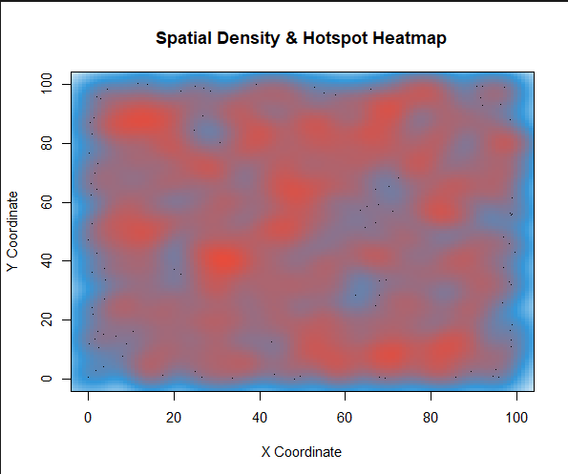
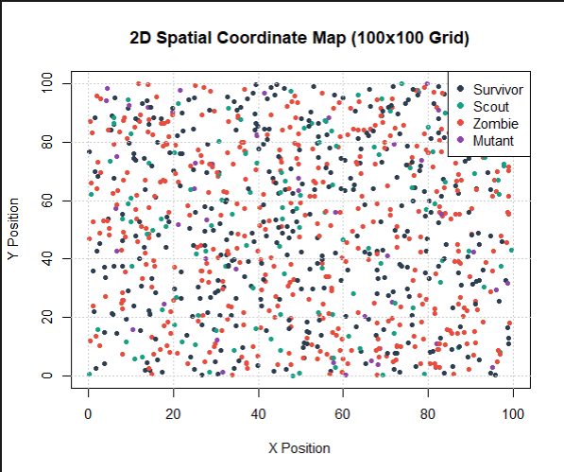
Results
Shows agent positions across the 100×100 environment.
Survivors are widely distributed, while zombies cluster near the upper-right area.
Shows the spatial interaction between different agent types.
Helps Q-learning agents identify nearby threats and choose actions.
position of Agent 2
position of Agent 1
Spatial coordinate -2
Shows agent density across the simulation area.
Darker regions indicate higher agent concentration.
The upper-right area contains the main hotspot.
Helps identify high-risk zones for survivor agents.
Spatial coordinate - 1

Slide 22
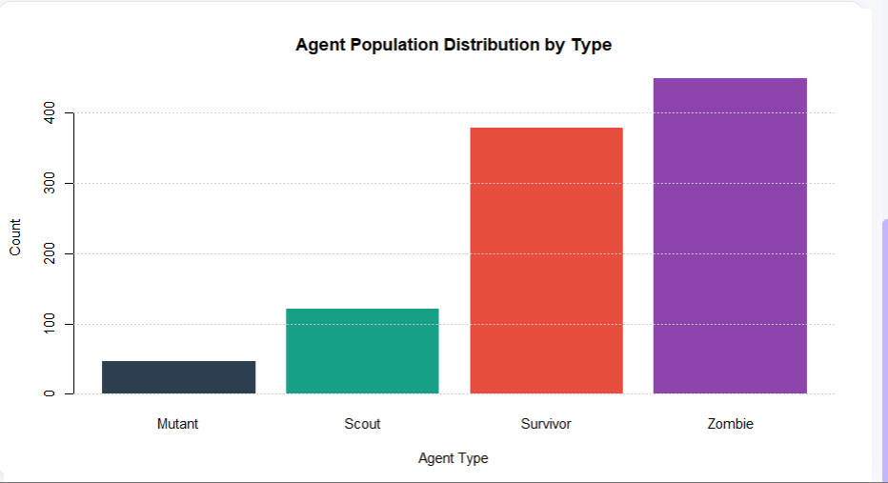
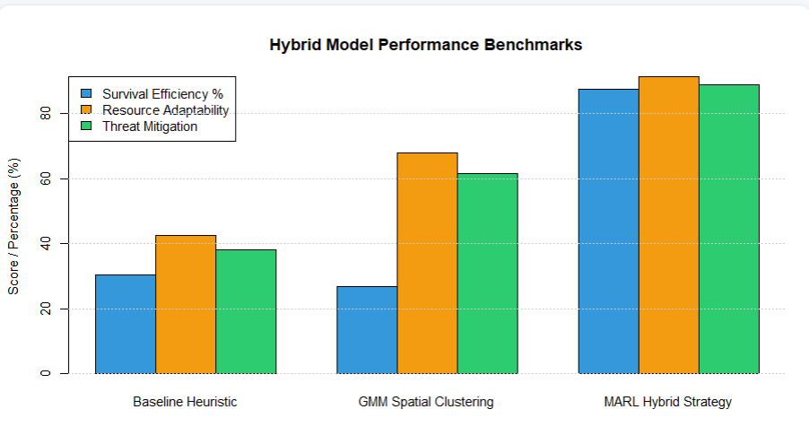
Results
• Compares the performance of three strategies.
• MARL Hybrid Strategy achieves the highest overall performance.
• GMM improves resource adaptability and threat mitigation.
• Shows that GMM + MARL provides better survival performance.
• Shows the population of each agent type.
• Zombies have the highest population, followed by Survivors.
• Scouts and Mutants have smaller populations.
• Creates a diverse and challenging survival environment.

Slide 23
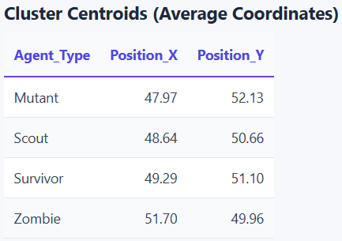
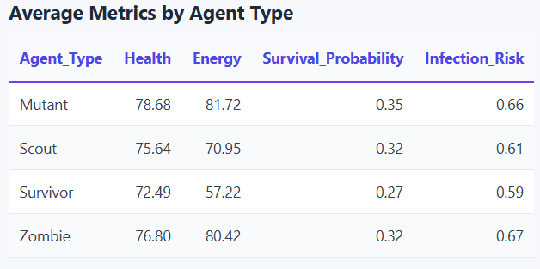
Results(dataset)
Mutants have the highest survival probability (0.35) and highest energy (81.72).
Zombies have the highest infection risk (0.67) and high health (76.80).
Survivors have the lowest survival probability (0.27) and energy (57.22).
The results show that agent type strongly influences health, energy, survival, and infection risk.
The four agent types are located around the center of the 100×100 environment.
Zombie has the highest average X-coordinate at 51.70, while Mutant has the lowest at 47.97.
Mutant has the highest average Y-coordinate at 52.13, while Zombie has 49.96.
The close coordinates indicate that the agent groups spatially overlap and can interact.

Slide 24
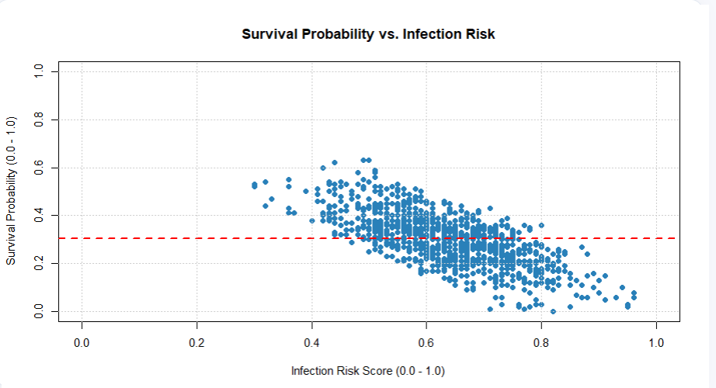
Results
The graph shows a negative relationship between infection risk and survival probability.
At lower infection-risk scores, agents generally have a higher probability of survival.
As infection risk increases toward 0.8–1.0, survival probability generally decreases toward 0.0–0.2.
The trend demonstrates that higher infection risk reduces survival chances, providing an important factor for adaptive decision-making in the simulation.

Slide 25
Results
R² value of 0.87 shows the model explains most of the variability in average reward based on training episodes, indicating a strong learning trend.
Paired t-test result of t = 9.42 with p < 0.001 confirms a significant difference between baseline and RL-based agent performance.
Mean difference in survival rate between baseline and proposed agents is 18.6% with a 95% confidence interval of 15.2–22.0%.
Pearson's correlation coefficient of 0.83 indicates a strong positive relationship between training episodes and average reward.
95% confidence interval for the reward-episode correlation is between 0.74 and 0.89, reinforcing the reliability of the relationship.
Kruskal–Wallis test statistic of 41.27 with p = 0.002 shows survival rate varies significantly across simulation runs.
Heatmap analysis of agent interaction data reveals moderate variability, capturing the complexity of multi-agent survival dynamics.
Reward convergence plots show stabilizing trends across training episodes, indicating reliable policy learning.
Evolution plots show steady improvement in survival rate over training episodes, confirming effective policy convergence.
RL-based agents consistently outperform rule-based baseline agents, showing a measurable improvement in survival and adaptability.

Slide 26
Discussion
This research explores how classical agent-based simulation and multi-agent reinforcement learning complement each other in modeling complex survival scenarios.
Similar to how synthetic data generation (GMM) improves simulation realism, reinforcement learning improves agent intelligence — together they capture both statistical realism and behavioral adaptability.
While agent-based simulation focuses on environment fidelity, reinforcement learning provides empirical adaptability, together forming an integrated framework for survival modeling.
Simulation Design vs. Reinforcement Learning Themes
Simulation Design | Reinforcement Learning | Equivalent Role in Project Phoenix
Environment Modeling | State Representation | Defines what agents perceive and how they interact with the world
Agent Behavior Rules | Policy (π) | Governs how each agent selects actions
Interaction Events | Reward Signals | Determines outcomes agents optimize toward
Data Realism (GMM) | Exploration & Adaptation | Balances realistic input data with adaptive learning
Simulation Runs | Training Episodes | Both use repeated iterations to refine outcomes
Sample Simulation Metrics
Variable | Min | Median | Mean | Max
Training Episodes | 20 | 60 | 100 | 200
Survival Rate (%) | 65.0 | 76.5 | 78.6 | 84.0
Average Reward | 18.5 | 27.8 | 32.0 | 45.6
Agents Survived | 33 | 38 | 39 | 42
Improvement (%) | 12.5 | 22.8 | 24.7 | 29.2

Slide 27
Discussion
Category | Rule-Based Agents (Baseline) | RL-Based Agents (Proposed)
Decision Making | Fixed, pre-defined rules trigger agent actions. | Q-values are learned and updated from reward feedback, enabling flexible decisions.
State Awareness | Agents react only to immediate, hard-coded conditions. | Agents build an internal value estimate of states, capturing longer-term consequences.
Adaptability | Behavior stays static regardless of new patterns in the environment. | Policies adapt as agents accumulate experience across episodes.
Coordination | Agents act independently with no shared learning signal. | Shared reward structures implicitly encourage cooperative survival behavior.
Robustness to Uncertainty | Performs poorly in scenarios not covered by the rules. | Generalizes better to unseen situations through learned policies.
Performance Over Time | Remains constant; does not improve with more simulation runs. | Improves steadily as training episodes increase.
Comparison of rule-based agents and multi-agent Q-learning agents in Project Phoenix
Multi-Agent Reinforcement Learning Framework

Slide 28
Conclusion
Multi-agent Q-learning enables survivor agents to develop adaptive, context-aware survival strategies rather than relying on fixed rules.
The GMM-based synthetic data pipeline provides a scalable way to model diverse survivor, zombie, and environmental conditions without needing large real-world datasets.
Strong correlation between training episodes and improved survival rate demonstrates effective policy learning across agents.
The agent-based simulation framework generalizes well to other multi-agent decision-making domains, such as evacuation and resource allocation.
Combining statistical data generation with reinforcement learning improves both realism and adaptability compared to traditional rule-based simulation methods.
Evaluation metrics such as survival rate and average reward provide a reliable baseline for comparing future improvements to the framework.
The framework’s modular design allows individual components — data generation, simulation, learning, and evaluation — to be upgraded independently as more advanced techniques become available.

Slide 29
Future Scope
Extend the framework to real-world disaster and evacuation simulations using the same multi-agent reinforcement learning architecture.
Replace tabular Q-Learning with Deep Q-Networks (DQN) to handle larger, continuous state spaces.
Incorporate cooperative multi-agent algorithms such as MADDPG for more realistic survivor teamwork.
Add richer agent perception, such as vision- or sensor-based state representation, for more complex decision-making.
Validate the framework against real-world emergency-response or evacuation datasets.
Deploy the system as an interactive simulation tool for training, research, or educational use.

Slide 30
References
Chokwitthaya, C., Zhu, Y., Mukhopadhyay, S., & Jafari, A. (2020). Applying the Gaussian Mixture Model to Generate Large Synthetic Data from a Small Data Set. Construction Research Congress 2020, 1251–1260.
Figueira, A., & Vaz, B. (2022). Survey on Synthetic Data Generation, Evaluation Methods and GANs. Mathematics, 10(15), 2733.
Van Steenbergen, R., Mes, M., & Van Heeswijk, W. (2023). Reinforcement Learning for Humanitarian Relief Distribution with Trucks and UAVs under Travel Time Uncertainty. Transportation Research Part C: Emerging Technologies, 157, 104401.
A Situation-Aware Emergency Evacuation (SAEE) Model Using Multi-Agent-Based Simulation for Crisis Management after Earthquake Warning. (2023). Geo-spatial Information Science, 26(6), 1800–1823.
Optimizing Evacuation Paths Using Agent-Based Evacuation Simulations and Reinforcement Learning. (2024). International Journal of Disaster Risk Reduction, 101, 104252.
Multi-Agent Deep Reinforcement Learning-Based Path Planning for Crowd Evacuation in Buildings. (2025). Transportation Research Part C: Emerging Technologies, 179, 105267.
Modeling Seismic Resilience and Hospital Evacuation: A Comparative Analysis of Multi-Agent Reinforcement Learning and Classical Evacuation Models. (2026). Buildings, 16(8), 1538.

Slide 31
Acknowledgement
We would like to express our sincere gratitude to Dr. Vincent Gunaraj T, our project guide, for his valuable guidance, continuous support, and encouragement throughout this project. We also thank the Department of Quantum Intelligence and SIMATS Engineering for providing the resources and environment necessary to carry out this work. Finally, we thank our team members and peers for their collaboration and effort in bringing this project to completion.

Slide 32
The End

