Slide 1
sEMG Gesture Classifier ASIC
Subject-independent hand-gesture recognition on chained INT8 LDA boards
Vinay Hariharan, Sudhindra Sahoo, Yashvardhan Khandegar, Digvijay Kumbhar
Under the supervision of Prof. Laxmeesha Somappa · BioNICS, Department of Electrical Engineering, IIT Bombay

Slide 2
Recognising Hand Gestures from Forearm Muscle Signals
PROBLEM
SIGNAL
Surface EMG: forearm muscle activity measured on the skin. Each gesture uses a different set of muscles.
GOAL
Decide the gesture continuously on a wearable, e.g. a prosthetic hand or a gesture interface.
HARD PART
A new user's signal differs: skin, fat, electrode placement and physiology all change it.
TARGET
≥ 60 % accuracy on users never seen in training, with the least hardware.
Forearm
8 surface
electrodes
AFE + ADC
8 bit, 985 Hz
Features
per channel
Classifier
Gesture
Hand Close · Hand Open · Wrist Flexion · Wrist Extension
What makes it hard → what it forces on the design
New user
never seen in training
evaluate only subject-independently
Always on
battery powered, wearable
integer only, one multiplier, slow clock
Real time
control must feel immediate
decision every 100 ms from the last 200 ms
Electrode count
8 to 24, per user and limb
identical 8-channel boards in a chain
Every design choice is judged by accuracy on an unseen person and by hardware cost.
Notes:
Optimal controller delay for myoelectric control is 100–125 ms (Farrell & Weir 2007), which sets the 100 ms decision rate. The deliverable is a fixed-function, fully integer chip, verified bit-exactly against a Python model.

Slide 3
FORS-EMG and How We Evaluate
DATASET
FORS-EMG [1]: 19 subjects × 12 gestures × 3 forearm orientations × 5 trials
8 electrodes · 985 Hz · 8000 samples (8.1 s) per recording
DATA
Public FORS-EMG [1]: each gesture recorded at rest, in supination and in pronation; a class pools all three.
PRE-PROCESSING
Causal band-pass and notch filters, exactly as a chip would run them.
EVALUATION
Leave-one-subject-out: the test subject never touches training, normalisation or quantisation.
STATISTICS
Paired per-subject tests; a difference counts only if its 95 % CI excludes zero.
causal filters, as the hardware runs them
Band-pass 20–450 Hz
4th-order Butterworth
Notch 50 Hz
Q = 30
Windows 200 ms
stride 100 ms
Features
→ classifier
Leave-one-subject-out (LOSO): one fold per subject
S02
S03
S04
S05
S06
S07
S08
S09
S10
S11
S12
S13
S14
S15
S16
S17
S18
S19
Training subjects
trials 1–4 train · trial 5 validates
Held-out subject
all trials test · never seen before
Only subject-independent accuracy is reported: the number a new user would actually see.
Notes:
Windows are cut after the split: an earlier window-level split put overlapping windows on both sides and produced a false 63 % ceiling. Paired tests are Wilcoxon signed-rank. The repository copy of the dataset lacks subject 1, so some later runs use 18 subjects; runs on the laptop use all 19.

Slide 4
Mixing Gesture Kinds: Which, and How Many
DATASET
Hand (whole grip)
Finger postures (deep, overlapping flexors)
Wrist (large superficial muscles)
THREE KINDS
Hand and wrist movements use large, superficial muscles; finger postures use deep, overlapping flexors.
HAND + FINGER (A)
Stuck at ≈ 65 % for every model; Index ↔ Index-Little alone caused ≈ 40 % of the errors.
HAND + WRIST (B)
79.4 %: +14.1 pp (p = 3.8 × 10⁻⁹), the largest gain in the project.
HOW MANY
Best 6 of 924 subsets: 69.0 %. All 12 gestures: 48.8 %.
Hand Close
Index
Index-Little
Wrist Flexion
Peace
Thumb Up
Wrist Extension
Hand Open
Radial Dev.
Thumb-Little
Right Angle
Ulnar Dev.
dark blue: the chosen set B (2 hand + 2 wrist)
Set | Mix of kinds | Gestures | INT8 % | Chance
A (4) | hand + finger | Hand Close, Hand Open, Index, Index-Little | 65.3 | 25.0
B (4) | hand + wrist | Hand Close, Hand Open, Wrist Flexion, Wrist Extension | 79.4 | 25.0
D (6) | hand + finger + wrist | Hand Close, Hand Open, Peace, Right Angle, Radial Deviation, Wrist Flexion | 69.0 | 16.7
C (12) | everything | all 12 gestures | 48.8 | 8.3
Which gestures we ask for matters more than any model we tried.
Notes:
Set B gain: +14.1 pp, 95 % CI [+11.3, +16.9], paired t-test. The 924 six-gesture subsets were ranked by their worst confused pair in the 12-class confusion matrix; the best (D) was predicted at 66.4 % before training and measured at 69.0 %. The main remaining error in set B is Hand Open ↔ Wrist Extension, which share the finger extensors. LOSO, 19 subjects.

Slide 5
Merge All 12 Gestures into 4 Classes, or Drop 8?
DATASET
Most frequent grouping, chosen from the training subjects inside each fold
QUESTION
Keep all 12 gestures by merging them into 4 classes of 3?
FAIR GROUPING
Best of the 15,400 possible splits, chosen from the training subjects only, inside every fold.
RESULT
60.9 % against 77.8 %: worse on all 19 subjects. Classifying 12 and mapping to groups: 63.1 %.
EARLIER 6-GROUP MAP
72.4 %, still 5.5 pp below dropping (18 of 19 subjects), and one group holds half of all windows.
WHY
Finger gestures stay confusable in any grouping; a merged class mixes patterns one Gaussian (LDA) fits poorly.
Grip
Opening
Finger
Mixed
Hand Close
Hand Open
Index
Peace
Thumb-Little
Ulnar Dev.
Index-Little
Radial Dev.
Thumb Up
Wrist Extension
Right Angle
Wrist Flexion
Hand Open + Wrist Extension together in 19 / 19 folds; Hand Close + both thumb gestures in 17 / 19
19 subjects, chip INT8 LDA | Gestures | Class rows | Accuracy % | vs drop
Drop to HC, HO, WF, WE | 4 of 12 | 4 | 77.82 ± 4.10 | —
Merge into 4 groups of 3 | all 12 | 4 | 60.91 ± 4.55 | −16.9 pp
12-class LDA, mapped to groups | all 12 | 12 | 63.07 ± 5.07 | −14.8 pp
12-class LDA (reference) | all 12 | 12 | 46.41 ± 5.55 | —
Earlier 6-group map, 6-class LDA | all 12 | 6 | 72.38 ± 4.11 | −5.5 pp
Earlier 6-group map, 12-class mapped | all 12 | 12 | 70.71 ± 4.62 | −7.1 pp
We drop gestures: from here on, 4 classes (Hand Close, Hand Open, Wrist Flexion, Wrist Extension).
Notes:
analysis/K_4_LDA_Merge_vs_Drop.py, run on all 19 subjects. Grouping: 12-class LDA cross-validated over the training subjects gives a 12 × 12 confusion matrix; the split into 4 groups of 3 with the most windows predicted inside their own group is used. Merge vs drop: −16.9 pp, 95 % CI [−20.3, −13.6], p = 3.8 × 10⁻⁶, 0 of 19 subjects better. 12→4 vs drop: −14.8 pp [−18.2, −11.3]. 12→4 vs merge-4: +2.2 pp [+0.5, +3.8], p = 0.02 — the cost of fitting one Gaussian to a mixture. Earlier design's fixed map (G1 = HC, Index, Index-Little, Peace, Right Angle, Thumb Up; G2 = HO + WE; G3–G6 = Radial Dev., Thumb-Little, Ulnar Dev., Wrist Flexion): 6-class LDA 72.4 %, −5.5 pp [−8.0, −2.9] vs drop, 1/18; 12-class mapped 70.7 %, which matches the 70.2 % of the earlier calibration checkpoint. Always answering G1 would already score 50 %.

Slide 6
Eight Classifiers on the Same 64 Features
MODEL SELECTION
Model | FP32 % | INT8 % | MACs | Bytes | vs MLP
MLP 64-16-4 | 79.65 | 79.57 | 1088 | 1168 | —
Gradient boosting | 79.63 | 79.26 | 0 | 19,200 | tied, over budget
Logistic regression | 79.33 | 79.19 | 256 | 272 | tied (p = 0.44)
Linear SVM | 79.31 | 78.30 | 256 | 272 | tied (p = 0.29)
LDA | 77.91 | 77.87 | 256 | 272 | tied (p = 0.09)
Random forest | 77.84 | 77.43 | 0 | 53,145 | worse (p = 0.046)
Extra trees | 76.29 | 76.04 | 0 | 38,015 | worse (p = 0.0009)
Decision tree | 73.69 | 73.17 | 0 | 5,055 | worse (p = 0.0002)
SAME INPUTS
64 features (8 time-domain types × 8 channels), same folds, same INT8 scheme, 10 KB budget.
RESULT
MLP, logistic regression, linear SVM and LDA are statistically tied.
TREES
Worse, or far over the memory budget.
BIGGER MLP
34× the memory buys nothing (bottom table): the spread is smaller than any one model's CI.
MLP width (set A) | 64-4 | 64-16-4 | 64-32-4 | 64-64-4 | 64-128-4
INT8 % | 65.28 | 63.63 | 63.93 | 64.87 | 64.02
Bytes | 272 | 1168 | 2320 | 4624 | 9232
Capacity is not the bottleneck: the limit is the information in 8 surface channels.
Notes:
MLP: ReLU, dropout 0.2, Adam with cosine learning rate, early stopping. LDA: shared covariance with Ledoit-Wolf shrinkage. Trees: depth 10; forests 25 trees of depth 8; gradient boosting 60 rounds of depth 4. The same tie between MLP and logistic regression appears at 4, 6 and 12 gestures. Width sweep spread 1.3 pp vs ±5.9 pp CI. LOSO, 19 subjects, set B except the width sweep (set A).

Slide 7
Why LDA, and Why INT8 Costs Nothing
MODEL SELECTION
Training: closed form
CLOSED-FORM TRAINING
Class means and one shared covariance, no optimiser: adapting to a new user is a few matrix operations.
CHEAP
4.3× fewer MACs and bytes than the MLP, for 1.7 pp inside the statistical tie.
INT8 IS FREE
28 FP32-vs-INT8 comparisons: 0.18 pp mean loss, worst 1.01 pp.
NO RESCALING
One weight scale for all classes leaves the argmax unchanged, so the chip never requantises.
Training
windows
(features)
Class means μₖ
shared covariance Σ
Wₖ = Σ⁻¹ μₖ
bₖ = −½ μₖᵀ Σ⁻¹ μₖ
+ log πₖ
INT8 W
INT32 b
one scale
Inference: one linear layer
q
40 × INT8
× W
4 × 40 INT8
+ b
INT32
argmax
class
64 features, 4 classes | LDA | MLP 64-16-4
MACs per decision | 256 | 1088
Bytes | 272 | 1168
INT8 accuracy | 77.87 % | 79.57 %
Training | closed form | gradient descent
LDA: in the same accuracy tie as an MLP, at a quarter of the cost, and trainable in closed form.
Notes:
Weights live in writable RAM, so a retrained or calibrated model is loaded without new silicon; LDA scores are log-likelihoods up to a shared constant. INT8: symmetric per-tensor scales at the 99.9th percentile, INT32 bias on the accumulator scale. argmax_k s·S_k = argmax_k S_k for any s > 0. The worst INT8 loss (1.01 pp) was the linear SVM, whose hinge loss produces larger weights.

Slide 8
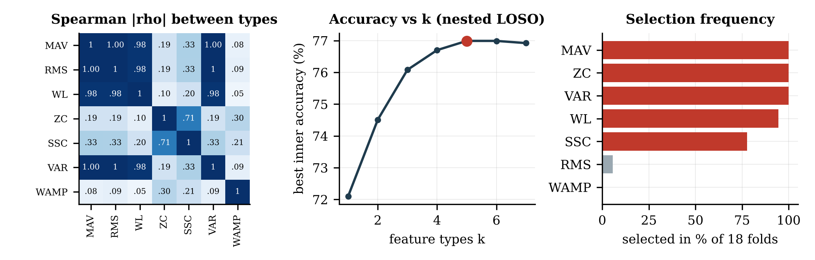
The Features Carry the Information
FEATURES
WHY TIME-DOMAIN
sEMG is noise-like: the information is in each channel's amplitude and rate of change. TD features + LDA is the standard real-time scheme [2, 3].
REDUNDANCY
MAV, RMS, WL and VAR are almost the same signal (|ρ| ≥ 0.977), as also reported in [4].
CULLING
Nested LOSO over all 127 subsets of 7 types; keep the smallest within one standard error of the best.
RESULT
5 types: 77.08 % vs 77.31 % with all 8 (p = 0.20), with 40 instead of 64 inputs.
Type | Per window | Decision
MAV | mean |x| | kept
WL | Σ |xₙ − xₙ₋₁| | kept
ZC | number of sign changes | kept
SSC | number of slope sign changes | kept
VAR | mean x² | kept
RMS | √(mean x²) | dropped: same as MAV / VAR
WAMP | count of |Δx| > threshold | dropped: saturated (98 %)
IEMG | Σ |x| = N · MAV | dropped: identical LDA
Five feature types keep all the accuracy with 40 instead of 64 inputs.
Notes:
Nested LOSO on the INT8 LDA, 18 subjects: for each held-out subject, all 127 subsets of the 7 candidate types are scored by an inner LOSO on the other 17. IEMG = N·MAV gives an identical LDA and was excluded beforehand. MAV, ZC and VAR were chosen in all 18 folds, WL in 17, SSC in 14. Non-inferior at a −1 pp margin. MACs 160 instead of 256, bytes 176 instead of 272.

Slide 9
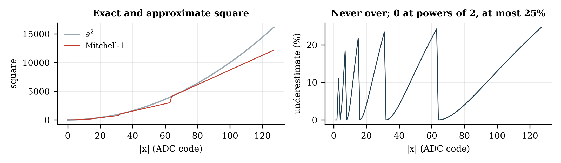
Integer Front End: Add, Compare and Shift Only
FEATURES
Float | On the chip | Hardware
MAV | SABS = Σ |x| (1/N absorbed by the normaliser) | add
WL | Σ |xₙ − xₙ₋₁| | subtract, add
ZC | sign of xₙ XOR sign of xₙ₋₁ | XOR, count
SSC | strict sign change of consecutive differences | compare; 2-bit history
VAR | POW = Σ a², a² ≈ a · 2^(p+1) − 2^(2p), p = ⌊log₂ a⌋ [6] | leading-one, 2 shifts, subtract
z-score | q = clip(((x − μ) + 2^(k−1)) >> k, −128, 127) | subtract, add, shift
GOAL
No division, square root, log or float threshold on the chip.
POWER FEATURE
Mitchell square [6]: never overestimates; the window sum has r = 0.9999 with Σx².
NORMALISER
(x − μ + 2^(k−1)) >> k, with integer μ and k from the training data.
RESULT
77.39 % vs 77.45 % for float features. Without a power feature: −1.9 pp.
CHIP MODEL
Bit-exact, 8-bit ADC: 77.61 % vs 77.83 % in software (p = 0.49).
The whole front end is add, compare and shift, at no measurable cost in accuracy.
Notes:
Six integer variants (H1–H6) against the float reference, same folds, 18 subjects. Every variant that keeps a power feature is non-inferior at −1 pp; dropping power fails. The shift normaliser costs nothing against z-scoring. μ is the rounded training mean; k is the smallest shift that never clips on training data (k = 1 for counts, 4–6 amplitude, 7–12 power). On 19 subjects the integer front end gives 77.79 % vs 77.88 % float.

Slide 10
If Features Matter, Should a CNN Do Better?
MODEL SELECTION
Option 2: depthwise-separable CNN on the raw window (Conv1d + BN + ReLU each)
IDEA
Let a CNN learn its own features from the raw window.
TRAINING
Same windows and folds as the LDA; per-electrode gain augmentation; INT8 with batch-norm folded in.
SEPARABLE CNN
79.1 %: +1.3 pp over the LDA, not significant (p = 0.20).
TWO-BRANCH CNN
80.5 %: +2.7 pp (p = 0.008), better on 15 of 19 subjects.
Raw window
8 × 196
Depthwise
8 → 32, k 15
Pointwise
32 → 32
Separable
32 → 48, k 7, /2
Separable
48 → 64, k 7, /2
Separable
64 → 64, k 5, /2
Global
average pool
FC 64 → 4
→ class
Option 5c: two-branch CNN
Raw window
8 × 196
temporal: depthwise k 15, /2
concat
64
2 separable
64 → 64, /2
pool
FC
spatial: pointwise 8 → 32, /2
19 subjects, INT8 | MACs / decision | Parameters | Accuracy
LDA, 40 features | 160 | 164 | 77.79 ± 4.39 %
CNN, option 2 | 751,584 | 11,732 | 79.10 ± 4.10 %
CNN, option 5c | 594,400 | 12,132 | 80.48 ± 3.81 %
The best CNN gains 2.7 pp for ≈ 3,700× the MACs: learned features find little the TD features miss.
Notes:
Training: AdamW, cosine learning rate, label smoothing 0.1, dropout 0.3, at most 150 epochs with early stopping on trial 5 (patience 20). Augmentation multiplies each electrode by exp(N(0, 0.3²)), imitating skin and contact differences between people. Paired with the LDA per subject: option 2 +1.31 pp [−1.00, +3.61], 14/5; option 5c +2.68 pp [+0.76, +4.61], 15/4. INT8 vs FP32 changes neither CNN measurably.

Slide 11
Adapting to a New User with One Recording per Gesture
CALIBRATION
PROBLEM
The global model: ≈ 78 % on average, under 60 % for the worst user.
CALIBRATION
The user records each gesture once (≈ 8 s each) and the model adapts.
LDA
Blend the user's class means and covariance into the global ones, recompute W, b and reload them over the config port.
LDA RESULT
78.0 % → 86.4 % (+8.3 pp); all 18 users improve, the worst most (S15: +30 pp).
Other subjects
trials 1–4
Global model
(LOSO fold)
calibration
New user
trial 1: each gesture
once (≈ 8 s each)
LDA: blend statistics
closed form
CNN: fine-tune
all weights
class means: ½ global + ½ user
covariance: ½ global + ½ user
W, b: one 40 × 40 solve
retrain all weights
LR 0.001, 20 epochs
≈ 12,000 weights
Test: same user, trials 3–5 only (never used for calibration)
One recording per gesture is worth more than any model change we tried.
Notes:
λ = 0.5. LDA, 18 subjects, test trials 3–5: 78.03 ± 4.76 % → 86.35 ± 2.56 %; +8.3 pp, 95 % CI [+4.4, +12.3], Wilcoxon p = 2 × 10⁻⁴, 18 of 18 improve. A second calibration trial adds only 0.4 pp. Worst users gain most: S15 +30.1 pp, S13 +20.1 pp. CNN calibration fine-tunes every weight on the same recording. No silicon change is needed for the LDA: μ, k, W and b are writable.

Slide 12
Calibration Results: LDA vs CNN
CALIBRATION
SETUP
CNN checkpoint: 12 gestures scored and mapped to 6 groups, held windows; 19 people × 5 rounds × 3 seeds.
RESULT
Calibrated CNN "two" ahead by +2.4 pp for all 19 people; CNN "small" level with the LDA (+0.3).
BAR NOT MET
Adoption needed +3 pp; "two" costs ≈ 870× the multiply-adds, a ≥ 9 MHz clock and retraining ≈ 12,000 weights per user.
ARM POSITION
Calibrated in one position: LDA −12.1 pp, CNN −9.6 pp. The CNN is more robust; both need all positions.
Calibration recorded | LDA (model C) | CNN two | CNN − LDA
1 trial (≈ 5 min) | 91.9 | 94.3 | +2.39 [+1.87, +2.90]
2 trials (≈ 10 min) | 92.7 | 95.2 | +2.55
3 trials (≈ 15 min) | 93.1 | 95.9 | +2.80
We keep the LDA: the calibrated CNN is better for everyone, but by 2.4 pp for ≈ 870× the arithmetic.
Notes:
Source: CNN checkpoint, version 11 (23 Oct 2026), sections 9.2–9.5 and 10. Model C: re-centre the features on the user's gestures, then blend the factory statistics with the user's (share chosen on validation). Of five ways to calibrate a CNN, only retraining all weights (way d, LR 0.001, 20 epochs, chosen on validation) beat the LDA. Calibration closes most of the CNN's head start: +6.7 pp before, +2.4 pp after. The CNN with 1 trial (94.3 %) beats the LDA with 3 trials (93.1 %). INT8 costs nothing after calibration (−0.05 pp). On the 12 separate gestures the calibrated CNN's lead is +5.4 pp; the group map hides half of it.

Slide 13
From One Chip to a Chain of Boards
HARDWARE
Host
shared configuration bus (writes addressed by board id)
BOARD
One 8-channel ADC pod + one chip; chain 1–3 boards for 8, 16 or 24 electrodes.
LOCAL WORK
Each board computes features, normalisation and its share of the LDA on its own channels.
TRAFFIC
Only 3 partial sums (96 bits) per decision cross between boards.
WHY NOT ONE BIG CHIP
Our first chip served 24 channels from one 1 MHz core: sized for 24 even when 8 are used (13.5 vs 3.7 kbit), with two clocks.
Board 0: head
Board 1
Board 2: tail
ADC pod: 8 channels
ADC pod: 8 channels
ADC pod: 8 channels
Stages 1–3 on its
own channels
→ 3 partial sums
Stages 1–3 on its
own channels
→ 3 partial sums
Stages 1–3 on its
own channels
→ 3 partial sums
chain link
+ bias, argmax
chain link
serial adder
chain link
serial adder
→ run, id ← partial sums (96 bits per decision)
class every 100 ms
one 256 kHz clock to every board
rdy: wired-AND
Identical boards, one slow clock, and compute that grows with the number of electrodes.
Notes:
The single-chip version (branch single_chip) used a 1 MHz core clock plus an 8 MHz SPI clock with a synchroniser between them. Here compute scales with the boards, so one 256 kHz clock suffices. There are no master/slave variants: more electrodes means more boards.

Slide 14
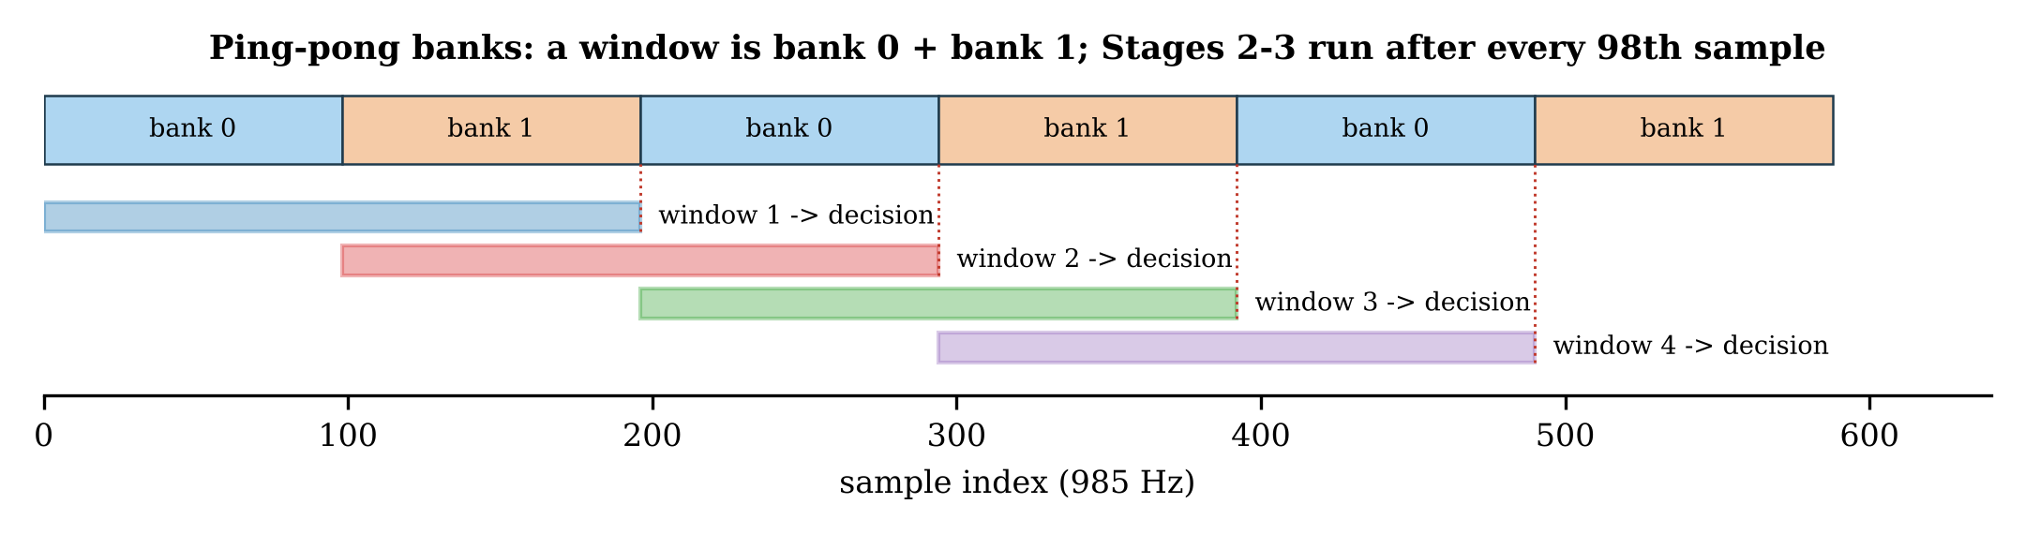
Datapath
HARDWARE: ONE BOARD
SPI
frame
every 98th
ADC pod
8 ch, 8 bit
emg_spi_adc
CONVST timer
64-bit SPI read
Stage 1
emg_feat_accum
+ emg_feat_alu
Stage 2
emg_shift_norm
(x − μ + 2^(k−1)) >> k
EVERY SAMPLE (984.6 Hz)
SPI reads 8 bytes; Stage 1 updates five running sums per channel, one channel per cycle (8 cycles).
EVERY 98TH SAMPLE
Stage 2 normalises 40 features (42 cycles); Stage 3 runs 3 rows × 40 MACs on one multiplier (125 cycles).
WINDOWS
Two ping-pong banks of 98 samples: window = bank 0 + bank 1, one write pointer, no sliding subtraction.
MEMORY
3.7 kbit, all writable, 1-cycle read: maps to SRAM or flip-flops unchanged.
history 8 × 10 b
banks 2 × 8 × 64 b
x_q RAM 40 × 8 b
cfg port
emg_cfg_regs
μ, k · W′ · b′
emg_core_ctrl
sequencing,
first-decision mask
emg_chain_link
barrier, serial add,
argmax (head)
Stage 3
emg_lda_mac
1 × (8 × 8) MAC
neighbours / class_out
One multiplier, a few adders and 3.7 kbit of memory per board.
Notes:
Stage 1 is a two-stage read / compute-and-write pipeline. Stage 2 adds the two bank fields, subtracts μ, rounds, shifts by k and clips: D + 2 cycles. Stage 3 loads each class's bias and performs D MACs: 3(D + 1) + 2 cycles with an INT32 accumulator. Each completed bank finishes a window and triggers one decision; the first decision after reset is masked.

Slide 15
Why Each Choice
HARDWARE: ONE BOARD
Question | Choice | Reason
Window, decision rate | 200 ms window, decision every 100 ms | ≈ 100 ms to the window centre: inside the 100–125 ms optimum [5]
How to window | 2 ping-pong banks of 98 samples | one write pointer; more overlap needs more banks and more decisions
ADC resolution | 8 bits | chip model with an 8-bit ADC: no detectable loss (p = 0.49)
Features | add, compare, shift; Mitchell square | no multiplier in Stage 1; non-inferior to float features
Normaliser | (x − μ + 2^(k−1)) >> k, clip to INT8 | no divider; no loss against z-scoring
Classifier | K−1 difference rows, one 8 × 8 MAC | 120 MACs per 99.5 ms: one multiplier is idle 99 % of the time
Scaling | one INT8 weight scale, INT32 accumulator | argmax unchanged, no requantisation; |score| ≤ 4047 on real data
Argmax | streaming compare, strict > | no comparator tree; ties go to the lower class, deterministic
Constants | writable RAM, not ROM | every electrode layout and every calibrated user needs its own model
First decision | masked (primed) | after reset only one bank is full
Memory size | sized for 8 channels: 3,656 bits | banks 1,024 · μ, k 1,080 · W′ 960 · x_q 320 · b′ 192 · history 80
Every block is the cheapest one that costs no measurable accuracy.

Slide 16
One Clock: 256 kHz
HARDWARE: ONE BOARD
One sample period: 260 cycles = 1.016 ms
LOWER BOUND
The SPI read: 64 bits at SCLK = clock / 2 takes 128 cycles per sample.
128 kHz
Reading alone would fill the whole 1.016 ms period.
256 kHz
Reading takes half the period; 256 kHz / 260 = 984.6 Hz, within 0.04 % of the data's 985 Hz.
SLACK
A stride's work is ≈ 280 of its 25,480 cycles.
ONE CLOCK
No clock-domain crossing, no drift between boards; 4× lower than the single chip's core clock.
SPI read: 64 bits × 2 cycles
Stage 1: 8
CONVST, conversion
on the 98th sample:
Stage 2: 42
next CONVST
0
65
130
195
260
After the 98th sample (overlaps the next sample's SPI read)
S2: 42
Stage 3: 125
Chain: 96 + N + 2
decision
≈ 280 cycles ≈ 1.1 ms with 8 channels per board (0.75 ms measured for 4 + 4)
Clock | SPI read per sample | Fits?
128 kHz | 1.0 ms of 1.016 ms | no: no room for conversion
256 kHz | 0.5 ms of 1.016 ms | yes, half the period free
1 MHz + 8 MHz (single chip) | 16 µs | yes, 4× the core clock and 2 domains
256 kHz is the slowest clock with room to read the ADC; everything else fits easily.
Notes:
Dynamic power scales with clock frequency, so the lower clock directly reduces power. The single chip needed a synchroniser between its 8 MHz SPI domain and 1 MHz core; here every block and every board shares one clock, so boards sample the same instant forever.

Slide 17
Splitting the LDA: Send K−1 Differences
HARDWARE: MULTI-BOARD
Score of class c is a sum over features
EXACT SPLIT
The LDA score is a sum over features, so it splits across boards without approximation.
DIFFERENCES
argmax only needs each score minus class 0's: class 0 needs no row, and the bias is added once, on the head.
SAVINGS
120 instead of 160 MACs and weights; 96 instead of 128 bits per decision.
CHECKED
Same decisions as the single-chip LDA on all 79 strides of real data.
s_{c} = Σ_{f} W_{cf} q_{f} + b_{c} = Σ_{boards} Σ_{f on board} W_{cf} q_{f} + b_{c}
Only the differences to class 0 matter
argmax_{c} s_{c} = argmax { 0, s₁ − s₀, s₂ − s₀, s₃ − s₀ }
Board j sends three partial sums (the head also adds the bias differences b′)
p_{c}(j) = Σ_{f on board j} W′_{cf} q_{f} , W′_{c} = W_{c} − W₀
The head decides
D_{c} = Σ_{j} p_{c}(j) , class = argmax { 0, D₁, D₂, D₃ }
What crosses per decision (one 8-channel board) | Bits
Raw samples (8 ch × 8 bit × 98) | 6,272
INT8 features (40 × 8) | 320
K = 4 class scores (4 × 32) | 128
K − 1 = 3 differences (3 × 32) | 96
Each board sends 96 bits per decision, whatever its channel count.

Slide 18
Chain Protocol: Who Am I, When to Start, When to Add
HARDWARE: MULTI-BOARD
prs_up = 0
prs_dn = 0
1
POSITION
Head = nothing upstream, tail = nothing downstream; the id ripples down (head 0, +1 per board).
Board 0: head (id 0)
Board 1: id 1
Board 2: tail (id 2)
run, id
run, id
Stage 3 → p₁, p₂, p₃
Stage 3 → p₁, p₂, p₃
Stage 3 → p₁, p₂, p₃
2
CONFIGURATION
Shared bus; a write goes to the board whose id equals cfg_board.
+ b′, full adder,
running argmax
full adder
+ carry flip-flop
full adder
+ carry flip-flop
dat, vld
dat, vld
START
The last write sets the head's core_en; run passes straight down, so every CONVST timer starts in the same cycle.
3
rdy (open drain)
rdy (open drain)
rdy (open drain)
4
BARRIER
The wired-AND rdy waits for the slowest board, with no master polling.
all_rdy: high only when every board has finished Stage 3; its rising edge = go, on every board in the same cycle
ADD AS THE BITS PASS
Each board adds its own bit (one full adder + carry) and forwards it a cycle later; the head compares each total.
5
Sum: tail sends 3 × 32 bits LSB first;
head holds the totals after 96 + N + 2 cycles
Same silicon everywhere: role and id
come from the neighbour pins
No master and no straps: roles, start and summation all come from the wiring.
Notes:
Configuration for a 4 + 4 split is 171 writes in 1.34 ms. rdy clears on go: clearing it on a board's own stride_done let a fast board re-raise it while a slow board's old rdy was still high, giving double decisions with uneven splits — found and fixed in simulation. Bit-serial needs 2 wires per link and a 1-bit adder per board, and takes 0.4 ms of the 99.5 ms stride. LSB first lets the carry ripple naturally.

Slide 19
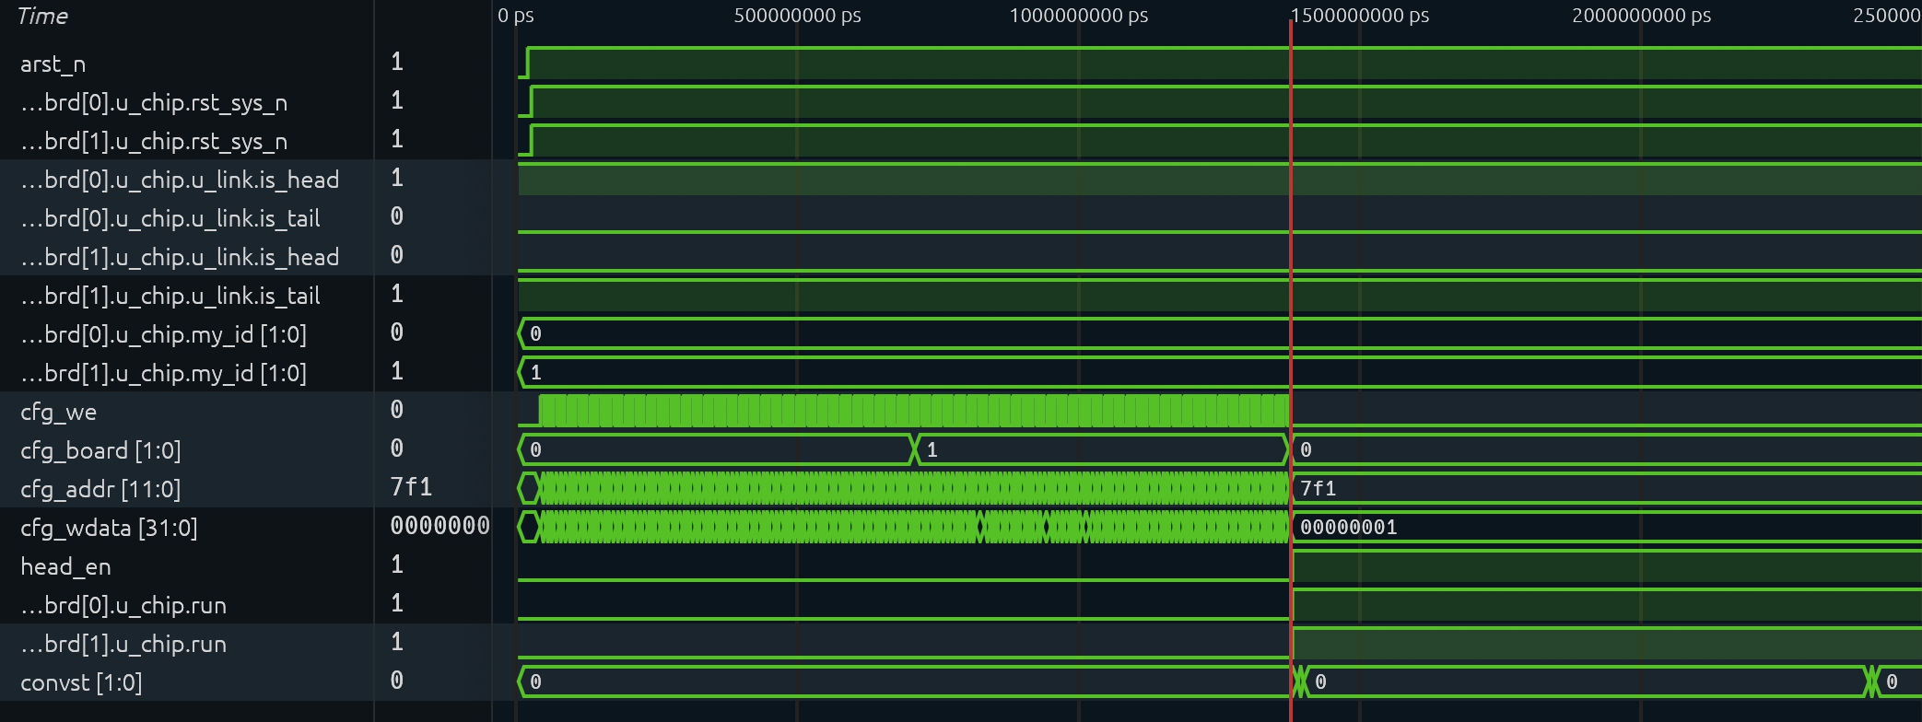
Start-up: Reset → Identity → Configuration → Run
OPERATION
1
2
3
4
5
1
Reset
arst_n rises at 20 µs; rst_sys_n follows on both boards.
2
Self-identification
From the neighbour pins only: board 0 is_head, board 1 is_tail; my_id = 0, 1.
3
Configuration
171 writes in ≈ 1.34 ms; cfg_board selects the board: 85 to board 0, then 85 to board 1.
4
Start
The last write is the head's core_en; run reaches both boards in the same cycle (1.38 ms).
5
Lockstep sampling
Both CONVST timers start together: one frame every 260 clocks = 1.016 ms.
config board 0 · 85 writes
config board 1 · 85 writes
running: CONVST every 1.016 ms
40 µs
0.70 ms
1.38 ms
2.40 ms
Each board receives, in this order:
n_ch
nwords = 3
μ, k × 20
W′ row 1 + b′1
W′ row 2 + b′2
W′ row 3 + b′3
core_en (head, last)
Both boards find their place, load their model and start sampling together within 1.4 ms.

Slide 20
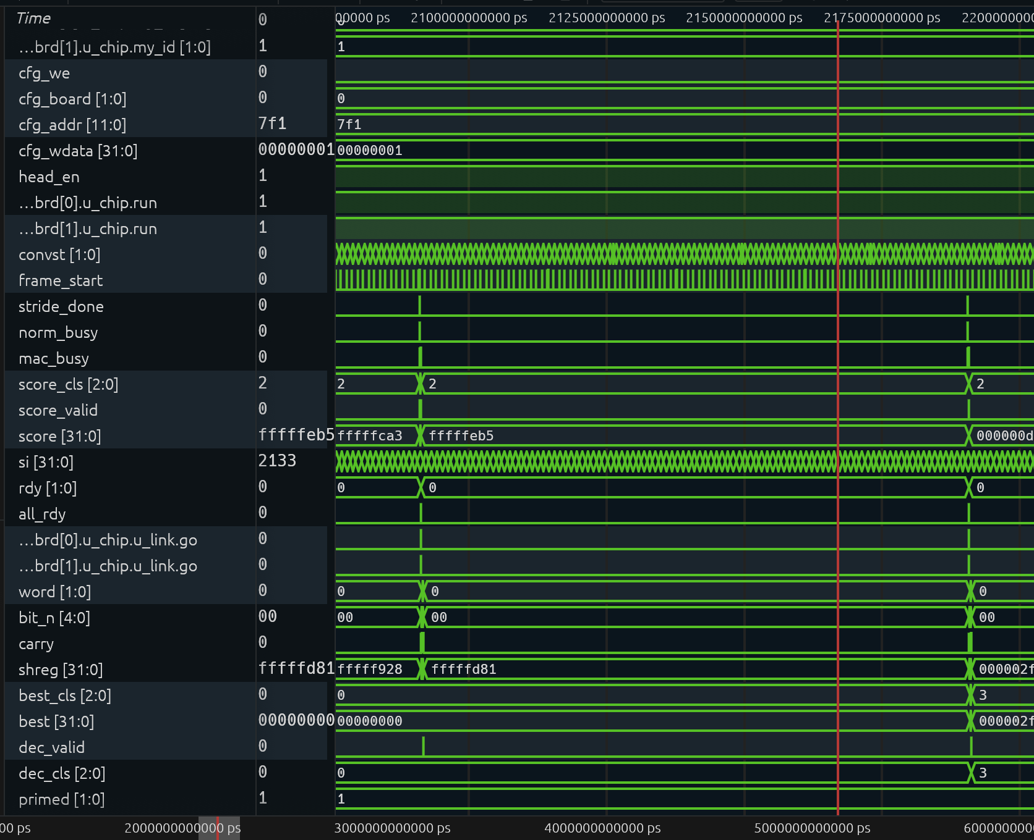
Steady State: One Burst of Work per Stride
OPERATION
6
7
8
6
Stride ends
After every 98th frame: stride_done → Stage 2 → Stage 3 → rdy / go → chain → dec_valid (decision 19, class 0).
7
Sampling
For the next 98 frames (99.5 ms) only CONVST, the SPI read and Stage 1 run; dec_cls holds the last class.
8
Next stride
Decision 20 at 2.191 s: dec_cls 0 → 3. primed = 1: every decision after the first is valid.
One stride (not to scale) and the window of each decision
98 frames × 1.016 ms = 99.5 ms: sample + Stage 1
Stages 2–3
+ chain
decision
stride n − 1 (bank 0)
stride n (bank 1)
window of decision n: 196 frames (50 % overlap)
The boards sample 99 % of the time; one ≈ 0.75 ms burst per stride does all the classification.

Slide 21
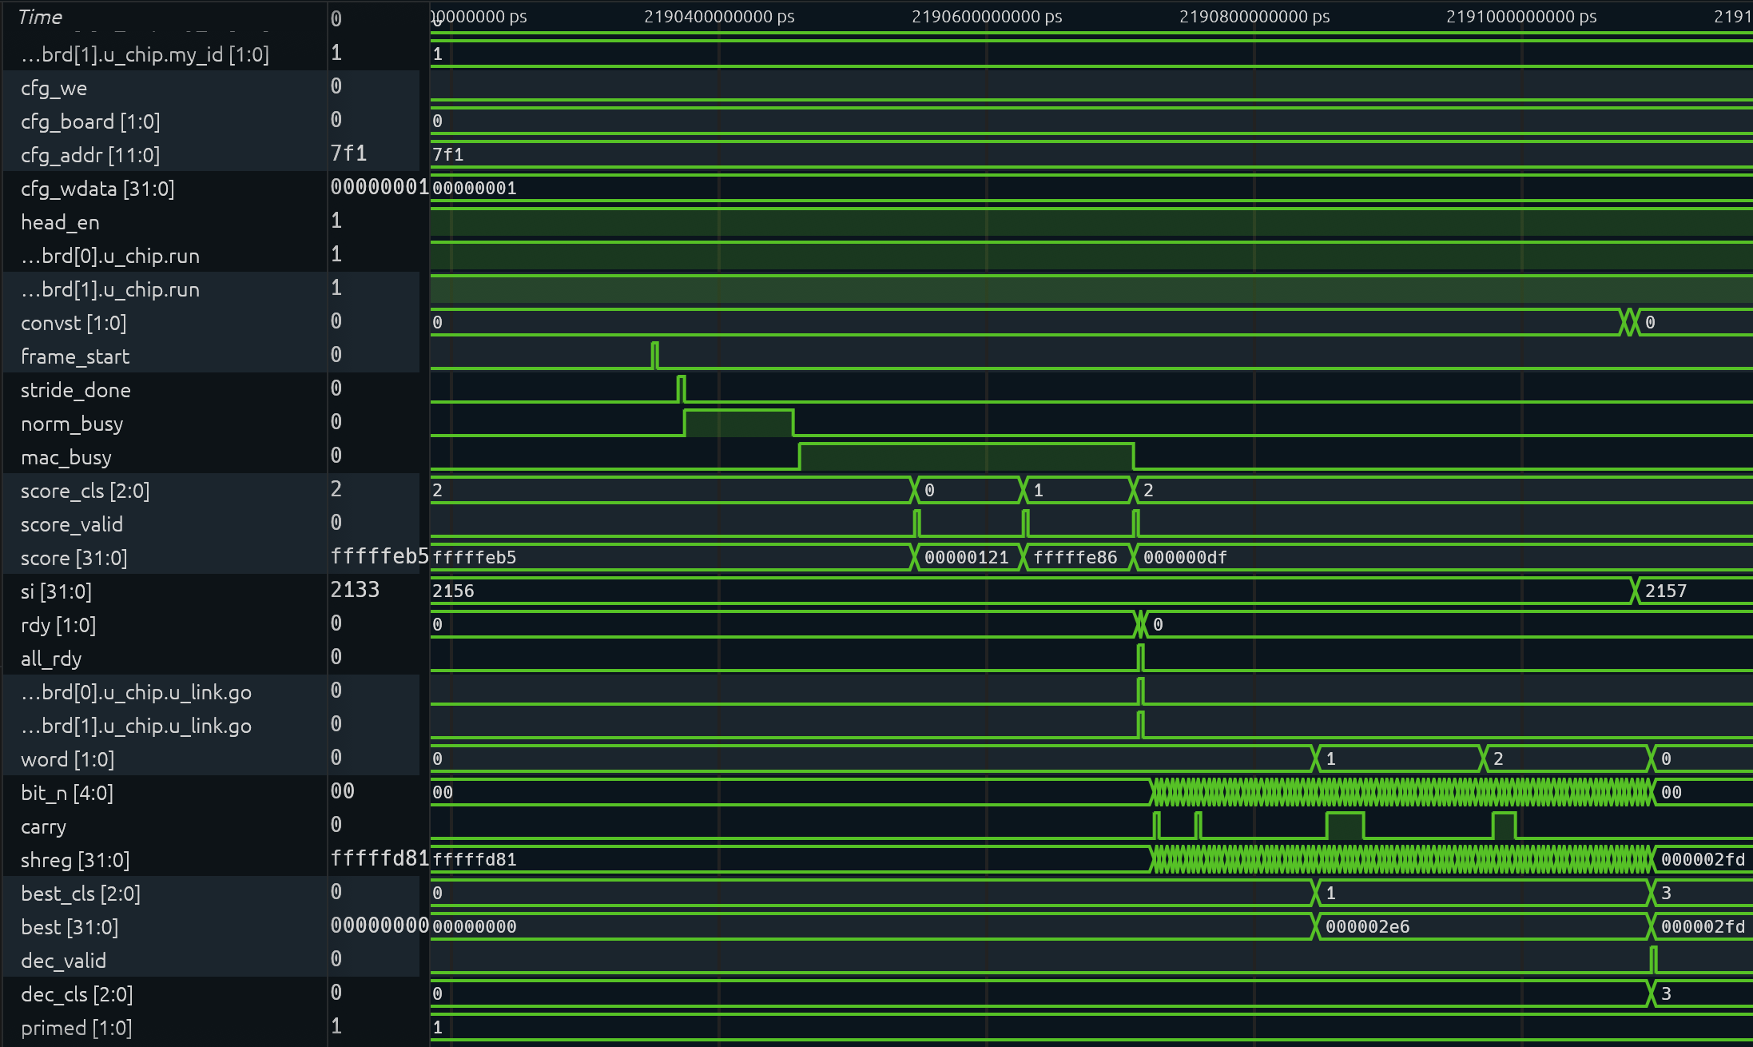
Inside One Stride: From the Last Frame to the Decision
OPERATION
9
10
11
12
13
14
15
9
Last frame
frame_start: the 98th frame is in; Stage 1 updates the features and raises stride_done.
10
Stage 2
norm_busy: 20 features of this board, 22 cycles (86 µs).
11
Stage 3
mac_busy: 3 rows × 21 cycles; partials 289, −378, 223 on score_valid (head, with b′).
12
Barrier
rdy on both boards → all_rdy → go in the same cycle.
13
Chain
The tail streams 3 × 32 bits LSB first; the head adds bit by bit into shreg.
14
Running argmax
D1 = 742 → best_cls 1; D2 = −255; D3 = 765 > 742 → best_cls 3.
15
Decision
dec_valid, dec_cls = 3, ≈ 0.75 ms after the last frame; equals the golden model.
Stage 2
Stage 3: 65 cycles
Chain: 3 × 32 bits
decision
Last frame to decision in ≈ 0.75 ms: D = (742, −255, 765), head + tail, so class 3.
Notes:
Stride 21: head partials 289, −378, 223 (with b′); tail partials 453, 123, 542; totals 742, −255, 765. argmax{0, D1, D2, D3} = class 3, the same as the golden model. The true gesture of this window is Hand Open: this is one of the model's own errors, reproduced exactly by the hardware.

Slide 22
Is the Hardware Exactly the Model?
VERIFICATION
Golden model (Python)
bit-exact Stages 1–3
Train on 17 subjects
→ μ, k, W′, b′
Config file
(per board)
GOLDEN MODEL
Python model of every integer in Stages 1–3; training uses its features, so training and chip see the same numbers.
CHAIN LINK ALONE
1–4 boards × 3000 random strides; expected sums and argmax computed inside the testbench.
MUTATION TEST
8 planted bugs (carry, ≥ instead of >, rdy, ids, …): the test fails on every one.
WHOLE CHIP, REAL DATA
Six board splits: 79 / 79 decisions bit-exact; 72 / 76 single-gesture windows correct.
Real FORS-EMG stream
subject 6, trial 1
7840 samples, 4 gestures
RTL: 1–3 boards + ADC pod models
one clock, real chain wiring
every decision compared with the golden model
Check | Result
emg_chain_link alone: 1–4 boards × 3000 random strides | pass
8 planted bugs (mutation test) | 8 / 8 caught
Whole chip: splits 8, 4+4, 2+6, 6+2, 5+3, 3+3+2 | 79 / 79 bit-exact
verify_all.py | 18 / 18 pass
The hardware is the model, bit for bit.
Notes:
The 4 errors on single-gesture windows are the model's own: the single-chip LDA makes the same decisions. Earlier, the feature ALU was tested on all 196,608 input combinations and the single-chip version was bit-exact at 8–24 channels with a cocotb chip-level test.

Slide 23
Results and Future Work
SUMMARY
Step | Result
Gesture set | Hand Close, Hand Open, Wrist Flexion, Wrist Extension: +14.1 pp; merging all 12 instead: −16.9 pp
Model | MLP, logistic regression, SVM, LDA statistically tied; LDA chosen (closed form, 4.3× cheaper)
CNN | Best CNN +2.7 pp; after calibration +2.4 pp; below the +3 pp bar, for ≈ 870× the MACs or more
Arithmetic | INT8: 0.18 pp mean loss; integer features and shift normaliser: no loss
Accuracy, new user | 77.6 % (bit-exact chip model, LOSO); target ≥ 60 %
With calibration | 86.4 % from one recording per gesture (LDA)
Hardware | 8 channels per board, 1–3 boards, one 256 kHz clock, one multiplier, 96 bits per decision between boards
Verification | 79 / 79 decisions bit-exact on real data, 8 / 8 planted bugs caught, 18 / 18 checks
Future work
ON-CHIP CALIBRATION
Update the class means on the device from one recording per gesture.
FOREARM ROTATION
Robustness to the forearm orientation (rest, supination, pronation).
REST / REJECT CLASS
Recognise movements outside the 4 gestures instead of forcing one of them.
SYNTHESIS AND SILICON
Area and power in a target process; tests with real ADC pods.
4 gestures, 77.6 % on a new user (86.4 % calibrated), one multiplier per board, verified bit-exactly.

Slide 24
References
REFERENCES
[1] FORS-EMG: A Novel sEMG Dataset for Hand Gesture Recognition Across Multiple Forearm Orientations, arXiv:2409.07484, 2024.
[2] B. Hudgins, P. Parker, R. N. Scott, “A new strategy for multifunction myoelectric control,” IEEE Trans. Biomed. Eng., vol. 40, no. 1, pp. 82–94, 1993.
[3] K. Englehart, B. Hudgins, “A robust, real-time control scheme for multifunction myoelectric control,” IEEE Trans. Biomed. Eng., vol. 50, no. 7, pp. 848–854, 2003.
[4] A. Phinyomark, P. Phukpattaranont, C. Limsakul, “Feature reduction and selection for EMG signal classification,” Expert Syst. Appl., vol. 39, no. 8, pp. 7420–7431, 2012.
[5] T. R. Farrell, R. F. Weir, “The optimal controller delay for myoelectric prostheses,” IEEE Trans. Neural Syst. Rehabil. Eng., vol. 15, no. 1, pp. 111–118, 2007.
[6] J. N. Mitchell, “Computer multiplication and division using binary logarithms,” IRE Trans. Electron. Comput., vol. EC-11, no. 4, pp. 512–517, 1962.
[7] O. Ledoit, M. Wolf, “A well-conditioned estimator for large-dimensional covariance matrices,” J. Multivariate Anal., vol. 88, no. 2, pp. 365–411, 2004.

