Slide 1
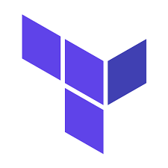
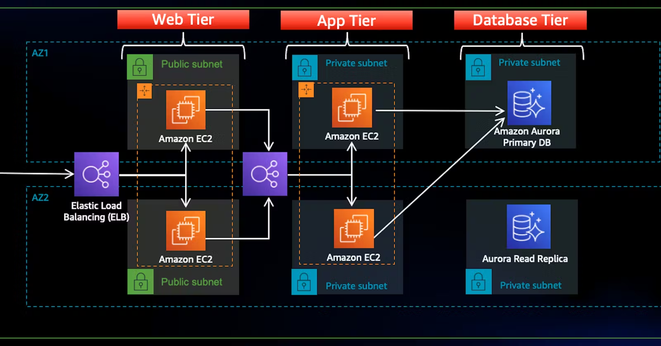
PROJECT-I
Deploy Three-Tier Architecture in AWS using Terraform
-Gollena Vinay

Slide 2
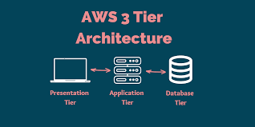
Prerequisites:
Basic knowledge of AWS & Terraform.
AWS account.
I AM user.
GitHub account.
AWS Access & Secret key.

Slide 3
List of Steps in the Pipeline
Create a provider file.
Create a variable file.
Create a file for VPC.
Create a file for subnet.
Create a file for Internet gatway.
Create a file for Route table.
Create a user data files.
Create a file for EC2 instances.
Create a file for Security groups for the front-end tier.
Create a file for security groups for database tier.
Create a file for Application load balancer.
Create a file for Auto scaling group.
Create a file for the RDS instance.
Create a file for outputs.
Verify the resources.

Slide 4
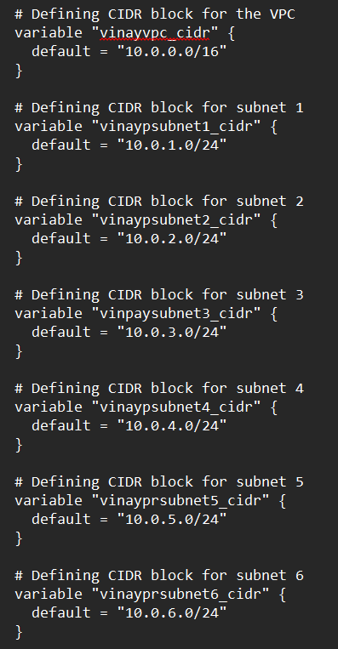
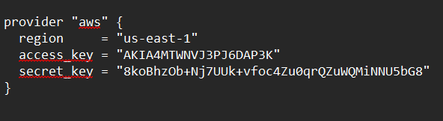
Provider and Variables

Slide 5
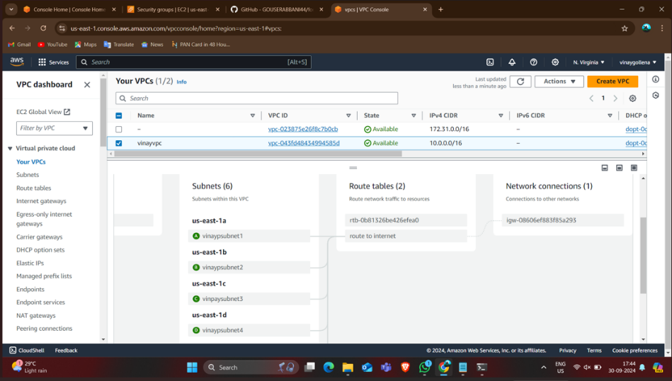
VPC ,Subnets,Internet Gateway and Route Table
A VPC provides an isolated virtual network, subnets divide it into manageable segments, an Internet Gateway enables internet connectivity for public subnets, and a Route Table directs traffic flow within the VPC and to external resources.

Slide 6
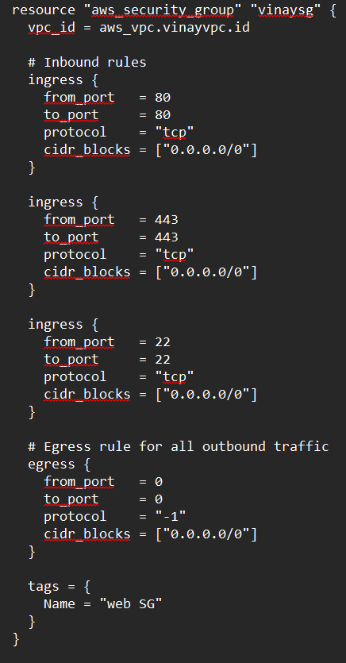
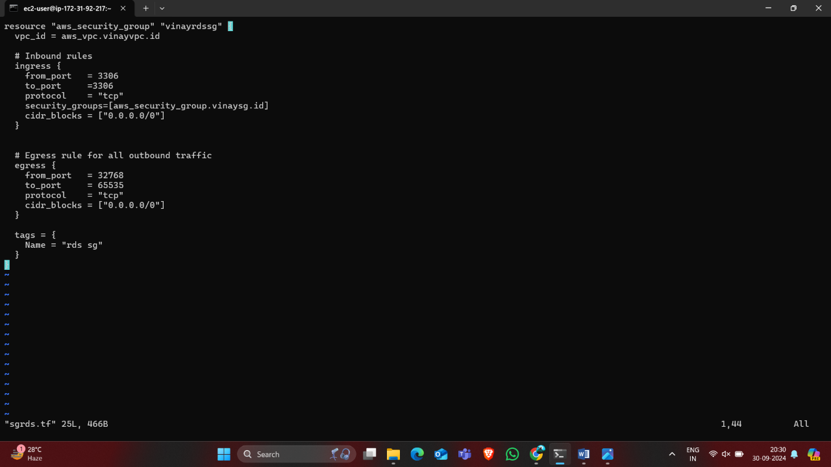
Security groups
Front-end tier
Database tier
Security groups for the front-end tier allow inbound traffic on ports 22 (SSH), 80 (HTTP), and 443 (HTTPS).
while the database tier permits access on ports 3306 (MySQL) and 32768 (custom application traffic) from the front-end servers

Slide 7
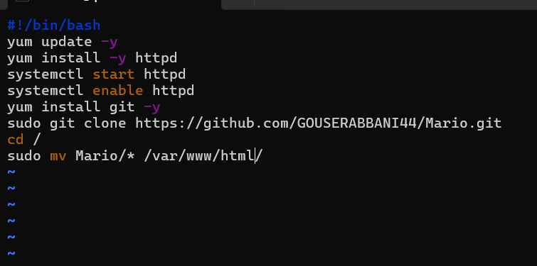
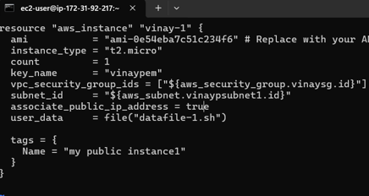
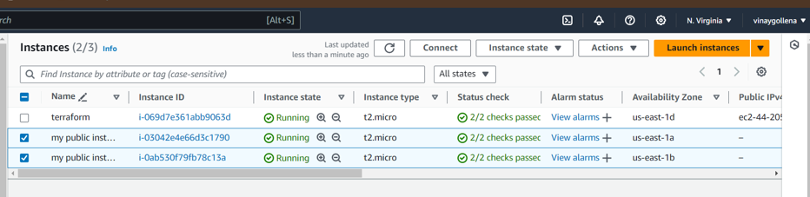
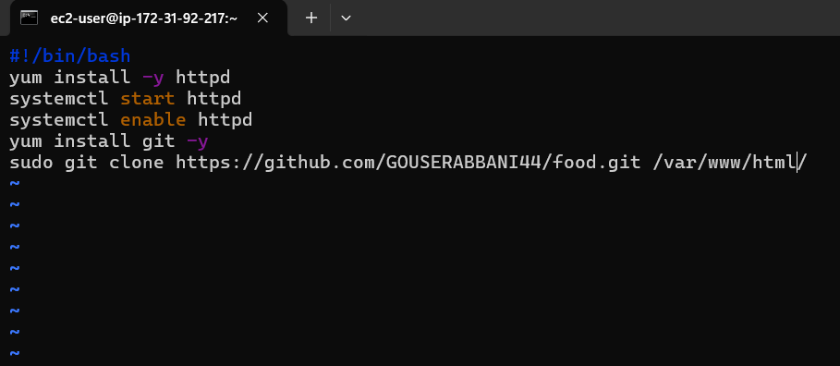
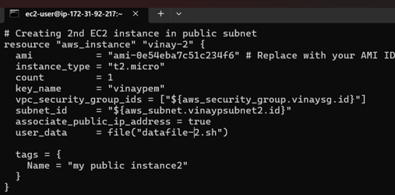
Data files and ec2 instances:
An EC2 instance is a virtual server in Amazon's Elastic Compute Cloud that can run applications and workloads. It offers flexible computing capacity, allowing users to scale resources up or down based on demand.
Data file-1 Instances Results
Data file-2

Slide 8
Load Balancer and Auto Scaling
Load Balancers distribute incoming
traffic across multiple instances to ensure
high availability and fault tolerance,
enhancing application performance.
Auto Scaling dynamically adjusts the
number of running instances based
on demand, optimizing resource
usage and cost efficiency

Slide 9
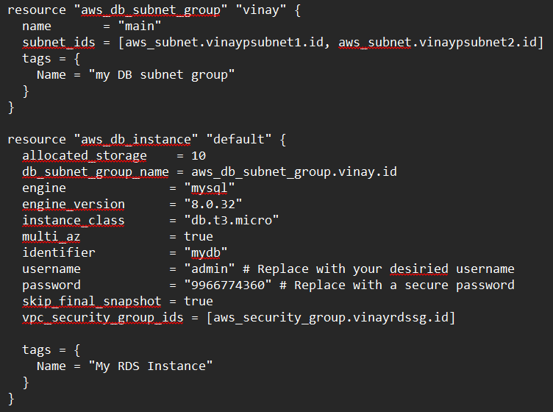
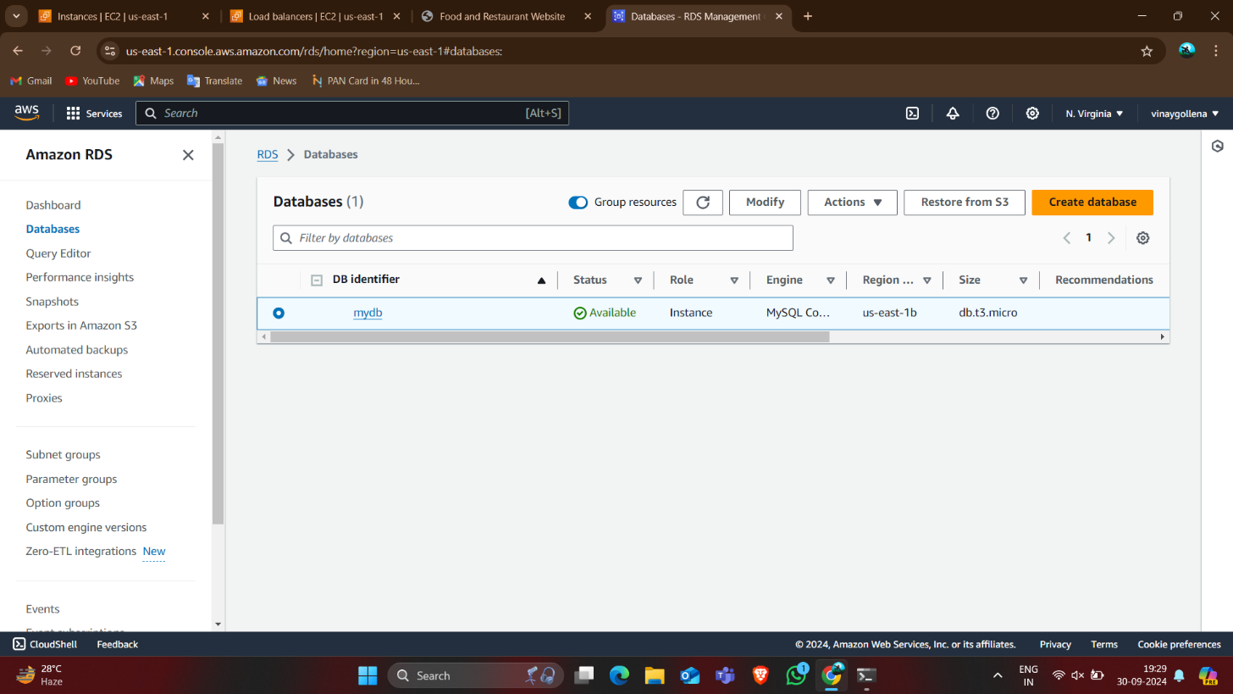
RDS Instance Setup
Amazon RDS (Relational Database Service) simplifies the setup, operation, and scaling of relational databases in the cloud. It automates tasks such as backups, patch management, and replication, allowing developers to focus on building applications without the complexity of database administration.

Slide 10
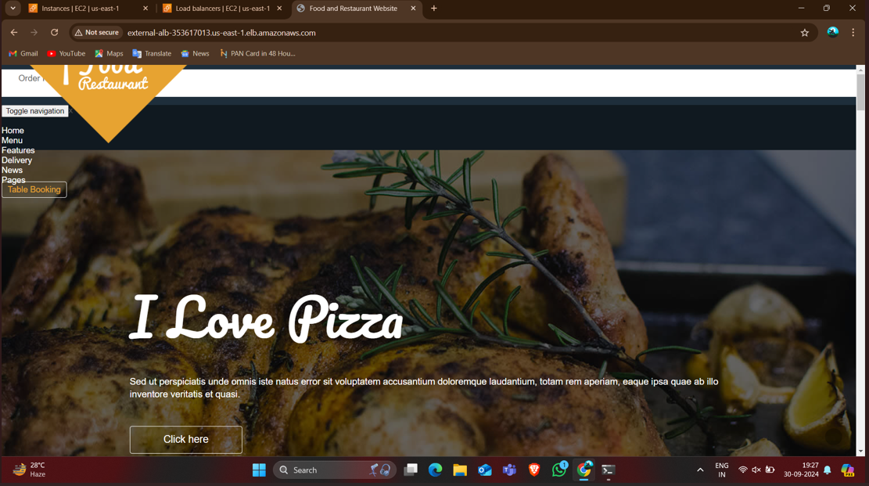
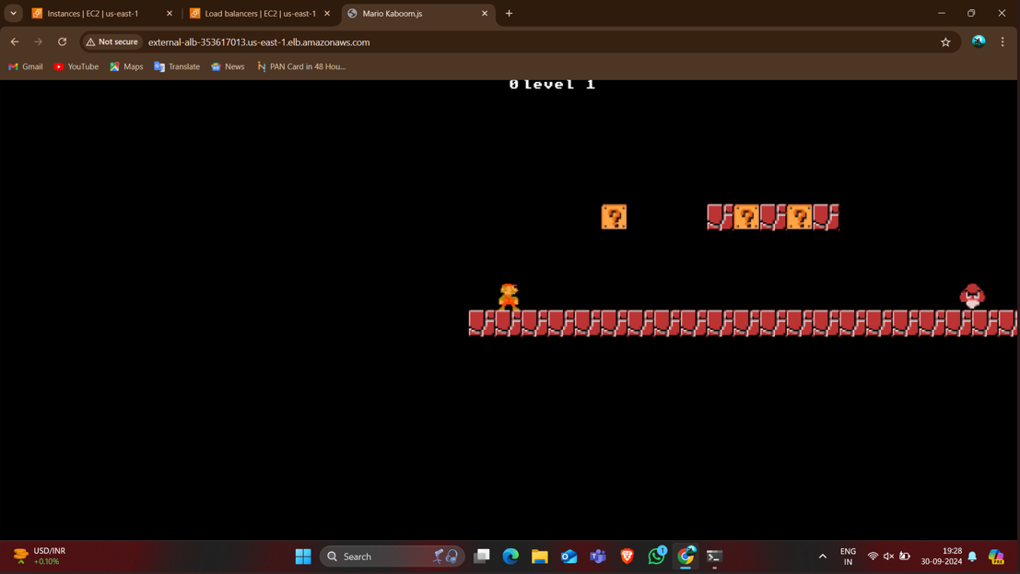
Results
1st instance
2nd instance

Slide 11


