Slide 1
Automated System for Material Return from Customer
PIP103 University Project-II
Review-1
Batch Number:CSE-G153
Roll Number | Student Name
20201CSE0779 | Amaan Masood Hagalwadi
20201CSE0782 | Syed Nabil
20201CSE0792 | Shaik Shoban
20201CSE0818 | Utlapalli Vinay Kumar
20201CSE0844 | Mandhapati Pavan Reddy
Under the Supervision of,
Dr . Naiwrita Borah
Assistent Professor
School of Computer Science & Engneering
Presidency University

Slide 2
Introduction
The aim of this proposed solution is to enhance the efficiency and reliability of the supply chain management and customer service by addressing the challenges associated with excess supply, damaged deliveries, and incorrect product returns.
The key objectives include Preventing Acceptance of Counterfeit or Fake Products by the implementation of a comprehensive product identification and verification system that aims to ensure that only genuine products are accepted during the return process. By cross-checking product IDs against a centralized database and incorporating stringent verification measures, the system helps in preventing the acceptance of counterfeit or fake products, reducing the likelihood of financial losses. This, in turn, helps in optimizing inventory management and preventing financial losses associated with the scrapping of damaged goods. This Enhances Product Return Process.

Slide 3
Introduction
The incorporation of advanced tracking technologies like RFID or barcoding, coupled with user-specific access levels, ensures a streamlined and controlled product return process. Equipping delivery personnel with the necessary tools and training enhances their ability to conduct thorough checks, contributing to a more efficient and reliable return process. Also, By ensuring the authenticity and quality of replaced products, the proposed solution aims to enhance overall customer satisfaction.
Customers can have confidence that the products they receive as replacements are genuine and meet the specified quality standards, contributing to a positive customer experience and optimizing Inventory Management by implementation of a robust product identification and verification system contributes to improved inventory management. This is achieved by reducing the influx of damaged or counterfeit products into the supply chain, allowing for more accurate inventory tracking and planning. The primary goal is to minimize financial losses associated with damaged or counterfeit products. By preventing the acceptance of such items and subsequently scrapping them, SKF can optimize its financial resources and allocate them more efficiently within the supply chain.

Slide 4
Literature Survey
Chai, S., Tan, R. Y., & Pan, Z. (2014). A research framework for RFID-enabled anticounterfeiting in the pharmaceutical supply chain [1], This paper proposes a research framework for RFID-enabled anti-counterfeiting in the pharmaceutical supply chain. The framework includes five stages: product identification, data collection, data analysis, decision making, and feedback. The authors also discuss the challenges and future research directions for RFID-enabled anti-counterfeiting.
Chen, J., Zhang, L., & Li, D. (2016). Research on product identification technology and application in supply chain management [3], This paper reviews the research on product identification technology and its application in supply chain management. The authors discuss the different types of product identification technologies, such as barcodes, RFID tags, and optical character recognition (OCR). They also discuss the benefits of using product identification technology in supply chain management, such as improved inventory accuracy, reduced costs, and improved customer satisfaction.

Slide 5
Literature Survey
Chai, S., Tan, R. Y., & Pan, Z. (2014). A research framework for RFID-enabled anticounterfeiting in the pharmaceutical supply chain [1], This paper proposes a research framework for RFID-enabled anti-counterfeiting in the pharmaceutical supply chain. The framework includes five stages: product identification, data collection, data analysis, decision making, and feedback. The authors also discuss the challenges and future research directions for RFID-enabled anti-counterfeiting.
Chen, J., Zhang, L., & Li, D. (2016). Research on product identification technology and application in supply chain management [3], This paper reviews the research on product identification technology and its application in supply chain management. The authors discuss the different types of product identification technologies, such as barcodes, RFID tags, and optical character recognition (OCR). They also discuss the benefits of using product identification technology in supply chain management, such as improved inventory accuracy, reduced costs, and improved customer satisfaction.

Slide 6
Project Basic Requirements
Hardware Requirements:
Processor: Dual-core processor or higher.
Memory (RAM): 4 GB of RAM or higher for smoother performance.
Storage: 20 GB of available storage space for the operating system, XAMPP, and development files.
Operating System: Compatible with Windows, macOS, or Linux.
Network Connectivity: Internet connectivity for software downloads and updates.
Display: Standard monitor with a resolution of 1280x800 or higher.
Input Devices: Keyboard and mouse for input.

Slide 7
Project Basic Requirements
Software Requirements:
Relational Database System (MySQL): Specify the use of MySQL to store and manage data.
Server-Side Scripting (PHP): Describe the role of PHP in handling server-side processing, including data validation, processing return justifications, and interacting with the database.
Front-End Technologies (HTML, CSS, JavaScript): Explain how HTML and CSS will structure and style the user interface, and how JavaScript will add interactivity, such as form validation and real-time updates.
Text Editor or IDE: Mention the tools used for coding, whether it's a text editor like Visual Studio Code or an integrated development environment (IDE) like PhpStorm.

Slide 8
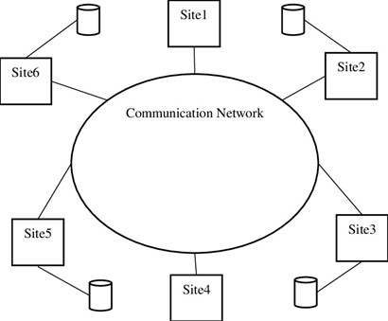
Proposed Method
Centralized Database:
Establish a centralized database to store detailed product information, including unique identifiers, specifications, and historical data.
Figure1:Database Structure

Slide 9
Proposed Method
2. Product Identification Mechanism:
Develop a mechanism to assign unique product IDs to each item in the inventory.
Integrate this mechanism with the production process to ensure that unique identifiers are assigned during manufacturing.
3. Verification Protocols:
Define stringent verification protocols to confirm the authenticity of returned products.
Incorporate matching criteria, such as unique identifiers, product specifications, and potentially advanced tracking technologies like RFID or barcoding.

Slide 10
Methodology
User Data Entry: Users enter product details and upload images through a user interface (UI) built using React, HTML, CSS, and JavaScript. The UI is designed for user-friendliness and easy data submission.
Data Processing: User-provided data is processed and stored in the backend database for subsequent analysis. Images are stored using SQL Database , while Node.js manages the processing activities.
Manufacturer Response: Manufacturers respond to return requests through an admin panel designed with React, HTML, CSS, JavaScript, and PHP. The admin panel facilitates a quick and effective decision-making process.

Slide 11
Methodology
Product Return Status: Users are informed about the status of their product return through the UI. They can track the return's progress, whether it's under review, approved, or rejected, enhancing transparency and user satisfaction.
This methodology ensures a well-structured, end-to-end system that includes user-friendly data input, robust data storage and processing, efficient manufacturer response, and transparent status updates for users. The use of modern web technologies and cloud-based solutions enhances the system's effectiveness and efficiency.

Slide 12
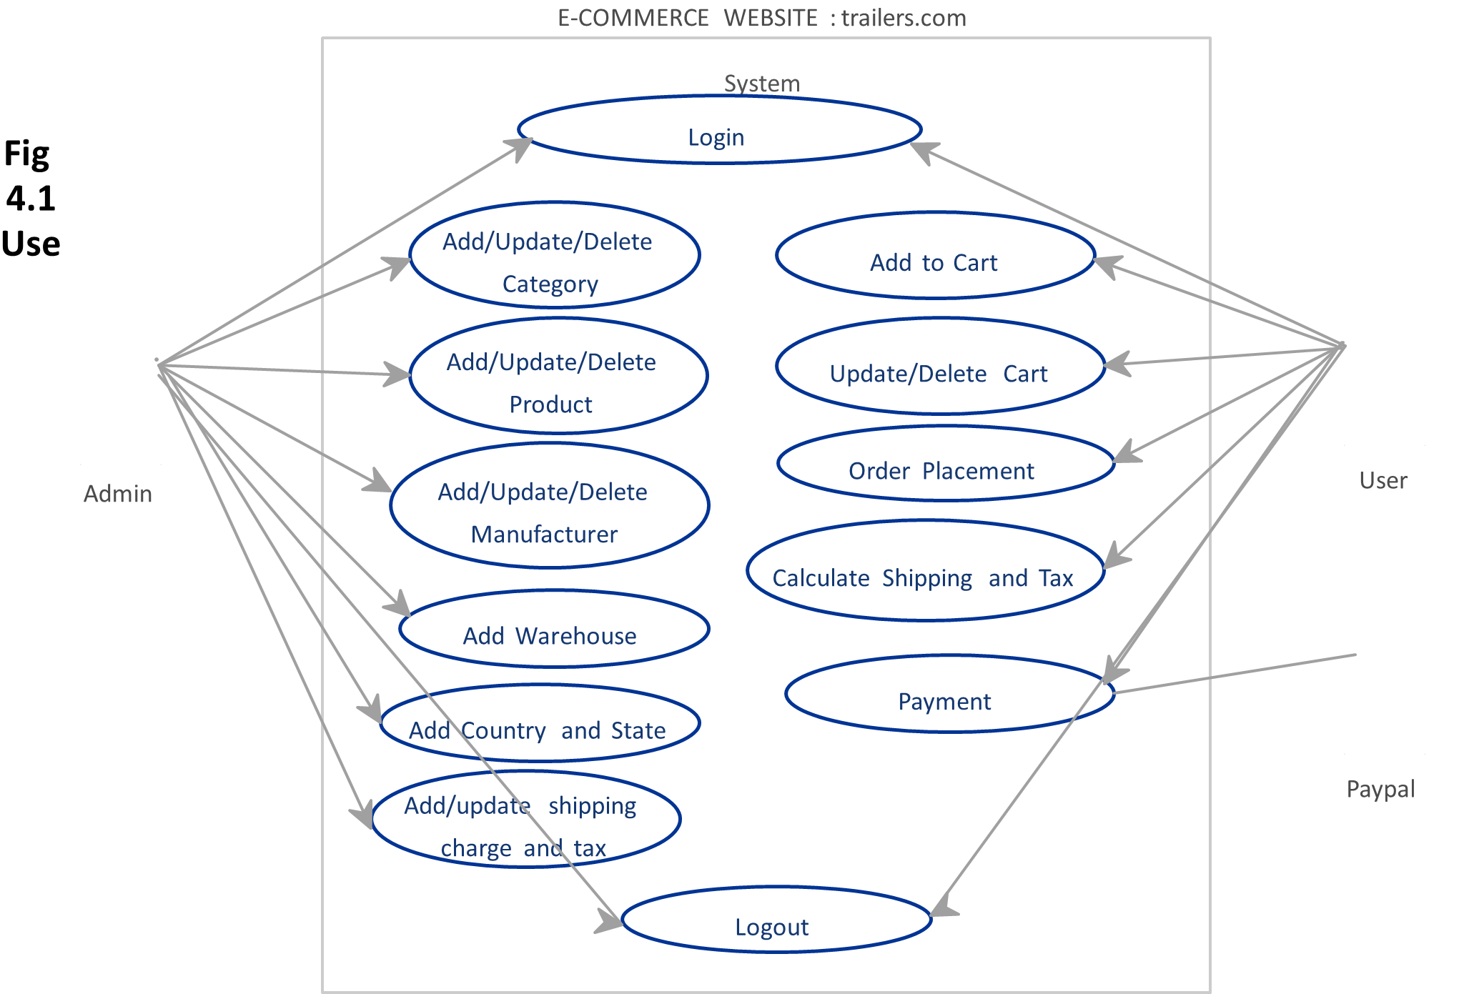
Use-Case Diagram
A use case diagram is a type of UML diagram that shows how users interact with a system. It is created by conducting a use case study, which is a process of gathering information about the system's users and their needs.
Figure 2: Use-Case Diagram

Slide 13
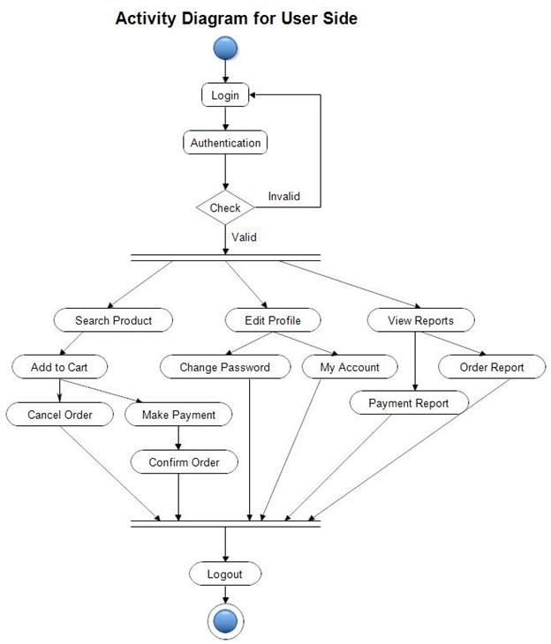
Activity Diagram
Activity diagrams show the flow of control through a system, and they can be used to identify potential bottlenecks or areas for improvement.
Figure 3: Activity Diagram

Slide 14
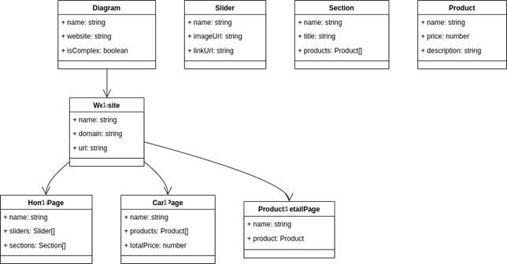
Class Diagram
A Class diagram in the Unified Modeling Language (UML) is a type of static structure diagram that describes the structure of a system by showing the system's classes, their attributes, operations (or methods), and the relationships among objects.
Figure 4: Class Diagram

Slide 15
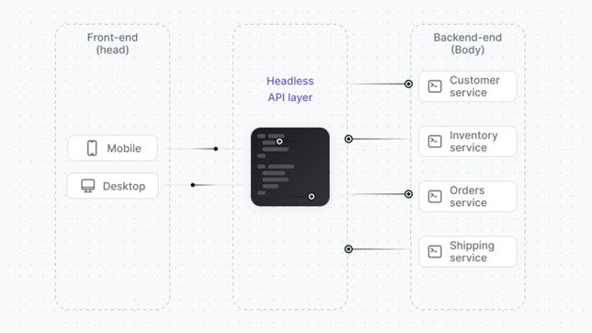
System Architecture
Figure 5: System Architecture

Slide 16
Goals
The following are the primary objectives for the UML's design.
1. Provide users with an easy-to-use, expressive visual modeling language so they can build and exchange useful models.
2. Give the basic concepts room to grow by providing tools for specialization and extensibility
3. Be independent of any particular programming language or development process.
4. Provide a formal foundation for understanding the modeling language.
5. Encourage the growth of OO tools' commercial use.
6. Promote the usage of higher level development concepts like components, frameworks, patterns, and partnerships.

Slide 17
Timeline of Project
Sl.No | Process | Review | Dates
1. | Task Finalization with Supervisor. | Review-0 | 12-10-2023
2. | Methods And Software Details. | Review-1 | 09-11-2023
3. | Front-end Development. | Review-2 | 30-11-2023
4. | Back-end Development. | Review-3 | 29-12-2023
5. | Demonstration. | Final viva | 10-01-2024

Slide 18
Expected Outcomes
The implementation of the "Automated Material Return System for Customer" is anticipated to yield transformative outcomes for businesses. Firstly, the streamlined return process will significantly reduce operational complexities, leading to a more efficient and cost-effective operation.
Manufacturer accountability will see a notable boost, as the system enables informed decision-making based on transparent data and images. This not only curtails unnecessary costs related to unwarranted returns but also establishes a foundation for enhancing product quality through targeted improvements.

Slide 19
Expected Outcomes
The focus on addressing legitimate customer concerns is expected to elevate overall customer satisfaction levels, fostering loyalty and positive brand perception. Ultimately, the Automated Material Return System has the potential to create a positive ripple effect, optimizing resources, reducing costs, and fortifying the relationship between businesses and their customers.

Slide 20
Conclusion
In conclusion, the implementation of this product identification and verification system will prove to be a pivotal success in mitigating the challenges posed by excess supply, incorrect deliveries, and damaged products. This comprehensive solution, integrating advanced tracking technologies and stringent verification measures, has not only significantly reduced financial losses associated with scrapped goods but has also elevated customer satisfaction levels through streamlined return processes and the assurance of product authenticity. The system's impact on supply chain efficiency is evident in reduced lead times, improved inventory turnover, and minimized blocked stocks. By enforcing user-specific access levels and providing tools and training for delivery personnel, the organization has fortified its operations against the acceptance of counterfeit items. The observed success underscores the effectiveness of leveraging technology and stringent protocols to transform supply chain and customer service operations, positioning for sustained growth and operational excellence. The commitment to continuous improvement ensures that the organization remains adaptable to evolving business needs and maintains its standing as an industry leader in delivering high – quality products and exceptional customer experience.

Slide 21
Reference
Chai, S., Tan, R. Y., & Pan, Z. (2014). A research framework for RFID-enabled anticounterfeiting in the pharmaceutical supply chain. International Journal of Production Research, 52(19), 5896-5912.
2. Taguchi, D., Takahashi, N., & Ueno, T. (2017). The impact of RFID-based product tracking on inventory accuracy and customer satisfaction in a grocery supply chain. International Journal of Production Research, 55(3), 894-910.
3. Chen, J., Zhang, L., & Li, D. (2016). Research on product identification technology and application in supply chain management. International Journal of Production Research, 54(16), 4848-4860.
4. D'Souza, D. M., & Taguchi, D. (2014). Product identification and tracking systems in retail supply chains: RFID vs. barcode technology. International Journal of Production Research, 52(18), 5486-5501.
5. Liu, Z., Zhang, Y., & Zhang, H. (2016). Research on product identification technology in the supply chain management of agricultural products. International Journal of Production Research, 54(18), 5595-5615.

Slide 22
Thank You

