Slide 1
Development of e-portal for marketing

Slide 2

HELLO!
We are from A13 Batch
Under the guidance of
P.ANITHA
Assistant Professor

Slide 3
Weekly Analysis
Week 1
LITERATURE SURVEY
Why do we choose you this project
Week 2
Requirement Analysis
Framework’s and Languages
1
2
System Modal of the Application
Design
Week 3
This step key part of any project
Coding and Implementation
Week 4
3
4

Slide 4
LITERATURE SURVEY
1
Why do we choose you this project

Slide 5
Our application helps Investors and Entrepreneurs to a single platform with proper guidance by efficient Mentors.

Slide 6
8%
45%
40%
Country’s GDP
Manufacturing Output
Country’s Exports
6,08,41,245
Total MSME’s in India

Slide 7
REQUIREMENTS ANALYSIS
2
Framework’s and Languages

Slide 8
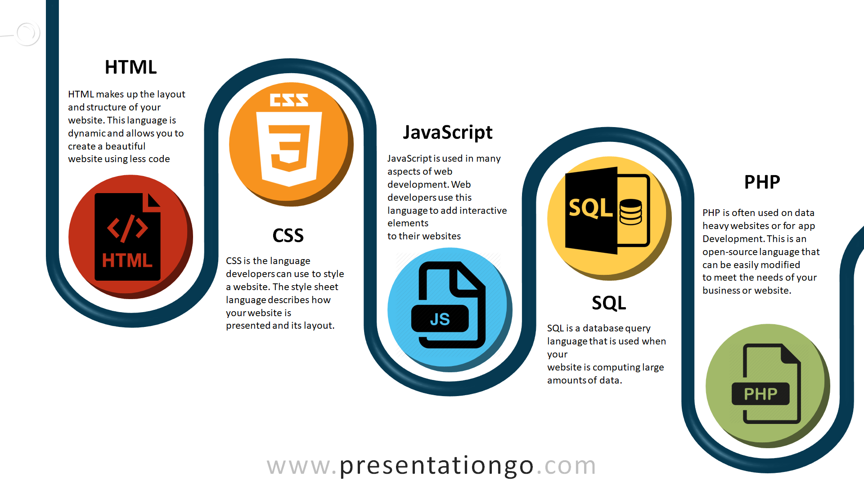
List of Technologies Used:

Slide 9
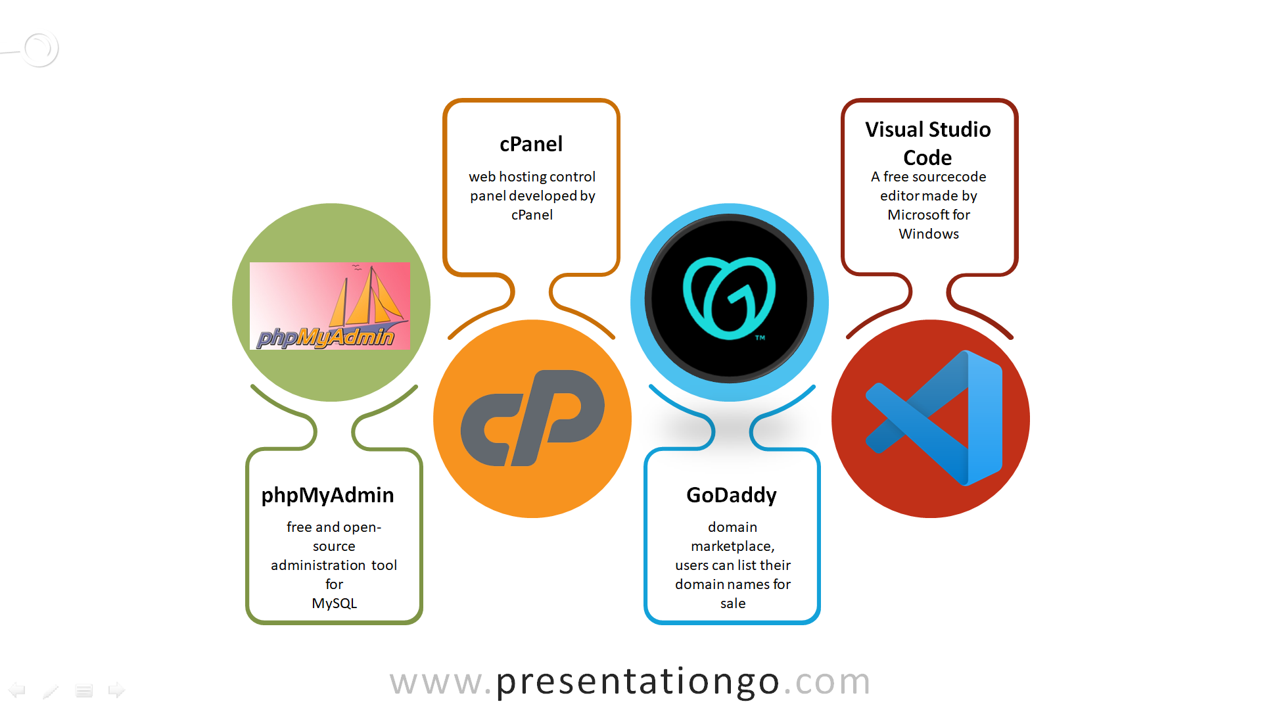
Tools Used :

Slide 10
DESIGN
3
System Modal of the Application

Slide 11
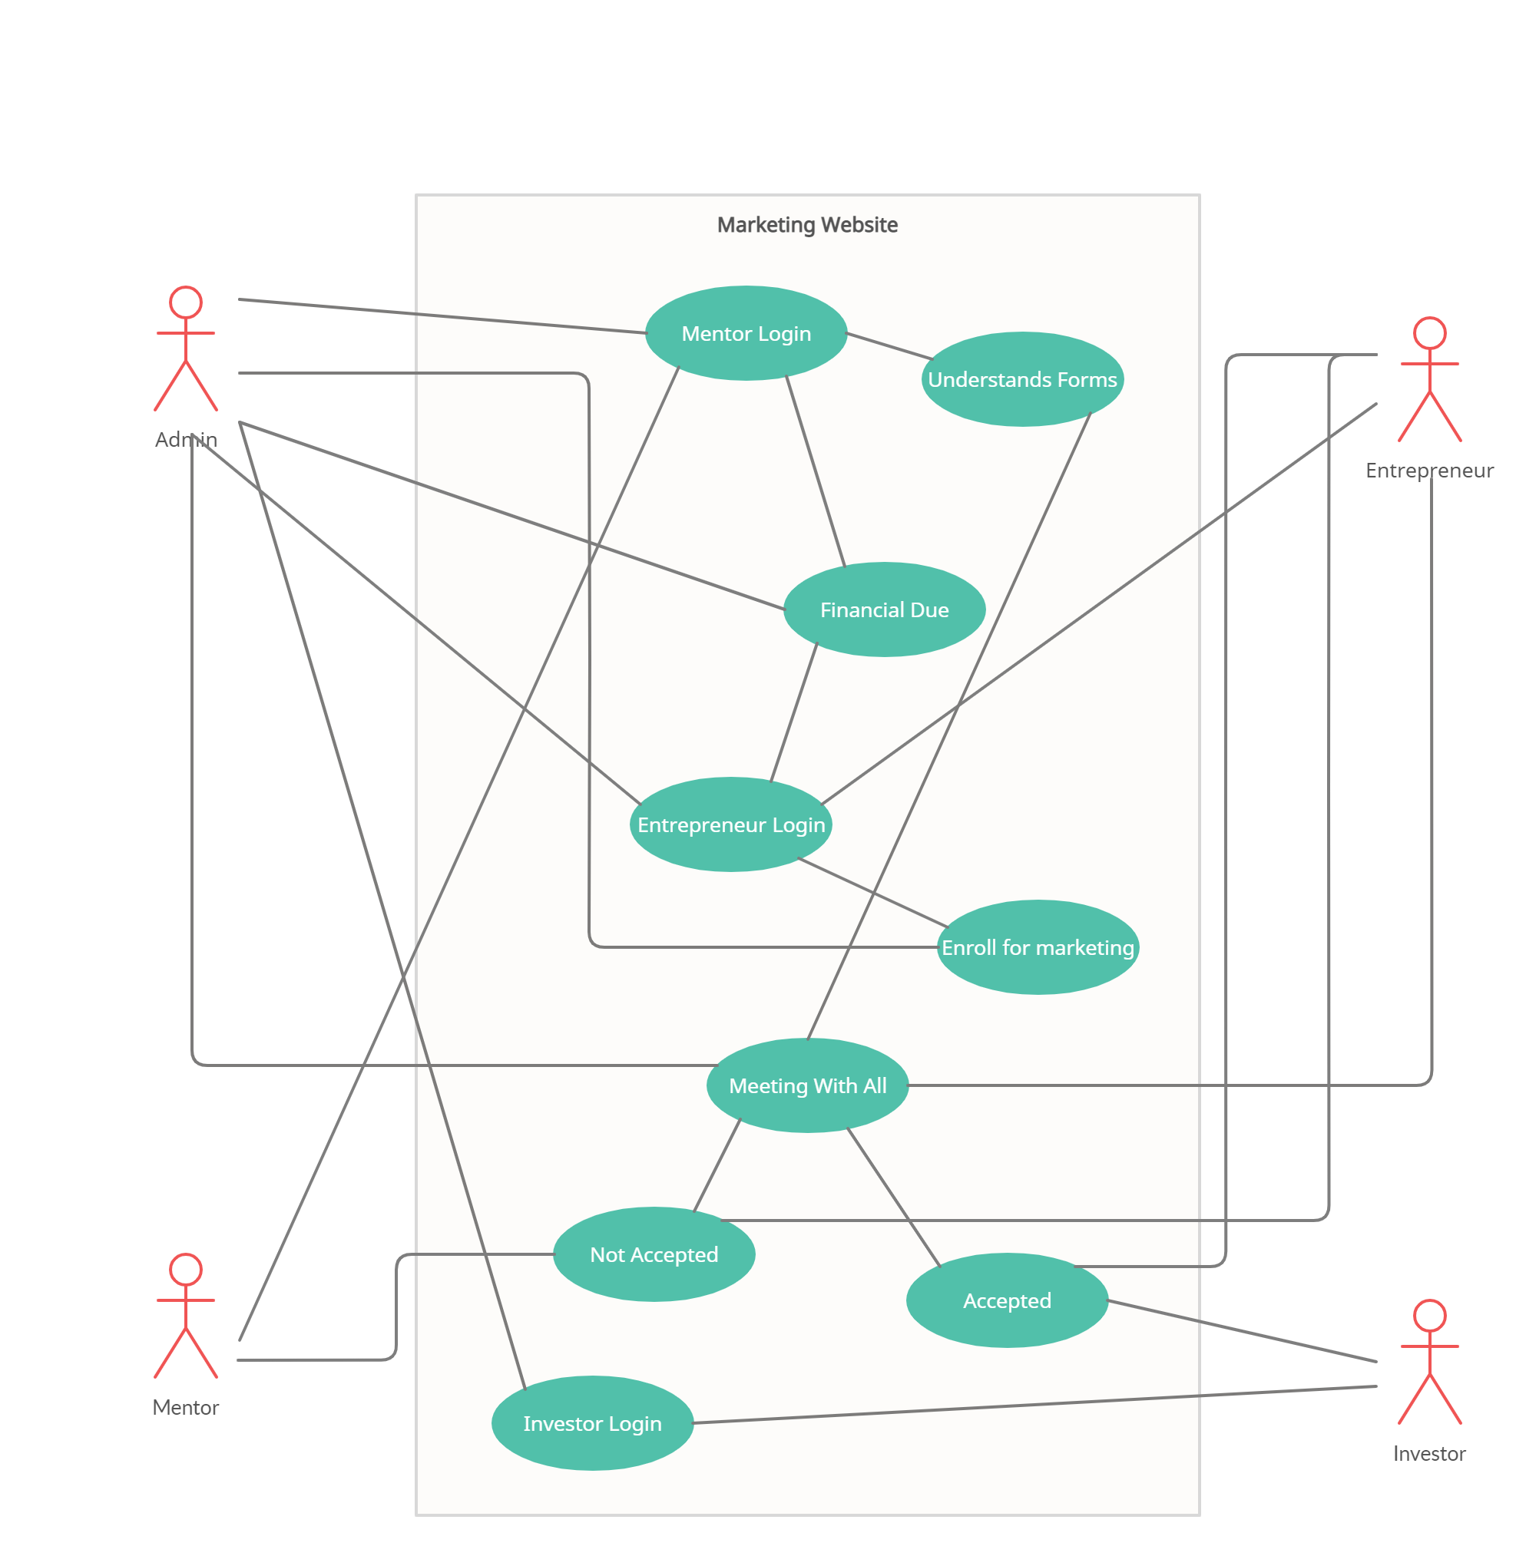
Use Case Diagram
Use case diagram is the primary form of system/software requirements for a new software program underdeveloped.

Slide 12
Coding And Implementation
4
This step key part of any project

