Slide 1

THE FUTURE OF FOOD BEGINS HERE
AI IN AGRICULTURE
& FARMING
How Artificial Intelligence is Feeding the World — and Why It Matters to Every One of Us
Presented By
G Pradeep Kumar
Emp Id: 2494592

Slide 2
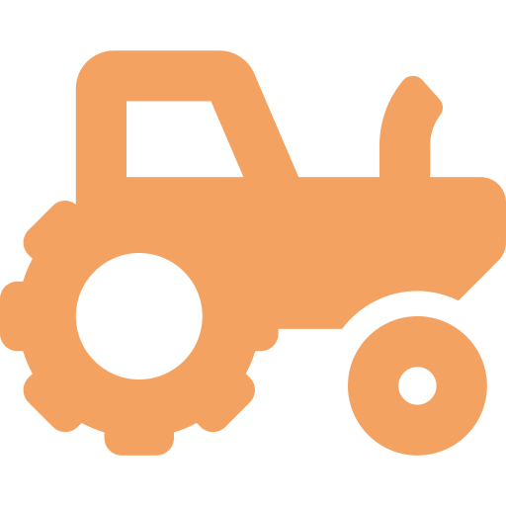
What if he could predict drought before it hits?
Detect crop disease 3 weeks early?
MEET RAVI.
A farmer in Tamil Nadu. 3 acres of land.
His family's entire livelihood
depends on this season's harvest.
Double his yield with half the water?
That's not science fiction. That's AI.

Slide 3



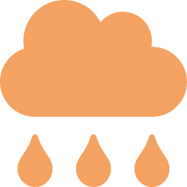
THE SCALE OF THE CHALLENGE
Agriculture feeds 8 billion people. But the system is under enormous stress.
40%
70%
2B+
14°C
of food lost to pests,
disease & waste
of fresh water used
by agriculture
people face food
insecurity globally
avg temp rise threatening
crop yields by 2050

Slide 4




WHAT DOES AI ACTUALLY DO ON A FARM?
Think of it as giving farmers a superpower — to see, predict, and act faster than ever.
DATA IN
AI BRAIN
ACTION OUT
Soil sensors
Satellite images
Weather feeds
Drone footage
Machine Learning
Computer Vision
Predictive Models
Neural Networks
Precise irrigation
Early disease alerts
Optimal harvest time
Yield predictions

Slide 5

USE CASE 1
Crop Disease Detection
with Computer Vision
A farmer used to wait until damage was visible to the naked eye.
By then, 30% of the crop was already lost.
Real Impact
95%
accuracy in
disease detection
1
Camera or phone scans leaf surface
3 weeks
earlier warning
vs naked eye
2
AI model identifies disease from 50,000 patterns
3
Alert sent to farmer's phone within seconds
60%
less pesticide
used
4
Precise treatment applied — only where needed
Real example: Plantix app
used by 1M+ farmers in India

Slide 6


USE CASE 2
Precision Irrigation — Water Every Drop Wisely
"Traditional irrigation wastes up to 50% of water. AI changes that equation dramatically."
Soil Sensors
Weather AI
Smart Drip
Measure moisture, pH, and nutrients in real-time across every zone of the farm
Predict rainfall, wind, and humidity 7–14 days out with 90%+ accuracy
Automated valves open only when needed, delivering exactly the right water
Result: Up to 30–50% water savings with AI irrigation systems

Slide 7





USE CASE 3
Eyes in the Sky —
Drones & Satellite Intelligence
A drone can survey 400 acres in under an hour. A farmer would take days walking the same land.
AI analyses every image to create detailed field health maps.
Detect stressed crops invisible to the eye
NDVI analysis to measure plant health across acres
🚁 John Deere's drone system
scanned 1 million acres in 2023
and improved yields by 15%
Spot pest hotspots before they spread
Track crop growth weekly, predict yield months ahead

Slide 8

USE CASE 4
Predict the Harvest — Before It Happens
How It Works
AI analyses 5+ years of farm history
Combines with real-time weather & market data
Predicts harvest quantity 90 days in advance
Farmer negotiates better prices BEFORE harvest
Government can plan food supply proactively
IBM Watson & Microsoft Azure FarmBeats — real products, deployed today

Slide 9

YOUR TURN.
Quick Scenario — What Would You Do?
You are a farmer. Your AI app warns you that your rice crop has a 78% chance of brown planthopper
attack in the next 10 days. But pesticide costs ₹15,000. Your neighbor doesn't trust the AI.
Do you spray? Do you wait? Do you share the alert with your neighbor?
Discuss with the person next to you — 60 seconds. Then we'll share.
A. Spray immediately — trust the AI
B. Wait and watch for 5 days
C. Share alert and decide together
D. Ignore — AI isn't always right

Slide 10
AI IN FARMING — AROUND THE WORLD
It's not a lab experiment. It's already happening.
🇮🇳 India
🇺🇸 USA
Microsoft x ICRISAT
John Deere See & Spray
AI advisory sent via SMS to farmers. Recommended optimal sowing dates → 30% yield increase in Telangana.
Computer vision identifies weeds vs crops. Reduces herbicide use by 90%. Saves $100M+ annually.
🇳🇱 Netherlands
🇰🇪 Kenya
Priva Greenhouse AI
Hello Tractor App
AI controls climate, water and nutrients in greenhouses. Produces 10x more food per m² than traditional farms.
AI matches smallholder farmers with nearby tractors. Reduced ploughing cost by 50% for 500,000 families.

Slide 11






BUT WAIT — IT'S NOT ALL PERFECT.
Real barriers. Real questions. We must face them honestly.
Connectivity Gap
Data Privacy
Digital Literacy
Rural farms often lack internet.
AI needs data to work.
Who owns the farmer's crop data?
Big Tech or the farmer?
Older farmers may distrust
or struggle with tech.
Cost Barrier
Bias in AI Models
Human Touch
AI tools can be expensive for
smallholder farmers.
Models trained on US crops
may fail in tropical regions.
Traditional farming wisdom
shouldn't be lost to algorithms.

Slide 12




THE FARM OF 2040
Imagine stepping onto a farm where every decision is AI-assisted, every resource is optimised, every harvest is predicted.
NOW
2030
2040
Disease detection apps
Fully autonomous tractors
Self-managing smart farms
Smart irrigation sensors
AI soil microbiome maps
AI plant genetics design
Drone crop surveys
Blockchain farm-to-fork
Zero-waste food systems
Yield prediction models
Robotic harvesting
Feeding 10B people
The revolution isn't coming. It's already here.

Slide 13




WHAT CAN YOU DO?
AI in agriculture isn't just for tech companies or governments. It involves all of us.
Students & Researchers
Farmers & Agri-workers
Build AI models trained on local crop data. Bridge the rural data gap.
Start with one AI tool — a disease detection app or soil sensor. See the difference.
Policy Makers
Consumers
Fund rural internet access. Subsidise AI tools for smallholders.
Support AI-grown products. Ask where your food comes from. Demand sustainable farming.

Slide 14

EVERY GRAIN OF RICE.
Every Drop of Water. Every Farm. Every Future.
Ravi — our farmer from the beginning — doesn't need to guess anymore.
With AI, he sees what's coming, acts before it's too late, and feeds his family and yours.
"The best time to plant a tree was 20 years ago. The best time to adopt AI farming is NOW."
Thank You · Questions Welcome

