Slide 1

Title: Predictive Maintenance in Industrial Machinery using Machine
Learning under the guidance of
Dr. Gujjeti Nagaraju
DONE BY: BATCH 2
22071A0239-M.HARSHINI
22071A0241-P.JAIDEEP KRISHNA
22071A0242-P.R.NIKHIL SAI
22071A0249-P.MOKSHAGNA
22071A0251-SAMYAK SHAH

Slide 2
ABSTRACT:
This project presents a machine learning–based predictive maintenance (PdM) system designed to analyze machinery operational data and anticipate maintenance requirements before failures occur. The primary objective of the system is to improve equipment reliability, minimize unplanned downtime, and optimize maintenance scheduling. By adopting predictive maintenance strategies, organizations can significantly reduce costs associated with unexpected breakdowns while enhancing overall operational efficiency.
The proposed framework for implementing the ML-driven PdM system consists of several structured stages. Initially, data is collected from a publicly available Kaggle dataset containing key operational parameters of machinery. This data then undergoes preprocessing, which includes cleaning, normalization, and handling missing values to ensure high data quality and consistency. Feature engineering is subsequently performed to extract and select meaningful features that contribute to improved model performance.
Following this, multiple machine learning algorithms are evaluated during the model selection phase to identify the most suitable model based on defined performance metrics. Finally, the selected model is rigorously evaluated to verify its accuracy, robustness, and reliability in predicting maintenance needs. This systematic approach ensures an effective and scalable predictive maintenance solution suitable for real-world industrial applications.

Slide 3
S.No | Title of Paper | Title of Journal / Conference | Reference with DOI | Gap Addressed | Objective of Research | Focus of the Paper (Methodology Used) | Summary in One Line
1. | A Review of Predictive Maintenance Techniques | IEEE Access | 10.1109/ACCESS.2017.2764721 | Reactive maintenance causes downtime | Study PdM techniques | Review of statistical & ML methods | Surveys PdM approaches and benefits
2. | Machine Learning for Predictive Maintenance | Reliability Engineering & System Safety | 10.1016/j.ress.2016.11.021 | Inefficient fault prediction | Apply ML for failure prediction | SVM, ANN analysis | ML improves fault prediction accuracy

Slide 4
S.No | Title of Paper | Title of Journal / Conference | Reference with DOI | Gap Addressed | Objective of Research | Focus of the Paper (Methodology Used) | Summary in One Line
3. | Predictive Maintenance in Industry 4.0 | Journal of Manufacturing Systems | 10.1016/j.jmsy.2018.01.001 | Lack of smart maintenance | Integrate PdM with Industry 4.0 | IoT + analytics framework | PdM enables smart manufacturing
4. | IoT-Based Predictive Maintenance | Sensors | 10.3390/s18020431 | Absence of real-time monitoring | Develop IoT PdM system | Sensor data + ML | IoT enables real-time PdM

Slide 5
S.No | Title of Paper | Title of Journal / Conference | Reference with DOI | Gap Addressed | Objective of Research | Focus of the Paper (Methodology Used) | Summary in One Line
5. | Data-Driven PdM Using ML | IEEE Transactions on Industrial Informatics | 10.1109/TII.2019.2891767 | High maintenance cost | Predict failures early | ML models on sensor data | Data-driven PdM reduces downtime
6. | Deep Learning for PdM | Mechanical Systems and Signal Processing | 10.1016/j.ymssp.2018.04.014 | Manual feature extraction | Use deep learning | CNN, RNN models | DL improves fault detection

Slide 6
S.No | Title of Paper | Title of Journal / Conference | Reference with DOI | Gap Addressed | Objective of Research | Focus of the Paper (Methodology Used) | Summary in One Line
7. | PdM of Rotating Machines | Applied Sciences | 10.3390/app9020266 | Unexpected machine failures | Improve fault diagnosis | Vibration analysis + ML | Accurate prediction of failures
8. | IoT and Big Data for PdM | Future Generation Computer Systems | 10.1016/j.future.2017.09.019 | Handling large sensor data | Big-data PdM framework | Hadoop + ML | Big data improves PdM scalability

Slide 7
S.No | Title of Paper | Title of Journal / Conference | Reference with DOI | Gap Addressed | Objective of Research | Focus of the Paper (Methodology Used) | Summary in One Line
9. | ML-Based Fault Detection | Engineering Failure Analysis | 10.1016/j.engfailanal.2017.12.005 | Late fault identification | Detect faults early | Classification algorithms | ML enables early fault detection
10. | PdM Using Cloud-IoT | Journal of Cleaner Production | 10.1016/j.jclepro.2018.10.151 | Limited scalability | Cloud-based PdM | IoT + cloud analytics | Cloud improves PdM efficiency

Slide 8
S.No | Title of Paper | Title of Journal / Conference | Reference with DOI | Gap Addressed | Objective of Research | Focus of the Paper (Methodology Used) | Summary in One Line
11. | Remaining Useful Life Prediction | Prognostics and Health Management | 10.1109/PHM.2017.7998316 | Inaccurate RUL prediction | Predict equipment life | Regression & ML | Accurate RUL estimation
12. | AI-Based PdM Framework | Computers in Industry | 10.1016/j.compind.2019.103194 | Manual maintenance planning | Automate maintenance | AI-based framework | AI improves maintenance decisions

Slide 9
S.No | Title of Paper | Title of Journal / Conference | Reference with DOI | Gap Addressed | Objective of Research | Focus of the Paper (Methodology Used) | Summary in One Line
13. | Smart Maintenance Using IoT | IEEE Internet of Things Journal | 10.1109/JIOT.2018.2876181 | Lack of smart maintenance | IoT-based PdM | IoT sensors + ML | Smart PdM reduces failures
14. | PdM in Manufacturing Systems | Procedia CIRP | 10.1016/j.procir.2016.07.058 | Large data processing | Survey PdM methods | ML survey | Reviews PdM ML techniques

Slide 10
S.No | Title of Paper | Title of Journal / Conference | Reference with DOI | Gap Addressed | Objective of Research | Focus of the Paper (Methodology Used) | Summary in One Line
15. | Hybrid ML Models for PdM | Expert Systems with Applications | 10.1016/j.eswa.2018.10.015 | Low prediction accuracy | Improve accuracy | Hybrid ML models | Hybrid models enhance PdM
16. | PdM Using ANN | Neural Computing & Applications | 10.1007/s00521-018-3409-4 | Poor fault detection | ANN-based PdM | Artificial Neural Networks | ANN improves detection

Slide 11
S.No | Title of Paper | Title of Journal / Conference | Reference with DOI | Gap Addressed | Objective of Research | Focus of the Paper (Methodology Used) | Summary in One Line
17. | IoT-Enabled PdM Architecture | Journal of Industrial Information Integration | 10.1016/j.jii.2018.01.002 | No unified architecture | Design PdM architecture | IoT architecture design | Unified PdM framework proposed
18. | ML Techniques for PdM | Measurement | 10.1016/j.measurement.2019.107299 | Inefficient maintenance | Evaluate ML techniques | Comparative ML study | Best ML models identified

Slide 12
S.No | Title of Paper | Title of Journal / Conference | Reference with DOI | Gap Addressed | Objective of Research | Focus of the Paper (Methodology Used) | Summary in One Line
19. | PdM for Smart Factories | Sensors and Actuators | 10.1016/j.sna.2018.07.041 | Equipment breakdowns | Predict failures | Sensor fusion + ML | PdM improves factory reliability
20. | Predictive Maintenance Using IoT & AI | Journal of Intelligent Manufacturing | 10.1007/s10845-019-01468-0 | Traditional maintenance issues | Implement intelligent PdM | AI + IoT framework | Intelligent PdM boosts productivity

Slide 13
Conclusion from research papers
Predictive maintenance (PdM) has emerged as a crucial element of contemporary industrial systems, particularly in the context of Industry 4.0, as can be seen from the thorough analysis of the chosen research publications.
Conventional maintenance methods, like reactive and preventative maintenance, are expensive, ineffective, and frequently result in unplanned equipment breakdowns and longer downtime.
Effective estimation of the Remaining Useful Life (RUL) of industrial equipment, precise problem identification, and early failure prediction are made possible by the integration of Machine Learning (ML) techniques with IoT-based sensor data, as the reviewed research clearly show.
Comparing algorithms like Support Vector Machines, Artificial Neural Networks, Random Forests, and Deep Learning models to traditional techniques, it has been demonstrated that these algorithms significantly increase prediction accuracy and reliability.
The research does, however, also note several difficulties, such as the necessity for high-quality labeled datasets, the complexity of the data, the expense of computation, and problems with integration in actual industrial locations. These gaps show that intelligent, scalable, and effective predictive maintenance solutions are required.
The analyzed research concludes that the combination of IoT and Machine Learning-based Predictive Maintenance systems improves equipment reliability, lowers maintenance costs, minimizes downtime, and boosts overall productivity.

Slide 14
Problem definition
Industrial machinery is critical for continuous production, but failures lead to high downtime and financial loss.
Most industries still use reactive or preventive maintenance, which is inefficient and costly.
Reactive maintenance causes unexpected breakdowns and production interruptions.
Preventive maintenance leads to unnecessary servicing, even when machines are healthy.
Key Components of the Proposed System
Industrial Machinery :Represents the equipment being monitored (motors, pumps, turbines, CNC machines, etc.).
Data acquisition unit: Converts raw sensor signals into digital form. Ensures reliable and synchronized data collection.
Machine learning module: Uses algorithms such as:Random Forest,Support Vector Machine (SVM),Artificial Neural Networks (ANN),LSTM / Deep Learning,Detects anomalies and predicts failures.
.

Slide 15
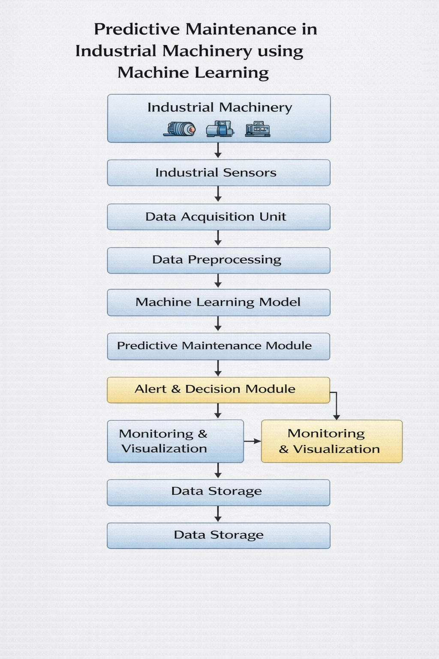
System View Of The Proposed System

Slide 16
Work plan
Phase | Activity
Phase 1 | Problem identification, literature review & requirement analysis
Phase 2 | Sensor selection, data collection & dataset preparation
Phase 3 | Data preprocessing & feature extraction (noise removal, normalization)
Phase 4 | Machine learning model development for failure prediction
Phase 5 | Model training, testing & performance evaluation
Phase 6 | System integration, visualization dashboard & result analysis

