Slide 1

UNIT-1

Slide 2



Slide 3
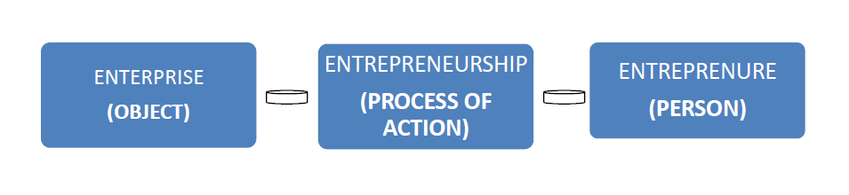
The ENTERPRISE is some business structure/object that usually carries out some commercial activity, creates new job positions, gains some profits.
ENTREPRENEURSHIP is the art of starting a business, basically a startup company offering creative product, process or service.
Simply It is an activity full of creativity.
An entrepreneur perceives everything as a chance and displays bias in taking decision to exploit the chance. An enterprise is created by an entrepreneur. The process of creation is called entrepreneurship

Slide 4

ENTREPRENEUR
The word ‘entrepreneur’ is derived from French word ‘Entrependre’ which means undertaking the risk of enterprise and further it was used to designate an organizer of musical or other entertainments.
Later in 16th century it was used for army leaders.
It was extended to cover civil engineering activities such as construction in 17th century.
But it was Richard Cantillon, an Irishman living in France who first used the term entrepreneur to refer to economic activities.
According to Cantillon “An entrepreneur is a person who buys factor services at certain prices with a view to selling its product at uncertain prices”.

Slide 5
Entrepreneur, according to Cantillon, is a bearer of risk, which is non-insurable.
Schum peter gave a central position to the entrepreneur who believed that an entrepreneur was a dynamic agent of change; that an entrepreneur was a catalyst who transformed increasingly physical, natural and human resources into correspondingly production possibilities.
Since then the term entrepreneur is used in various ways and various views.

Slide 6

Video on Entrepreneurship

Slide 7
Meaning of Entrepreneur
Entrepreneur is a person who tries to create something new, searches new opportunities, bears risk, unites various factors of production like land, labour and capital carries innovations and from his skill and farsightedness faces unforeseen circumstances and thereby earns profits.
Entrepreneurs are the pioneers who are instrumental in the economic development, growth and development of and prosperity of a country.

Slide 8
Definition
There are various views about entrepreneur which are broadly classified into three groups, namely risk bearer, organizer and innovator.
Entrepreneur as Risk Bear :
Richard Cantilon –
Entrepreneur as an agent who buys factors as production at certain prices in order to combine them into a product with a view to selling it at uncertain prices in future.
Illustrated a farmer who pays contractual incomes, which are certain to land owners and labourers and sells at prices that are ‘uncertain’.
Includes, merchants also who make certain payments in expectation of uncertain receipts.
Hence both of them are risk-bearing agents of production.
F.H. Knight
Entrepreneur to be a specialized group of persons who bears uncertainly.
Uncertainty is defined as risk, which cannot be insured against and is incalculable.
He made distinction between certainty and risk.
A risk can be reduced through the insurance principle, where the distribution of outcome in a group of instance is known, whereas uncertainty cannot be calculated

Slide 9
Contd...
Entrepreneur as an Organizer :
J Baptist –
An entrepreneur is one who combines the land of one, the labour of another and capital of yet another, and thus produces a product.
By selling the product in the market, he pays interest on capital, rent on land and wages to laborers and what remains is his/her profit”.
Say made distinction between the role of capitalist as a financer and the entrepreneur as an organizer.
This concept of entrepreneur is associated with the functions of coordination, organization and supervision.
Entrepreneur as an Innovator :
Joseph A. Schumpeter Peter in 1934 assigned a crucial role of ‘innovation’ to the entrepreneur.
He considered economic development as a dynamic change brought by entrepreneur by instituting new combinations of factors of production, i.e. Innovations.

Slide 10
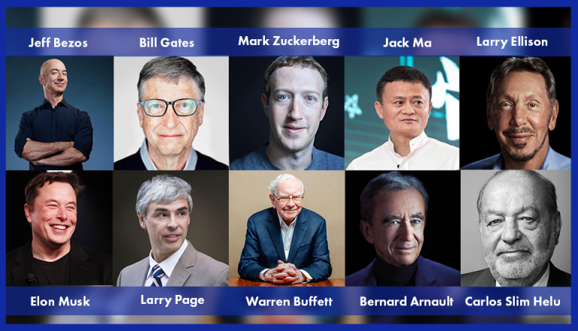
Some of Entrepreneurs
Amazon
Microsoft
Facebook
Alibaba
Oracle
Berkshire Hathaway
LVMH Moet Hennessy Louis Vuitton
Telmex, América Móvil, and Grupo Carso
Tesla
Google

Slide 11
Definitions by different authors
F.A. Walker : “Entrepreneur is one who is endowed with more than average capacities in the task of organizing and coordinating the factors of production, i.e. land, labour capital and enterprises”.
Marx regarded entrepreneur as social parasite.
Gilbraith : “An entrepreneur must accept the challenge and should be willing hard to achieve something”.
Peter F. Drucker - an entrepreneur as one who always searches for change, responds to it and exploits it as an opportunity. Innovation is the basic tool of entrepreneurs, the means by which they exploit change as an opportunity for a different business or service.
E.E. Hagen : “An entrepreneur is an economic man who tries to maximize his profits by innovation, involve problem solving and gets satisfaction from using his capabilities on attacking problems.

Slide 12
6. Mark Casson : “An entrepreneur is a person who specializes in taking judgement decision about the coordination of scarce resources”.
7. Frank Young : entrepreneur as a change agent.
8. Max Weber : “Entrepreneurs are a product of particular social condition in which they are brought up and it is the society which shapes individuals as entrepreneurs”.
9.International Labour Organization (ILO) defines “entrepreneurs as those people who have the ability to see and evaluate business opportunities, together with the necessary resources to take advantage of them and to initiate appropriate action to ensure success”.
10. Akhouri – “Entrepreneur as a character who combines innovativess, readiness to take risk, sensing opportunities, identifying and mobilizing potential resources, concern for excellence and who is persistent in achieving the goal”

Slide 13


Slide 14
Video on valuable lessons

Slide 15

Characteristics of Entrepreneur

Slide 16
CHARACTERISTICS OF ENTREPRENEUR :
Entrepreneur is an agent:
An entrepreneur is perceived as an economic agent who assembles materials for producing goods at a cost that ensures profits and re-accumulation of capital.
Also acts as a change agent who brings about changes in the structure and formation of the organization, market and the arena of goods and services.

Slide 17
2. Entrepreneur is a risk-taker
A risk-taking ability is essential for an entrepreneur.
Without the will to explore the unknown, one cannot discover something unique.
And this uniqueness might make all the difference.
Entrepreneurs have a differentiated approach towards risks.
Good entrepreneurs are always ready to invest their time and money.
But, they always have a backup for every risk they take.

Slide 18

3.Entrepreneur is a profit maker:
An entrepreneur is an individual who establishes and manages the business for the principle purpose of profit and growth.
4. Entrepreneur is an achievement motivator
David C. McClelland has initiated this concept of the entrepreneur by calling him “as per sun with a strong desire for achievement.”
Meredith and others have expressed the same concept while they termed “entrepreneurs are action-oriented, highly’ motivated individuals.”
Therefore, entrepreneurs have to have a deep-rooted need for achieving their goals.

Slide 19
5. Passion:
Work should be your passion. So when you work, you enjoy what you’re doing and stay highly motivated.
Passion acts as a driving force, with which, you are motivated to strive for better.
It also allows you the ability to put in those extra hours in the office which can or may make a difference.
At the beginning of every entrepreneurial venture or any venture, there are hurdles but your passion ensures that you are able to overcome these roadblocks and forge ahead towards your goal.

Slide 20
6. Creativity:
Creativity gives birth to something new.
For without creativity, there is no innovation possible.
Entrepreneurs usually have the knack to pin down a lot of ideas and act on them.
Not necessarily every idea might be a hit.
But the experience obtained is gold.
Creativity helps in coming up with new solutions for the problems at hand and allows one to think of solutions that are out of the box.

Slide 21
7. Professionalism:
Professionalism is a quality which all good entrepreneurs must possess.
An entrepreneurs mannerisms and behavior with their employees and clientele goes a long way in developing the culture of the organization.
8. Knowledge:
Knowledge is the key to success.
An entrepreneur should possess complete knowledge of his niche or industry.
For only with knowledge can a difficulty be solved or a crisis is tackled.
He should know what his strengths & weaknesses are so that they can be worked on and can result in a healthier organization.

Slide 22
9. Open-mindedness towards learning, people, and even failure:
An entrepreneur must be accepting.
The true realization of which scenario or event can be a useful opportunity is necessary.
To recognize such openings, an open-minded attitude is required.
An entrepreneur should be determined.
He should face his losses with a positive attitude and his wins, humbly.
Any good businessman will know not to frown on a defeat.

Slide 23
10. Entrepreneur is a reward receiver:
An entrepreneur is a person who creates something new of value by devoting time and efforts and in turn receives monetary and personal rewards.

Slide 24
Competencies of Entrepreneur
A competence is an underlying characteristics of a person, which results is effective and/or superior performance in a job.
In simple terms, a competence is a combination of body of knowledge, set of skills and cluster of appropriate motives/traits that an individual possesses to perform a given task.

Slide 25
What is Body of Knowledge: Knowledge means collections of information and retention of facts that an individual stores in some parts of his brain.
What is a Skill: Skill is the ability to demonstrate a system and sequence of behaviour that are functionally related to attaining a performance goal.
Motives and Traits: A motive is a recurrent concern for a goal state or condition appearing in fantacy, which drives, directs and selects behaviour of the individual.

Slide 26
Following is a list of major competencies that contribute towards top performance:
Initiative:
All entrepreneur takes action that go beyond job requirements or the demand of the situation.
Does things before being asked or forced by, the events.
Acts to extend the business into new areas, products; or services.

Slide 27
2.Sees and Acts on Opportunities
Looks for and takes action on opportunities.
Sees and acts on opportunities for business, educational or personal growth.
Seizes unusual opportunities to obtain financing, equipment, land, work space or assistance

Slide 28
3.Persistence(Resolution):
Takes repeated action to overcome obstacle that get in the way of reaching goals.
Takes repeated or different actions to overcome obstacles.
Takes action in the face of a significant obstacle.

Slide 29
4. Information Seeking: Takes action on own-to get information to help reach objectives or clarify problems.
Personally undertaking a research or analysis to find out answer of some problem.
Seeking information to clarify what is needed.
Using contacts& networks to obtain desired information.

Slide 30
5. Concern for High Quality of Work: Do things that meet or beat existing standards of excellence.
Stating a desire to produce work of high quality.
Compares own work or own company's work favourably to that of others.

Slide 31
6. Commitment to Work Contract: Places the highest priority on getting a job completed.
Makes a personal sacrifice or expends extraordinary effort to complete a job.
Accepts full responsibility for problems in completing a job for others.
Expressing utmost concern for the customers.

Slide 32
7. Efficiency Orientation:
Finds ways to do things faster or with fewer resources or at a lower cost.
Looks for or finds ways to do things faster or at less cost.
Uses information or business tools in improve efficiency.
Expresses concern about costs vs. benefits of some improvement, change, or course of action.

Slide 33
8. Systematic Planning
Develops and uses logical, step-by-step plans to reach goals.
Plans by breaking a large task down into sub-tasks.
Develops plans that anticipate obstacles.
Evaluates alternatives.
Takes a logical and systematic approach to activities.

Slide 34
9.Problem Solving:
Identifies new and potentially unique ideas to reach goals.
Switches to an alternative strategy to reach a goal.
Generates new ideas. or innovative solutions.
10. Self-Confidence:
Has a strong belief in self and own abilities.
Expresses confidence in own ability to complete a task or meet a challenge.
Sticks with own judgement in the face or opposition or early lack of success.
Does something that he says is risky

Slide 35
11.Use of Influence Strategies:
Uses of variety of strategies to affect others.
Acts to develop business contacts.
Uses influential people as agents to accomplish own objectives.
Selectively limits the information given to other.
12. Monitoring
Develops or uses procedures to ensure that work is completed or that work gets standards or quality.
Personally supervises all aspects of a project
13. Concern for Employee Welfare:
Takes action to improve the welfare of employees.
Takes positive action in response to employees' personal concerns.
Expresses concern about the welfare of employees.

Slide 36
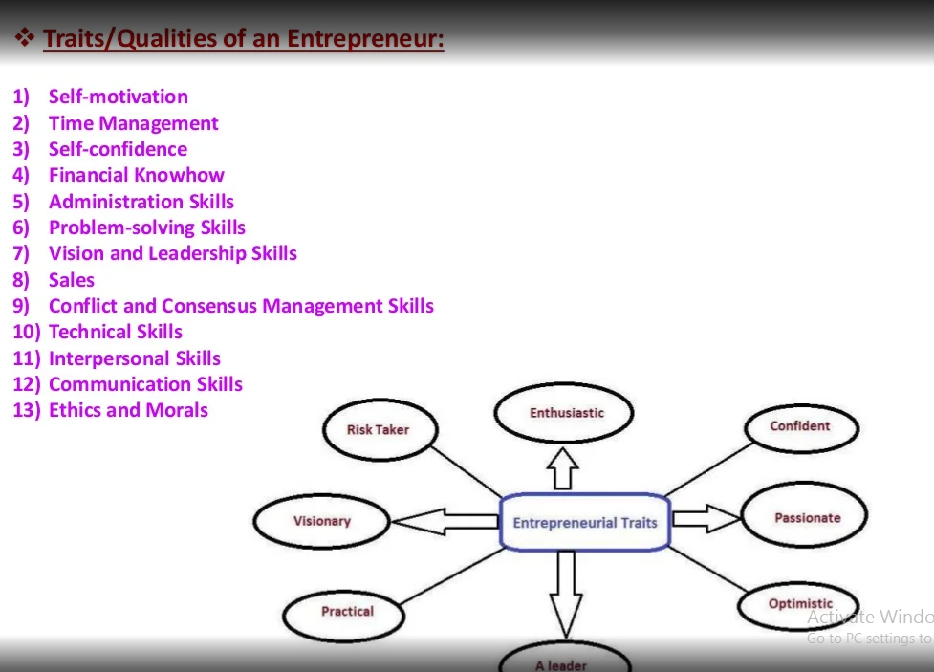

Slide 37
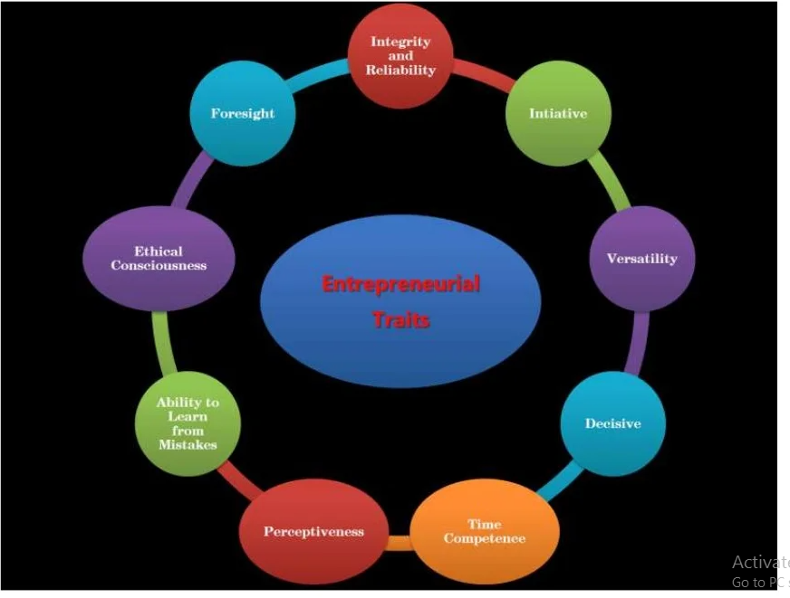
Entrepreneurial traits/Qualities

Slide 38
Everybody has their own path to success. There are a few common traits and characteristics that all successful entrepreneurs have in common.
Vision: Successful entrepreneurs have a clear vision of what their business will be and can concisely articulate its purpose, goals and market position.
They have identified (and can succinctly describe) the who, what, where, when and why of their business.
Passion: A successful entrepreneur is passionate about their business. It is hard work, and putting in long hours will be tough if you don’t love what you are doing.
People with passion know what it is that drives them to keep working to achieve their vision.

Slide 39
Resolve: Entrepreneurs remain tough when the going gets rough. They don’t give up easily.
They can accept rejection and are willing to learn from their mistakes.
They are willing and able to adapt and modify their plan in order to be successful the next time around.
Willingness to work hard: Being an entrepreneur is harder than being an employee.
To be successful, the entrepreneur must be willing to put in the time and effort required, often for little or no pay at the beginning.
Successful entrepreneurs recognize the risk and necessary work that achieving their goals will entail.

Slide 40
5. Confidence: Successful entrepreneurs have confidence in themselves and in their business. They must believe in their ability and in their idea.
Every entrepreneur will face rejection along the way and successful entrepreneurs are those with the confidence to keep going and bounce back after a setback.
6. Flexibility: Things do not always go as planned. A successful entrepreneur is flexible.
They learn from their mistakes and are willing to adapt and change as they go along. They take advice from others and are open to trying new approaches

Slide 41
7. Can sell: An entrepreneur must be comfortable selling. Even with a sales team, the leader must be an expert at networking and be able to promote themselves and their business to bankers, customers, suppliers and staff.
8. Careful with money: Successful entrepreneurs are good money managers. They prudently invest in overhead and always keep track of the money and manage their cash flow.

Slide 42
9. Willing to ask for and accept help: An entrepreneur needs to be a jack of all trades but the most successful entrepreneurs know their limitations, realize they can’t do everything and are willing to delegate to others.
They are willing to ask for help. They seek out and pay for expert advice when needed.
10. Risk taking: No matter how successful your business, there will be bumps along the road. A successful entrepreneur is resilient and can bounce back from a setback.
They use setbacks as an opportunity to learn and grow. They understand that failure is part of the game.

Slide 43
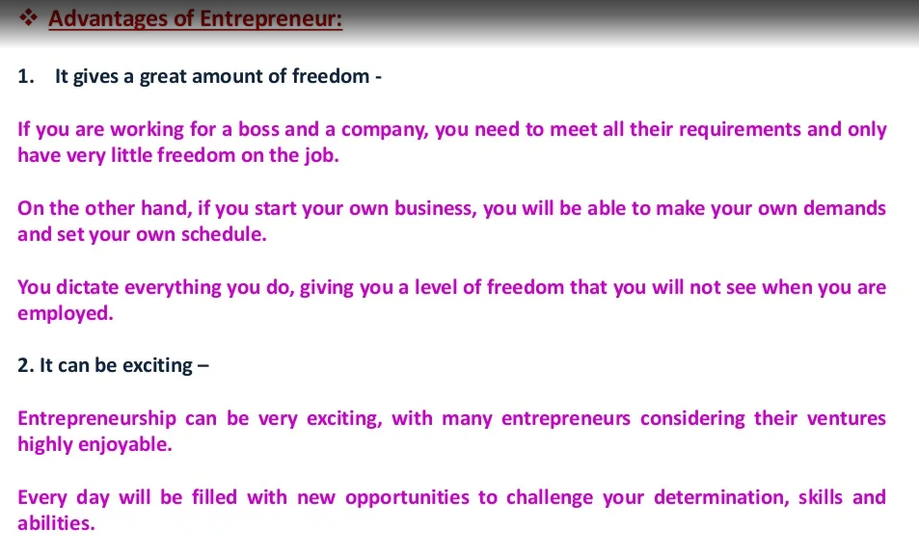
Advantages of Entrepreneur

Slide 44
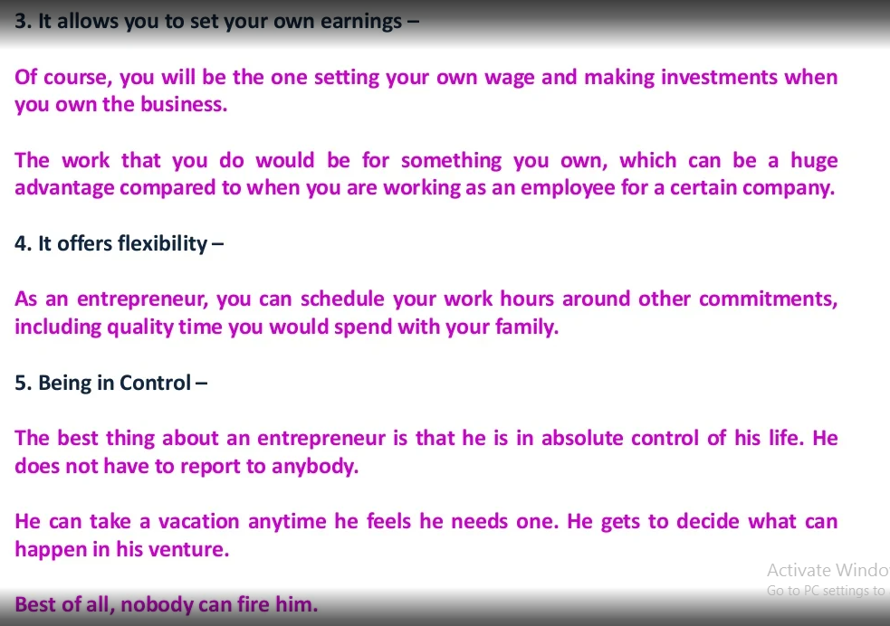

Slide 45
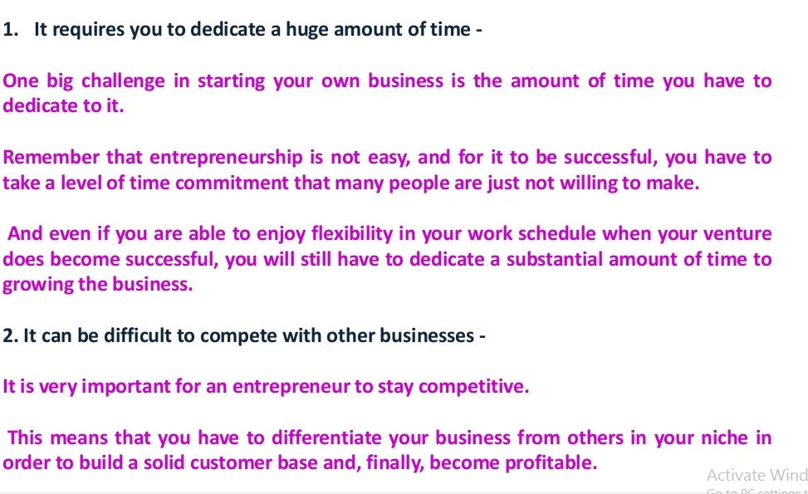
Disadvantages of Entrepreneur

Slide 46
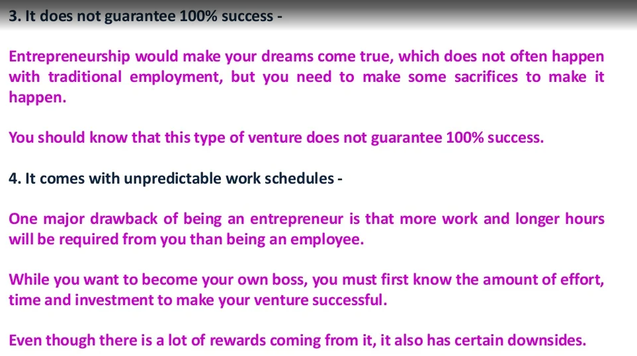

Slide 47
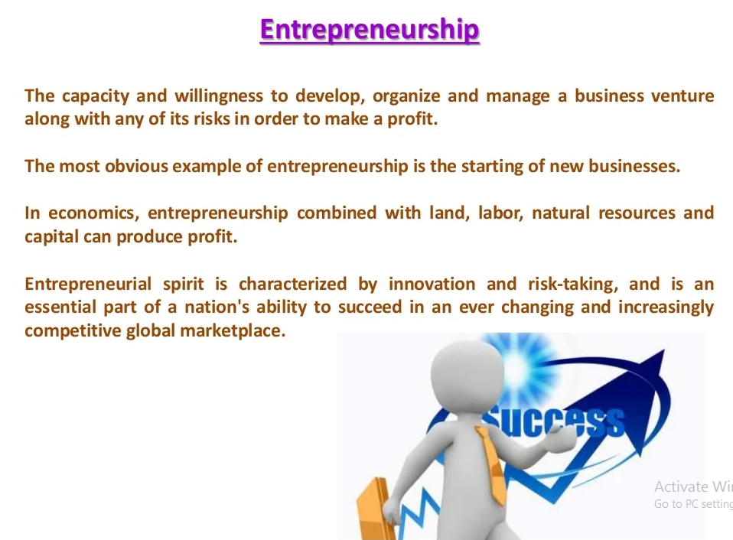

Slide 48
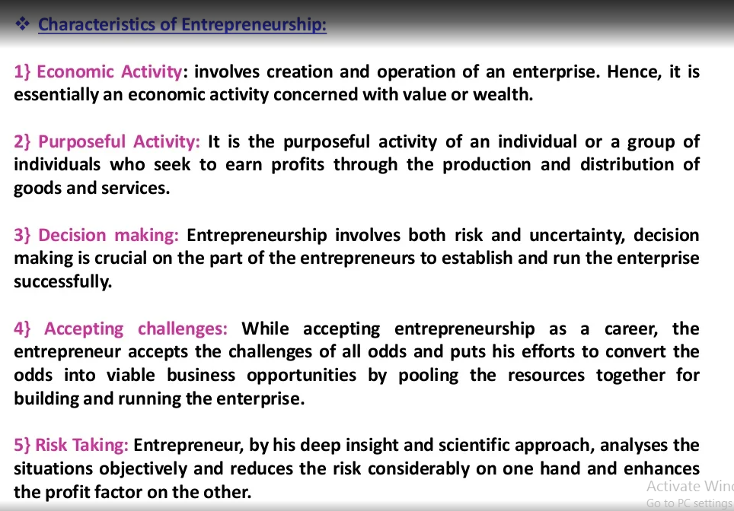

Slide 49
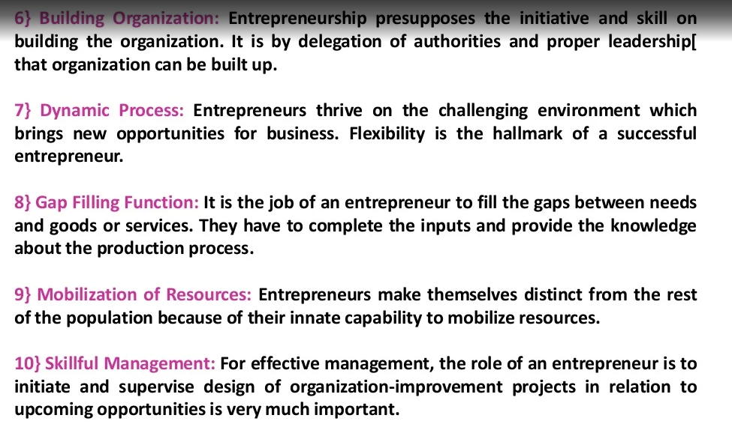

Slide 50
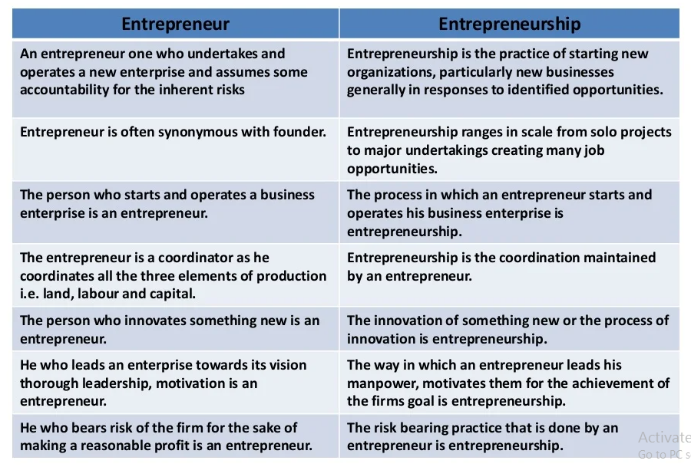
Difference between Entrepreneur and Entrepreneurship

Slide 51
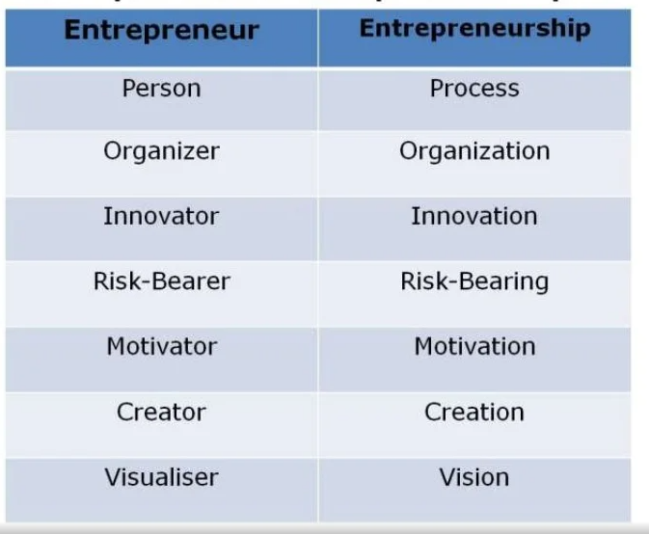
Relation ship between Entrepreneur and Entrepreneurship

Slide 52
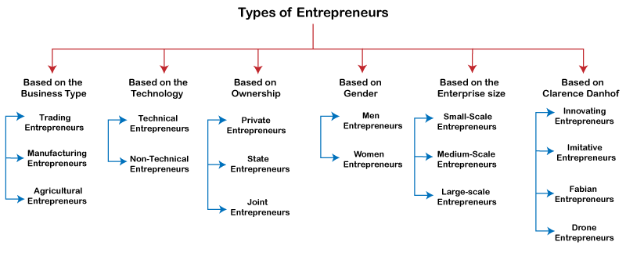
Classification of Entrepreneurs

Slide 53
Based on the Business Type
Trading Entrepreneur: A trading entrepreneur refers to a person who undertakes business-related activities. These types of entrepreneurs usually buy finished products in bulk from manufacturers at some discount. They then sell these products directly or with the help of retailers or vendors with profits. A business entrepreneur usually acts as a middleman between manufacturers and customers. This may include wholesalers, retailers, dealers, etc.
Manufacturing Entrepreneur: The founder of a business to manufacture products is known as a manufacturing entrepreneur. Manufacturing entrepreneurs analyze market needs or customer needs and manufacture products to meet such requirements of customer using various resources or technologies.
Agricultural Entrepreneur: Agricultural entrepreneurs refer to the types of entrepreneurs who primarily do agricultural work. They participate in a wide range of agricultural activities such as farming, irrigation, agricultural produce, mechanization, technology, etc.

Slide 54
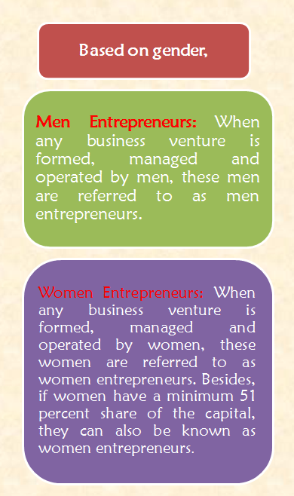
Based on Ownership
Private Entrepreneur: When an entrepreneur starts something personal of his or her own, such as setting up an enterprise, he/she is called a private entrepreneur. A private entrepreneur is the only person who plays the sole proprietor role for a business venture and bears the risk associated with it.
State Entrepreneur: When a state or government does a business or industrial undertaking, it is referred to as a 'state entrepreneur'. In this case, the government is the sole owner of the enterprise and will bear all the profits and losses involved with it.
Joint Entrepreneurs: When a business or industrial undertaking is established and operated jointly by the private entrepreneur and the government, it is called joint entrepreneurship. The parties involved are called joint entrepreneurs. In this case, risk and profits are shared by both parties. However, the sharing percentages generally depend on the type of business and the agreement between the two parties.

Slide 55
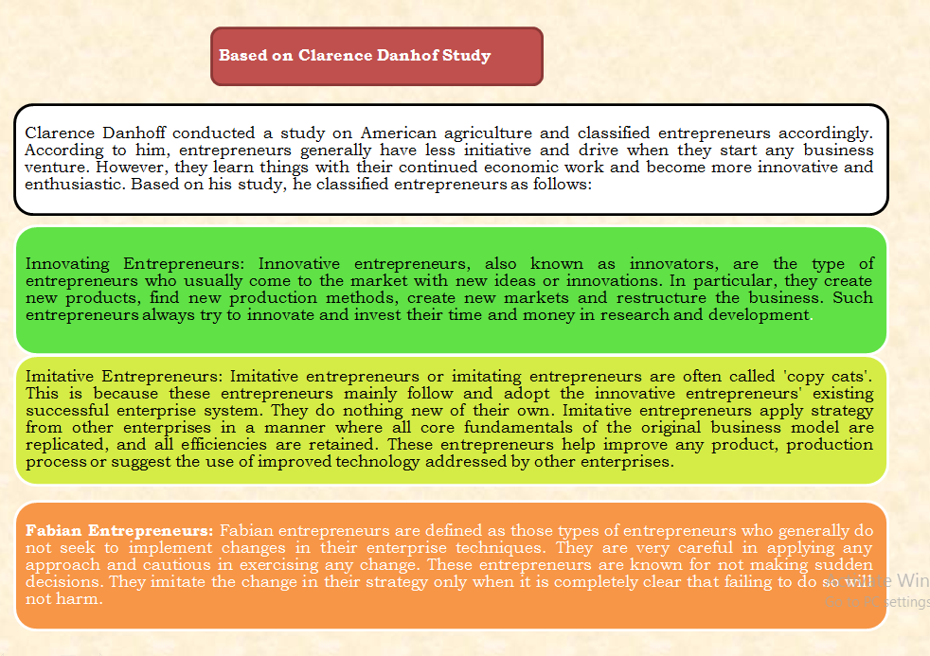
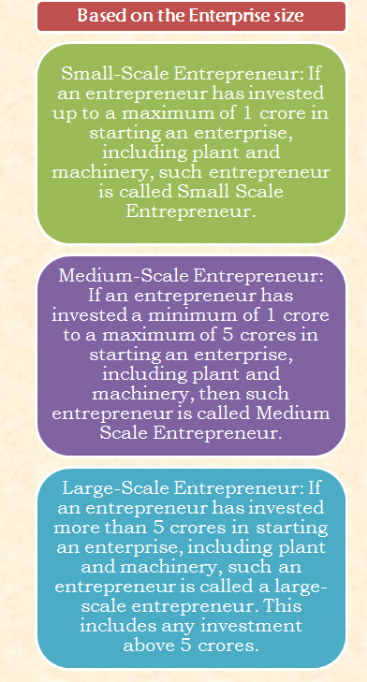

Slide 56
Other Types of Entrepreneurs
Solo Operators: Solo operators include those types of entrepreneurs who start their work primarily alone. However, these entrepreneurs employ few employees if they require. It is the most common type of entrepreneur, and most people start their ventures like solo operators.
Active Partners: Active partners include entrepreneurs who jointly start their ventures. This may include two or more people. However, each person should have equal participation in the operation of the business. Besides, when the entrepreneurs support only with the money but do not actively participate in the business's operation, they are just called 'partners'.
Inventors: Inventors include entrepreneurs who work effectively and invent new products, using their ability and inventiveness. These entrepreneurs are generally primarily interested in innovative strategies.
Challengers: Challengers include entrepreneurs who seek new challenges in enterprise ventures, including manufacturing, distribution, and marketing. Once they achieve their set challenge, they begin to set and acquire new challenges.
Buyers: Buyers include entrepreneurs who do not like to take too much risk in completely new business establishments. These entrepreneurs mainly purchase on-going enterprises by paying a decent amount and start their operations. This ultimately reduces the risk of establishing a new enterprise as the existing enterprise typically has better business value and customer reach.
Life-Timers: Life-timers includes entrepreneurs who consider enterprises as an integral part of their lives. In particular, these entrepreneurs mainly learn skills from their elders and continue to operate family ventures further. These entrepreneurs usually consider their enterprises a family tradition.

Slide 57
Functions of Entrepreneurs
In practice, an entrepreneur does perform all the functions necessary right from the genesis of a business idea up to the establishment of an enterprise.
According to Peter Kilby(1971), there are 13 functions to be performed by the entrepreneur to establish and run his/her enterprise.

Slide 58
Perception of market opportunities
Gaining command over scarce resources
Purchasing inputs.
Marketing the products
Dealing with officials
Managing human resources within the enterprise.
Managing customer and supplier relations
Managing finance
Managing Production
Acquiring and overseeing assembly of the factory.
Industrial Engineering
Upgrading process and product
Introducing the new product techniques and products.

Slide 59
All these functions can be listed in the following sequential order
Business idea generation and selection of the best suitable business idea.
Determination of the business objectives.
Product analysis and market research
Determination of the form of owner ship/organization
Completion of promotional formalities
Raising necessary funds
Procuring machine and material
Recruitment of men
Undertaking the business operations.

Slide 60
1. Taking Initiative
Entrepreneurship is a pro-active activity that takes such actions, which others can’t even perceive.
This unique function of entrepreneurship provides our civilization with a wide variety of products, ways of actions, production techniques, etc.
Therefore, taking initiative with such end and qualification is the prime function of entrepreneurship in every economy.

Slide 61
2. Organizing Resources:
Organizing entails identifying those resources that are required to transform a particular idea into reality. The resources include human and nonhuman resources.
Organizing in entrepreneurship will increase productivity, promote new ventures, distribute and supervise work and responsibility, and will remove barriers to work.

Slide 62
3. Identifying Opportunities and Prospects:
Entrepreneurship searches those activities of value that have an economic and social contribution.
It identifies new opportunities in the socio-economic arena which have got profitable prospects therefore, entrepreneurs are called searchers of hopes into blind spots and this function enormously indebted our society to entrepreneurship

Slide 63
4. Risk-Taking
Entrepreneurship takes the risk for the new venture.
For innovative actions in the field of production technology for new products in a volatile market and new raw materials used in production.
Moreover, it also takes the risk for theft, robbery, snatching market fall and hooliganism that may be involved with new entrepreneurship This is a major function of entrepreneurship in developing countries.

Slide 64
5. Decision Making:
Entrepreneurship is a new initiative therefore, it has to decide multivariate issues that affect new ventures.
Entrepreneurship has to decide upon equipment to be used quality, price and its variation, deficiency, capital structure, the feasibility of the project, organizational structure, philosophy of management, etc. that will guide, run and prosper the new venture or distinct attempt for entrepreneurship.

Slide 65
6. Technology Transfer and Adaptation
Entrepreneurship throughout the world brings invented technology from different comers of the world and makes it appropriate by making required adjustments for local conditions.
This function of entrepreneurship involves identifying appropriate technology with market potentials and adapts it into the local environment.
Sometimes, the technology uses indigenous materials that reduce cost and wastage of resources. This entrepreneurial function virtually makes the world united in terms of homogeneous technology.

Slide 66
7. Innovation:
Entrepreneurship innovates a new production process or technology, market, sources of new materials, management, strategy or technique, investment opportunity, etc. that Schumpeter (1934) calls as the fundamental characteristics of entrepreneurship.
Under the context of the changing environment, the entrepreneur locates the most feasible opportunity for the venture as well as improved or distinct technology that gives competitive advantages or a new opportunity to prosperity.

Slide 67
8. Fostering Autonomy:
Entrepreneurship is an exposure of creative faculty that provides personal satisfaction and independence. The unique freedom to think differently is the impetus for entrepreneurship.
Thus, entrepreneurship Fosters autonomy to advent something new of value by the application of devoted efforts and time.

Slide 68
9. Social Responsibility
Entrepreneurship with its innovative technology somehow promotes human efforts. It restarts closed industries with innovative managerial strategies and techniques
It also motivates new entrepreneurs and attracts them to engage into an entrepreneurial venture.
Entrepreneurship provides new products or ideas that give momentum and diversity into society.
Therefore, entrepreneurship performs social responsibility that protects the welfare, benefit and economic gain of the society. It also promotes the community standard by providing jobs and amenities.

Slide 69
10. Public Relations:
Entrepreneurship is a new venture that requires social acceptance by the regulatory bodies and the public at large. The government, as well as the persons’ who will be subject to entrepreneurship, would be convinced through public relations to accept and to allow the entrepreneur to execute an entrepreneurial venture.
History tells that many entrepreneurs were disregarded, coerced and even eliminated for their entrepreneurial activities. Failure is costly and therefore, public relation is a significant function of entrepreneurship.

Slide 70
11. Experience Sharing
Entrepreneurship may spread in society through publishing and sharing its success stories.
Thus, entrepreneurship holds workshops, industrial visits through which the entrepreneurial experience in different counties may be shared with a widespread adaptation of success.
This function will benefit the economies of the countries as well as the world bodies

Slide 71
12. Managerial Roles
Entrepreneurs perform several managerial roles to keep their venture functioning with success.
The roles are interpersonal roles that consist of a figurehead role, leadership role, and liaison role; informational roles that include recipient role, disseminator role, and the spokesperson role; decisional roles that consist of an entrepreneurial role, disturbance-handler role, resource allocator role, and the negotiator role.

Slide 72
13. Balanced Economic Development
Sustainable economic development requires a balanced development among various regions and sectors of a country.
Every country tries to ensure such a situation that makes industrialization throughout the country “possible.
Entrepreneurs make it possible by establishing business ventures in various parts of the country in various sectors of the industry.

Slide 73
Entrepreneurial Functions
Managerial Functions
Promotional Functions
Commercial Functions
The various functions performed by entrepreneur are classified as

