Slide 1


Visvesvaraya technological university - belagavi
DEPARTMENT OF STUDIES IN ELECTRONICS AND COMMUNICATION ENGINEERING UNIVERSITY B.D.T COLLEGE OF ENGINEERING DAVANGERE 577004
Under the guidance of :
Dr. Ravindra P Rajput (Chairman, Professor)
NINGARAJA D B 4UB20EC038
POOJA MAYACHARI 4UB20EC039
PRADEEP G NAIK 4UB20EC040
PRAJWAL P 4UB20EC041

Slide 2
Mini-Project Title:
“Weather Report Monitoring System Using IOT”

Slide 3
CONTENTs →
Introduction.
What is weather monitoring system?
Components & Description
Block Diagram & Circuit Diagram
Working of the system
Advantages &Application
Conclusion & Future Scope

Slide 4
Introduction →
Welcome to the presentation on “Weather Repoart Monitoring System Using IOT”.
This presentation will provide an overview of the Weather Repoart Monitoring System and demonstrate how NodeMCU can be used to implement it.

Slide 5
About weather monitoring system →
Keeping Track of weather is a very critical operation.
A constant coordination is required between both teams to collect.
This data is viewed by normal public to plan their day, ships and sea route planning, fishing department, disaster relief department and more.

Slide 6
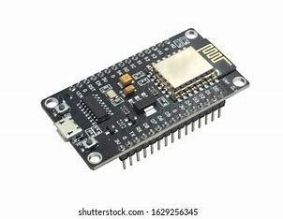
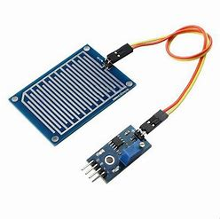
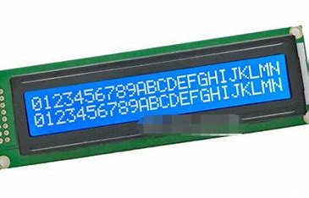
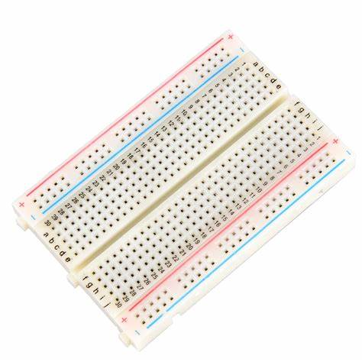
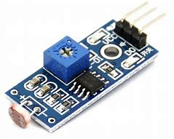
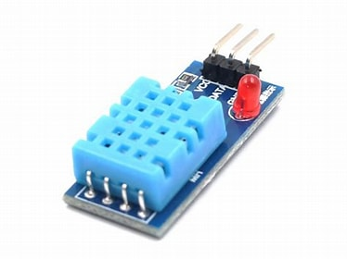
Components & Description →
NodeMCU ESP8266 board
Rain Sensor
LCD Display
LDR sensor
DHT11 sensor(Temperature & Humidity Sensor)
Breadboard

Slide 7
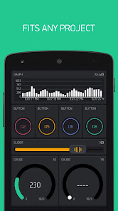
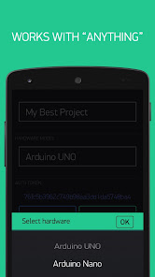
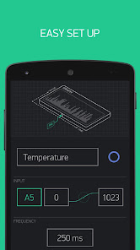
Blynk application displaying result →
Blynk is a platform that allows you to build mobile applications for controlling and monitoring your hardware projects.
It provides a drag-and-drop interface that enables you to create a user interface for your IoT (Internet of Things) projects without the need for extensive programming knowledge.
The platform supports a wide range of hardware devices and development boards, including Arduino, Raspberry Pi, ESP8266, and more.

Slide 8
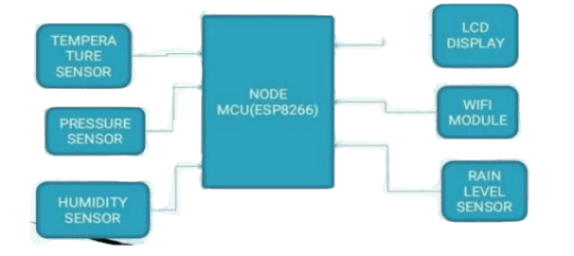
Block diagram
Fig: Block Diagram NodeMCU

Slide 9
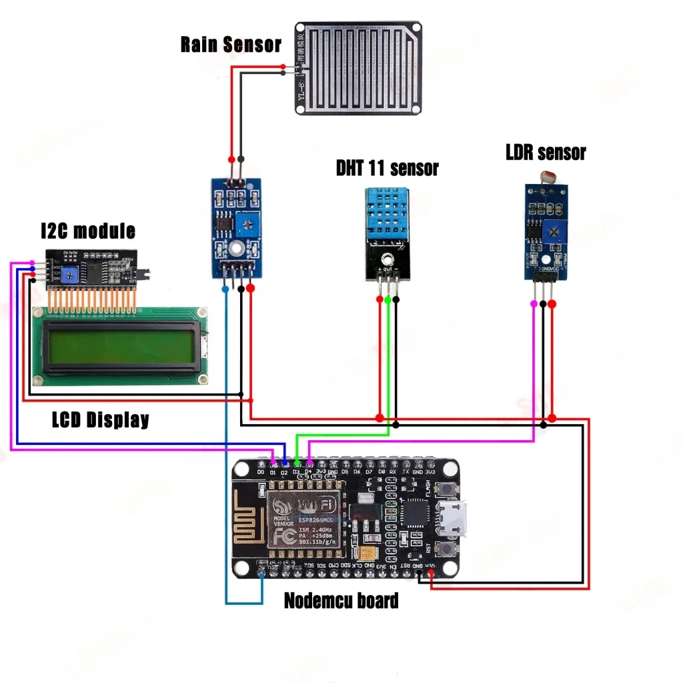
Circuit diagram
Fig: Circuit Diagram

Slide 10
Working of the system →
When power up this system. the NodeMCU board connects to the Blynk app through the Blynk cloud.
Also, it receives values through sensors. Then, the NodeMCU board sends those values to the Blynk app and the LCD display.
Due to this process sensor values can be seen on the Blynk app interface and on the LCD.

Slide 11
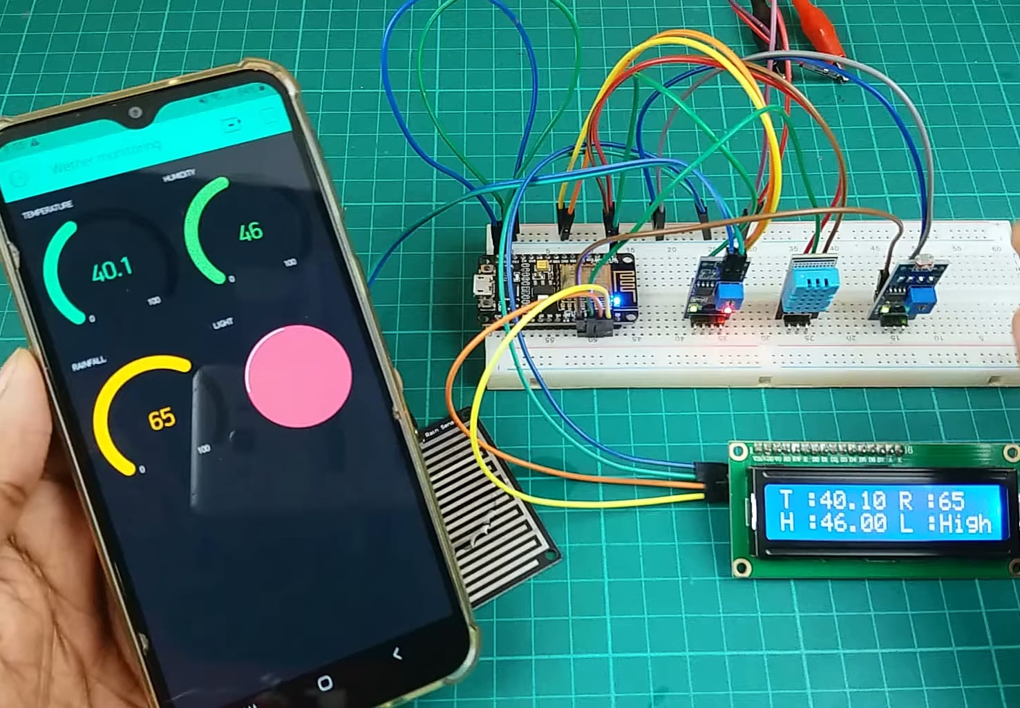
OUTPUT →
Program and Algorithm

Slide 12
Advantages:
Instant data Capture from Sensors
Data Transmission over IOT For Display
Less power consumption
Accuracy is High
Smart way to monitor Environment
The low cost and efforts are less in this system

Slide 13
Application →
Public Safety
Agriculture
Aviation
Energy Sector
Urban Planning
Tourism and Recreation

Slide 14
Conclusion →
Smart environment.
The smart way to monitor the environment an efficient, low-cost embedded system is presented in this paper.
This model can be expanded to monitor the developing cities and industrial zones for pollution monitoring.
To protect the public health from pollution, this model provides an efficient and low-cost solution for continuous monitoring of environment.

Slide 15
Future Scope →
One can implement a few more sensors and connect it to the satellite as a global feature of this system.
Adding more sensors to monitor other environmental parameters such as CO2, Pressure and Oxygen Sensor.
In aircraft, navigation and the military there is a great scope of this real-time system.
It can also be implemented in hospitals or medical institutes for the research & study in “Effect of Weather on Health and Diseases”, hence to provide better precaution alerts.

Slide 16
THANK YOU…….

