Slide 1

Siddaganga Institute of Technology Affiliated to Visveswaraya Technology University, Belagavi
PROJECT TITLE: LIFE SAVER APP
Under the Guidance of:
Bandenawaz Bagwan

Slide 2

PROJECT MEMBERS: ADITYA T R (ISE) KISHAN S RAO (ISE) SANATH S PAI (ISE) SHIVKUMAR (CSE) SIDDESH M G (CSE)
LIFE SAVER APP

Slide 3
CONTENTS
Abstract.
Introduction.
Objective.
Tools used.
Usage of particular tool in the App.
Further Implementations.
Applications.
Conclusion.

Slide 4
ABSTRACT
More often we come across the emergency situations
where we are in need of immediate help, but due to
network problems one may not be able to communicate
regarding what to do at that situation.
In this application we are providing help to the user by
Both online and offline modes.

Slide 5
INTRODUCTION
LIFE SAVER APP
ONLINE MODE
OFFLINE MODE
APP

Slide 6
OBJECTIVE
The main objective of the app is to provide instant
help to the user in case of emergency by providing
both online and offline support. And to provide the
instant messaging and calling option for the user In
one click.

Slide 7

TOOLS USED IN THE APPLICATION
Fire Base.
Expandable List View.
Search Tool Bar.
Card View.
Recycler View.
Navigation drawer.
Web View (online mode).

Slide 8
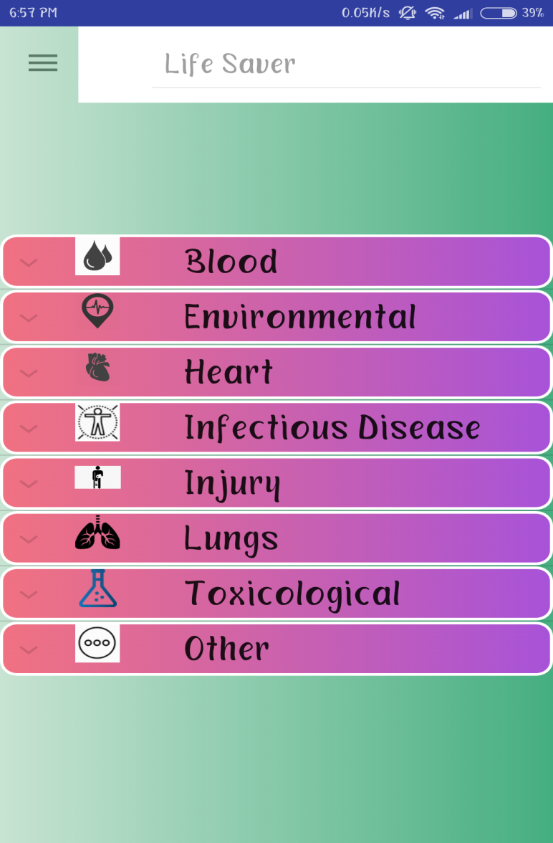
EXPANDABLE LIST VIEW
By using expandable list view
the user can select the situation
required.
It has two fields:
1.Header -
a.Internal health issues
b.external conditions
2.Child -
contains fields with respect to header

Slide 9
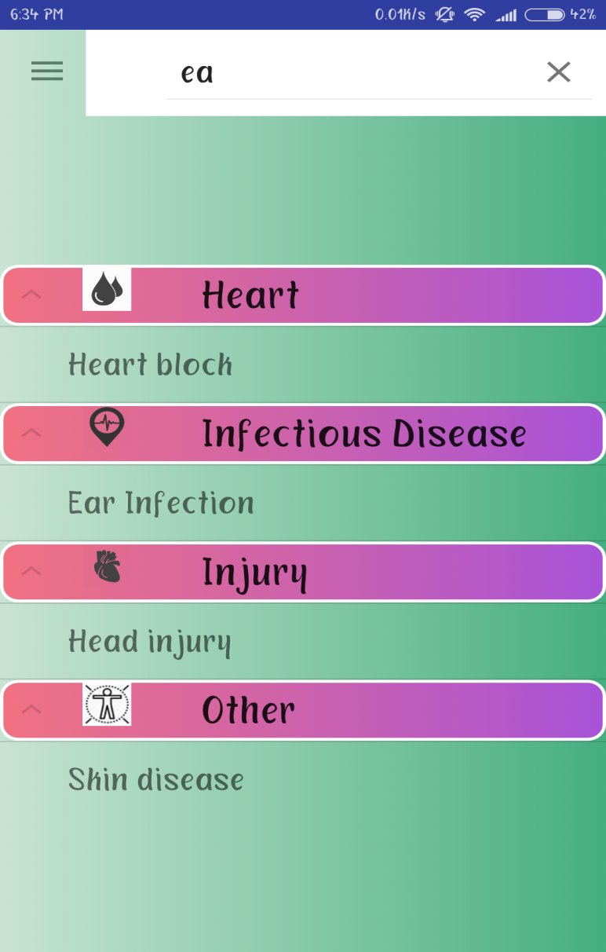
SEARCH BAR
Search tool bar is added
above expandable list view.
Search Bar helps user to
select one among many
fields in child field in
expandable list view.

Slide 10
APP VIEW
1.Recycler View.
2.Card View.
Recycler View will be implemented in the app to make the app user friendly.
Card view will be implemented to provide DO’S and DONT’S for selected field by the user.

Slide 11
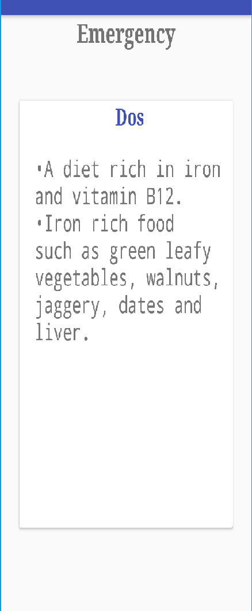
APP VIEW(contd…..)
Recycler View will be implemented in the app to make the app user friendly.
Card view will be implemented to provide DO’S and DONT’S for selected field by the user.

Slide 12
FIRE BASE (REAL TIME DATA BASE AND AUTH)
Emergency number added by user is stored in real time data base.
The login info is also stored in database

Slide 13
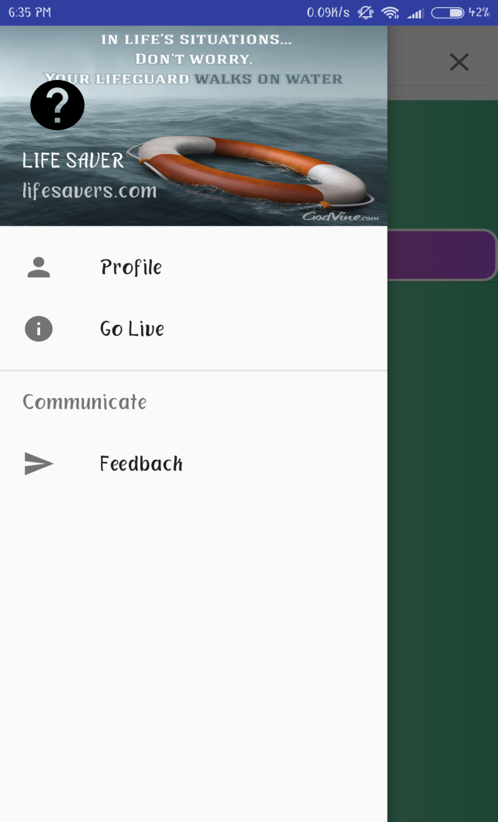
Navigation drawer activity
Navigation drawer activity: It contains three fields
Profile : contains user information
Go live : network auth is added works in online mode
Feedback : User can add feedback after using the app.

Slide 14
Emergency Button
Emergency button: An Emergency button is added
so that in case of emergency user can press the
button through which a phone call and a message
be sent to a person which is given by user
Message sent also contains coordinates of users location.

Slide 15
APPLICATIONS
It is very useful application for a person who
is in emergency and also for the people to get
information and remedies about the disease they
are suffering from.

Slide 16
CONCLUSION
The application is user friendly.
Provide help in the emergency situations.
Instant sending of co-ordinates helps to track the person in emergency.

Slide 17

THANK YOU

