Slide 1
Customer Support Analytics
Data Warehouse Pipeline
Raw → Staging → Dimensions → Fact Table → Insights
200
150
40
4
Cases
Customers
Agents
Regions

Slide 2
The Data We Started With
cases.csv
customers.csv
agents.csv
200 rows
150 rows
40 rows
— case_id — unique ticket ID
— customer_id — unique ID
— agent_id — unique ID
— created_at — when ticket was opened
— customer_name
— agent_name
— closed_at — empty for open tickets
— region — APAC / LATAM / Europe / NA
— team — Billing / Tier 1 / Tier 2 / Escalations
— customer_id / agent_id
— signup_date
— category · priority · status
All three files loaded exactly as received into the Raw layer — all strings, no transformations.

Slide 3
Step 1 — Profile Before You Design
What we found before writing a single line of SQL
9
123
39
0
Closed — no
closed timestamp
Open/On-Hold/In-Progress
with closed date
NULL closed date
Open / On Hold
Orphan customer
or agent joins
HIGH
MED
OK
OK
Flag it. Set resolution
time = NULL. Never delete.
Status and timestamp
disagree. Flag both.
Expected behaviour.
No flag needed.
Clean today. Check
still runs every load.
Key findings from profiling
— Status split: On Hold (57) · Open (50) · Closed (47) · In Progress (46)
— Average resolution time for Closed cases: ~97 hours — about 4 days
— High priority resolves faster (54h avg) than Low priority (126h avg) — counterintuitive finding
— Decision: flag bad rows, never delete — you need the audit trail to fix the upstream system

Slide 4
Step 2 — Data Model · Why Star Schema?
dim_date
date_key · month · quarter · year
dim_customer
fact_cases
dim_agent
sk_customer · name
region · signup_date
grain = 1 row per case
sk_agent · agent_name
team
200 rows
Why Star Schema — not 3NF or Data Vault?
Star Schema ✓
Read-heavy analytics · one source system · BI tools optimised natively for it
3NF
Designed for OLTP write-heavy workloads — wrong fit for analytics reporting
Data Vault
Justified at 10+ sources with frequent schema changes — overkill for this project

Slide 5
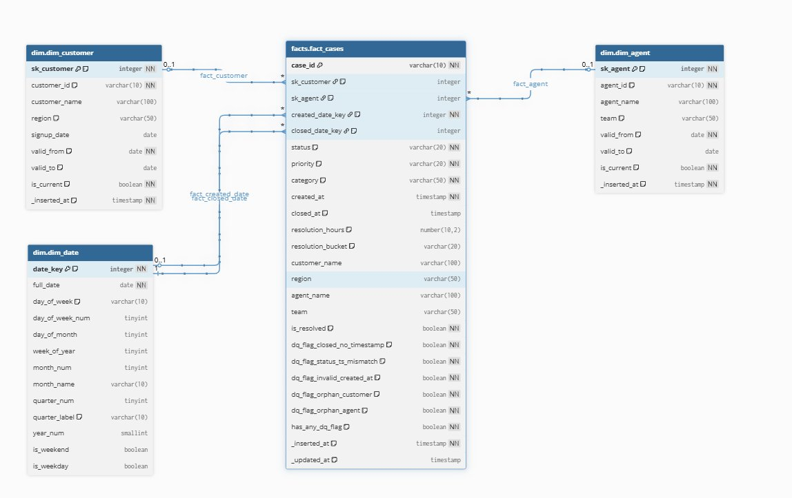
Data Model — Entity Relationship Diagram

Slide 6
Step 3 — The 4-Layer Architecture
01
02
03
04
Raw
Staging
Dimensions
Fact Table
Land every CSV row exactly
as received. All strings,
no transformations.
Parse types, normalise values,
compute resolution time,
raise all 5 DQ flags.
Clean lookup tables for
customer, agent and date.
Surrogate keys + SCD2 ready.
One row per case.
All metrics + context
already joined in.
→
→
→
Why
Why
Why
Why
Replay from here
if anything breaks.
All business logic
in one place.
Stable joins even
if source IDs change.
Zero joins for
most BI queries.
Each layer has one job. Change a rule in staging and everything downstream picks it up automatically.

Slide 7
Step 4 — Pipeline Execution Order
1
COPY INTO raw tables
4
INSERT dim_customer + agent
CSV → internal stage → raw
All VARCHAR — never fail on load
_source_file tracks every row
NOT EXISTS guard — safe to rerun
SCD2 columns ready for production
Surrogate keys auto-generated
2
MERGE stg_customers + agents
5
MERGE facts.fact_cases
Customers first, agents second
Both needed before cases MERGE
to check for orphan records
Join to dims (is_current = TRUE)
Update only if something changed
DQ rows included, flagged
3
MERGE stg_cases
6
Post-load validation
Parse timestamps with TRY_
Compute resolution time + bucket
Raise all 5 DQ flags here
6 checks: row count, DQ %,
negative hours, orphans,
resolution sanity by priority
MERGE everywhere — not INSERT. Idempotent: safe to rerun after any failure without creating duplicates.

Slide 8
Step 5 — Data Quality Checks
5 DQ flags in the fact table
dq_flag_closed_no_timestamp
Closed status but no closed_at date
9 rows
dq_flag_status_ts_mismatch
Open/On-Hold/In-Progress but has a closed_at
123 rows
dq_flag_invalid_created_at
created_at string could not be parsed
0 rows
dq_flag_orphan_customer
customer_id not found in dim_customer
0 rows
dq_flag_orphan_agent
agent_id not found in dim_agent
0 rows
has_any_dq_flag
Summary boolean — KPI queries filter WHERE has_any_dq_flag = FALSE
6 validation checks after every load
— Row count > 0 — catches a complete pipeline failure or empty file
— Closed cases with NULL resolution — measures the 9 upstream bug rows
— DQ flag % — alert if percentage increases significantly between runs
— NULL sk_customer / sk_agent — orphan surrogate keys should be zero
— No negative resolution hours — catches time-travel bugs
— Avg resolution by priority — sanity check the numbers make sense

Slide 9
Key Insights — What the Data Says
96.8h
53.7h
60.9h
130h
Overall avg resolution
High priority avg
Tier 2 avg (best)
Tier 1 avg (slowest)
Avg resolution hours by priority · clean closed cases only
Region breakdown
High
53.7h
LATAM
62
23% closed — lowest
Urgent
94.8h
North America
49
Europe
47
Medium
113.5h
APAC
42
Low
126.3h
Team performance
Urgent cases (95h) resolve slower than High (54h) — the Urgent queue may be under-resourced.
Tier 2
60.9h
Billing
107.5h
Escalations
121.8h
Tier 1
130.1h

Slide 10
Taking This to Production
Scale
Orchestration
— Partition fact table by created date (monthly)
— Fixed execution order — cannot be swapped
— Incremental MERGE — new/updated rows only
— Customers + agents load before cases
— Cloud DW auto-scales compute by load
— Dimensions must load before fact table
— Clustering on date key for fast range queries
— Alert on first failure — never proceed blind
Schema changes
Monitoring
— New column → add as NULLABLE to raw first
— Row count check after every load
— Cascade: staging → dimensions → fact
— DQ flag % > 5% → alert before dashboard refreshes
— SCD2 columns already on dim tables
— Negative resolution hours → immediate alert
— Never drop a column without deprecation window
— 6 validation queries run as automated tests

Slide 11
What we delivered
One fact table.
Every question answered.
No joins at query time.
Resolution time · case volume · agent performance · regional trends — all single-table queries
Data quality is transparent — 5 flags, dirty rows visible, never silently dropped or deleted
Architecture is layered — each component changes independently without touching the others
SCD2 columns already in place — no DDL change needed when production requirements arrive
Happy to go deep on any part of this.

