Slide 1
Predicting Ethylene Concentration Using Ml
Project Guide:
Mr Vorem Kishore
Assistant Professor
Dept. of CSE(aiml & iot)
VNRVJIET
Batch - 09
Presented by:
Jejjari Vinay (22071A1021)
Kammari Shiva Sai (22071A1022)
Kasam Manjunadh (22071A1024)
Kommina Rohitha (22071A1027)

Slide 2
Agenda
Abstract
Summary of Literature Review
Proposed System
System Architecture
System Requirements
Modules
Work Flow Diagram
Status of Project Work

Slide 3
Abstract
This project aims to develop a machine learning model to predict ethylene gas concentration from TGS sensor data.
It enhances early warning systems for safety in industrial, agricultural, and manufacturing environments.
The system aims to provide a low-latency model for real-time applications.

Slide 4
Summary of Literature Review
Gas Leaks, Especially Gases Like Ethylene are more prominent and dangerous.
Ethylene is hard to detect as it’s colourless and odourless
There are many methods and instruments to detect ethylene gas, but are sophisticated and expensive.
Detection of ethylene gas in lower concentrations is a challenge.
Solutions which use MQ Gas Sensors exist, but are more generalised and not tailored to specific gas detection.

Slide 5
Summary of Literature Review
Literature review explores estimating specific gas concentration using multiple general-purpose sensors combined with machine learning instead of dedicated gas sensors.
Individual sensors have low selectivity, but their combined response forms a distinct pattern for different gases and concentrations.
Machine learning models learn the relationship between multi-sensor response patterns and gas concentration levels.
Literature review show that this sensor fusion approach can achieve accuracy comparable to specialized gas sensors.
The system offers advantages including lower cost, simple hardware design, easier maintenance, and scalability.
Detection capability can be adapted for different gases through model retraining without changing hardware.

Slide 6
Proposed System
Developing a Machine Learning Model that Can Accurately detect the Concentration of Ethylene Gas (in PPM) in a mixture of gases using raw sensor readings of Metal Oxide Semiconductor Gas Readings
Anticipating high predictive accuracy, enabling reliable ethylene concentration forecasting for leak detection and process optimization.
The resulting modular system has scope to support proactive safety alerts and environmental monitoring. It facilitates future enhancements such as multi-gas detection, real-time data integration, and advanced hybrid models.

Slide 7
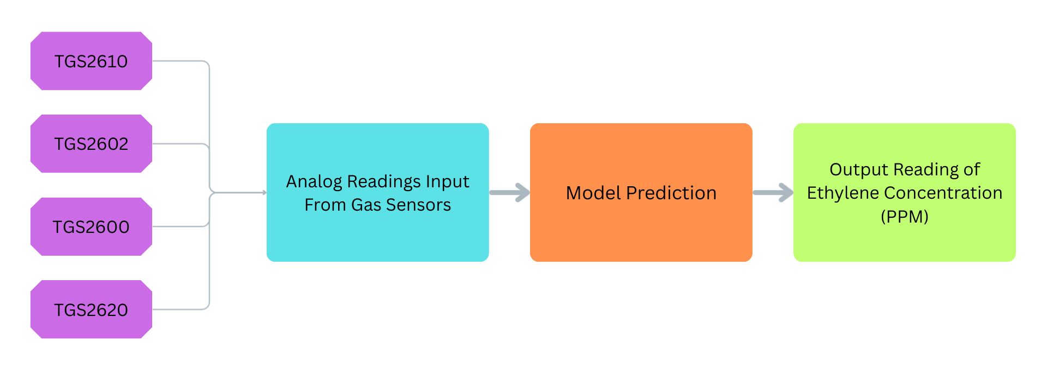
System Architecture

Slide 8
System Requirements
A. Functional Requirements
The system should collect raw sensor readings from Metal Oxide Semiconductor (MOS/TGS) gas sensors.
The system should process and preprocess sensor data for noise removal and normalization.
The system should train a machine learning model using sensor data to learn patterns related to ethylene concentration.
The system should predict ethylene gas concentration in parts per million (PPM) from the sensor readings.
The system should support real-time or low-latency prediction for early gas leak detection.
The system should display predicted ethylene concentration values for monitoring and analysis.
The system should store sensor readings and prediction outputs for further evaluation and model improvement.

Slide 9
System Requirements
B. Non - Functional Requirements
Accuracy: The prediction model should provide reliable ethylene concentration estimation.
Low Latency: The system should produce predictions quickly to enable real-time monitoring.
Scalability: The system should support future extensions such as multi-gas detection.
Reliability: The system should operate consistently for continuous environmental monitoring.
Maintainability: Machine learning models should be easily updated or retrained with new data.
Cost Efficiency: The system should use low-cost general-purpose sensors and simple hardware infrastructure.

Slide 10
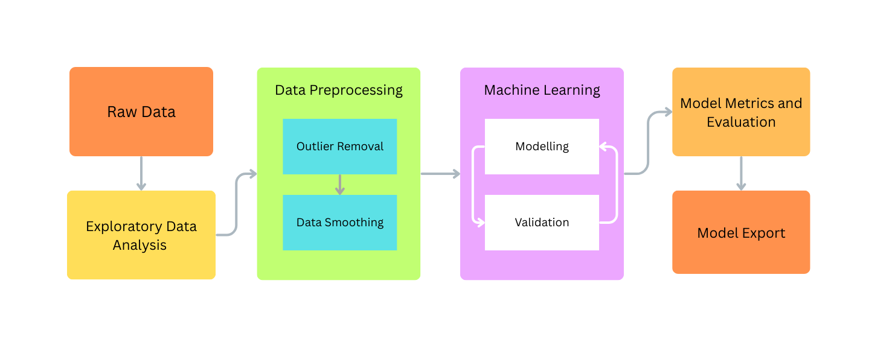
Work Flow Diagram

Slide 11
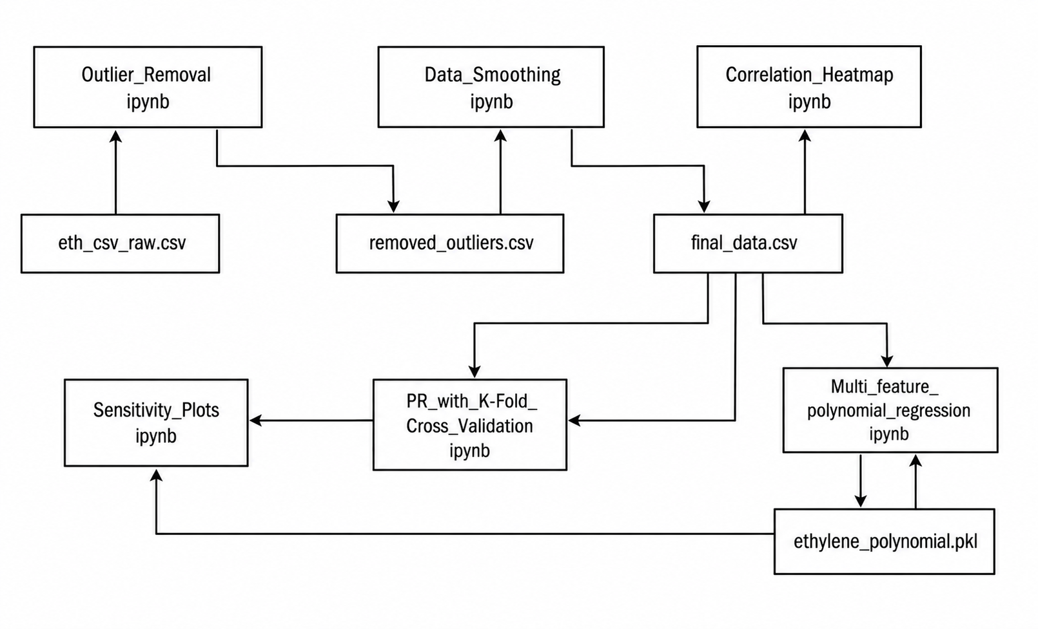
Project Structure

Slide 12
Component : Outlier Removal
1. Loaded a large CSV dataset (~4.1 million rows) containing gas sensor readings and gas concentrations into a pandas Data Frame.
2. Removed all rows where Ethylene concentration = 0 ppm, reducing the dataset to ~1.8 million rows.
3. Applied min–max normalization to 16 sensor columns (TGS sensors), scaling each feature to the range [0, 1].
4. Defined and applied a function that:
Grouped data by Ethylene concentration levels
Within each group, removed outliers using the IQR (Interquartile Range) method across all sensor columns
5. Produced a cleaned dataset (~1.26 million rows after outlier removal) and saved it to a new CSV file named "Removed_Outliers.csv".

Slide 13
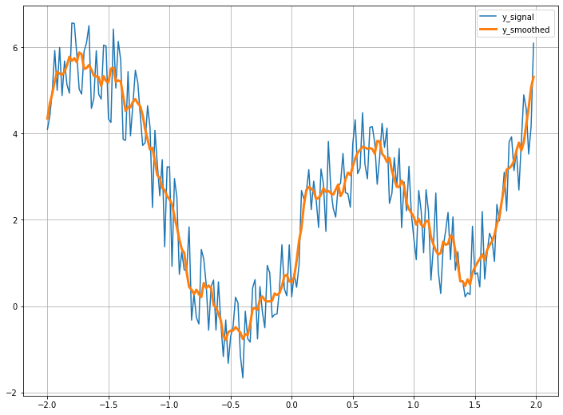
Component : Data Smoothing
1. Loaded the cleaned dataset (Removed_Outliers.csv) and visualized the relationship between TGS2620-3 sensor values and ethylene concentration using scatter plots.
2. Applied a series of manual filtering conditions to remove remaining anomalous data points based on specific thresholds between ethylene concentration and TGS2620-3 values, progressively refining the dataset.
3. Dropped unnecessary columns, corrected column naming issues, and retained only relevant features, resulting in a dataset of approximately 1.24 million rows.
4. Applied Savitzky–Golay filtering (window length = 15, polynomial order = 3) to smooth all sensor signal columns and reduce noise.
5. Performed log transformation on the ethylene concentration values and saved the final processed dataset to "Final_Data.csv".

Slide 14
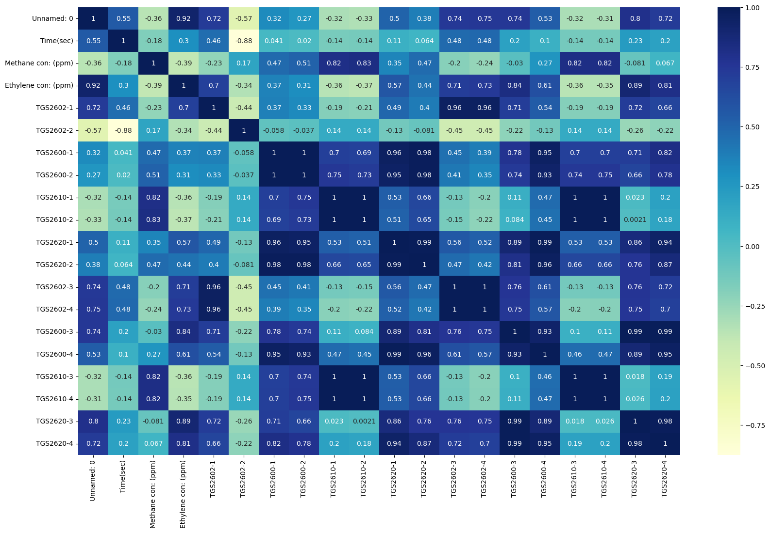
Component : Correlation Heatmap
1. Loaded the final processed dataset ("Final_Data.csv") into a pandas DataFrame.
2. Imported visualization libraries (matplotlib and seaborn) for plotting.
3. Computed the correlation matrix of all numerical features in the dataset using df.corr().
4. Created a heatmap visualization of the correlation matrix using seaborn, with the "YlGnBu" color map and annotation enabled to display correlation values.

Slide 15
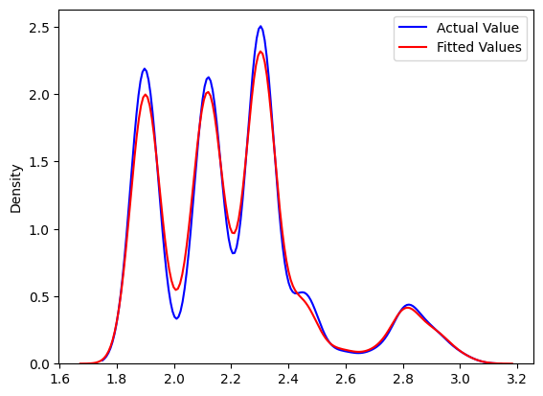
Component : Multi Feature Polynomial Regression
1. Loaded the final processed dataset ("Final_Data.csv") and reduced its size by sampling every 50th row to improve computational efficiency.
2. Selected 16 sensor features as input variables (X) and ethylene concentration (log-transformed) as the target variable (Y), then split the data into training and testing sets (80/20).
3. Built a machine learning pipeline consisting of:
- StandardScaler (feature scaling)
- PolynomialFeatures (degree = 3) to capture non-linear relationships
- LinearRegression model
4. Trained the pipeline on the training data and generated predictions (yhat) on the test set.
5. Visualized model performance using:
- Distribution plots comparing actual vs predicted values
- Scatter plot of sensor readings vs predictions
- Actual vs predicted scatter plot with a reference diagonal line

Slide 16
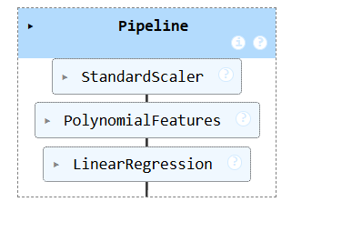
Component : Multi Feature Polynomial Regression
6. Evaluated model performance using metrics:
- Mean Squared Error ≈ 0.00107
- R² Score ≈ 0.985 (very high accuracy)
- R² Error ≈ 0.0148
7. Saved the trained model to a file ("ethylene_polynomial.pkl") using joblib and reloaded it for reuse.
8. Tested the saved model on a sample input and converted predictions back from log scale to ppm, showing close agreement between actual (~10 ppm) and predicted (~9.98 ppm) values.

Slide 17
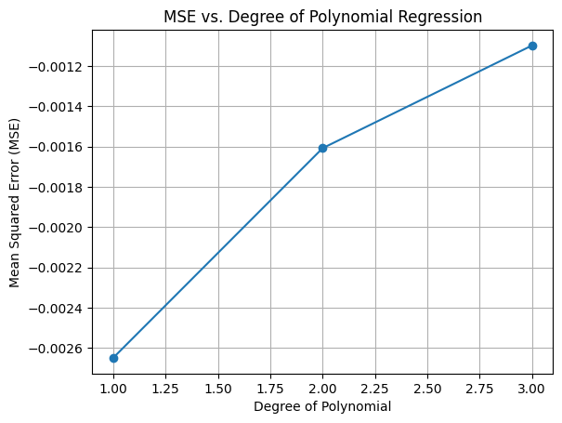
Component : PR With K Fold Cross Validation
1. Loaded the final processed dataset ("Final_Data.csv") and reduced its size by sampling every 50th row to improve efficiency.
2. Selected 16 sensor features as input variables (X) and ethylene concentration as the target variable (Y).
3. Implemented a function to evaluate polynomial regression models of different degrees (1 to 3) using K-Fold cross-validation (10 splits), calculating Mean Squared Error (MSE) for each degree.
4. Plotted MSE vs polynomial degree to analyze how model complexity affects performance and to help choose the optimal degree.

Slide 18
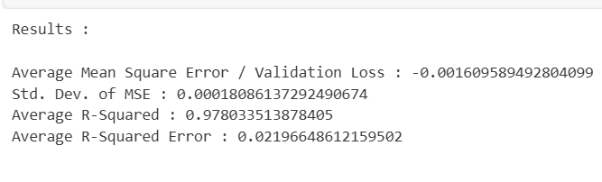
Component : PR With K Fold Cross Validation
5. Built a polynomial regression pipeline (degree = 2) with:
- StandardScaler (feature scaling)
- PolynomialFeatures (degree = 2)
- LinearRegression model
6. Evaluated the model using 10-fold cross-validation, computing:
- Negative Mean Squared Error (used internally by sklearn)
- R² scores for each fold
7. Visualized the distribution of R² scores across folds using a histogram.
8. Reported final evaluation metrics:
- Average MSE ≈ -0.00161 (negative due to scoring convention)
- Standard deviation of MSE ≈ 0.00018
- Average R² ≈ 0.978
- R² error ≈ 0.022

Slide 19
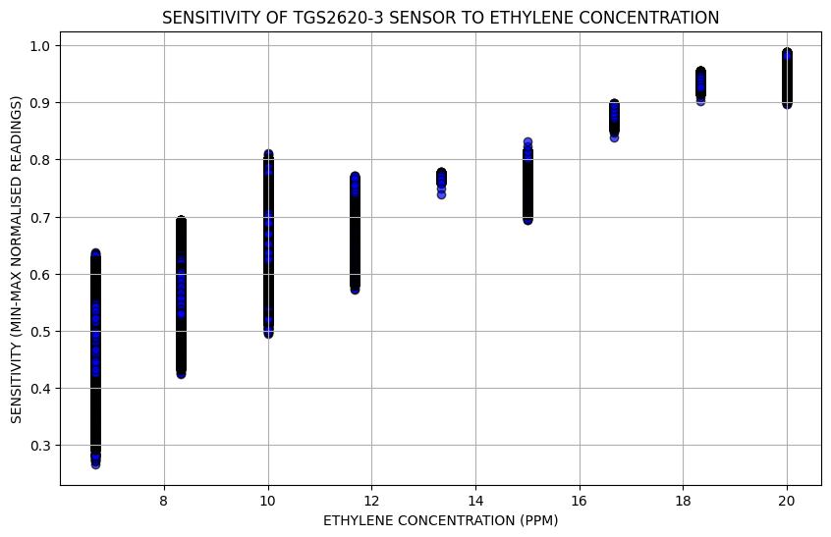
Component : Sensitivity Plots
1. Loaded the final processed dataset ("Final_Data.csv") into a pandas DataFrame and inspected the initial rows.
2. Converted the ethylene concentration values back from logarithmic scale to original ppm values using the exponential function.
3. Selected ethylene concentration as the independent variable and TGS2620-3 sensor readings as the dependent variable for analysis.
4. Created a scatter plot to visualize the relationship between ethylene concentration (ppm) and normalized sensor sensitivity.
5. Configured the plot with labels, title, grid, and styling to clearly show how the TGS2620-3 sensor responds to varying ethylene concentrations.

