Slide 1
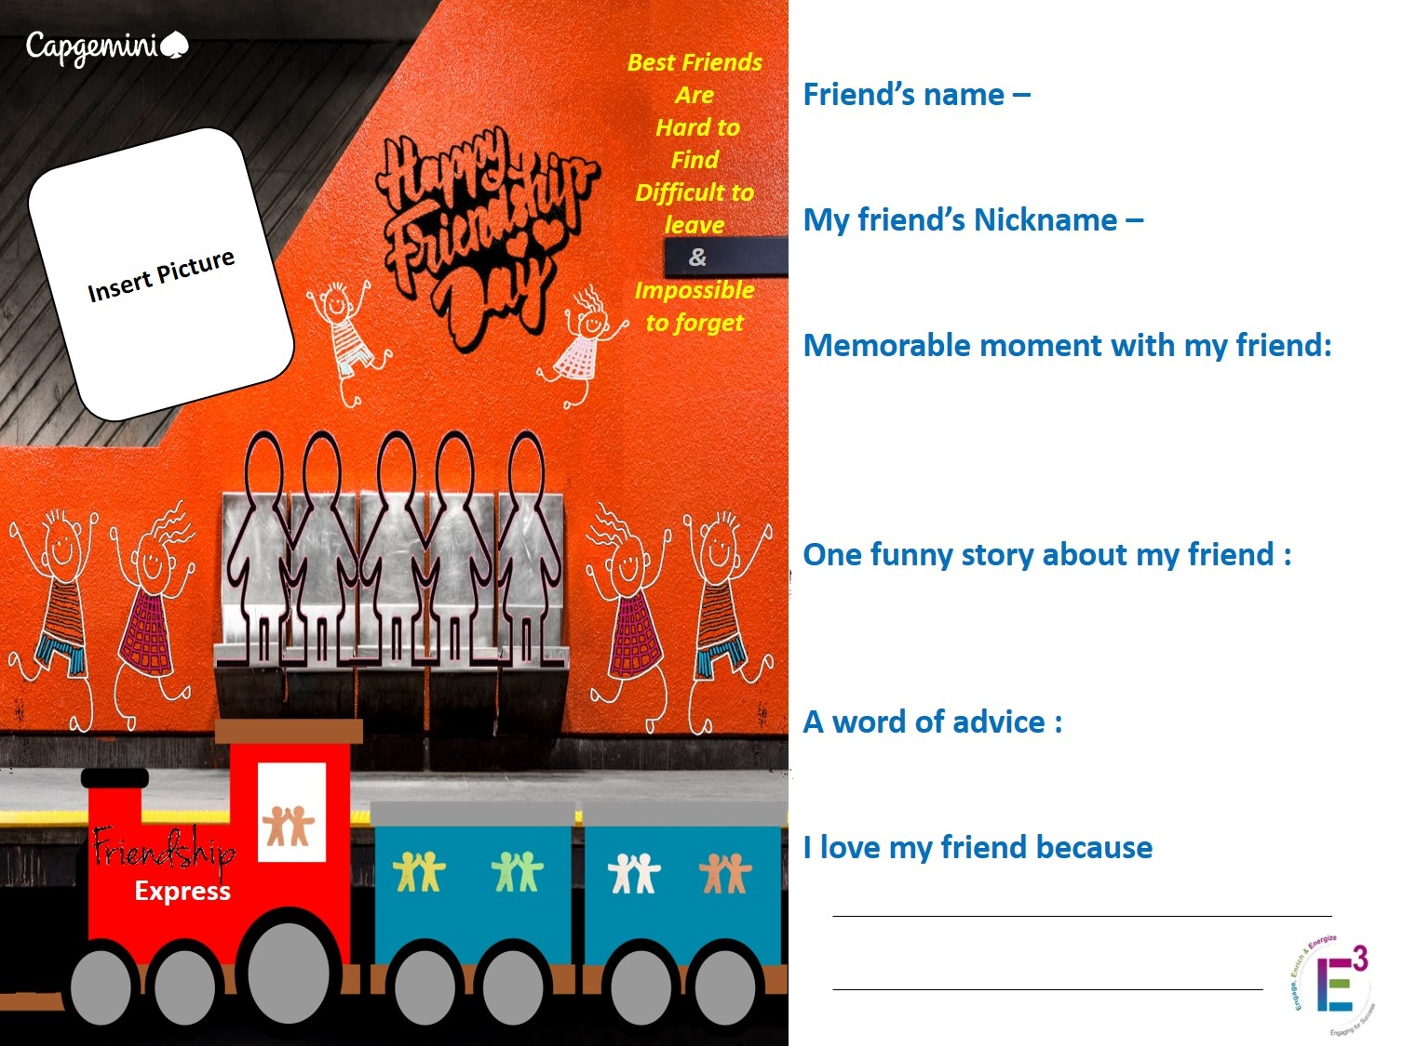
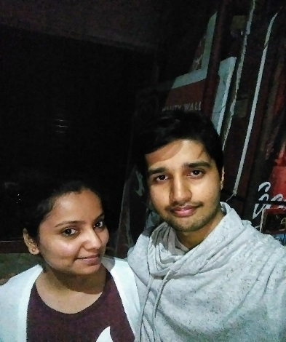
Himanshi Varshney
Himmu
Coop Project and Goa trip
Once she gave an icompass test and the test taken count was 2
Reduce the amount of stress and tension you take
Wishes always good and Never
Breaks the Trust.

