Slide 1
Viral Vibes

Slide 2
Agenda
INTRODUCTION
MERN STACK OVERVIEW MATERIAL UI
MONGOOSE FRONT-END COMPONENTS
BACK-END API ENDPOINTS DATABASE SCHEMA
SUMMARY

Slide 3

Introduction
PURPOSE: To create a social media application that allows users to share viral content with others.
TECHNOLOGIES USED :
MongoDB
Express
React
NodeJS
Material UI
Mongoose

Slide 4
MERN STACK OVERVIEW

Slide 5
MongoDB: A NoSQL Database that stores data in the form of JSON-like documents
Express: A web application Framework for NodeJS
React: A JavaScript library for building user interfaces
NodeJS: A JavaScript runtime that allows server-side execution of JavaScript code
Material UI: It is an open-source React Component Library that implements Google’s Material Design
Mongoose: It is an Object Data Modelling Library for MongoDB and NodeJS

Slide 6
Mongoose
Mongoose is an Object Data Modeling (ODM) library for MongoDB and NodeJS.
It provides a higher-level abstraction over the MongoDB driver and allows for easier data modeling.
Used in Viral Vibes to define the schema for data stored in MongoDB.

Slide 7
FRONT-END COMPONENTS
Viral Vibes uses Material UI components to create a modern and consistent user interface.
Examples of components used include: AppBar, Button, Card, Dialog, Form and List.

Slide 8
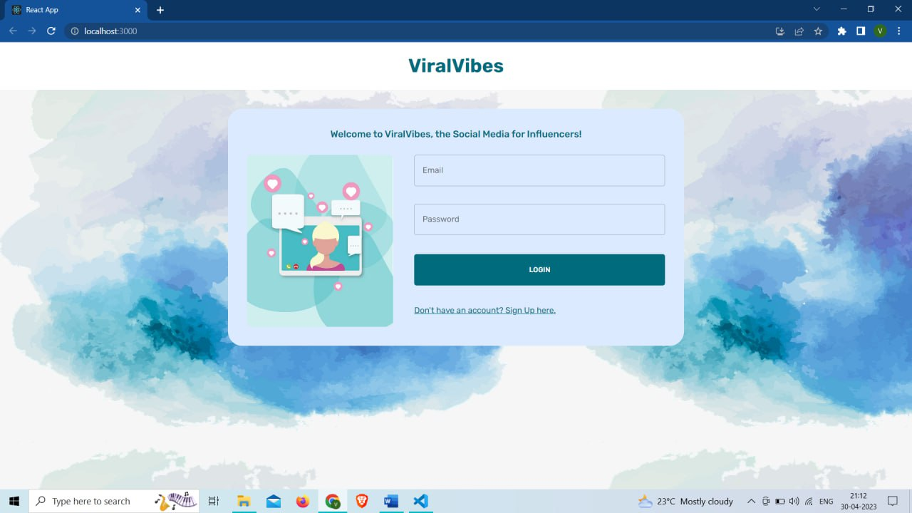

Slide 9
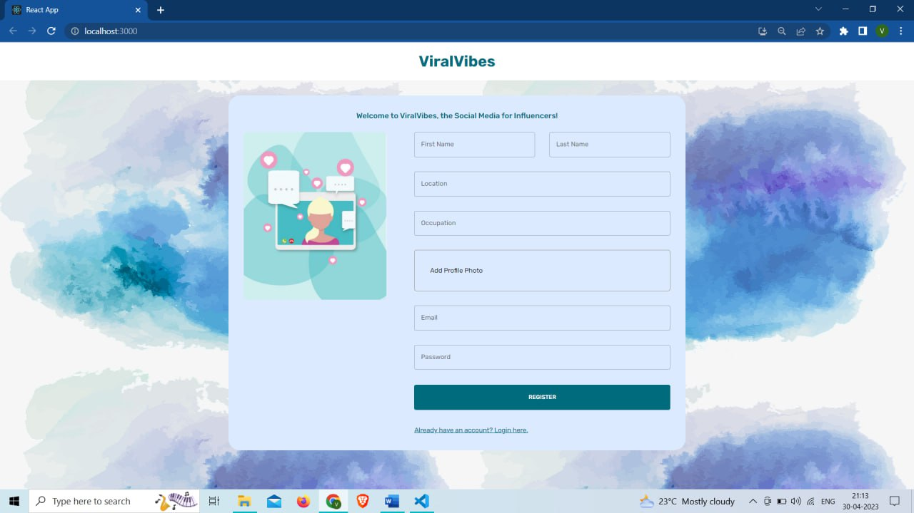

Slide 10
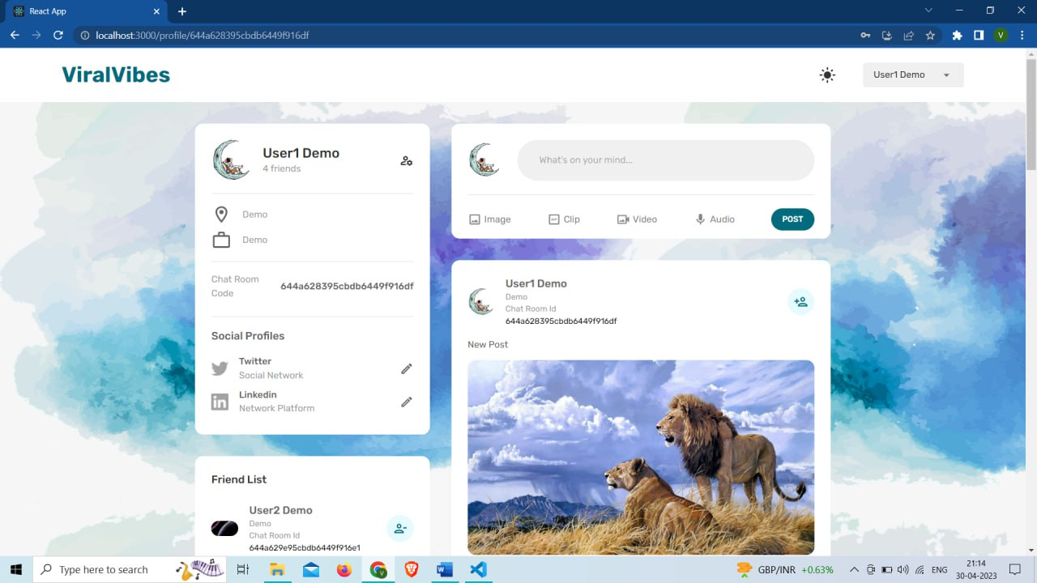

Slide 11
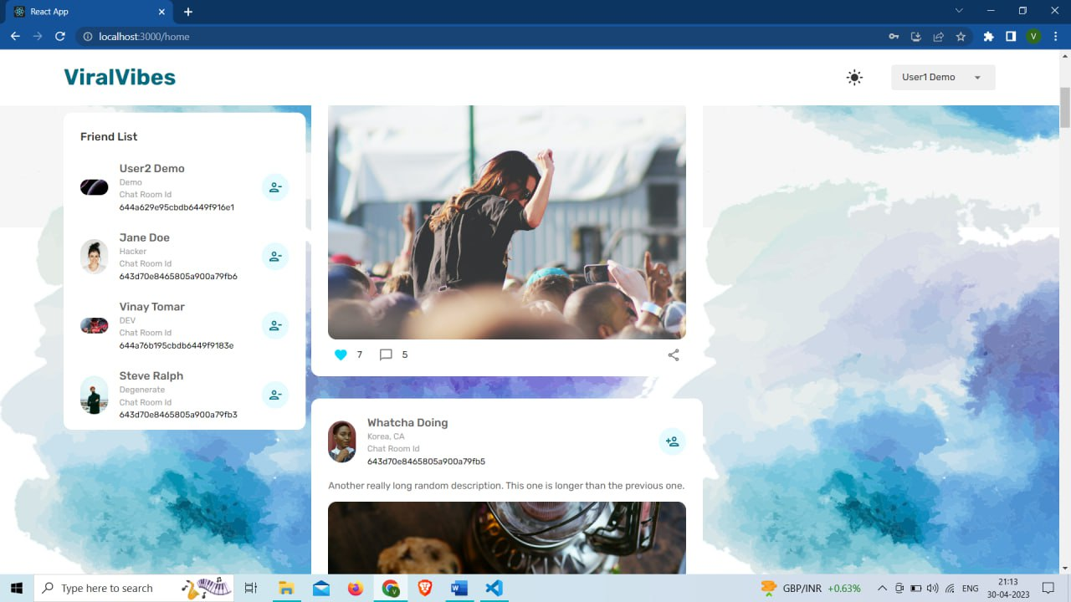

Slide 12
BACK-END API ENDPOINTS
Viral Vibes uses NodeJS/Express to create API endpoints for communication with the front-end.
Examples of endpoints include: GET /api/users to retrieve user data, POST /api/users to create new users, and GET /api/content to retrieve viral content.

Slide 13
Database Schema
Viral Vibes uses Mongoose to define the schema for data stored in MongoDB.
Examples of schema include: User schema with fields for username, email, and password, and Content schema with fields for title, description, and URL.

Slide 14


Meet Our Team
Ayush Tiwari
Shubhi Gupta​
Vinay tomar
Vibhu rathore

Slide 15

Summary
Viral Vibes is a social media platform built using the MERN stack and Material UI and Mongoose libraries.
Its purpose is to allow users to share viral content with each other.
The project architecture includes a React front-end, NodeJS/Express back-end, MongoDB database, and Mongoose schema definitions.

Slide 16
Thank you

