Slide 1
AI PATIENT RISK SEGREGATION
1
Data Upload
MediCluster
2
Clustering Engine
A clinical dashboard for clustering patient populations, identifying risk tiers, and extending care workflows with AI.
3
Risk Tiers
Unsupervised patient risk stratification
4
Clinical Action
Imaging analysis and patient overview
Medication reminders, dispatch, and MCI triage
4
8+
Algorithms
App Modules
Roadmap
CtrlAltElite | M S Engineering College | May 2026
Next clinical intelligence features
MediCluster | Patient Health Risk Segregation
1

Slide 2
Problem
Healthcare teams need fast, explainable patient risk grouping from mixed clinical data.
1
Unlabelled data
2
Fragmented context
Many datasets do not include clean risk labels, making supervised prediction difficult.
Vitals, images, medications, triage, and dispatch data often live in separate workflows.
3
Slow escalation
4
Low trust in black boxes
Clinicians need early signals before deterioration becomes obvious at the bedside.
Risk predictions must show why a patient is high risk, not only the final label.
Goal: convert raw patient data into risk tiers, explanations, and operational next steps in one dashboard.
MediCluster | Patient Health Risk Segregation
2

Slide 3
Solution
MediCluster turns patient rows into interpretable cohorts and care actions.
1
Upload
2
Preprocess
3
Cluster
4
Label Risk
5
Act
CSV or sample patient records with vitals and labs.
Clean numeric features, impute missing values, scale, and reduce dimensions.
K-Means, DBSCAN, Hierarchical, or GMM groups similar patients.
Composite clinical signals map clusters to Low, Moderate, High, Critical.
Review dashboards, patient profiles, imaging, reminders, triage, and dispatch.
Clinician-facing output
ML-facing output
Workflow output
Risk tiers, tables, plots, metrics, profiles
Cluster quality, PCA/UMAP/t-SNE, anomalies
Imaging, reminders, MCI board, dispatch
MediCluster | Patient Health Risk Segregation
3

Slide 4
Architecture
Three-service app: React dashboard, Node API gateway, Python ML engine, MongoDB storage.
React Frontend
Node API Gateway
Python ML Engine
Dashboard
Dataset routes
Clustering
Imaging
Cluster routes
Explainability
Predict
Media routes
Anomalies
Patients
Triage routes
NLP
MCI board
AI routes
Imaging
MongoDB stores datasets, cluster results, media metadata, reminders, dispatch records
MediCluster | Patient Health Risk Segregation
4

Slide 5
Current Product
What is already present in the codebase today.
Risk Clustering
Patient View
Imaging AI
K-Means, DBSCAN, Hierarchical, GMM, comparison metrics, risk distribution
Cluster history, patient media, overall risk, searchable patient profile
X-ray/DICOM upload, model selector, pathology findings, clinical info
Risk Prediction
Medication Reminders
Emergency Workflow
Predict new patient tier from saved cluster centroids and vitals
Medication schedule builder plus AI prescription parser
Dispatch, MCI triage board, voice-to-triage, hospital allocation
MediCluster | Patient Health Risk Segregation
5

Slide 6
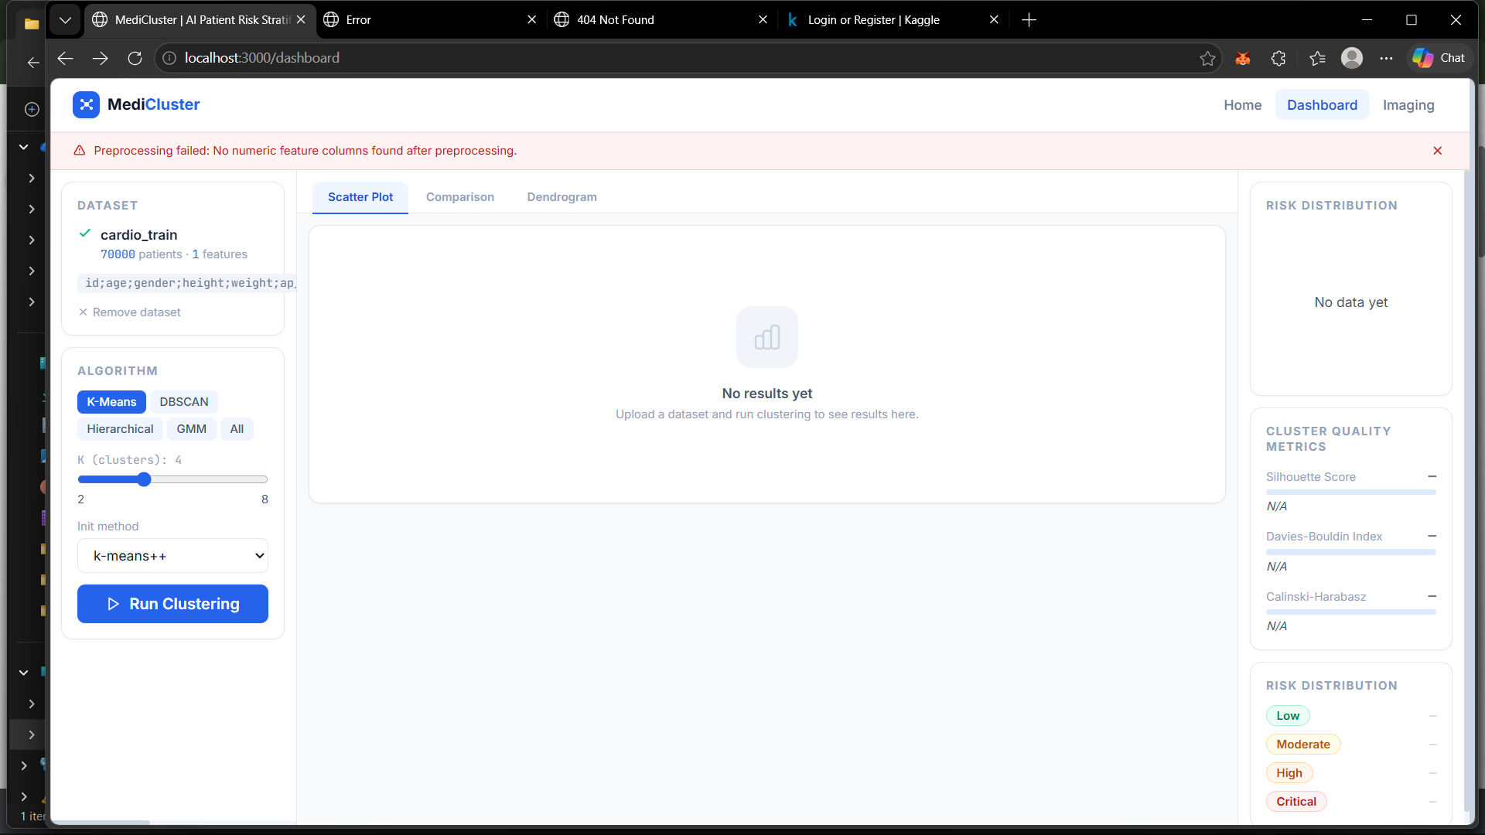
Dashboard Experience
A single workbench for clustering runs, risk distribution, patient tables, and exports.
Core UI Surfaces
Upload and preview datasets
Tune clustering parameters
Explore PCA scatter plots
Compare algorithms side-by-side
Export reports to PDF
Open patient-level details
MediCluster | Patient Health Risk Segregation
6

Slide 7
AI/ML Engine
Existing ML endpoints create a strong base for the next feature push.
1
Clustering
5
Clinical NLP
K-Means, DBSCAN, Hierarchical, GMM
Notes analysis, risk keywords, ICD-10 suggestions
2
AutoML
6
Forecasting
Optimal K, feature ranking, UMAP/t-SNE
Vitals trend prediction and MEWS scoring
3
Explainability
7
Medical Imaging
SHAP global and per-patient feature drivers
Pathology detection and Grad-CAM heatmaps
4
Anomaly Detection
8
RAG Assistant
Isolation Forest patient outlier flags
Natural-language Q&A over indexed patients
Most recommended next step: expose more of these ML endpoints in the React UI instead of building new backend logic first.
MediCluster | Patient Health Risk Segregation
7

Slide 8
Feature Roadmap
High-impact additions ranked by demo value and implementation fit.
1
Auto Cluster Recommendation
Quick
2
Anomaly Watchlist
Quick
Suggest best K before running clustering
Flag unusual patients and open their profiles
3
SHAP Explainability
Medium
4
UMAP / t-SNE Toggle
Medium
Show top drivers behind risk assignment
Better visual separation than PCA only
5
Grad-CAM Imaging
Medium
6
Vitals Forecasting
Medium
Heatmap where image model focused
Trend risk and MEWS-based escalation
7
Drug Interaction Checker
Quick
8
Dataset Quality Report
Quick
Warn inside medication reminders
Missing values, outliers, ignored columns
MediCluster | Patient Health Risk Segregation
8

Slide 9
Build Plan
Recommended implementation order for a polished next version.
Phase 1
Phase 2
Phase 3
Quick UI Wins
Risk Intelligence
Clinical Depth
Recommend K button
Anomaly watchlist
Grad-CAM heatmaps
Dataset quality report
SHAP patient explanations
Vitals forecasting
Drug interaction warning
UMAP/t-SNE scatter toggle
Care plan generator
Estimated effort: 1-2 days
Estimated effort: 2-4 days
Estimated effort: 3-5 days
MediCluster | Patient Health Risk Segregation
9

Slide 10
Feature Deep Dive
The five strongest additions for a hackathon demo.
1
Auto-K
Uses /optimal-k to recommend cluster count and improves first-run accuracy.
2
Anomalies
Uses Isolation Forest to create a watchlist of patients that do not fit cohort patterns.
3
SHAP
Explains risk drivers at patient and cohort level, increasing trust.
4
Grad-CAM
Adds visual evidence for imaging findings with heatmap overlays.
5
Interactions
Checks medications while reminders are created and flags unsafe combinations.
MediCluster | Patient Health Risk Segregation
10

Slide 11
Expected Impact
What the improved version demonstrates clearly.
Faster
Clearer
Safer
Risk screening from raw patient data
Reason codes and visual explanations
Medication and deterioration warnings
Demo narrative
Upload patient data, cluster into risk tiers, inspect high-risk patients, explain why they are high risk, review imaging and medication risks, then escalate through triage or dispatch workflows.
MediCluster | Patient Health Risk Segregation
11

Slide 12
NEXT VERSION
From risk segregation to clinical decision support
MediCluster already has the backend intelligence. The next step is a polished, explainable UI that turns those signals into action.
Build Auto-K + Anomalies first
Add SHAP and Grad-CAM
Finish care plan workflows
MediCluster | Patient Health Risk Segregation
12

