Slide 1
Exploring Toronto to find best places to start a Chinese restaurant business
IBM Applied Data Science Capstone Project
February 2020
Vinay

Slide 2
introduction
The demographics of Toronto, Ontario, Canada make Toronto one of the most multicultural and multiracial cities in the world..
Toronto also has established ethnic neighborhoods such as the multiple Chinatowns, Corso Italia, Little Italy, Little India, Greektown, Koreatown, Little Jamaica, Little Portugal and Roncesvalles, which celebrate the city's multiculturalism.
This project will include steps to decide whether it is a good idea to open a Chinese Restaurant in Toronto and if yes, which neighborhood holds the maximum likelihood to make the business thrive.

Slide 3
Target audience
Business personnel who wants to start a new Chinese restaurant and wants to identify the areas where the business will thrive the most targeting the Asian/Chinese crowd
A Data Analyst or Data Scientist who wants to practice real world business problems and identify solutions based on statistical, exploratory and visual analytics.
A restaurant chain owner who wants to expand his business in various areas of Toronto attracting more crowd and increasing the revenue of his business.

Slide 4
Data acquisition
The following sources were used in this project
Wikipedia (for Toronto demographics and population information)
ArcGIS (for extracting coordinates for postal codes)
Foursquare (for venue information data and location)

Slide 5
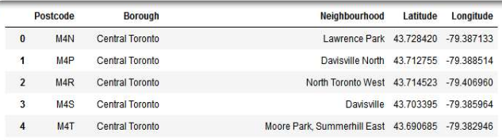
Data cleaning and pre-processing
The scraped data from Wikipedia pages had to be cleaned in order to eliminate the missing values. It also included some redundancy that had to be reduced so that it would not affect our analysis.
Here is a glimpse of the data frame after cleaning and merging:

Slide 6
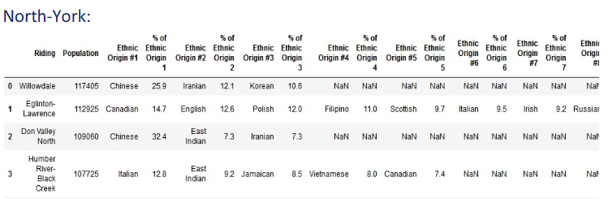
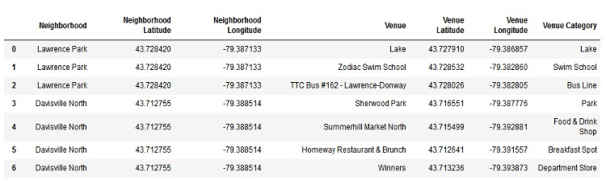
We scrape the Ethnic diversity data from the Wikipedia page as well. The first image shows one of the dataframes for population diversity in Toronto.
The second image is the data for different venues collected using the Foursquare API.

Slide 7
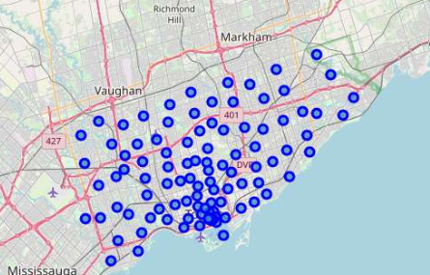
Exploratory data analysis
The first step in exploratory data analysis performed was to get a visual of the spread of neighborhoods
This was done using Folium and Leaflet libraries which are used to visualize the geospatial data points on a map.
We notice that the Downtown Toronto area is very densely populated with different neighborhoods and it goes on decreasing as we move away.

Slide 8
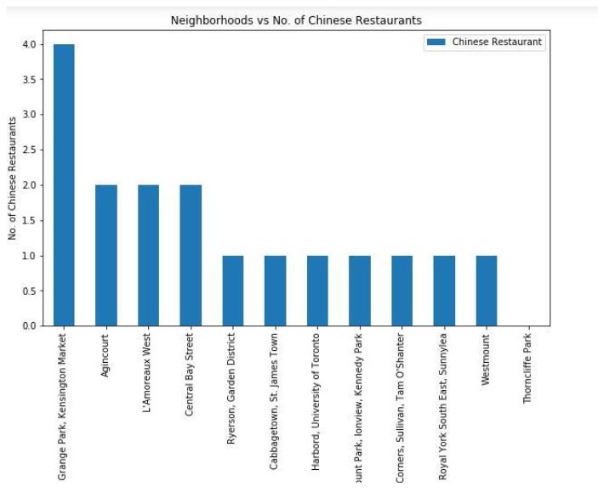
Exploratory data analysis
The image shows the bar plot showing top neighborhoods with Chinese restaurants

Slide 9
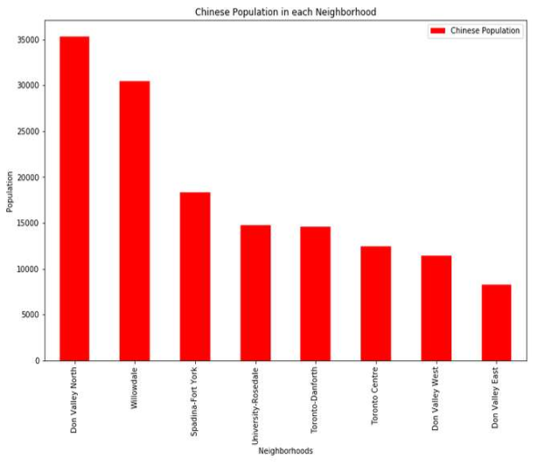
Exploratory data analysis
Next, we try to check how are the neighborhoods and the Chinese population related.
These steps will be helpful in our final decision making.

Slide 10
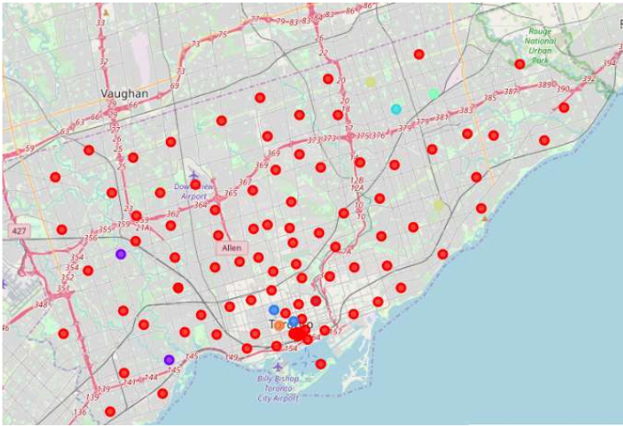
K-Means Clustering
Next, we cluster our data using K-Means clustering technique with 7 clusters.
This method will cluster our data based on similarities between their features.
In the image, we see our neighborhoods distributed in 7 different clusters. The points in each cluster can be identified by their cluster colors.

Slide 11
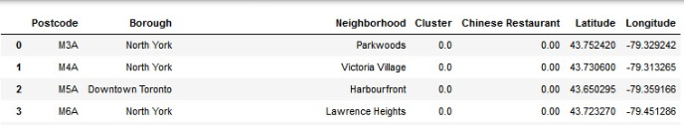
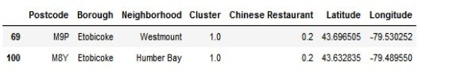
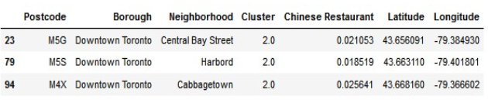




Analyzing the results
Here is our data that is divided in 7 different clusters.
Each cluster consists of data points whose values are similar to each other and could be classified ass a single group.
Using these results, we could identify the areas which could turn out to be a good fit for our business and also the ones which already have a number of Chinese restaurants and should be avoided as they can turn out to be a great competition for our business.

Slide 12
Results
We have found out that :
Etobicoke, Scarborough, Downtown Toronto and North York have the greatest number of Chinese Restaurants.
Willowdale, Don Valley-North, West and East, Spadina-Fort York, Toronto-Dan Forth, University-Rosedale and Toronto Centre hold the highest Chinese population densities.
Etobicoke and Downtown Toronto are the areas with a large amount Chinese restaurants and there would be a lot of competition around these areas.
Scarborough and North York have a significantly high number of Chinese populated areas.
Considering Scarborough already has some Chinese Restaurants, the best option would be to choose the areas based under North York as it holds least competition and high population.

Slide 13
Conclusion
We started with a business problem in our minds and step by step, followed the procedure which the real Data Scientists follow.
We came through a lot of Python libraries which made our process easier to fetch, visualize, manipulate and analyse the data.
There were some areas which need improvement and could end up in better results if provided with proper data sources and more time in hand.
More machine learning techniques could be used to get better results after comparisons.
All in all, this project was fun and interesting. Now, I would at least have an idea if someone asks me for an advice on starting a new business.

