Slide 1


Amazon Product Review Analysis
Presented by-
Vibhakar Sharma
Vinit Gole
Vinay G.
Udbhav Mishra

Slide 2

Content
Introduction
Case Study
Data description
Exploratory Data Analysis
Sentiment Analysis
Reasons for negative reviewed products
Extraction of product names from text
Time Series Analysis – Future Forecast
Trends of Customers
Business Insights

Slide 3
INTRODUCTION
When a customer decides to buy a product online, he/she will lookup at the reviews which were provided by those customers who have already purchased that product. So, customers need to rely largely on product reviews to make up their minds for better decision making on purchase.
As a result, analysing past data on product reviews is very vital for any organization to improve on their existing product and forecast bettersales in the near future.
Therefore, models able to predict the user rating from the text review are critically important. Getting an overall sense of a textual review could in turn improve consumer experience

Slide 4
CASE STUDY
Amazon Product Review Analysis:
Categories taken for analysis : Toys and Games, Video Games
Data Source : http://jmcauley.ucsd.edu/data/amazon/
Each category contains two datasets: 5 core (product reviews) & product ratings
Data size : Review = 3,99,377 observations, Rating = 35,77,524 observations

Slide 5
DATA DESCRIPTION
Rating Dataset
reviewerID : UserId of the reviewer
item : Id of the product
rating : rating of the product
timestamp : time of the review
Review Dataset
reviewerID : ID of the reviewer
asin : ID of the product
reviewerName : name of the reviewer
helpful : helpfulness rating of the review, e.g. 2/3
reviewText : text of the review
overall : rating of the product
summary : summary of the review
unixReviewTime : time of the review (unix time)
Review Time : time of the review (raw)

Slide 6
Exploratory Data Analysis:
For the purpose of EDA, we have made use of Tableau Dashboard to find interpretations from the data. Each analysis has been plotted and consolidated in the form of a dashboard.
We are hereby attaching the dashboard link below for reference:
Link To Dashboard

Slide 7
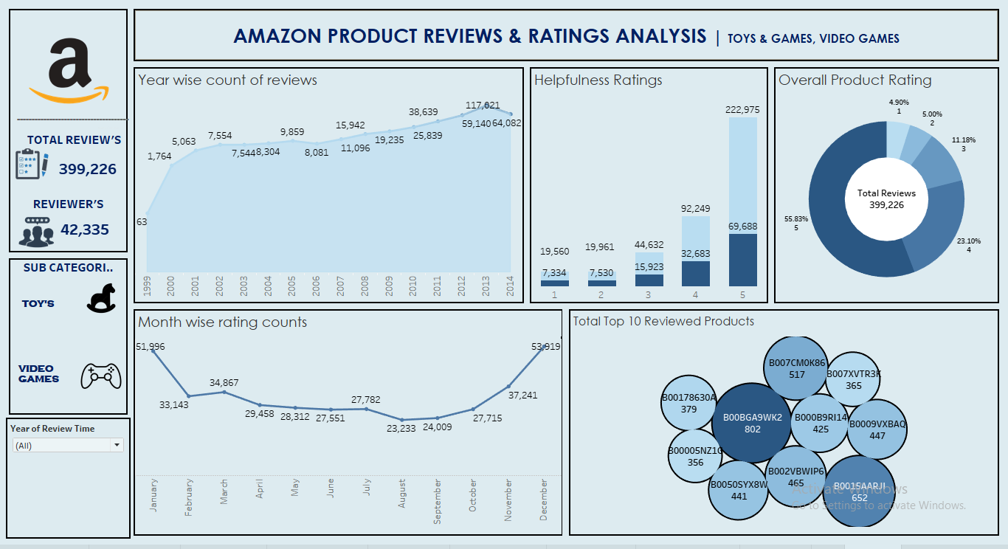
TABLEAU DASHBOARD

Slide 8
EDA Interpretation :
Out of total data of Toys and Games 61.3% of product reviews are highly positive whereas Video Games category has 51.9% highly positive reviews.
Toys and Games category has 4707 negative reviews that accounts of 2.81% of total reviews whereas Video games category has 13663 negative reviews that accounts all of 5.18% of total reviews of category.
As review trends are highest in January and December in both category, there may be the chances of high sales during these months.
Also August is the month having least review count of 9150 & 14098 in both dataset, so more focus should be on the august month.
BOOBGA9WK2 is the product ID highest positive reviews of 571 and BOOOFKBCX4 is the product id with highest negative reviews of 151 in Video Games category.

Slide 9
Is EDA enough for analysis ?
Review Text | Rating | Sentiment after review analysis
I like the delivery process but the product is worst. | 4 | Negative
I ordered the game 4 days back and it delivered today. The game has superior graphics but amazon should work on delivery staff behavior. I am very disappointed with delivery boy’s behavior. | 1 | Highly Positive
So can we improve our products ? What we require for that ?
REASONS !!
Here Sentiment Analysis comes into picture…

Slide 10
Sentiment Analysis:
For the purpose of sentiment analysis, we have made use of TextBlob python library. Here with the help of mentioned library we fetched out the polarity scores for particular text reviews and then classified the polarity scores into 4 different sentiments which are followed by :
Highly Positive – >0.5
Positive – 0.1-0.5
Neutral - 0
Negative - < 0
Accuracy : 90%

Slide 11
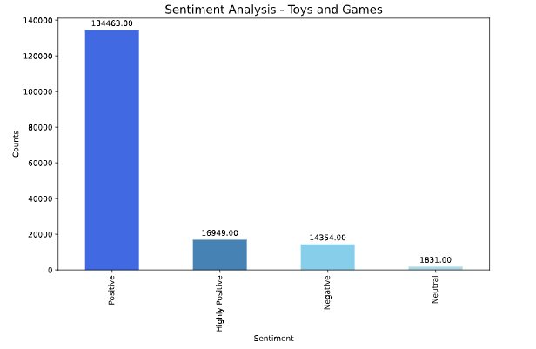
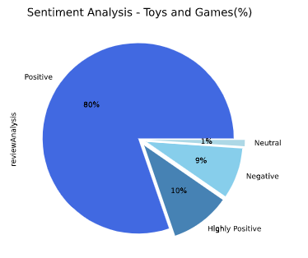
Sentiment Analysis (Toys and Games) :
INTERPRETATION : Out of total reviews majority of reviews which is about 80% are positive whereas Neutral is on least with only 1% of total reviews.

Slide 12
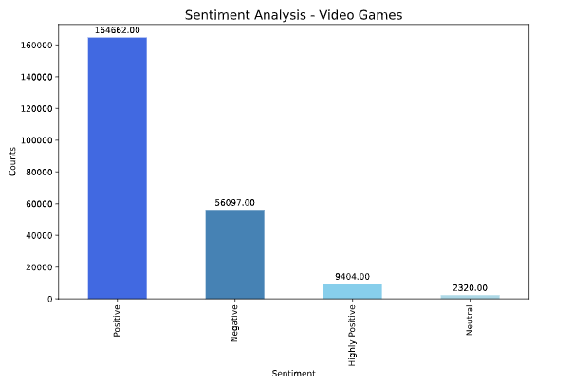
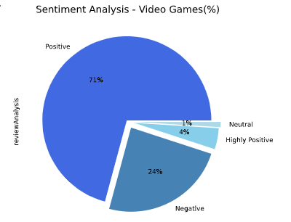
Sentiment Analysis (Video Games) :
INTERPRETATION : Out of total reviews majority of reviews(Video games) which is about 71% are positive whereas Neutral is on least with only 1% of total reviews.

Slide 13
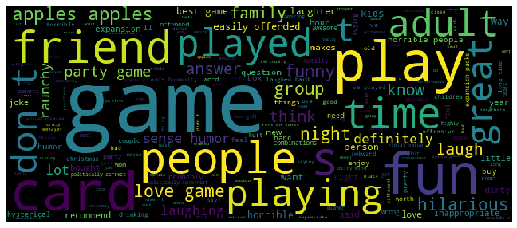
Let’s find the reason for most negatively reviewed product (Toys and Games) :
Most negatively populated product id in Toys and Games : Card/ B004S8F7QM
Wordcloud library has been used here to plot the particular text chart. The size of words are depend on the frequency of times it occurred in all the reviews.
INTERPRETATION : After analyzing and verify the results with Aspect extractor(pyabsa) method, we interpret that Card quality, Poor Replay and Adult theme are the major reasons for the highest negative reviews for the product Card/B004S8F7QM in Toys and Games category.

Slide 14
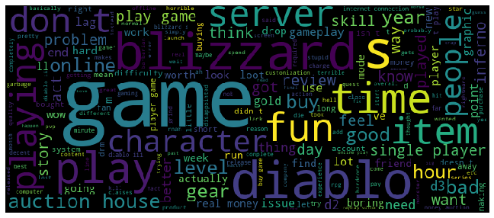
Now the reason for most negatively reviewed product (Video Games) :
Most negatively populated product id in Video Games : Blizzard/ B00178630A
INTERPRETATION : After analyzing and verify the results with Aspect extractor(pyabsa) method, we interpret that Server and Installing Error are the major reasons for the highest negative reviews for the product Blizzard/B00178630A in Video Games category.

Slide 15
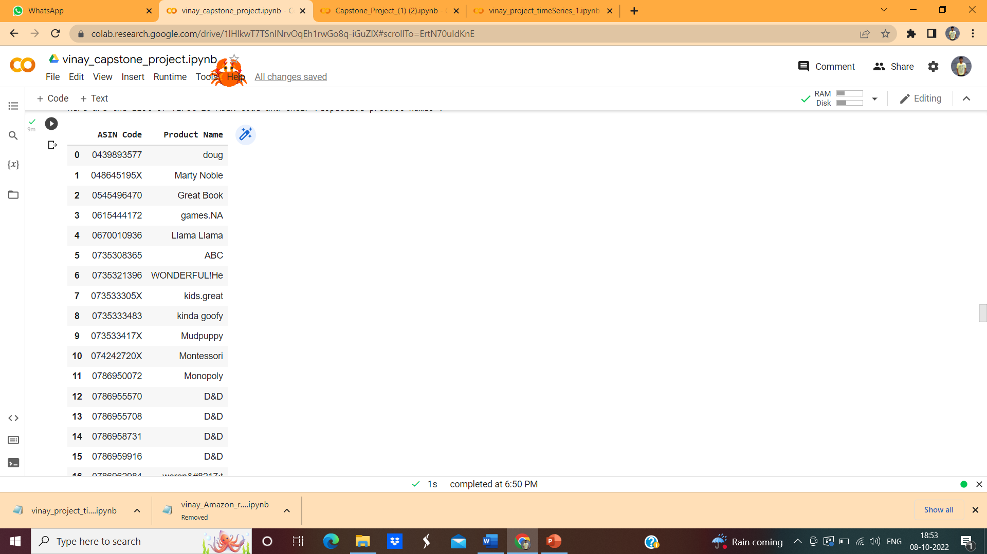

Recommended Product Names:
Toys and Games
Video Games
We make use Name Entity Recognition (NER) method to extract the product names from given text.
INTERPRETATION: These are the product names based on the review text and summary.

Slide 16
Future Forecast :
For the purpose of future forecast, we have made use of Time Series Sarima model. The time period we have for following category :
Toys and Game(Actual values) – From year 1999-2014
Toys and Game(Forecast values) – After year 2014
Video Games(Actual values) – From year 2000-2014
Video Games(Forecast values) – After year 2014

Slide 17
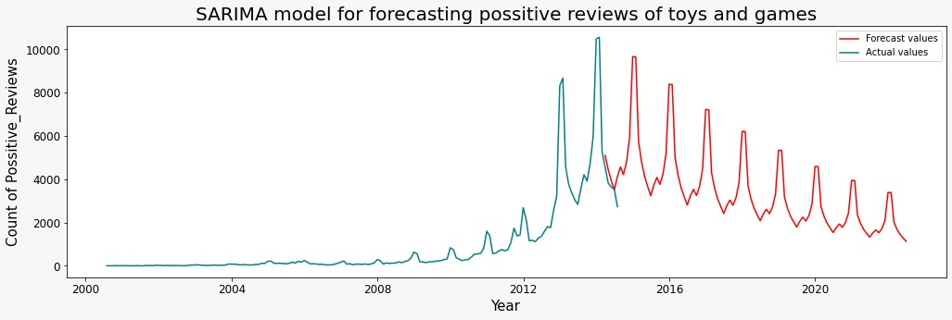
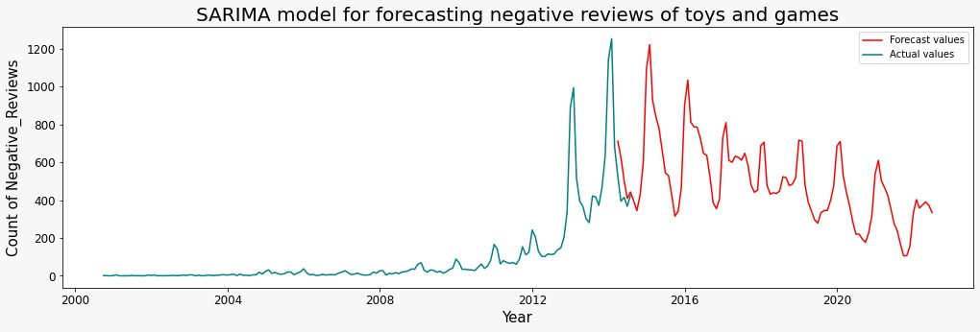
Future Trends (Toys and Games) :
INTERPRETATION : Considering the Toys and Games Dataset, we can see that there is a decline in the Positive and Negative sentiments trend, after year 2014.

Slide 18
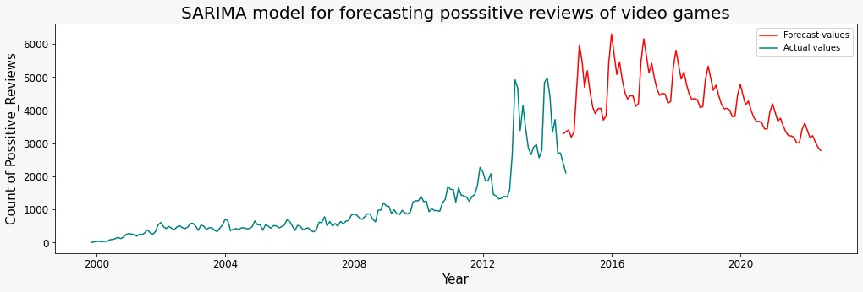
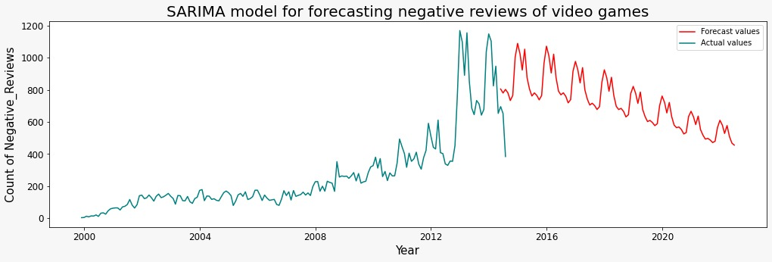
Future Trends (Video Games) :
INTERPRETATION : Considering the Video Games Dataset, the trend for Positive sentiments is increasing till 2018 and tends to fall after 2018. The Negative sentiments tends to decline after 2014.

Slide 19
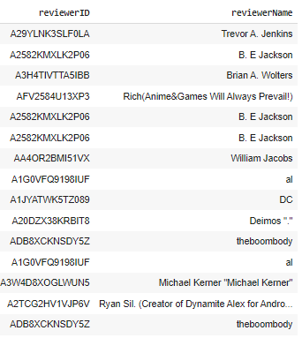
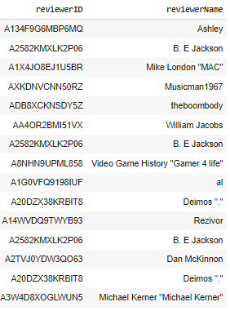
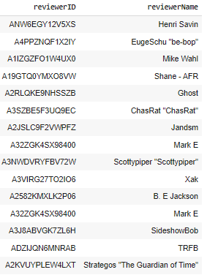
Review Trends of Customer :
INTERPRETATION : Out of 43715 customer, 46% customers which is 21406 reviewed on both categories. It can be a possibilities of that these 46% are buying products from both categories as well.

Slide 20
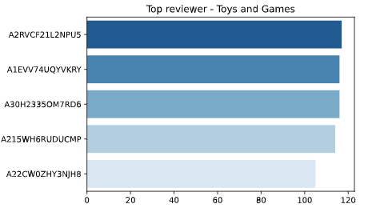
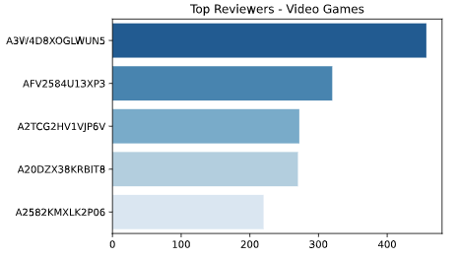
Valuable Reviewers :
INTERPRETATION : Here we have top 5 valuable reviwers of each category those are also the common reviewers from both Toys and Games as well as Video Games.

Slide 21
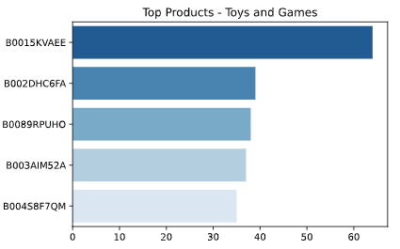
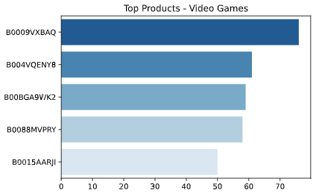
Valuable Products :
INTERPRETATION : Here we have the top valuable and preferred reviewed products of common reviewers of both category.

Slide 22
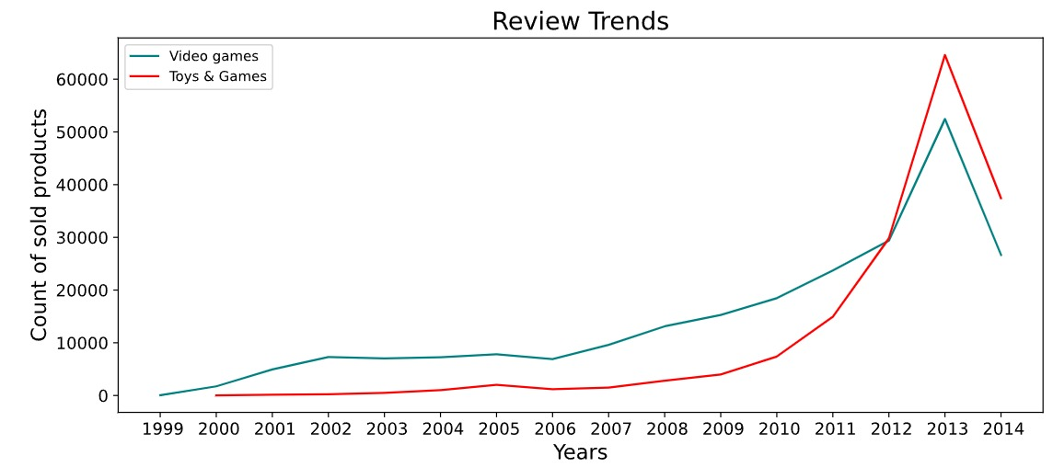
Review Trends of Customer :
Review Counts
INTERPRETATION : Overall review trend seems to a sudden increase after year 2012.
The trend of Toys and Games category is comparatively higher than Video Games after the year 2012.

Slide 23
Business Insights
Toys and Games are the most preferable category with having 9% negative reviews from the year 2000-2014 which is least in both category.
Video Games should be more focus category as it exhibits 24% of negative reviews from 1999-2014.
Card and Blizzard are the most negatively reviewed products in Toys and Games,
Video Games respectively.
The trend of Video Games are going to increase after 2014 till the year 2018.

Slide 24
Thank You
“We all need people who will give us feedback. That’s how we improve.”
– Bill Gates

