Slide 1
Mask2Flow-TSE
Two-Stage Target Speaker Extraction with Masking and Flow Matching
Phase One · Progress Review
Vinay Reddy Galigutta
Roll No: 25CS60R85
M.Tech CSE, IIT Kharagpur
Prof. K. Sreenivasa Rao
Professor
IIT Kharagpur
Reproduction of Moon et al., arXiv:2603.12837 · no reference implementation exists

Slide 2
What has changed since the last review
Everything below post-dates the 14 September deck
The last presentation ended at the padding-fix and vocoder work. Since then the project ran five complete campaigns and reached a measured ceiling.
Catastrophic outliers — diagnosed at t≈0 and cut 3.6× — 12.7% → 3.5%
Multi-speaker — 3 and 4 speakers were never trained on; now +5.2 / +4.1 pp
Cross-corpus — validated on Libri2Mix, a corpus we did not build
Low-SNR gap — the system was WORSE than doing nothing below 1 dB; now +19 pp
Onset defect — found by ear, root-caused as a stage interaction, still open
Ceiling analysis — remaining headroom quantified — and it is not where we assumed
15 candidate changes were formally evaluated: 4 promoted, 11 rejected.

Slide 3
Where the system stands today
All figures from job 11112, the deployed configuration
Condition
Do nothing
This system
Ceiling
Corpus-wide accuracy (n=400)
71.0%
86.2%
90.8%
2 speakers (n=300)
70.3%
85.7%
90.3%
3 speakers (n=300)
64.3%
80.0%
90.3%
4 speakers (n=300)
61.4%
77.0%
90.3%
Low SNR [−10,1) dB
64.0%
80.3%
90.3%
Accuracy = 1 − EER over genuine/impostor trials. The ceiling is the clean target passed through the same vocoder and speaker encoder — so it is what perfect extraction of perfect speech would score.
Signal quality: in-domain SI-SDR +1.75 dB vs mixture · Libri2Mix +3.39 dB · in-domain catastrophic rate 10.2%

Slide 4
Correction to the last deck
A claim we made in September turned out to be wrong
Previously stated:
“This project confirmed the paper's target regime (D≈100%, I≈0%) on real data: the mask removes energy and never adds it.”
Why that is false here
Our log-mel is log(mel + 1e−8), so every bin quieter than unit power is NEGATIVE. Multiplying a negative value by a mask in [0,1] moves it toward zero — that is, makes it LOUDER.
Measured on real audio: 74.2% of mixture bins are negative at low SNR, and 73.5% of target bins are unreachable by ANY mask in [0,1].
The paper specifies neither the log offset nor the base, so this is an under-specified paper detail rather than an implementation bug — but it became the central question of the low-SNR campaign, and the oracle experiment later priced it at 16.9 pp.

Slide 5
Five campaigns, in order
Each one starts from a measured failure, not a guess
1
t≈0 catastrophic outliers
12.7% → 3.5% catastrophic
PROMOTED
2
Speaker-count generalization
4-spk 72.6% → 77.0%
PROMOTED
3
Cross-corpus validation
confirmed on Libri2Mix + found the SNR gap
DIAGNOSTIC
4
Low-SNR coverage gap
61.3% → 80.3%, a 22 dB SI-SDR swing
PROMOTED
5
Onset gate
root-caused as a stage interaction
OPEN

Slide 6
Campaign 1 · The problem
A small number of samples failed catastrophically
Symptom
12.7% of test samples came out WORSE than the Stage 1 input they started from — some collapsing to −75 dB SI-SDR. The median looked healthy; the tail did not.
Diagnosis
We instrumented the Euler loop and measured the guidance disagreement at each step. For the failing samples, ‖v_cond − v_uncond‖ at t=0 ran 5–40× its magnitude at every later step.
Why that happens
At t=0 the flow input equals Stage 1's output exactly — there is no interpolation signal toward the target yet, so the network must extrapolate the whole trajectory from one frozen point. Classifier-free guidance then multiplies that raw disagreement into an oversized first step that the remaining three steps cannot correct.

Slide 7
Campaign 1 · What we ruled out first
Three cheaper explanations, all tested and rejected
✕ CFG amplification — Lowering the guidance scale did not remove the outliers.
✕ CFG warm-up — Running the first steps unguided did not remove them either.
✕ Euler step count — More steps did not help — the damage is done by step one.
The fix that worked: retrain, not re-tune
If the model is bad at t≈0 because it rarely trains there, the answer is to train there more. We fine-tuned with t≈0 over-weighted in the sampling distribution — a change to the training curriculum, not to inference.
This became the template for every later campaign: diagnose the coverage gap, then change the curriculum that created it.

Slide 8
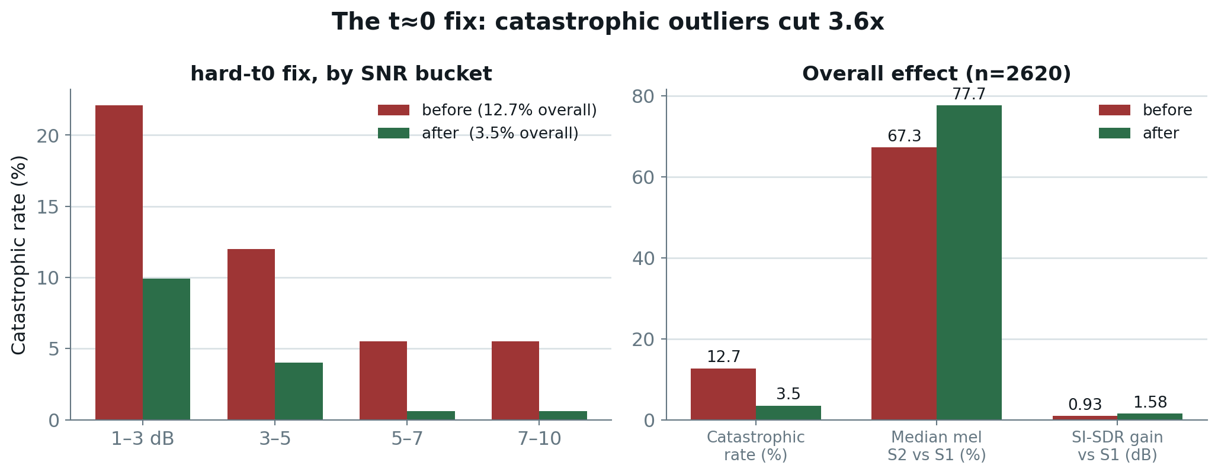
Campaign 1 · Result
n=2620, full test-clean
Catastrophic rate fell 3.6× and improved in EVERY SNR bucket — which is what confirmed we had fixed the diagnosed cause, not just moved an aggregate.

Slide 9
Campaign 2 · Speaker-count generalization
A gap we created by how we trained
The model had only ever been trained on 2-speaker mixtures. Nobody had measured what it does with three or four simultaneous talkers.
First measurement (job 10866):
2 speakers: 86.3%
3 speakers: 76.7%
4 speakers: 72.6%
The fix
A speaker-count curriculum during fine-tuning — P(2 speakers)=0.5, P(3)=0.3, P(4)=0.2 — so the model sees the conditions it will be asked about.
Result: 3-speaker 76.7 → 81.9%, 4-speaker 72.6 → 76.7%, 2-speaker held flat. The gains land exactly where coverage had been missing, which is the signature of a coverage fix rather than a lucky checkpoint.

Slide 10
Campaign 3 · Why cross-corpus validation
Every number so far came from one mixer
All results to this point used our own on-the-fly mixture generator. That leaves an obvious question: are we measuring the system, or the data pipeline we built for it?
Libri2Mix (JorisCos/LibriMix) is a standard benchmark generated by an independent toolchain. We generated its test set and ran the full pipeline over 6,000 samples.
This also exercised the variable-length chunked inference path for the first time — Libri2Mix mixtures are real utterances, not our fixed 10-second training window.
The result split into good news and a discovery we did not expect.

Slide 11
Campaign 3 · The discovery
The aggregate looked bad — and that was informative
Raw aggregate: median mel improvement 23.9%, catastrophic rate 26.7%, SI-SDR vs mixture −0.61 dB. Taken at face value, the system looked broken on an external corpus.
The cause was not generalization failure
Libri2Mix has no SNR floor. Each source is normalized independently, so the target is quieter than the interferer in 60.6% of samples. Our own mixer uses snr_min = 1.0 dB — meaning the model had NEVER, in its entire training history, seen a mixture where the target was the quieter voice.
Splitting exactly on that boundary:
In-distribution (≥1 dB): 73.4% median, 5.7% catastrophic — consistent with our in-house 77.7% / 3.5%
Out-of-distribution (<1 dB): −19.0% median, 40.3% catastrophic

Slide 12
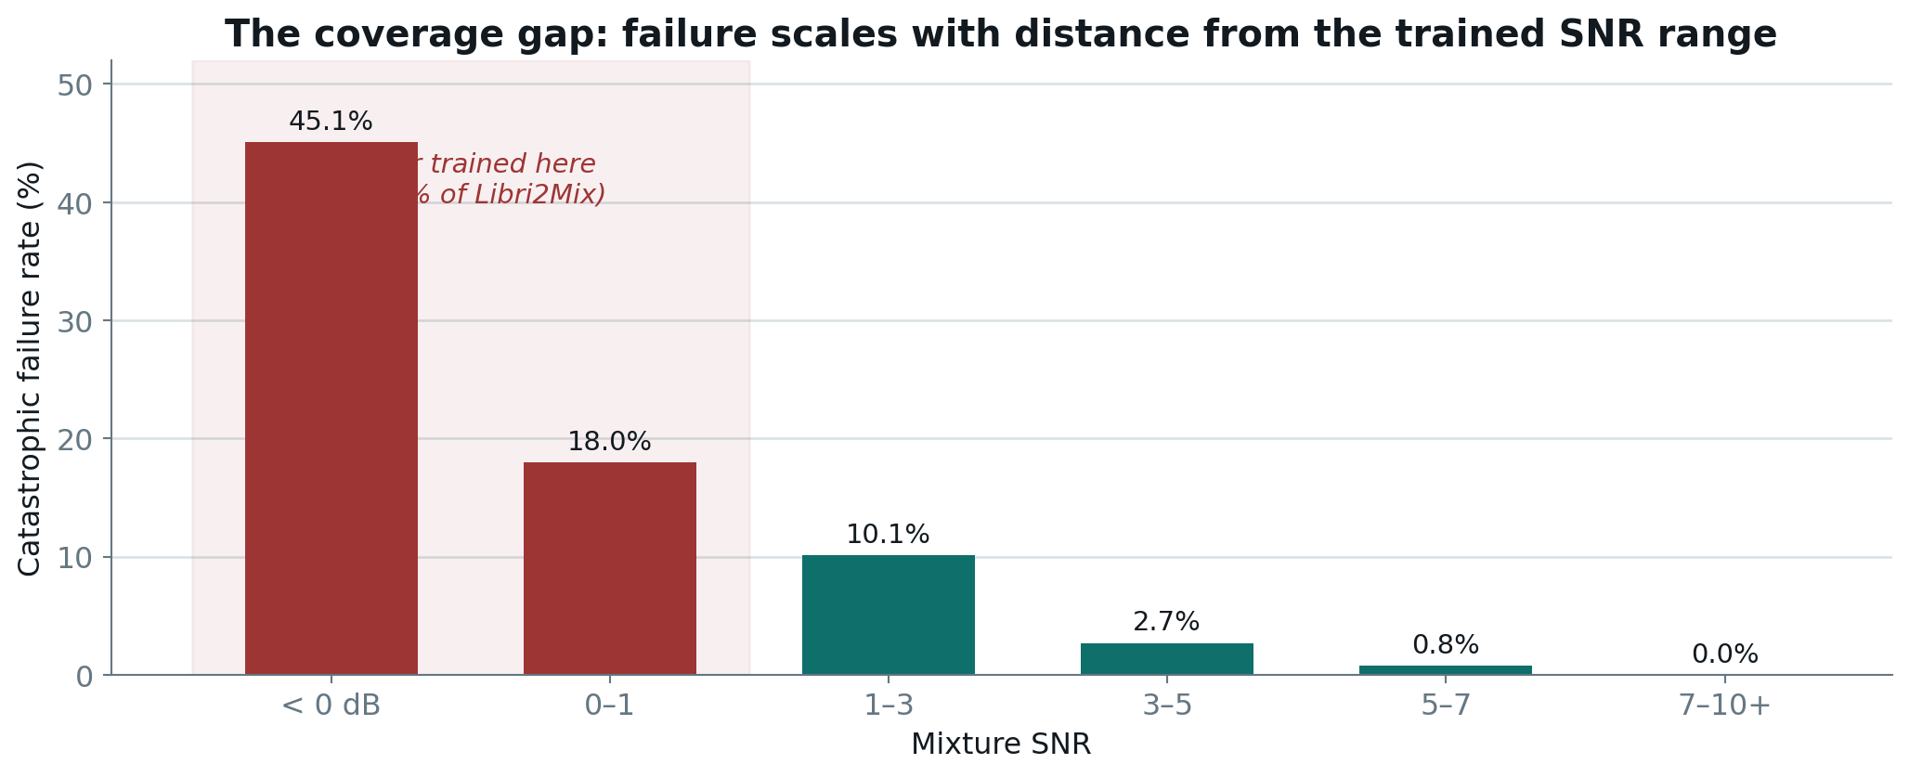
Campaign 3 · Coverage, not capability
The shape of the failure identifies its cause
A smooth monotonic trend — not a cliff. Performance degrades in proportion to how far the mixture sits outside the trained range, which is what a training-coverage gap looks like. An architectural limit would not be this orderly.

Slide 13
Campaign 4 · The low-SNR campaign
The largest single line of work in Phase One
Target: the sub-1 dB regime where the system was actively harmful — 61.3% accuracy against a 64.0% do-nothing baseline. Running the extractor made things worse.
This campaign is worth walking through in detail because most of it failed, and the failures are what located the real constraint.
Attempt 1
50% low-SNR curriculum on Stage 2
REJECTED
Attempt 2
25% low-SNR curriculum on Stage 2
REJECTED
Diagnostic
Oracle decomposition — where is the ceiling?
KEY RESULT
Attempt 3
Stage 1 A/B: multiplicative vs log-gain
PROMOTED
Attempt 4
Stage 2 adaptation to the new Stage 1
PROMOTED*
Attempt 5
Guidance re-tune, cfg 1.5 → 2.5
ADOPTED

Slide 14
Campaign 4 · Why the first two attempts failed
Teaching Stage 2 the new regime cost more than it bought
50% low-SNR curriculum
Target won decisively: low-SNR accuracy 61.3 → 71.3%, SI-SDR −5.94 → +4.11 dB. But corpus-wide accuracy fell 86.5 → 82.0% and the in-domain catastrophic rate rose 3.7 → 15.5% — a 4.2× increase.
25% low-SNR curriculum
Run specifically to test whether a gentler mix found a sweet spot. It kept 38–76% of the gain and 62–73% of the cost — roughly proportional, with no knee in the curve.
What the pair established
Two points on one curve showed the trade is INHERENT at Stage 2, not a tuning failure. We stopped curriculum-weight tuning there rather than running a third mix — and went looking for where the constraint actually lived.

Slide 15
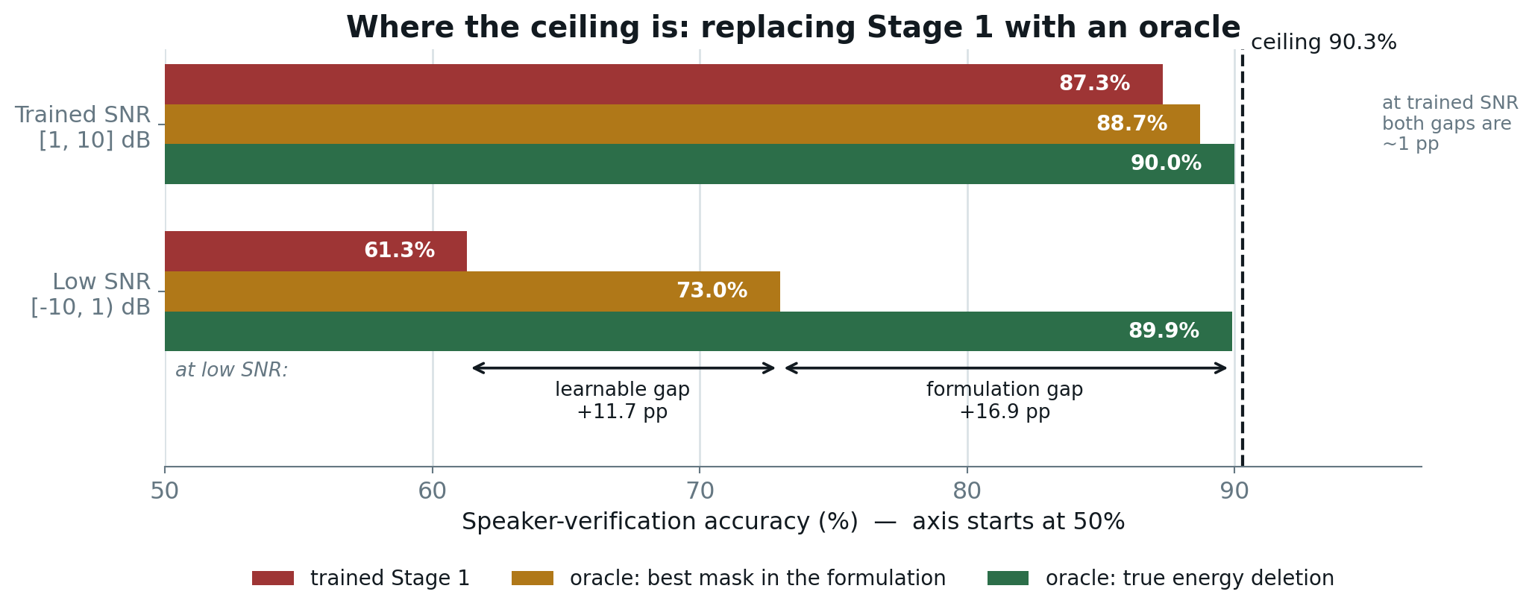
Campaign 4 · The oracle experiment
Asking where the ceiling is, without training anything
We replaced Stage 1 with two oracles built from the clean target — evaluation only, no training, no promotion possible. Each answers a different question:
Oracle A — the best mask that exists WITHIN the paper's formulation (per-bin least squares). If this barely beats the trained network, the network is already near its formulation's limit and retraining Stage 1 cannot help.
Oracle B — true energy deletion, a mask on linear power. This prices what CHANGING the formulation could buy.

Slide 16
Campaign 4 · What the oracle told us
Both gaps are real, and both open at low SNR
At low SNR:
Learnable gap (network → best mask): +11.7 pp — the network falls short of its own formulation
Formulation gap (best mask → true deletion): +16.9 pp — the formulation itself is the larger limit
At trained SNR both collapse to about a point — which is the first evidence that the system is near-saturated in the regime it was built for.
Why this mattered more than either number
It answered a question we had been arguing from intuition: is Stage 1 or Stage 2 the bottleneck? The answer was BOTH, in different proportions, and specifically at low SNR. That redirected the campaign from Stage 2 curricula — which had just failed twice — to Stage 1, where the next attempt succeeded.

Slide 17
Campaign 4 · The Stage 1 A/B
Same curriculum, same seed, one variable
Two arms, identical in every respect except the mask formulation:
Multiplicative — the paper's Eq. 9, X × M
Log-gain — X + log(M), which makes true deletion achievable
Log-gain produced the most accurate Stage 1 ever measured in this project — mel MSE 2.296 against 5.939 for multiplicative, a 2.6× improvement.
And it failed anyway
The frozen Stage 2 destroyed it — worsening its input in 97.7–98.7% of samples. Stage 2 had been trained for 300k steps against multiplicative-mask output and had never seen a mask output BELOW the mixture. A better Stage 1 is worthless to a Stage 2 that was not trained against it.
The multiplicative arm was promoted: low-SNR +8.4 pp at zero corpus-wide cost.

Slide 18
Campaign 4 · Adapting Stage 2, and an honest override
Where we knowingly broke our own rule
After promoting Stage 1, Stage 2 was SUBTRACTING at low SNR (−1.40 dB vs Stage 1) because its input distribution had moved underneath it. We re-adapted it.
Target met decisively: S2-vs-S1 −1.40 → +1.79 dB, low-SNR accuracy 69.7 → 78.7%
Two retention bars FAILED: in-domain mel catastrophic 4.6 → 9.7% (bar ≤5%), Libri2Mix in-distribution 4.9 → 7.3% (bar ≤6%)
We promoted it anyway, and documented why
Both failing bars were the mel proxy. The SI-SDR severity check contradicted them: severe audio regressions barely moved (2.1 → 2.7%), and the share of mel-“catastrophic” cases whose audio was actually fine ROSE to 64%. Moving a bar after seeing results is exactly what pre-registration exists to prevent — so it is reported as an override rather than presented as a clean pass.

Slide 19
Campaign 4 · The free win
A change that cost no training at all
The guidance scale had been set to 1.5 and validated back when BOTH stages were different models. Nobody had re-checked it after two promotions.
A sweep found it mis-tuned for the current pipeline. Moving to cfg 2.5:
2 / 3 / 4-speaker: 84.3 / 78.3 / 74.9 → 85.7 / 80.0 / 77.0
Corpus-wide: 85.2% → 86.2%
Low-SNR: 78.7% → 80.3%
Cost: −0.09 dB SI-SDR and +0.5 pp catastrophic. Accuracy plateaued at 2.5 while outliers began climbing at 3.0, so we stopped there rather than pushing further.
Lesson: after changing components, re-validate the operating point. It had silently become wrong.

Slide 20
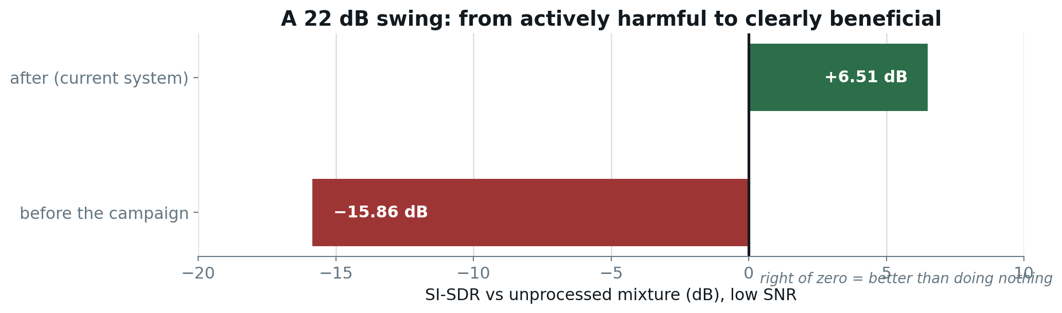
Campaign 4 · End-to-end result
The regime went from harmful to beneficial
Low-SNR accuracy 61.3 → 80.3% · Libri2Mix aggregate −0.04 → +3.39 dB
The honest cost, measured against doing nothing: in-domain SI-SDR fell +1.90 → +1.75 dB and 2/3-speaker accuracy is 1.6 / 2.1 pp below its all-time peak. 4-speaker is at its best ever.
We report both framings. If you only care about in-domain 2-speaker performance, this campaign was a small net loss; the case for it rests entirely on the low-SNR and cross-corpus regimes.

Slide 21
Campaign 5 · A defect no metric could see
Found by listening, not by measuring
After the low-SNR campaign every metric said the system had improved. A routine listening check said otherwise: the first half-second of some utterances was audibly damped.
Measured, it is not gradual damping but a GATE — the output sits on a flat ≈−60 dB floor and then switches on abruptly.
Localizing it:
First speech burst: −4.08 dB
Interior onsets (after silence): +0.29 dB
Sustained speech: +0.01 dB
Interior onsets are acoustically the same event and are reproduced perfectly — so this is a POSITION-0 effect, not an acoustic one. Frame 0 is the only frame with no left context for the DiT's rotary attention.

Slide 22
Campaign 5 · Which change caused it
A 2×2 ablation over the two promotions
Both pre-promotion checkpoints survived, so we could run every combination at the deployed operating point — with old/old as the method's own control.
Stage 1
Stage 2
Gated
Median onset
4-spk gated
old
old
1 / 24
−1.00 dB
0 / 8
NEW
old
1 / 24
−2.01 dB
0 / 8
old
NEW
2 / 24
−1.95 dB
0 / 8
NEW
NEW
7 / 24
−4.67 dB
3 / 8
Neither promotion causes it alone — each is indistinguishable from the control. Only the PAIR gates, and superadditively: summing the individual effects predicts ≈2/24, we measured 7/24.
This removes the cheapest remedy. There is no single promotion to revert, because neither is individually at fault — the defect lives in the coupling between them.

Slide 23
Campaign 5 · Two attempts, both failed
And they failed in the same place
The bar was fixed in advance at ≤1/24 gated — the pre-campaign level — on the grounds that a defect the campaign introduced should be absent after a fix.
Attempt 1 — targeted fine-tune
Fine-tuned Stage 2 against the failing condition. Result: 7/24 → 4/24 — and 4-speaker did not move at all.
Attempt 2 — inference-side repair
Spliced a silent lead-in so the weak region falls in discarded frames. No retraining. Result: 7/24 → 6/24 — and 4-speaker did not move at all.
Both failing in the 4-speaker condition is what the ablation predicts
A defect that lives in the interaction between two checkpoints is reachable neither by adjusting one stage, nor by post-processing the pair's output. Reported as a characterized limitation with an established cause — not quietly dropped.

Slide 24
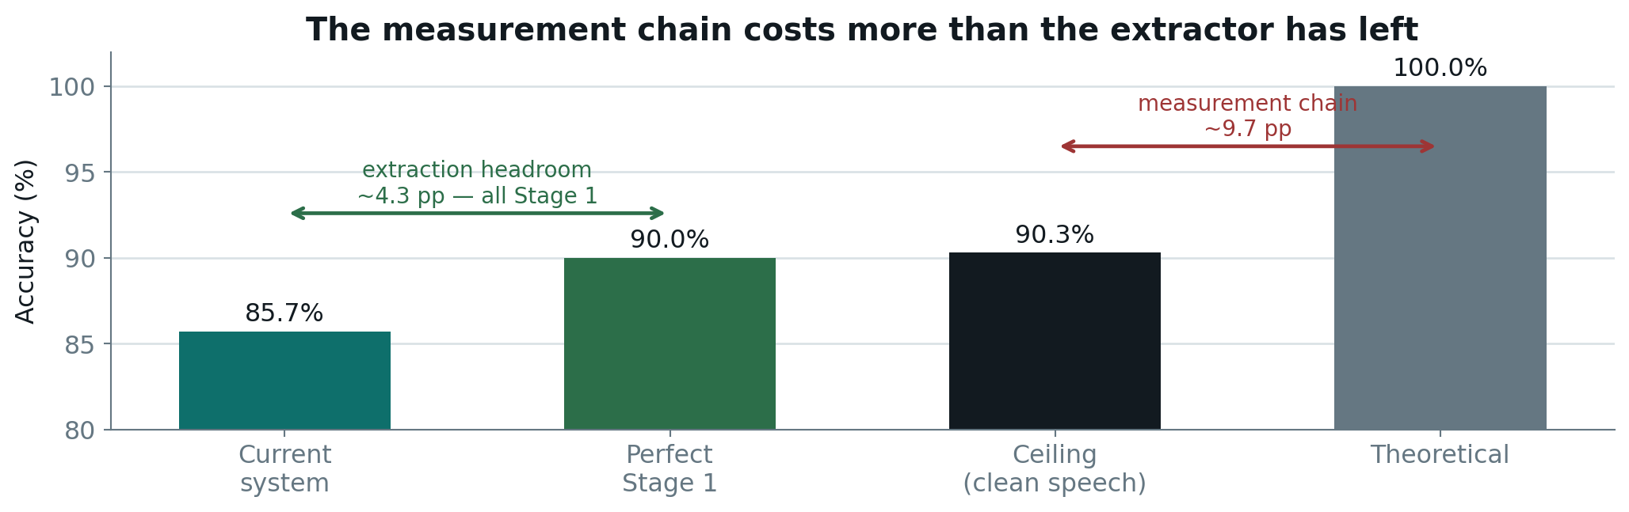
How much room is actually left?
The question that redirected Phase Two
The ceiling probe passes the GROUND-TRUTH clean target through the same mel → HiFi-GAN → WavLM chain as every other probe. So 90.3% is what perfect extraction of perfectly clean speech scores.
The remaining 9.7 pp is lost by the vocoder and speaker encoder before extraction quality enters the picture at all.

Slide 25
The prediction, and the test
Five experiments that all failed — as predicted
The ceiling analysis said Stage 2 and the operating point are SATURATED at the trained SNR: a perfect Stage 1 would score 90.0% against a 90.3% ceiling.
If that is true, inference-time tuning should buy nothing. We tested five:
✕ Onset padding/splice (repair the gate at inference) → no accuracy change
✕ CFG warm-up (flagged as ‘improves everything’) → accuracy fell everywhere
✕ Longer enrollment (5s) (known strong TSE lever) → worse — the ceiling itself fell
✕ Heun ODE solver (2nd-order, at equal compute) → worse, especially at low SNR
✕ Alternate projection (never-evaluated checkpoint) → same accuracy, lower AUC
Five for five. That is not bad luck — it is what a saturated operating point looks like, and it is the strongest evidence that the ceiling analysis is correct.

Slide 26
Two of those rejections taught us something
The mechanism matters more than the verdict
Heun solver — why a better integrator made things worse
Stage 2 is trained with a RECTIFIED FLOW objective, which explicitly optimizes for straight trajectories. Euler is exact on a straight line, so there was no integration error left for a 2nd-order method to recover — while halving the steps to hold compute fixed also halved the number of guidance applications. Our unit test confirms the solver IS more accurate on a curved field; the model simply does not produce one.
CFG warm-up — why ‘no metric worse’ was an illusion
It had been flagged twice as the only change improving every measured metric with nothing worse. It had never been measured on ACCURACY, because only one of five evaluation scripts exposed the flag. Wired through and measured: the quality gains replicated, and accuracy fell in every condition. Warm-up is simply weaker guidance re-parameterized.

Slide 27
Listening tests
The metrics are proxies — these are the actual outputs
Every number in this deck is a proxy for one question: does the output sound like the target speaker? The following slides contain the real audio, embedded — click to play.
Each slide gives you three clips for the same sample:
Mixture — what a microphone would pick up — all speakers at once
Extracted — our system's output — this is the one to judge
Clean target — ground truth, vocoded from its own mel — the ceiling
All samples come from the CURRENT deployed checkpoint at the trained SNR range. The clean target is vocoded rather than raw, so you hear the vocoder's own ceiling — that is deliberate, it is the fair comparison.

Slide 28

Listening · 2 speakers
Sample: 2speakers/sample_01 · current checkpoint, trained SNR
Mixture
all speakers together
What you are hearing
• Target speaker 1188, one interferer (5105) at +4.8 dB
• Mel improvement over Stage 1: +82.6%
• Speaker similarity to reference: mixture −0.02 → extracted 0.60
• Vocoded ceiling for this sample: 0.54
Extracted ◀ our output
judge this one
Clean target
ground-truth ceiling
EXTRACTION EXCEEDS THE CEILING
The extracted output scores HIGHER on speaker similarity than the vocoded ground truth (0.60 vs 0.54). That is not an error: both pass through the same vocoder, and the extraction happens to land slightly closer to the reference embedding than the vocoded original does. It is a useful reminder that the ceiling is a measurement artifact, not a physical limit.

Slide 29
Listening · 3 speakers
Sample: 3speakers/sample_01 · current checkpoint, trained SNR
Mixture
all speakers together
What you are hearing
• Target 1188, two interferers (5105, 2094) at +8.1 and +1.3 dB
• Mel improvement over Stage 1: +81.8%
• Speaker similarity: mixture 0.44 → extracted 0.48
• Vocoded ceiling: 0.54
Extracted ◀ our output
judge this one
Clean target
ground-truth ceiling
CLEAR EXTRACTION, HARDER CASE
Three simultaneous talkers, one of them only 1.3 dB below the target. The mel improvement holds up at +81.8%, but notice the similarity gain over the mixture is much smaller than in the 2-speaker case — the mixture already partly resembles the target when the interferers are quieter, so there is less headroom for the metric to show.

Slide 30
Listening · 4 speakers
Sample: 4speakers/sample_03 · current checkpoint, trained SNR
Mixture
all speakers together
What you are hearing
• Target 1188, three interferers at +7.1, +9.2 and +5.4 dB
• Mel improvement over Stage 1: +29.6%
• Speaker similarity: mixture 0.36 → extracted 0.66
• Vocoded ceiling: 0.70
Extracted ◀ our output
judge this one
Clean target
ground-truth ceiling
WORKS, BUT DEGRADING
The best of our four-speaker samples: similarity climbs from 0.36 to 0.66 against a 0.70 ceiling. But the mel improvement has fallen to +29.6% from the +80% range seen at two speakers — the visible cost of asking a model trained on two voices to handle four.

Slide 31
Listening · Where it still fails
Sample: 4speakers/sample_01 · current checkpoint, trained SNR
Mixture
all speakers together
What you are hearing
• Target 1188, three interferers at +1.3, +2.5 and +9.7 dB
• Mel change vs Stage 1: −18.7% (Stage 2 made it WORSE)
• Speaker similarity: mixture 0.12 → extracted 0.24
• Vocoded ceiling: 0.54
Extracted ◀ our output
judge this one
Clean target
ground-truth ceiling
FAILURE CASE — SHOWN DELIBERATELY
Two of the three interferers sit within 2.5 dB of the target. Stage 2 degrades its own input here rather than improving it. We include this because a deck of only successful samples would misrepresent the system — this is what the 4-speaker catastrophic rate sounds like, and it is the condition both onset mitigations also failed on.

Slide 32
Engineering: defects that would not have raised an error
The dangerous class — silent corruption, not crashes
Padding dilution
Enrollment clips shorter than 3 s were zero-padded before mean-pooled embedding, diluting every speaker vector. Fixing it moved accuracy +0.6/+0.2/+0.3 pp — a MEASUREMENT correction that re-based every later comparison.
Missing training data
The config listed three LibriSpeech splits; only one was ever on disk. Every checkpoint trained on ~100 h instead of ~960 h, with no error anywhere.
Partial extraction
An interrupted extraction left 83,232 of 104,014 files — 80% complete. Because tar extracts by path, the missing fifth was WHOLE SPEAKER DIRECTORIES.
RIR contamination
The reverb corpus ships 843 noise recordings beside the impulse responses; a recursive glob would have convolved speech with noise as if it were reverb.
Each of these produced plausible-looking results rather than a failure. That is why the project now verifies completeness by COUNT, never by existence.

Slide 33
The recurring methodological trap
Learned three separate times
A change that improves every metric you happen to be looking at has NOT been shown to be free.
1 · mel vs SI-SDR
At low SNR the two metrics disagreed in DIRECTION — mel said mildly positive, SI-SDR said severely negative. A deletion-only mask forced to remove most of the spectrum takes target energy with it.
2 · log-gain Stage 1
A 2.6× more accurate Stage 1 produced a WORSE pipeline, because Stage 2 had never been trained against that input family.
3 · CFG warm-up
Improved mel and SI-SDR with nothing worse — because the diagnostic that surfaced it never measured accuracy, the one axis that carried the cost.
The habit that came out of it: ask which axis the current diagnostic CANNOT see, and measure that one before believing the result.

Slide 34
Infrastructure reality
A material fraction of elapsed time went to cluster faults
SLURM auth daemon died mid-job
The munge socket vanished during extraction, killing the job. Cluster-level; job scripts were made idempotent in response.
GPU occupied by a foreign process
14,994 MiB of a 16,384 MiB P100 held by another process. Per-sample time degraded 5.5 s → 76.8 s — a 14× slowdown. A 5-minute stage took 347 minutes. Visible only because our launcher prints nvidia-smi at job start.
Filesystem full
A 15.5-hour training run died at step 21,874 with ENOSPC. The shared volume swung 161 GB → 38 GB overnight through other users' activity.
NFS write failures
Extraction of a checksum-verified archive failed twice with I/O errors at 450 GB+ free — a storage fault, not capacity. Still unresolved.
Two practices came out of this: print environment diagnostics before doing work, and make every long job idempotent.

Slide 35
Data expansion
Prerequisite for Phase Two
The ceiling analysis says the remaining extraction headroom is in Stage 1. The obvious lever is more data — and we discovered we had far less than the config claimed.
Before
Now
Training hours
~100 h
~600 h
Training speakers
251
~1,417
Splits on disk
train-clean-100
+ train-other-500
For a speaker-conditioned task the 5.6× increase in SPEAKER COUNT is arguably more relevant than the hours — the model had only ever seen 251 identities.
train-clean-360 is downloaded and checksum-verified but BLOCKED: extraction fails with NFS I/O errors at 450 GB+ free. It would add 360 h on top of 600 h — a smaller increment than the first expansion, so it is not a blocker.

Slide 36
Phase Two
Following the ceiling analysis, not intuition
1
Stage 1 retrain on ~600 h
~47 h
All remaining extraction headroom (~4.3 pp) is here
2
Stage 2 adaptation
~13 h
MANDATORY — log-gain proved a better Stage 1 alone makes it worse
3
Measurement chain
1–2 d
The larger pool at ~9.7 pp: vocoder + speaker encoder
4
Multi-utterance enrollment
hours
We rejected a longer window on ONE clip; pooling several is untested
5
Onset gate
4–13 h
Co-adapt both stages, or weight the loss toward failing frames

Slide 37
What Phase One establishes
The position we are starting Phase Two from
A working, validated system
86.2% corpus-wide accuracy against a 71.0% do-nothing baseline and a 90.8% ceiling, holding up on a corpus we did not build.
A quantified ceiling
We know where effort will and will not pay: ~4.3 pp in Stage 1, ~9.7 pp in the measurement chain, nothing at the operating point.
Four characterized limitations
Each with an established root cause — two mitigated, one closed, one open and explained.
A decision discipline that works
Pre-registered bars caught five changes that looked like improvements and were not. Eleven of fifteen candidates were rejected.
The rejections are the more useful half of this report. A system whose failures are understood is in a better position than one whose successes are unexplained.

Slide 38
Every change we evaluated
4 promoted · 11 rejected
Ordered as run. Colour indicates the verdict.
Safety-net fallback
REJECTED
cfg 1.5 → 2.5
ADOPTED
hard-t0 fine-tune
PROMOTED
log-gain pair
REJECTED
hard-multispeaker FT
PROMOTED
onset fine-tune
REJECTED
50% low-SNR curriculum
REJECTED
onset padding/splice
REJECTED
25% low-SNR curriculum
REJECTED
CFG warm-up
REJECTED
log-gain S1, frozen S2
REJECTED
reference_length 5 s
REJECTED
Stage 1 low-SNR FT
PROMOTED
Heun solver
REJECTED
Stage 2 adaptation
OVERRIDE
projection_best
REJECTED
Every rejection came with a measured mechanism, not just a number — which is what makes them reusable knowledge rather than dead ends.

Slide 39
Thank you
Questions?
Mask2Flow-TSE · Phase One · Vinay Reddy Galigutta · 25CS60R85

