Slide 1
Employee salary prediction using MACHINE LEARNING ALGORITHM
CAPSTONE PROJECT
Vinay Rathore
KIET group of institutions (Delhi –NCR)
Computer Science (AI)
STU67827d5674a651736605014

Slide 2
OUTLINE
Problem Statement (Should not include solution)
System Development Approach (Technology Used)
Algorithm & Deployment (Step by Step Procedure)
Result
Conclusion
Future Scope(Optonal)
References

Slide 3
Problem Statement
Predicting employee income level is crucial for workforce analysis and HR decision-making.
The goal is to classify whether an individual earns >50K or ≤50K annually.
Uses input features like age, education level, occupation, working hours, and native country.
Manual classification is time-consuming, inaccurate, and prone to bias.
A machine learning model helps automate and accurately predict income class, improving efficiency.

Slide 4
System Approach
✅ 1. System Requirements
Processor: Intel i5 or higher (recommended for faster computation)
RAM: Minimum 4 GB (8 GB recommended)
Storage: At least 1 GB of free space
Operating System: Windows, Linux, or macOS
Browser: Google Chrome, Firefox (for Streamlit web interface)
Python Version: Python 3.7 or higher
📚 2. Required Libraries
pandas – for data loading and manipulation
numpy – for numerical operations
scikit-learn – for preprocessing, model training, and evaluation
joblib – for saving and loading trained models
streamlit – for building the interactive web app
pyngrok – for exposing local Streamlit app to the internet (optional, for deployment)

Slide 5
Algorithm & Deployment
Data Collection
Loaded the Adult Salary Dataset (also known as the Census Income dataset) containing demographic and employment-related features.
Data Preprocessing
Handled missing values, dropped unnecessary columns (like 'education'), and applied Label Encoding to categorical features.
Model Building
Trained multiple classification models (e.g., Decision Tree, Random Forest, etc.) and selected the best-performing one based on accuracy.
Model Saving
Saved the trained model using joblib for future use without retraining.
Web App Development
Built an interactive user interface using Streamlit to take employee inputs and show predictions.
Encoding Logic for Inputs
Applied the same encoding used during training to ensure consistent model performance.
Batch Prediction Feature
Added CSV upload functionality to perform predictions on multiple employees at once.
Deployment
Used pyngrok to deploy the Streamlit app and make it accessible via a public URL.

Slide 6
Algorithm & Deployment
Encoding Logic for Inputs
Applied the same encoding used during training to ensure consistent model performance.
Batch Prediction Feature
Added CSV upload functionality to perform predictions on multiple employees at once.
Deployment
Used pyngrok to deploy the Streamlit app and make it accessible via a public URL.
9. Model Evaluation Evaluated model performance using metrics like accuracy, precision, recall, and confusion matrix.
10.Testing & Validation Performed testing on various input combinations to validate prediction consistency.

Slide 7
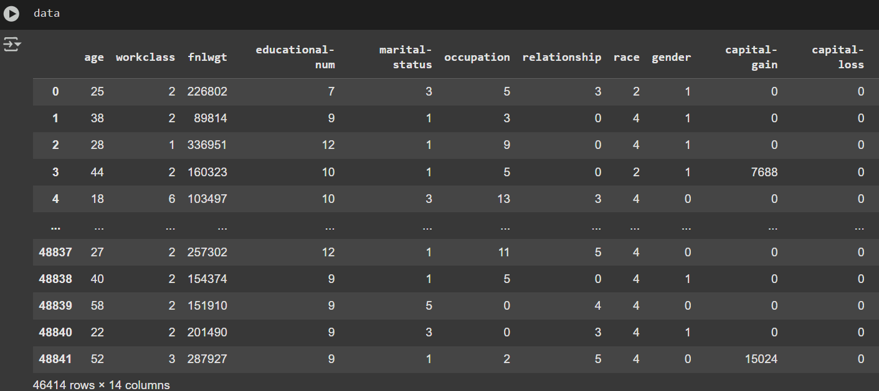
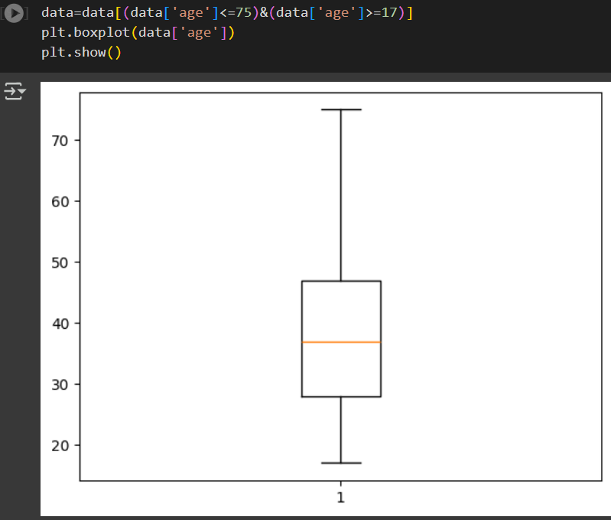
Result

Slide 8
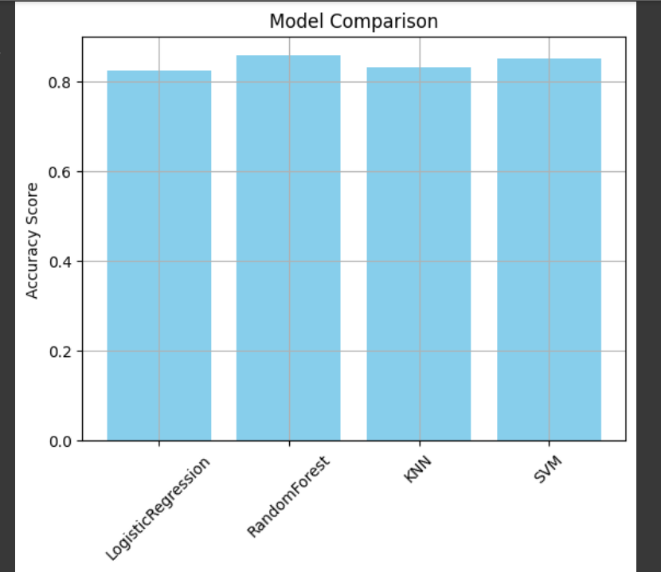
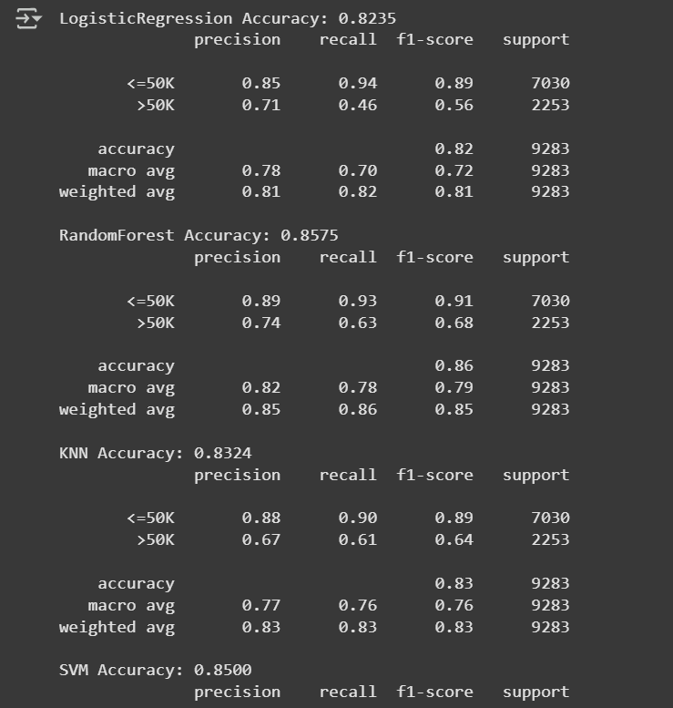
Result

Slide 9
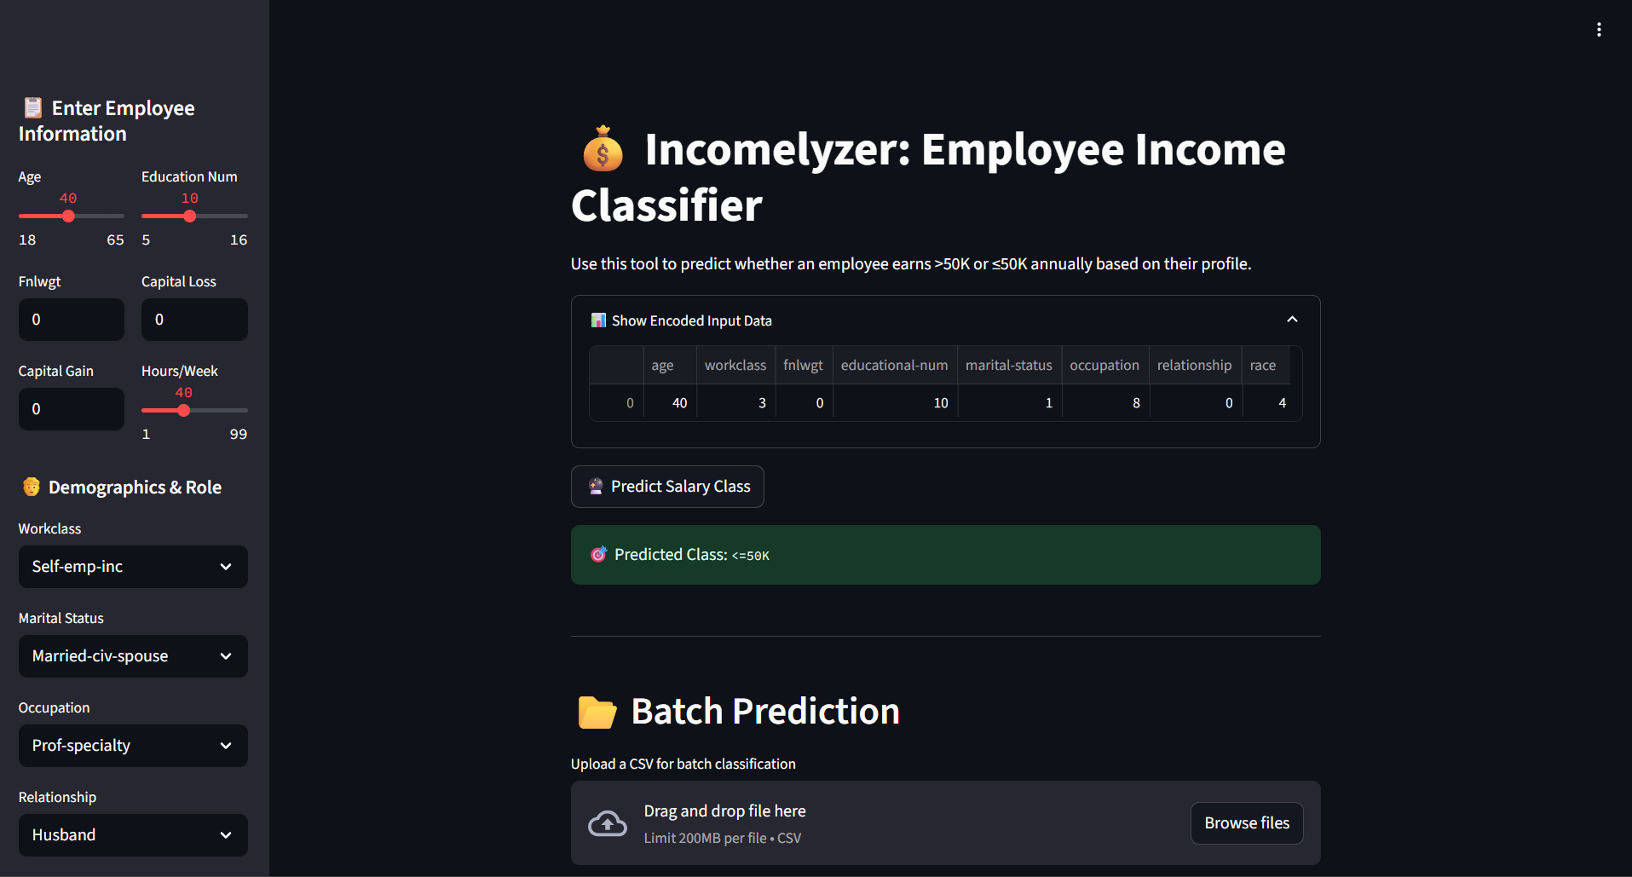
Result
Github Link
https://github.com/vinayR-cmd/Employee_Salary_Prediction.git

Slide 10
Conclusion
📊 Findings & Discussion
The model accurately classifies employee income as >50K or ≤50K using demographic and work-related data.
The Streamlit app enables both real-time and batch predictions with a user-friendly interface.
Encoding consistency was a key challenge, especially for categorical variables.
Temporary deployment via ngrok had limitations (max 3 tunnels).
Future improvements:
Use OneHotEncoder for better unseen data handling
Save encoders with the model
Deploy on Streamlit Cloud for stability
Add confidence scores for predictions

Slide 11
Future scope(Optional)
🔮 Future Scope
Deploy on cloud platforms like Streamlit Cloud, Heroku, or AWS for 24/7 accessibility without ngrok limits.
Integrate confidence scores using predict_proba() to show prediction certainty.
Enhance encoding with OneHotEncoder or OrdinalEncoder to better handle unseen input values.
Add visual analytics (charts/graphs) for feature importance and prediction distribution.
Extend to a regression model to predict exact salary range instead of just classification.
Enable user authentication and data saving to personalize predictions for HR departments.

Slide 12
References
💻 Google Colab (Model development & testing): https://colab.research.google.com
🧠 Scikit-Learn (ML Library): https://scikit-learn.org
📄 Pandas Documentation (Data Manipulation): https://pandas.pydata.org/docs
🌐 Streamlit (Web App Framework): https://streamlit.io
🌍 Pyngrok (Expose local app online): https://github.com/alexdlaird/pyngrok
📘 Joblib (Model Saving & Loading): https://joblib.readthedocs.io
🧾 GitHub (Project hosting & version control): https://github.com
📚 Python Official Docs: https://docs.python.org/3/

Slide 13
THANK YOU

