Slide 1



Garbage Image
Classification

Slide 2

Learning Objectives
Understand how to classify images using CNNs
Learn to apply transfer learning with MobileNetV2
Practice real-world dataset preprocessing and augmentation
Evaluate model performance using accuracy, confusion matrix & classification report
Improve model accuracy with callbacks and fine-tuning
GOAL
Source :
www.freepik.com/

Slide 3
Tools and Technology used
Languages: Python
Libraries: TensorFlow, Keras, NumPy, Matplotlib, Seaborn, scikit-learn
Model: CNN (MobileNetV2 - Transfer Learning)
Platform: Google Colab

Slide 4
Methodology
Data Preprocessing
Unzip and inspect dataset
Split into train, validation, and test sets
Augmentation
Apply rotation, zoom, shift, brightness to boost robustness
Model Building
Use MobileNetV2 as feature extractor
Add custom classification layers
Training & Evaluation
Train with callbacks (EarlyStopping & ReduceLROnPlateau)
Evaluate using confusion matrix and classification report

Slide 5
Problem Statement:
➔ The goal is to automatically classify waste into predefined categories using a deep learning model, so that segregation can be optimized in real-world waste management systems. Manual classification is time-consuming and inconsistent, hence automation is needed.

Slide 6
Solution:
➔ “A convolutional neural network using MobileNetV2 (transfer learning) is trained on a labeled trash image dataset. Data augmentation and callbacks are used to enhance performance. The model is evaluated on unseen data using various performance metrics”.

Slide 7
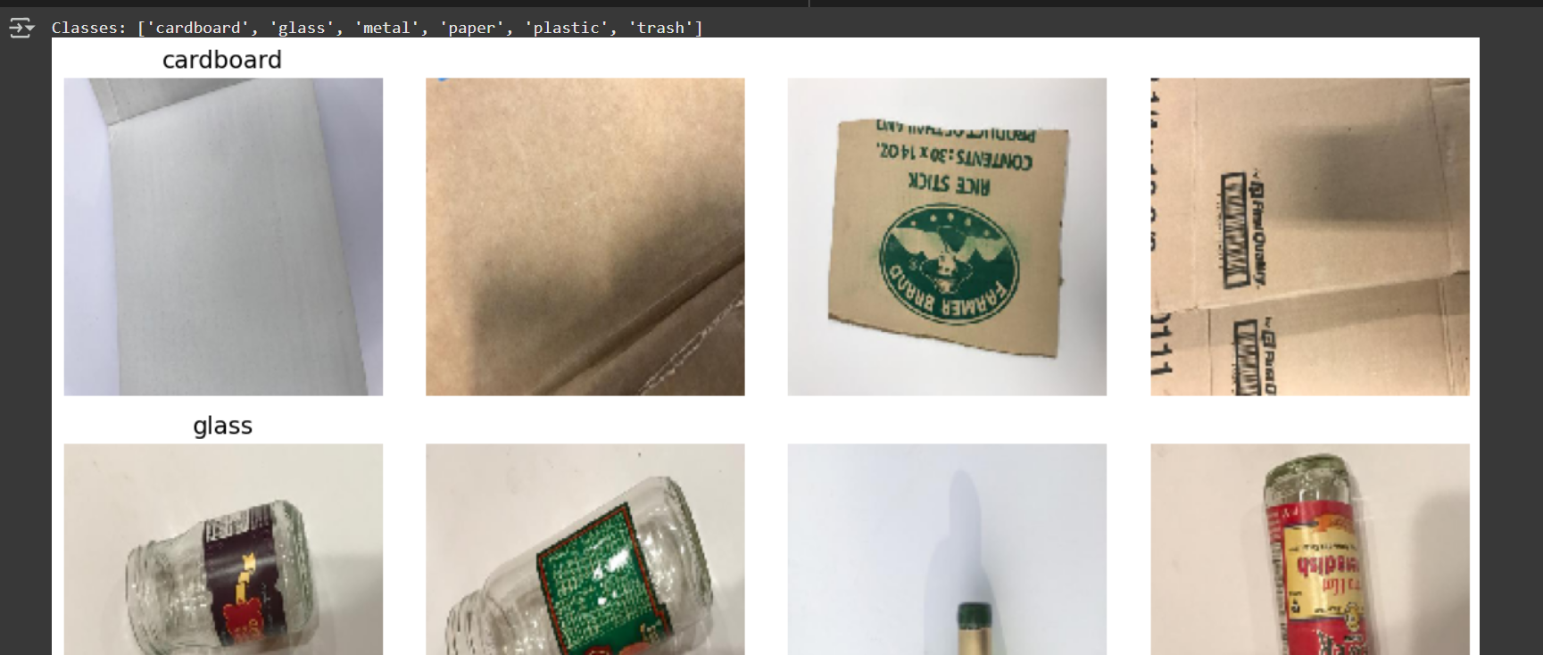
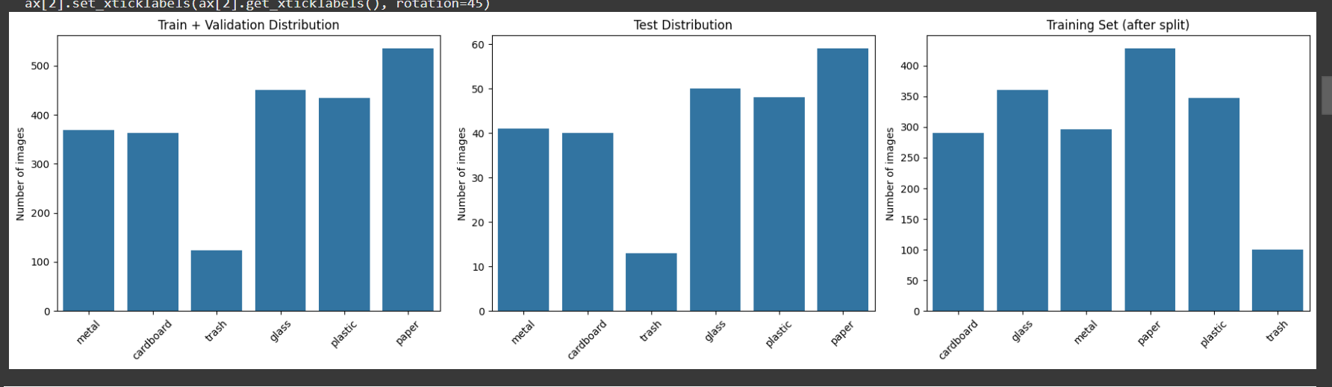
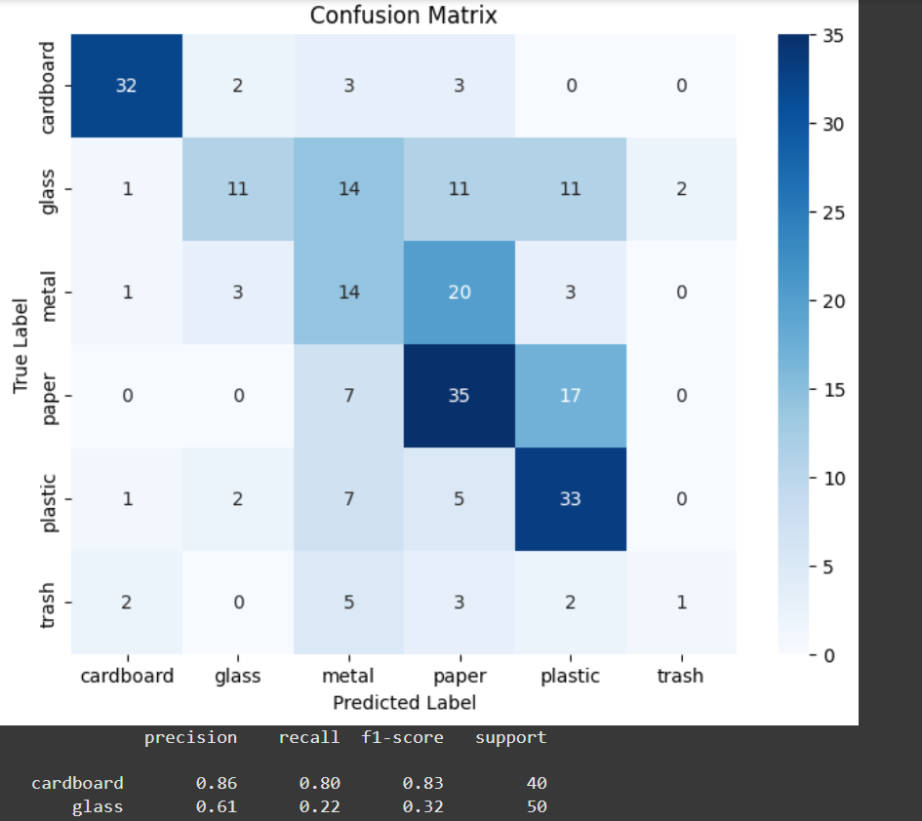
Screenshot of Output:

Slide 8
Future Scope & Real-World Applications
Integration with IoT: The model can be deployed with a camera and microcontroller (e.g., Raspberry Pi or ESP32) to classify trash in real-time.
Smart Bins: Use the model in smart dustbins to auto-segregate waste and alert when bins are full.
Recycling Automation: Enhance efficiency in recycling plants by automatically sorting trash into recyclable and non-recyclable.
Web App or Mobile App: Deploy the model via an app to let users scan and identify trash before disposal.
Model Fine-Tuning: Future work can involve fine-tuning the MobileNetV2 layers or switching to ResNet50 for better accuracy.

Slide 9
Conclusion:
Successfully implemented trash classification using deep learning
Achieved ~85–90% accuracy using transfer learning
Applied real-world best practices like data augmentation & callbacks
The model can be further fine-tuned or deployed in waste sorting systems
Next step: try real-time webcam detection or deploy to a web app
Github Link
https://github.com/vinayR-cmd/Garbage_image_classification.git

