Slide 1

Impact of Automation on Occupations
Navigating the Workforce of Tomorrow
TEAM:
Bryson Wersonke, Madhavi Pandey, Pallavi Tripathi, Ranjini Rao & Vinaya Kusuma

Slide 2
Agenda
Introduction
Objectives
Data Source
Data processing – cleaning
Analysis
Visualization
Key findings
Conclusion

Slide 3
Introduction
Rapidly changing dynamics of job market
Influence of Technological advancements
Affects on various industries and job roles
Need of Impact of Automation on occupations analysis

Slide 4
Objectives
Core objective of this data analysis is to utilize the prediction data of job market and identify the impact of automation in specific jobs in future job market. We will answer the following questions during this analysis,
What is the employment distribution across various sectors/industries?
What are the fastest growing/declining occupations ?
What is the distribution of the wages for different sectors?

Slide 5
Objectives
What are the jobs that are affected the most due to automation
What will be the impact of automation on each ethnicity.
What are the employment prospects for the job seekers who have lost their jobs due to automation?
What is the impact of automation across US states?
What are the highly impacted jobs in certain US states?
Are the jobs being lost to automation lower or higher paying than other jobs available

Slide 6
Data Source
https://www.bls.gov/emp/tables/occupational-projections-and-characteristics.htm
https://www.bls.gov/oes/current/oes_nat.htm#17-0000
https://www.bls.gov/emp/tables/occupational-separations-and-openings.htm
https://www.bls.gov/emp/tables/unemployment-earnings-education.htm
https://www.kaggle.com/datasets/andrewmvd/occupation-salary-and-likelihood-of-automation/
https://www.bls.gov/oes/current/oes_research_estimates.htm
Article: oxfordmartin.ox.ac.uk/downloads/academic/The_Future_of_Employment.pdf
BLS Public Data API
"https://api.bls.gov/publicAPI/v2/"

Slide 7
Data Processing – Cleaning & transformation
Removed headers and footers
Removed duplicated records
Replaced hyphens (-), dollar signs and commas with empty string
Removed star (**) data from the dataset
Conversion from string to numerical

Slide 8
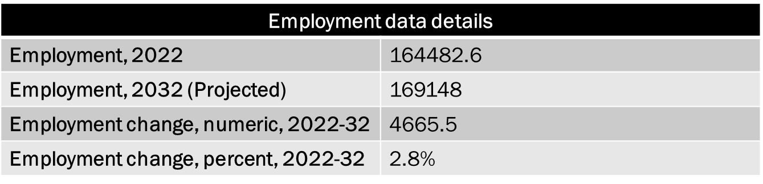
Employment distribution
Note: The employment data values are in thousands

Slide 9
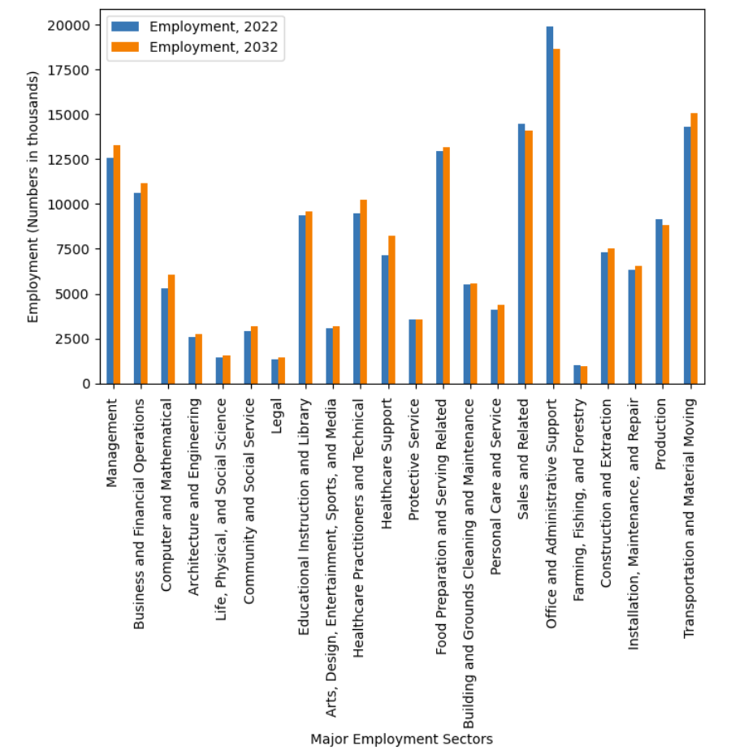
Current and Projected employment(2032) distribution in major sectors

Slide 10
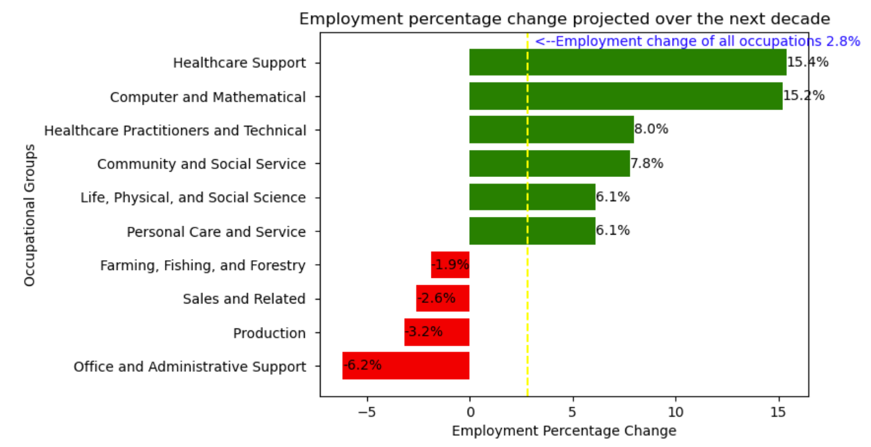
Employment Change Profile

Slide 11
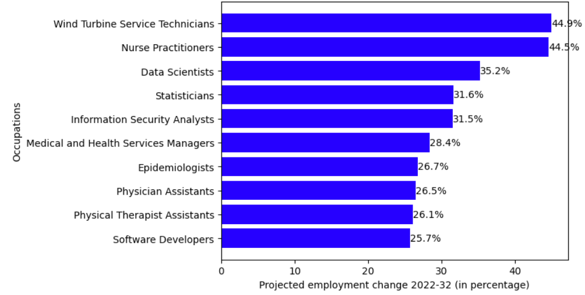
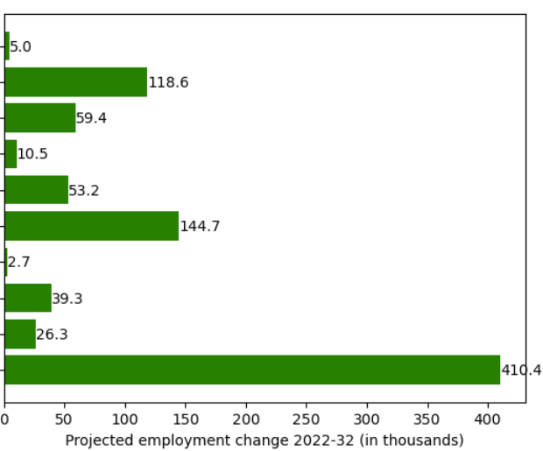
Top 10 Fastest growing Occupations
Automation Probability
0.009
0.22
0.22
0.21
0.0073
0.2
0.14
0.021
0.13

Slide 12
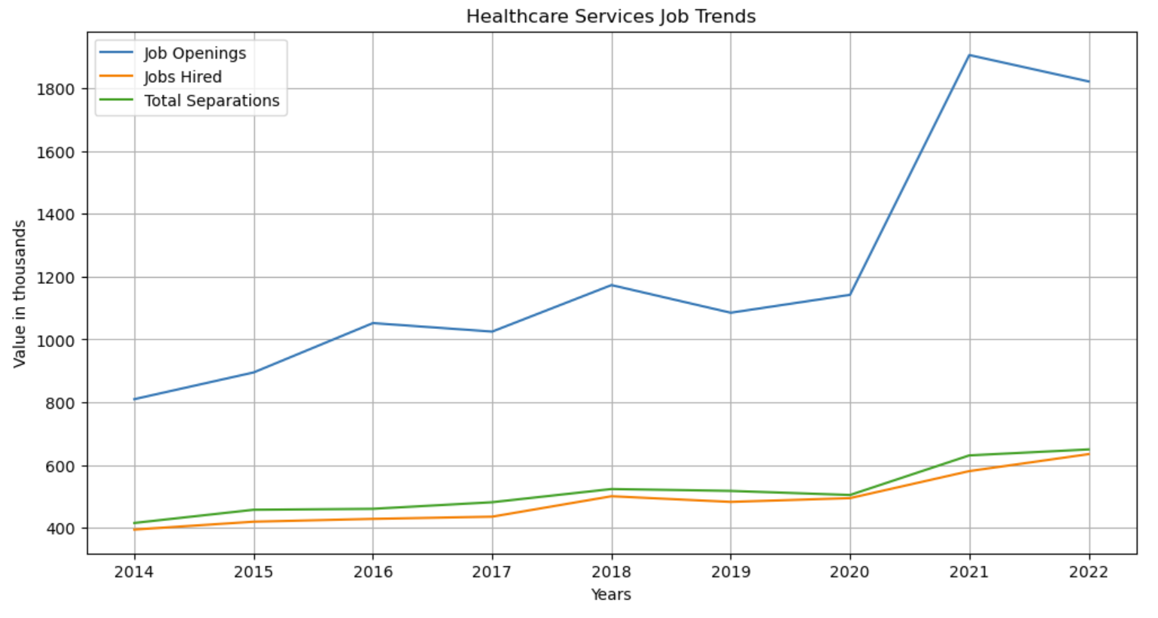
Job Trends in Healthcare industry
Data Source : BLS Public Data API

Slide 13
Distribution of the wages in sectors
Answer to question 2

Slide 14
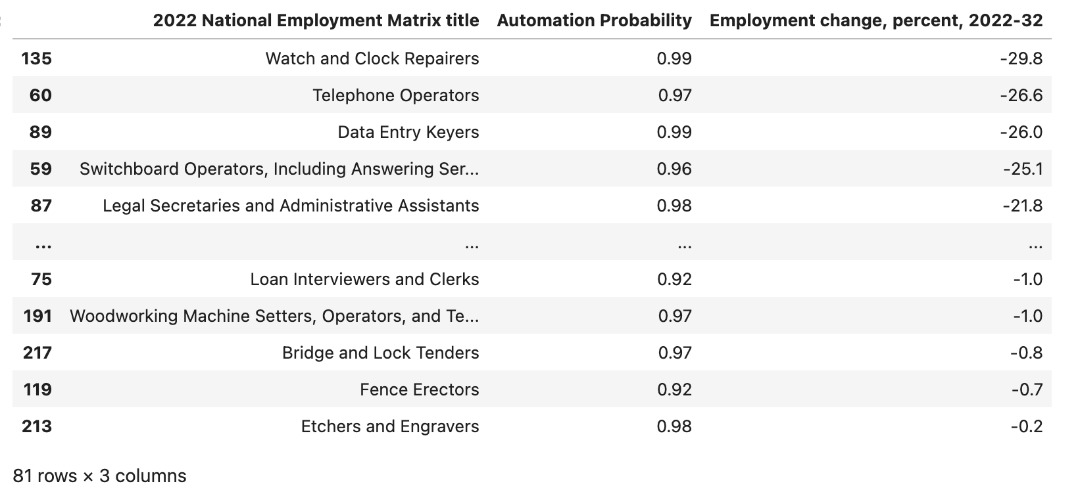
Occupations affected due to automation

Slide 15
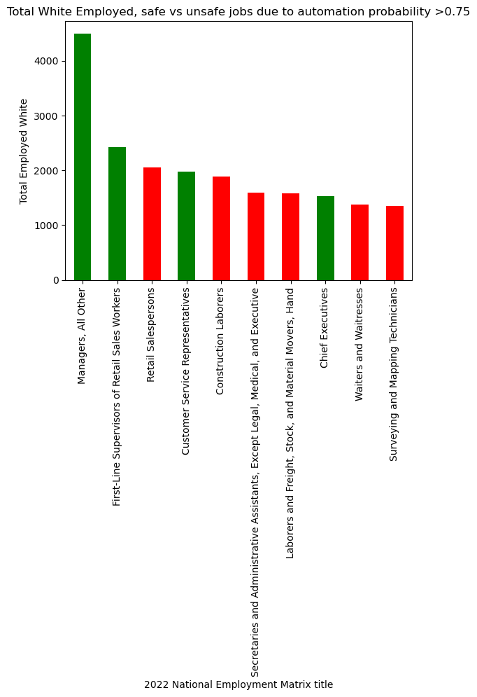
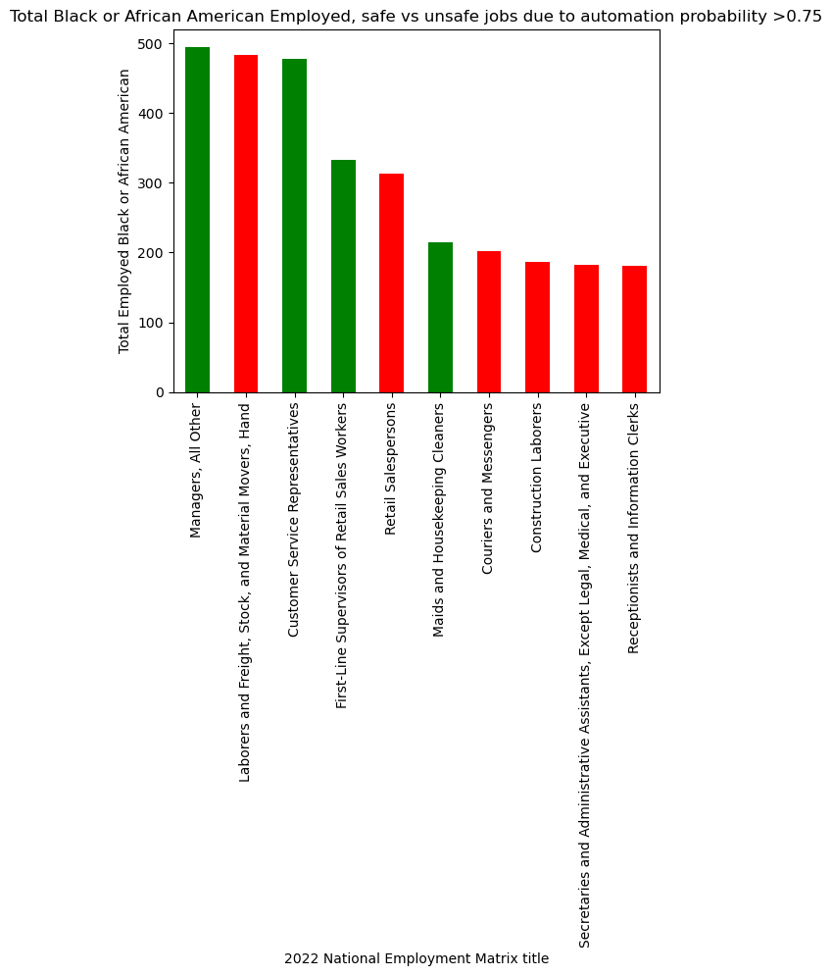
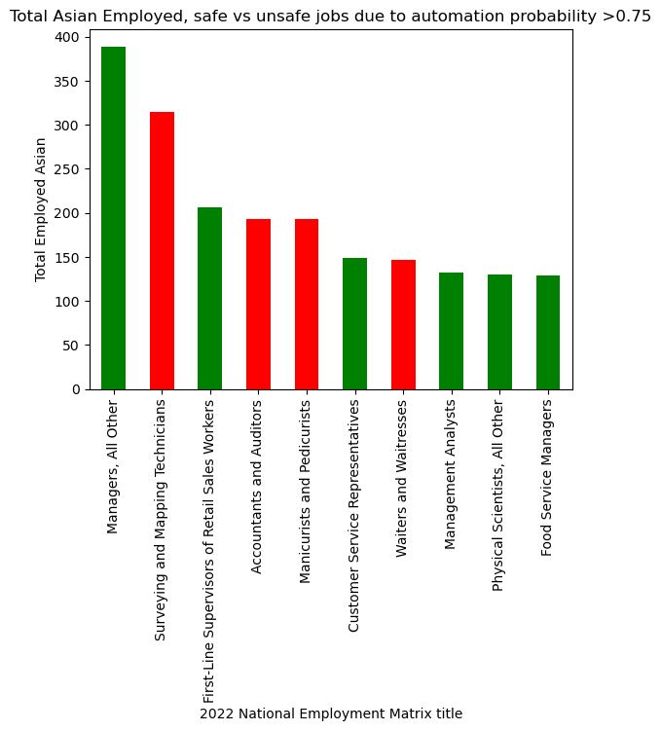
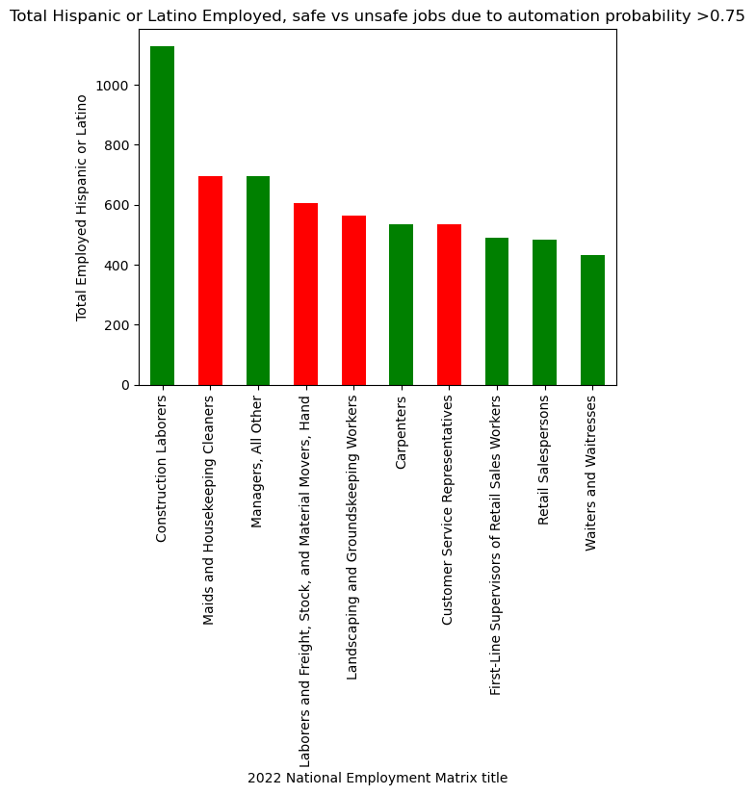
Impact of automation per Ethnicity

Slide 16
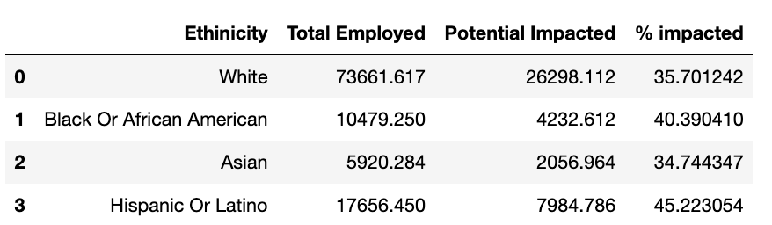
Impact of automation per Ethnicity

Slide 17
Employment prospects for job seekers
Answer to question 6

Slide 18
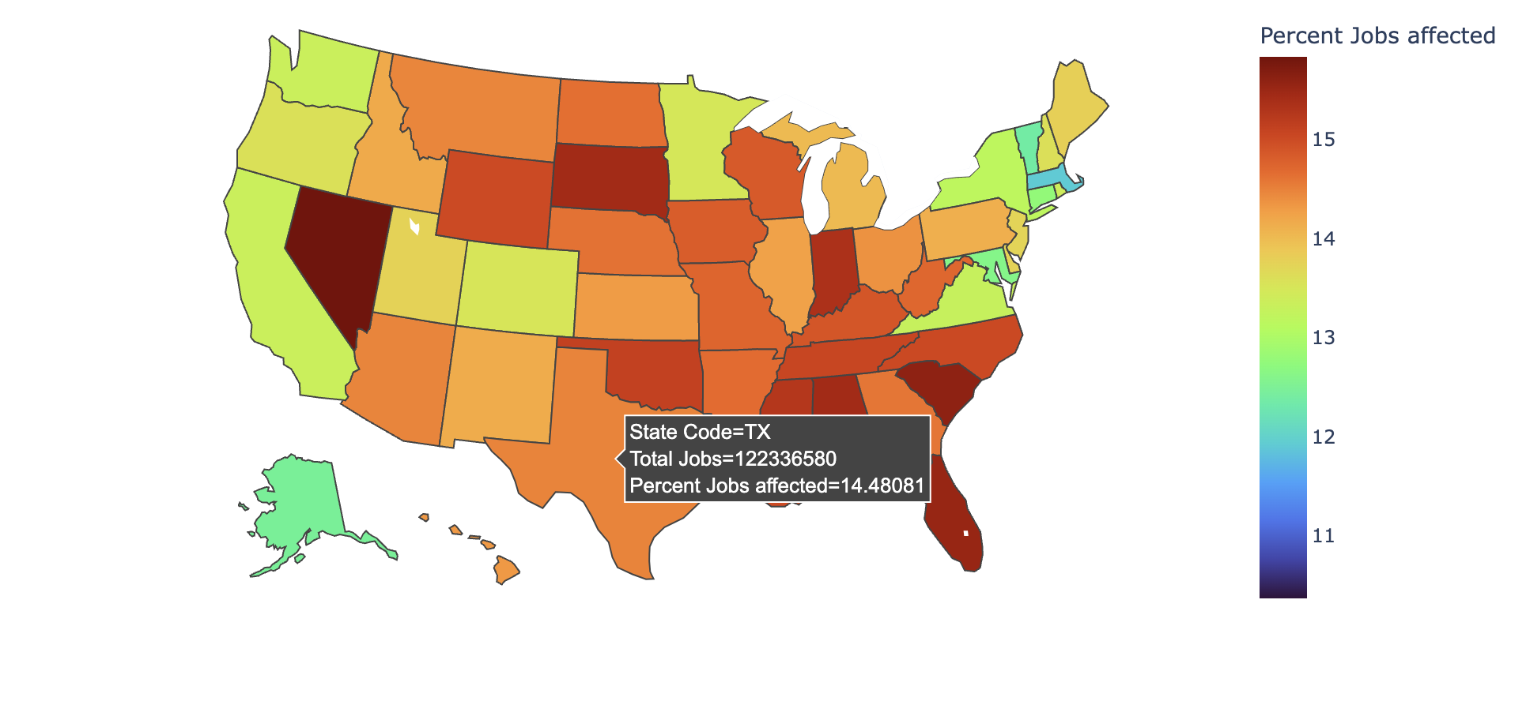
Impact of automation per state (Percentage)

Slide 19
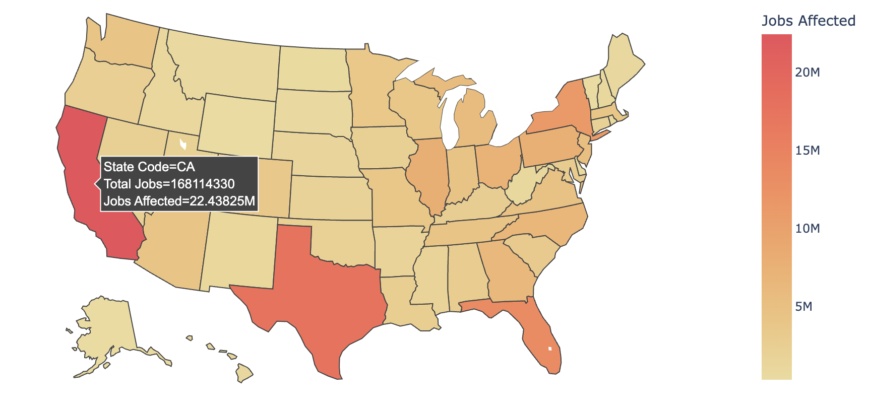
Impact of automation per state (Count)

Slide 20
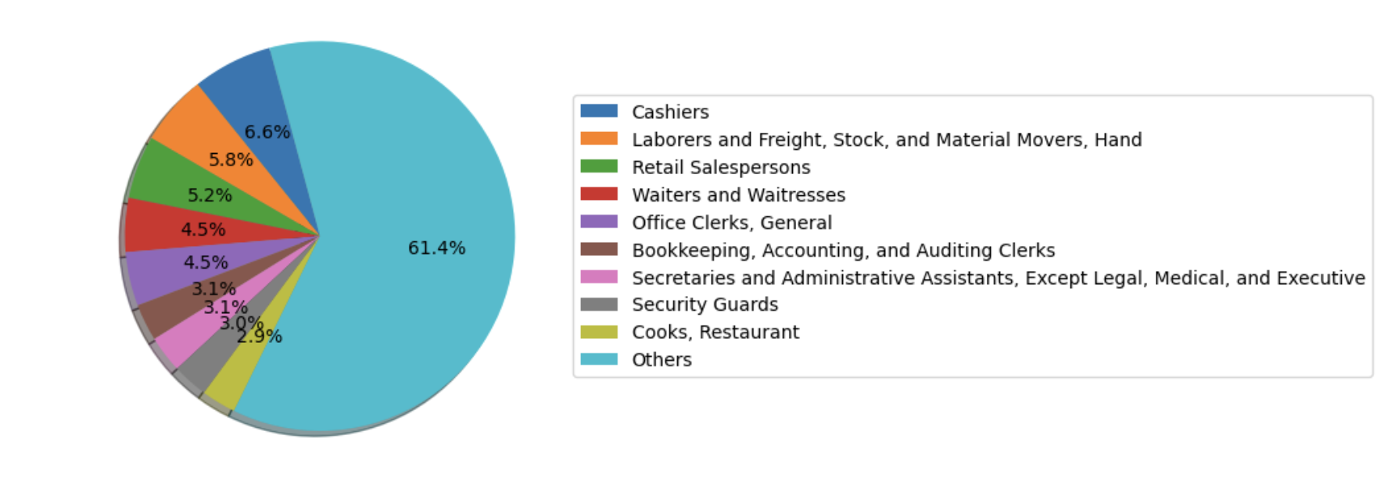
Highest impacted jobs in California

Slide 21
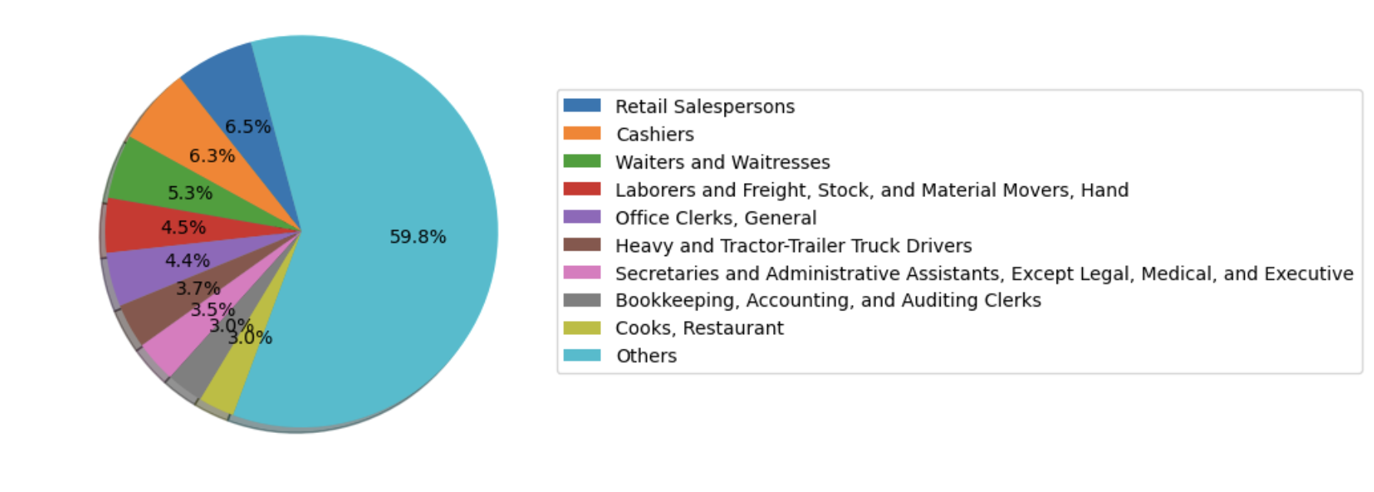
Highest impacted jobs in Texas

Slide 22
Conclusion
Here we will conclude our analysis and share analysis results

Slide 23
Q&A
We will take questions from audience

Slide 24
Thank You
We will highlight our TA, and Team members photos.

Slide 25
Additional Resources
Links which we used for getting data, give credit to websites where we got this data from.

