Slide 1

Impact of Automation on Occupations
Navigating the Workforce of Tomorrow
TEAM:
Bryson Wersonke, Madhavi Pandey, Pallavi Tripathi, Ranjini Rao & Vinaya Kusuma

Slide 2
Agenda
Introduction
Objectives
Data Source
Data processing – cleaning
Analysis
Visualization
Key findings
Conclusion

Slide 3
Introduction
Rapidly changing dynamics of job market
Influence of Technological advancements
Affects on various industries and job roles
Need of Impact of Automation on occupations analysis

Slide 4
Objectives
To utilize the predicted job market data and automation probability of the jobs to identify the impact of automation on occupations
Analyze the current and projected employment distribution across the major sectors/industries
Inspect the distribution of the wages for different sectors
Figure out the fastest growing/declining occupations

Slide 5
Objectives
Access the openings, hired and total separations data for the one of the leading industries using API
What are the jobs that are affected the most due to automation
Assess the correlation between various factors that influence employment automation
Identify employment prospects for the job seekers who have lost their jobs due to automation

Slide 6
Data Source
https://www.bls.gov/emp/tables/occupational-projections-and-characteristics.htm
https://www.bls.gov/oes/current/oes_nat.htm#17-0000
https://www.bls.gov/emp/tables/occupational-separations-and-openings.htm
https://www.bls.gov/emp/tables/unemployment-earnings-education.htm
https://www.kaggle.com/datasets/andrewmvd/occupation-salary-and-likelihood-of-automation/
https://www.bls.gov/oes/current/oes_research_estimates.htm
Article: oxfordmartin.ox.ac.uk/downloads/academic/The_Future_of_Employment.pdf
BLS Public Data API
"https://api.bls.gov/publicAPI/v2/"

Slide 7
Data Processing – Cleaning & transformation
Remove headers and footers
Remove duplicated records
Replace hyphens (-), dollar signs and commas with empty string
Remove star (**) data from the dataset
Conversion from string to numerical

Slide 8
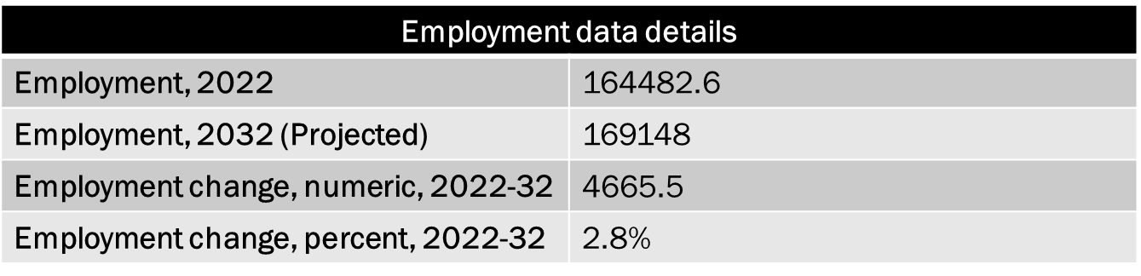
Employment distribution
Note: The employment data values are in thousands

Slide 9
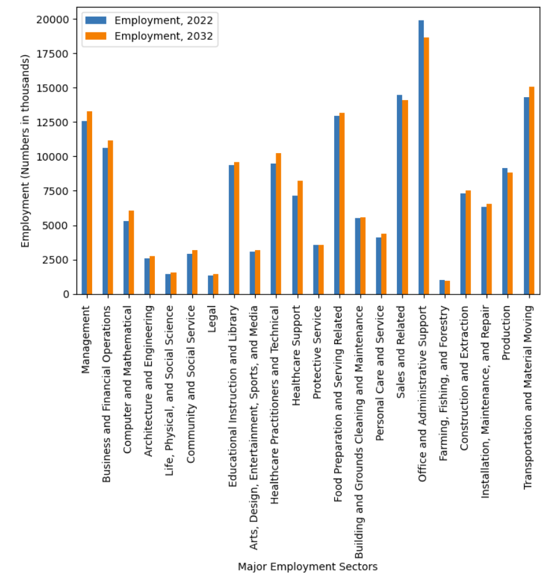
Current and Projected employment(2032) distribution in major sectors

Slide 10
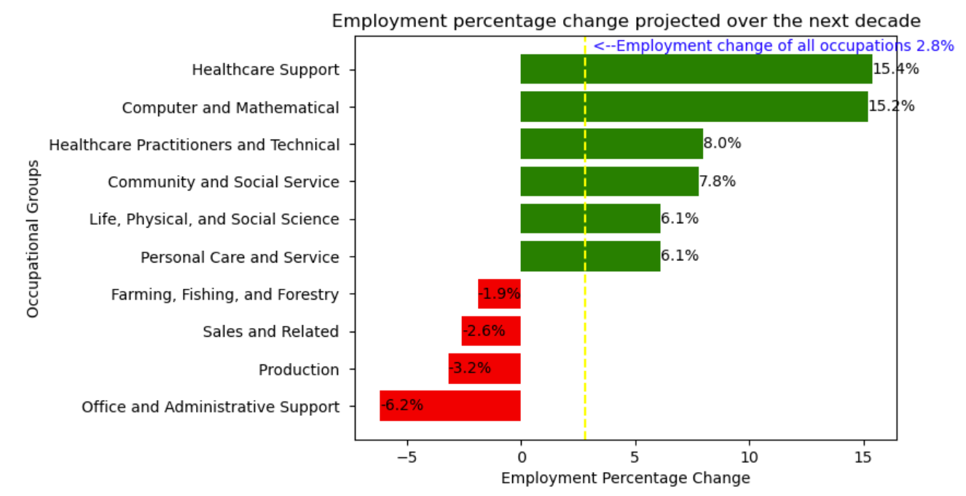
Employment Change Profile

Slide 11
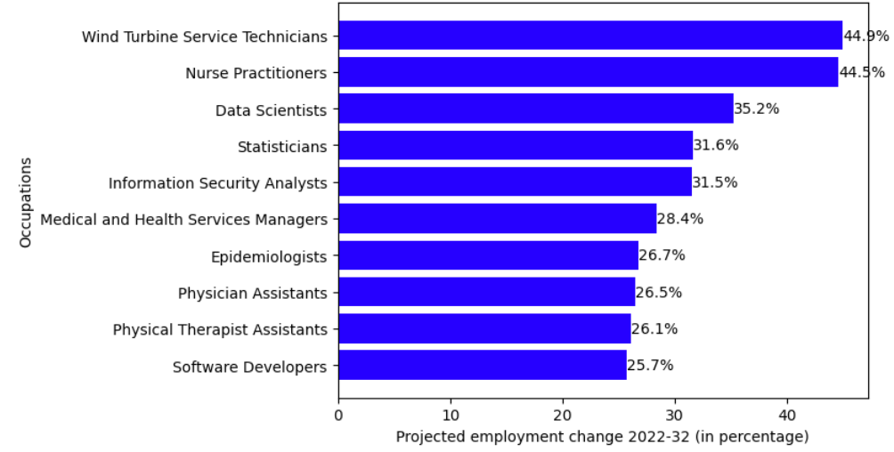
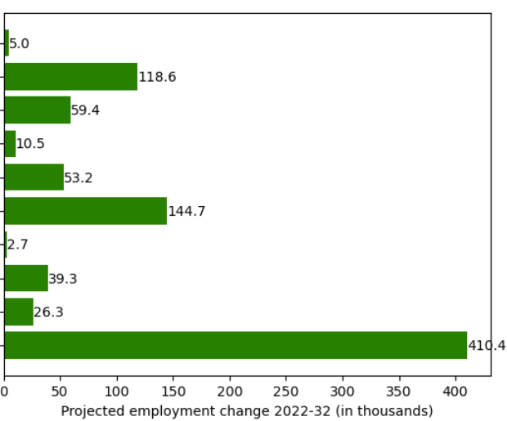
Top 10 Fastest growing Occupations
Automation Probability
0.009
0.22
0.22
0.21
0.0073
0.2
0.14
0.021
0.13

Slide 12
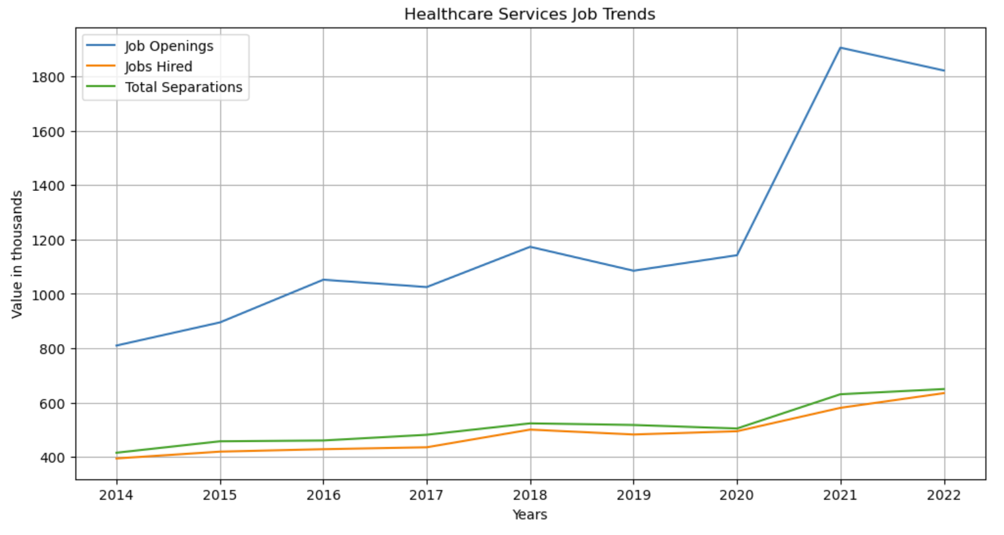
Job Trends in Healthcare industry
Data Source : BLS Public Data API

Slide 13
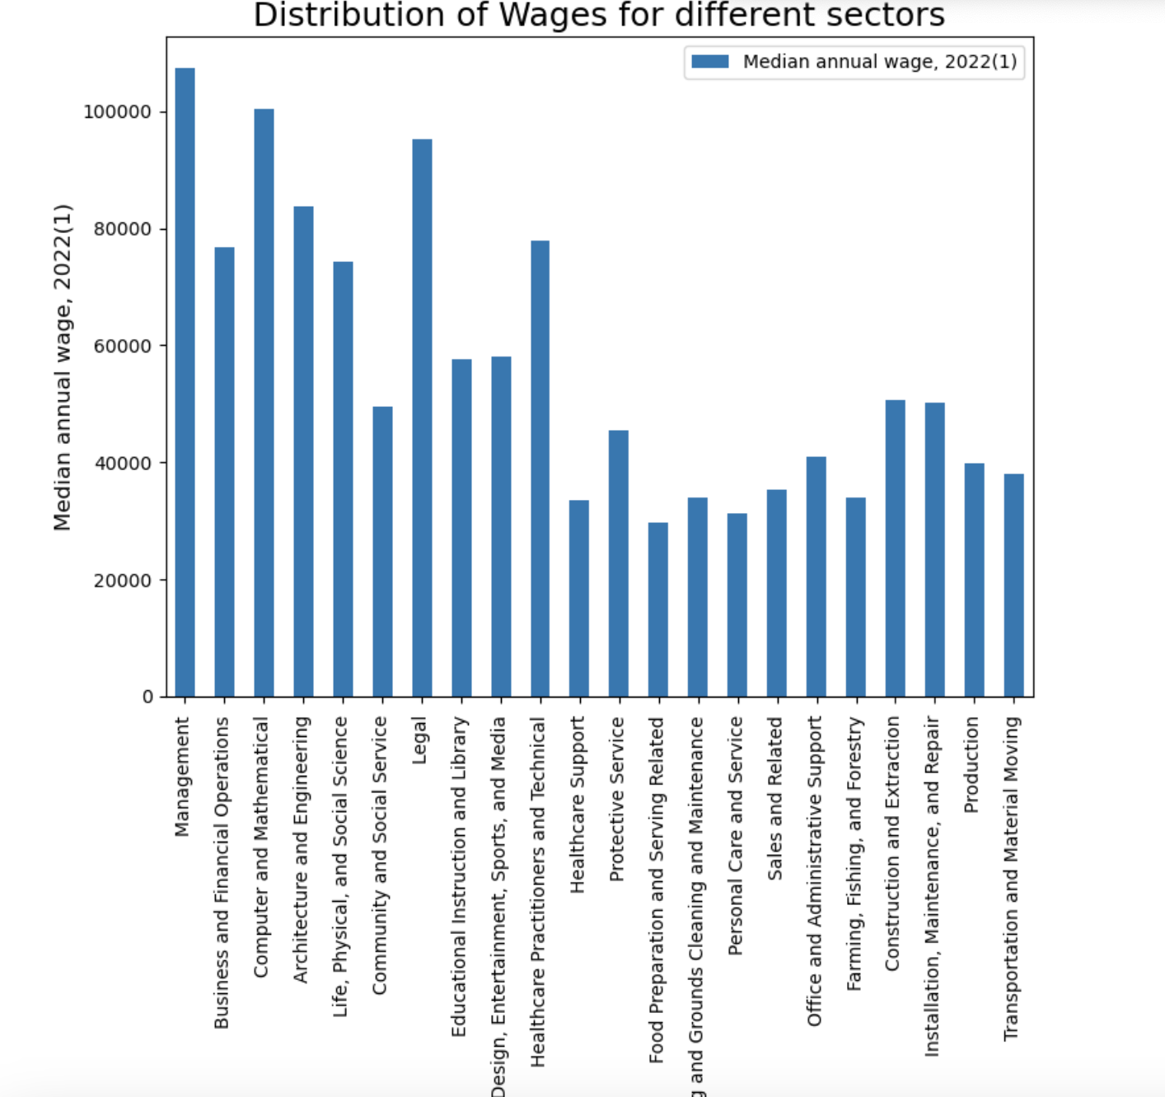
Wages Distribution
Across 22 major occupations, Bar graph here exhibits the highest and lowest paying jobs
Highest Pay | Lowest Pay
Management | Food Industry
Computer and Math occupation | Sales Jobs
Legal | Healthcare Support

Slide 14
Correlation between the job experience for declining jobs and automation probability
2022 National Employment Matrix title | Employment change, percent, 2022-32 | Work experience in a related occupation | Automation Probability
Telemarketers | -20.6 | 0 | 0.99
Data entry keyers | -26 | 0 | 0.99
Shipping, receiving, and inventory clerks | -8.4 | 0 | 0.98
Order clerks | -18.2 | 0 | 0.98
Bookkeeping, accounting, and auditing clerks | -6.2 | 0 | 0.98
Legal secretaries and administrative assistants | -21.8 | 0 | 0.98
Inspectors, testers, sorters, samplers, and ... | -3.9 | 0 | 0.98
Tellers | -14.5 | 0 | 0.98
Cashiers | -10.4 | 0 | 0.97
Payroll and timekeeping clerks | -16.4 | 0 | 0.97
Secretaries and administrative assistants, e... | -11.6 | 0 | 0.96
Office clerks, general | -6.6 | 0 | 0.96
Bill and account collectors | -9.6 | 0 | 0.95
Notes:
Occupations with 0 experience is showing high probability of Automation

Slide 15
2022 National Employment Matrix title | Employment change, percent, 2022-32 | Work experience in a related occupation | Automation Probability
Waiters and waitresses | -3.1 | 0 | 0.94
Retail salespersons | -2.1 | 0 | 0.92
Sewing machine operators | -15.2 | 0 | 0.89
Food preparation workers | -4.8 | 0 | 0.87
Executive secretaries and executive administ... | -21.1 | Less than 5 years | 0.86
Cooks, fast food | -13.7 | 0 | 0.81
Cutting, punching, and press machine setters... | -10.9 | 0 | 0.78
Postal service mail carriers | -6.7 | 0 | 0.68
Correctional officers and jailers | -7.5 | 0 | 0.6
Customer service representatives | -5.5 | 0 | 0.55
First-line supervisors of retail sales workers | -6.7 | Less than 5 years | 0.28
Childcare workers | -2 | 0 | 0.084
Farmers, ranchers, and other agricultural ma... | -4.6 | 5 years or more | 0.047
Chief executives | -8.2 | 5 years or more | 0.015
First-line supervisors of office and adminis... | -5.2 | Less than 5 years | 0.014
Buyers and purchasing agents | -7.7 | 0 | 0
Miscellaneous assemblers and fabricators | -7.5 | 0 | 0
Total, all occupations | 2.8 | 0 | 0
Notes:
Work experience of 5 years and higher are looking into less chance of automation.

Slide 16
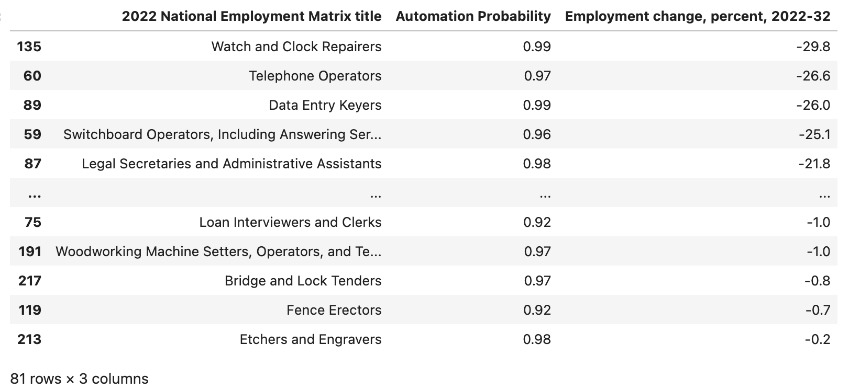
Occupations affected due to automation

Slide 17
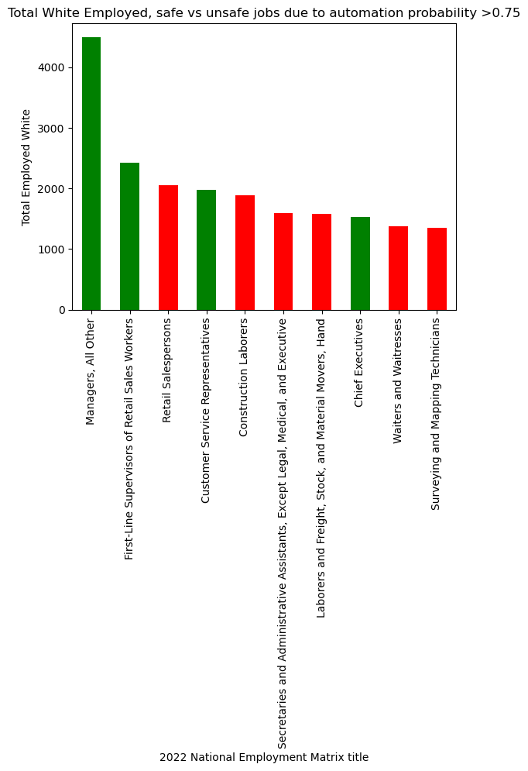
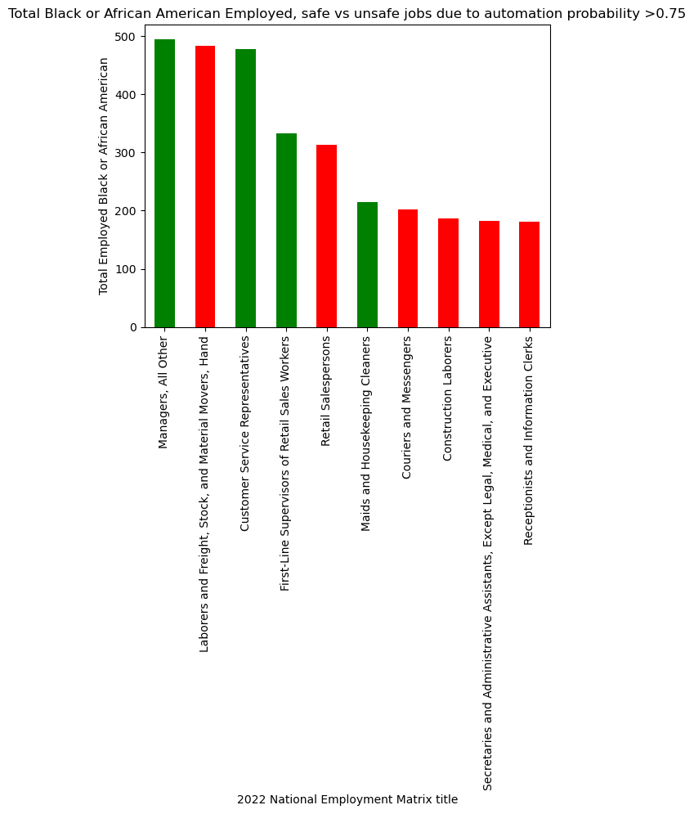
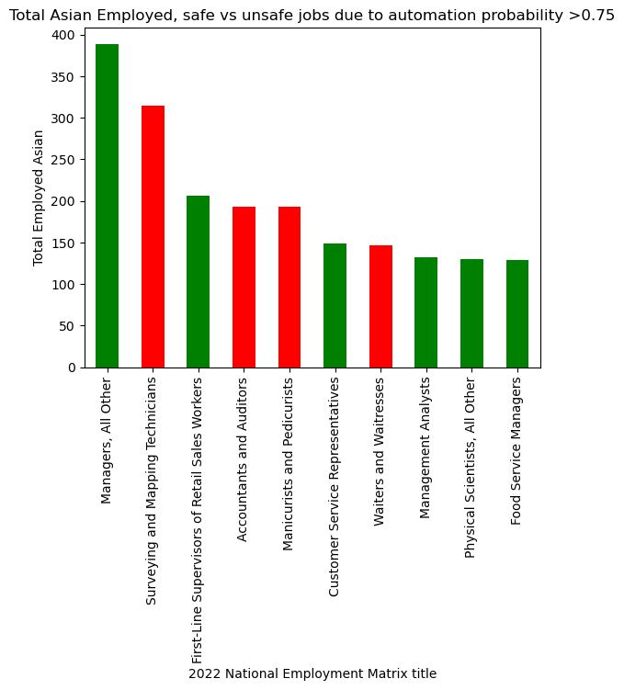
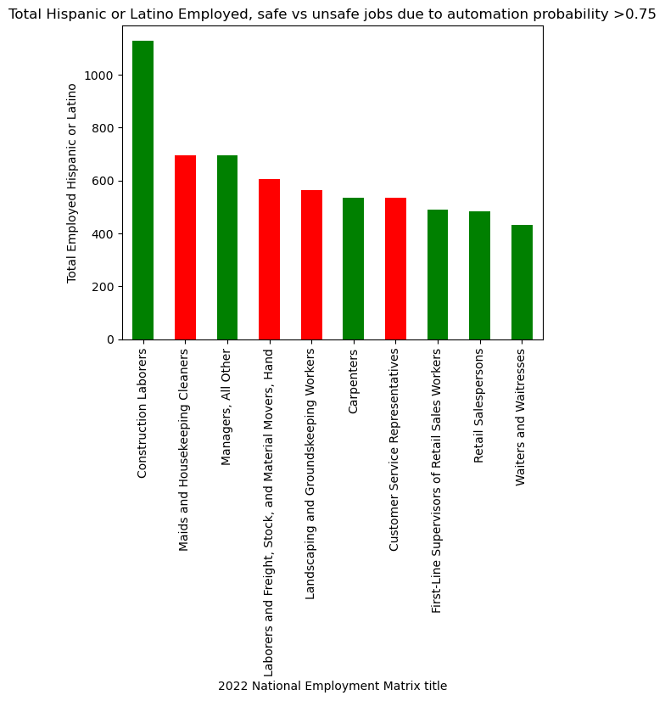
Impact of automation per Ethnicity

Slide 18
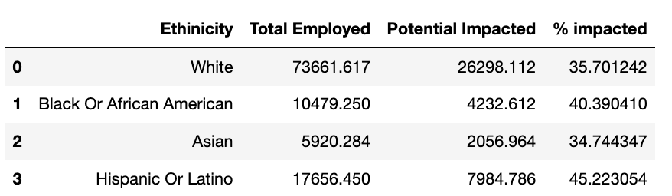
Impact of automation per Ethnicity

Slide 19
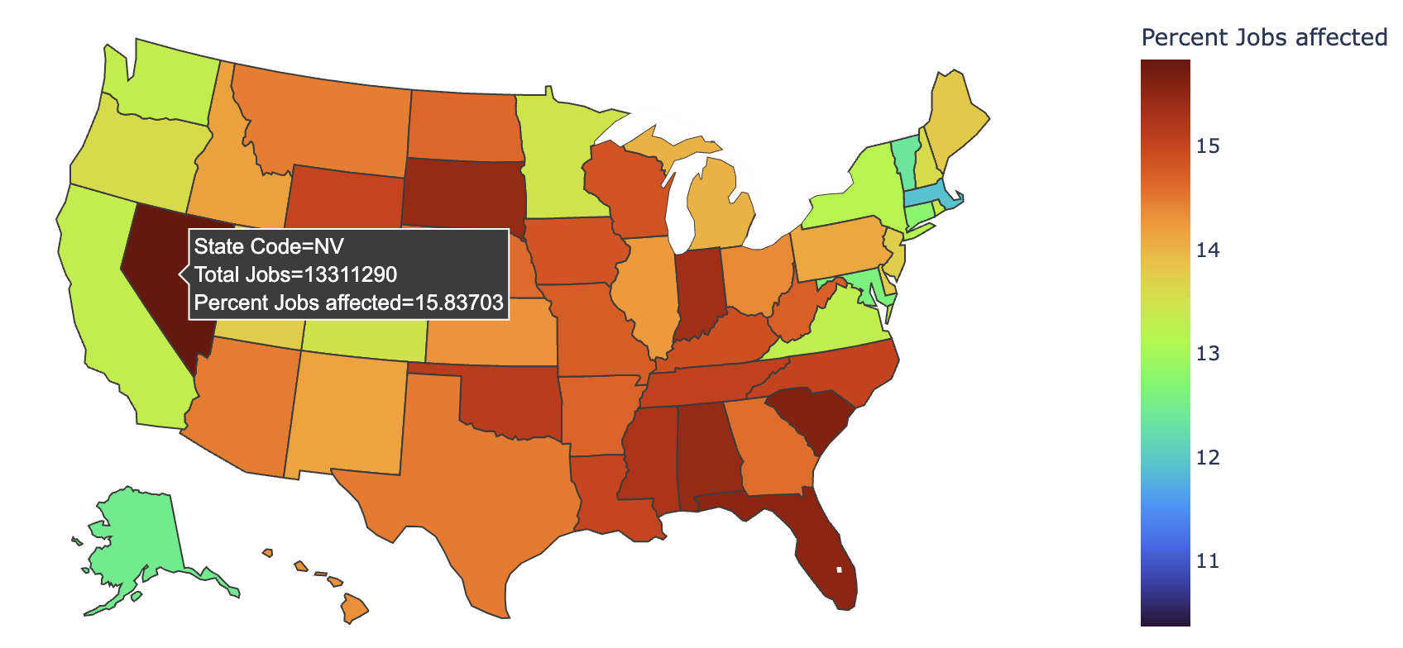
Impact of automation per state (Percentage)

Slide 20
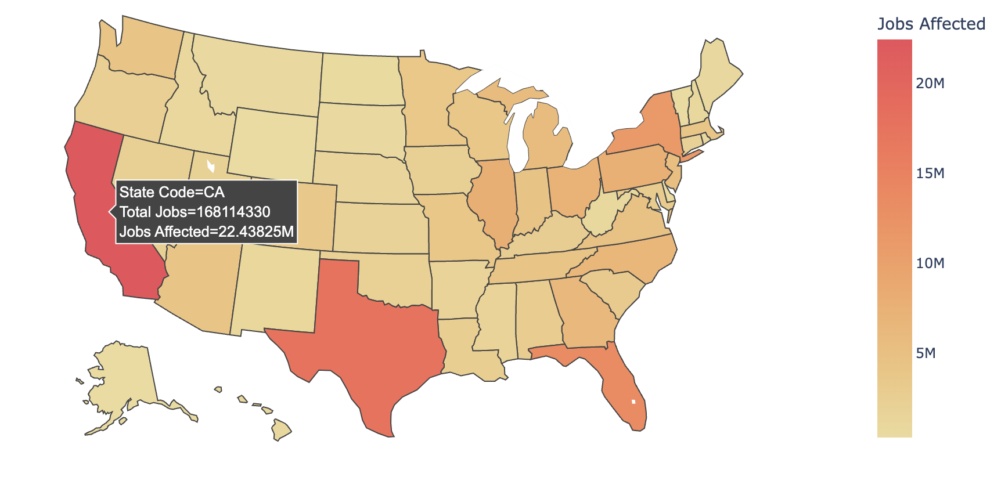
Impact of automation per state (Count)

Slide 21
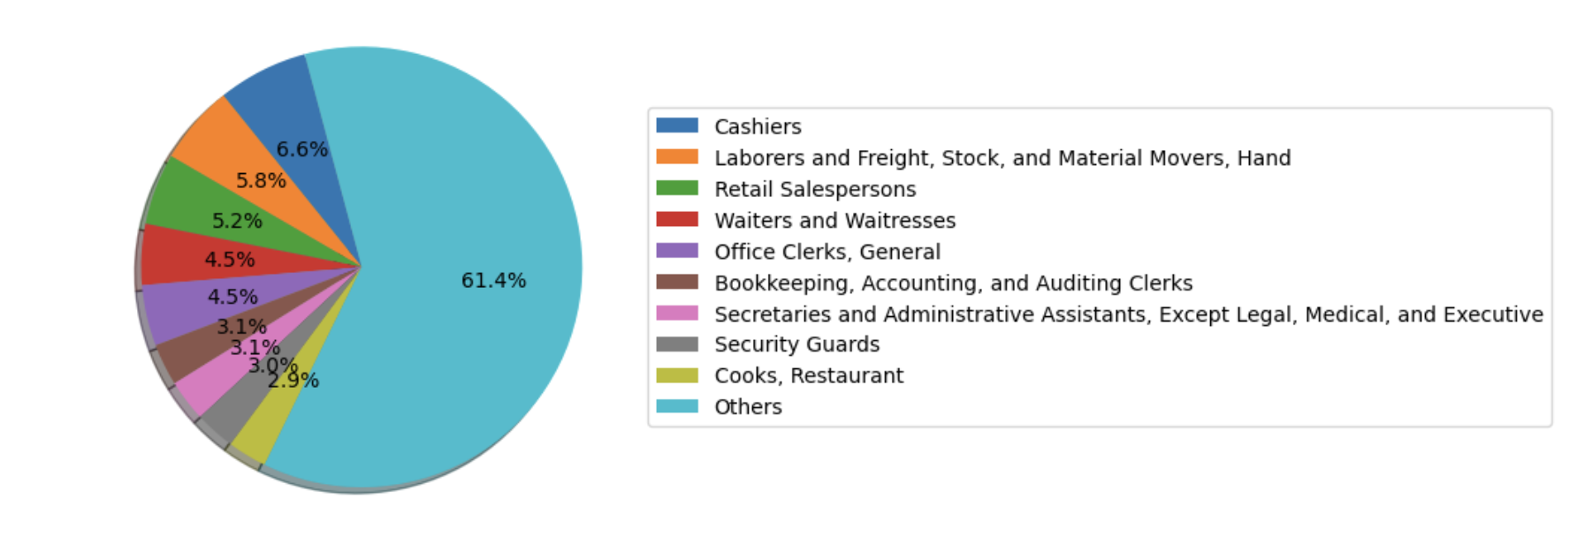
Highest impacted jobs in California

Slide 22
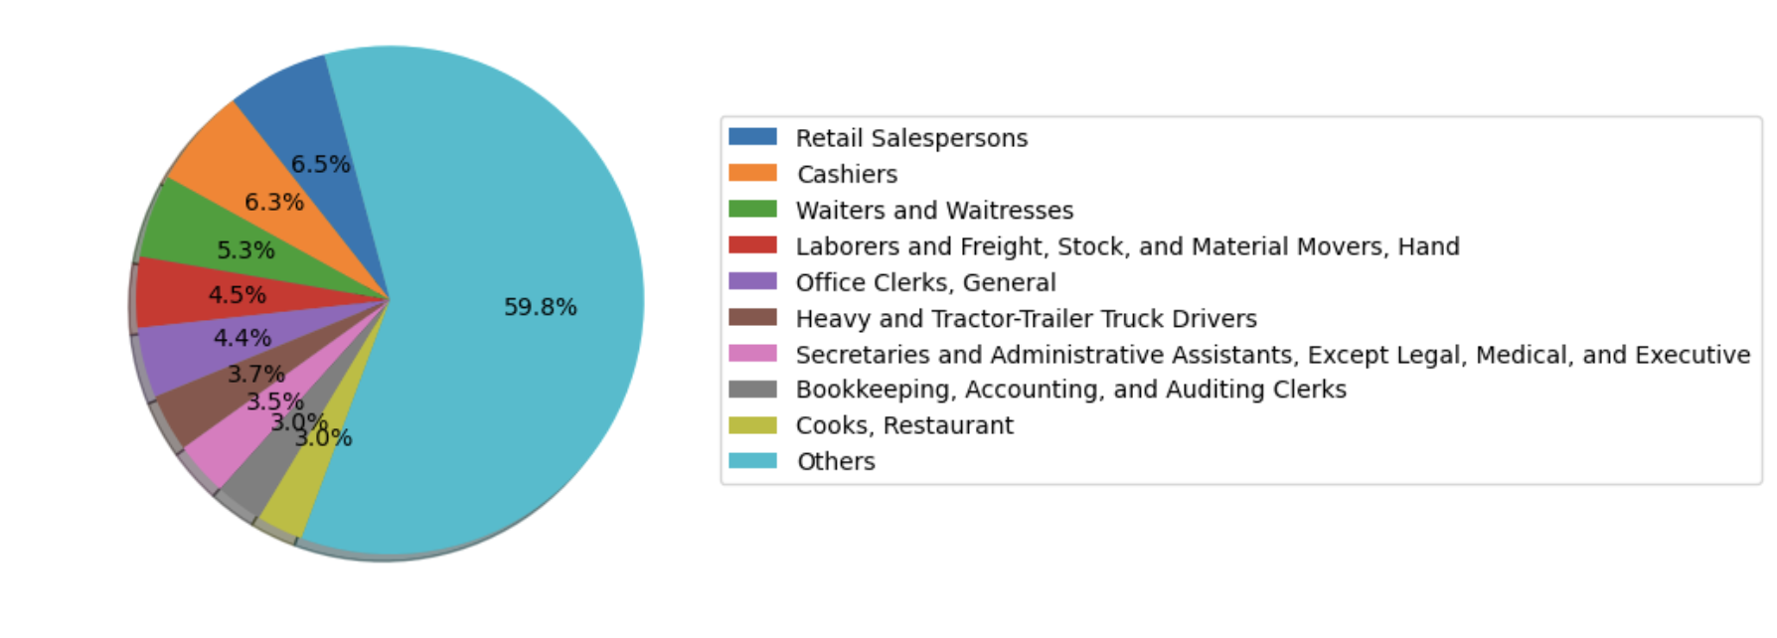
Highest impacted jobs in Texas

Slide 23
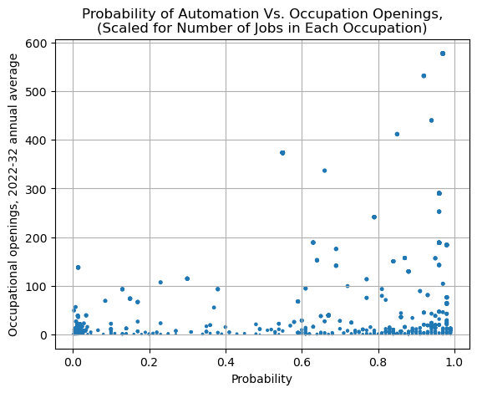
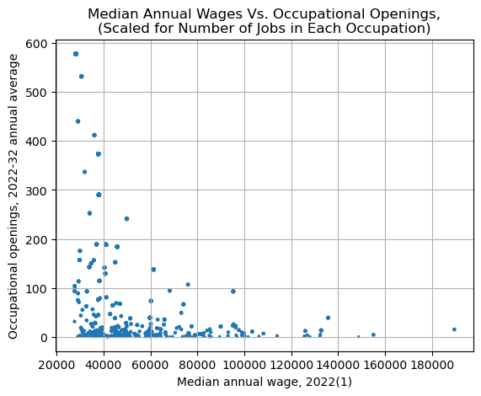
Employment prospects for job seekers

Slide 24
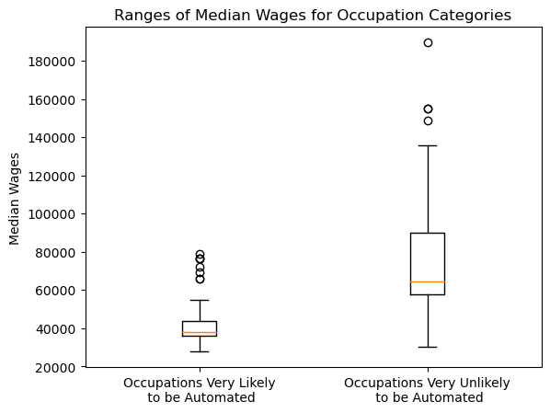
Employment prospects for job seekers

Slide 25
Conclusion

Slide 26


Slide 27
Q&A

