Slide 1
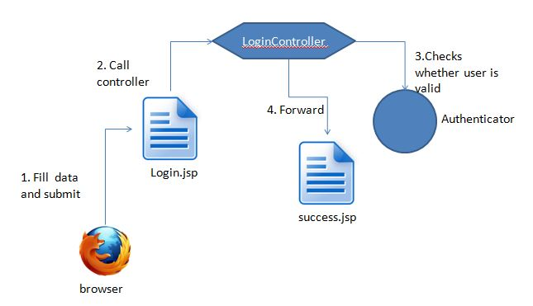

Slide 2
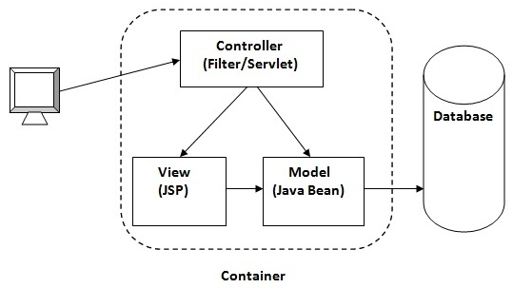

Slide 3
The Model Layer
This is the data layer which contains business logic of the system, and also represents the state of the application.
It’s independent of the presentation layer, the controller fetches the data from the Model layer and sends it to the View layer.

Slide 4
The Controller Layer
Controller layer acts as an interface between View and Model. It receives requests from the View layer and processes them, including the necessary validations.
The requests are further sent to Model layer for data processing, and once they are processed, the data is sent back to the Controller and then displayed on the View.

Slide 5
The View Layer
This layer represents the output of the application, usually some form of UI. The presentation layer is used to display the Model data fetched by the Controller.

Slide 6
Project Directory Structure
Project Context Root Folder
WebContent
WEB-INF
Web.xml
Lib
Views (All jsp files for UI )
Images/media/styles etc.
Java_Resources
Src
Com.controllers
Com.filters
Com.models
Com.dao
Com.services

