Slide 1
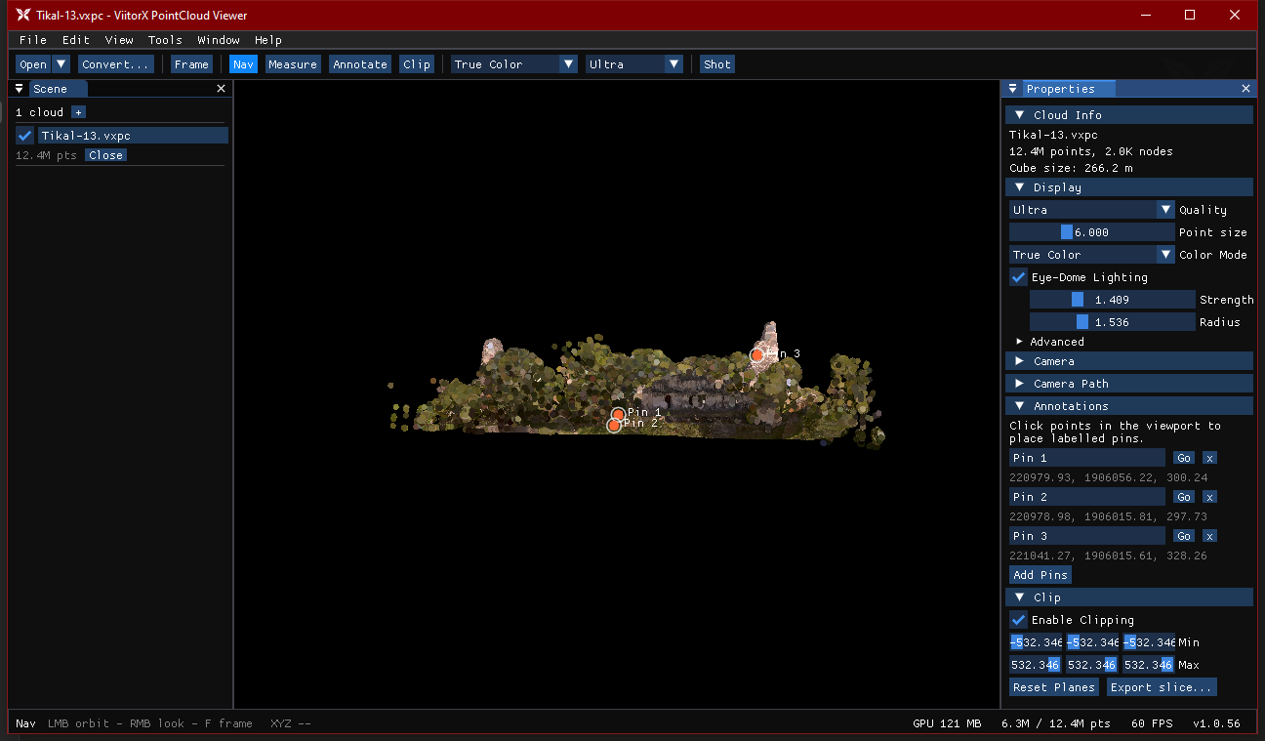
VIITORX
PointCloud Viewer
Complete Feature Guide
v1.0.61
Out-of-core viewer for billion-point clouds
LAS · LAZ · E57 · PLY · PTS · XYZ
Tikal-13 — 12.4M points, streamed live in ViitorX

Slide 2
1
OVERVIEW
What is ViitorX?
Built to open clouds bigger than RAM
Out-of-core
Octree LOD
Ingests very large scans (LAS/LAZ, E57, PLY, PTS/XYZ) — billions of points, larger than memory.
Converts each scan into a streamable on-disk octree, then streams nodes on demand.
Frustum culling + screen-space-error LOD keep only what you can see on the GPU.
Async loading with an LRU GPU-memory budget — smooth navigation, bounded memory.
Portable .vxpc package holds the whole cloud plus your bookmarks, measurements & annotations.
Streams data far larger than RAM
Screen-space-error detail control
GPU-budgeted
60 FPS
LRU eviction keeps a steady frame rate
12.4M points drawn interactively

Slide 3
2
DOCKED SHELL
The Workspace
1
1
Menu bar File · Edit · View · Tools · Window · Help
2
2
Toolbar Open, Convert, Frame, tools, color & quality
5
3
3
Scene panel Loaded clouds, visibility, add / close
4
4
Viewport Central 3D view — orbit, fly, measure
5
Properties Display, camera, annotations, clip
6
Status bar Mode hint · GPU · points · FPS · version
6

Slide 4
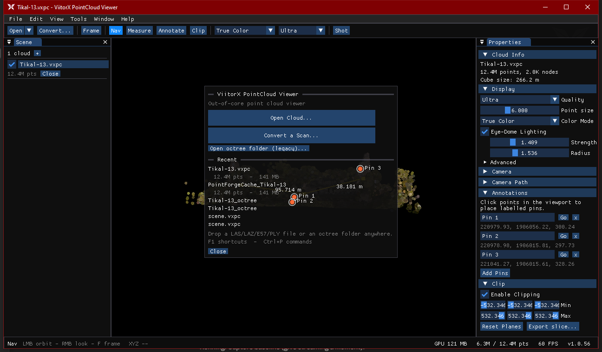
3
GETTING STARTED
Opening a Cloud
How to open
File ▸ Open Cloud… (Ctrl+O) — pick a .vxpc package or an octree's meta.bin
Drag & drop a .vxpc or octree folder onto the window
File ▸ Open Octree Folder… for legacy loose-folder octrees
Recent list on the Welcome screen re-opens past clouds in one click
Drop a raw LAS/LAZ/E57/PLY/PTS/XYZ file → the Convert wizard opens automatically
Welcome screen — quick actions, recent clouds, drag-and-drop hint

Slide 5
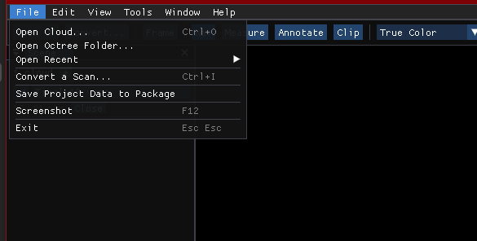
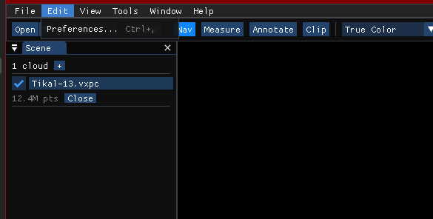
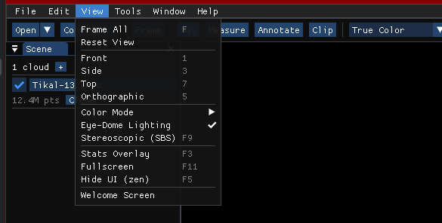
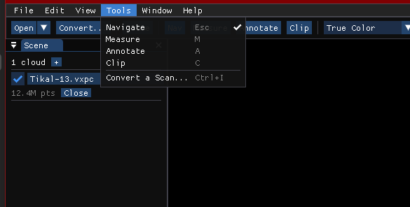
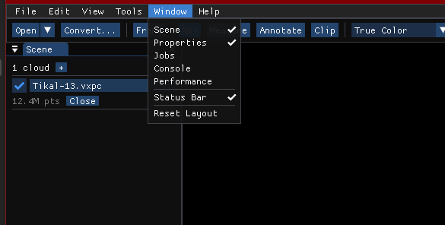
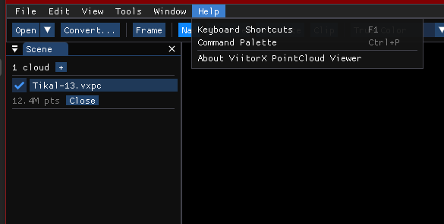
4
REFERENCE
Menus at a Glance
File Open, Convert, Save to package, Screenshot
Edit Preferences (Ctrl+,)
View Presets, color mode, EDL, stereo, zen
Tools Navigate · Measure · Annotate · Clip
Window Toggle panels + Reset Layout
Help Shortcuts (F1), Command Palette, About

Slide 6
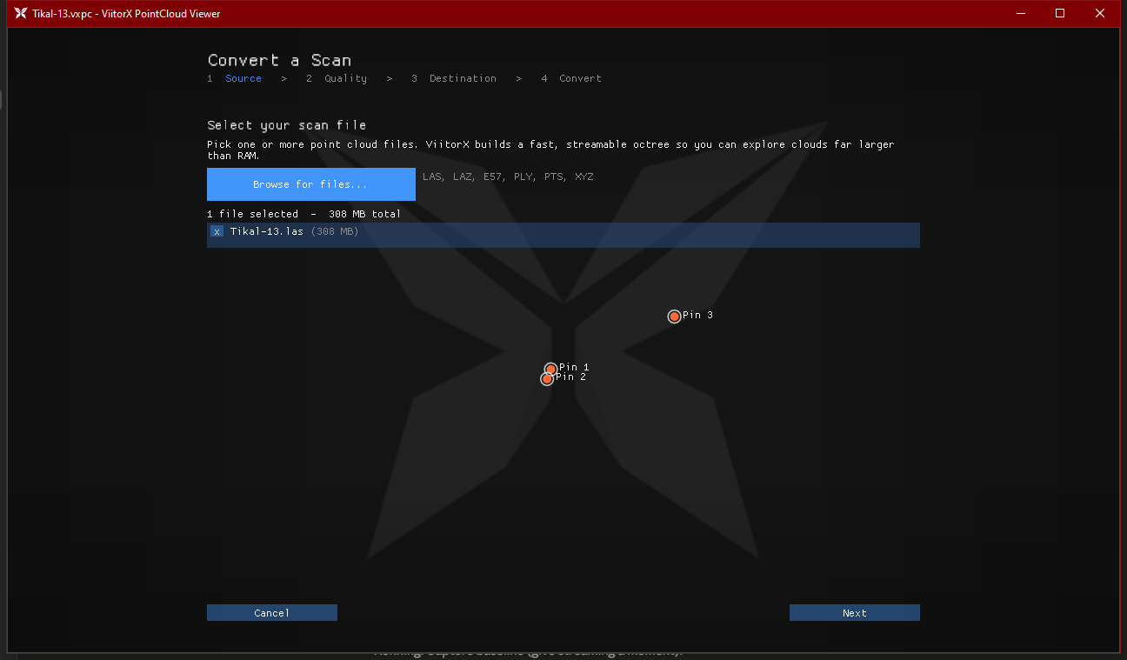
5
CONVERT WIZARD
Importing Scans — 1. Source
Pick your scan files
Open the wizard: File ▸ Convert a Scan… (Ctrl+I)
Browse for files… — select one or many, or drag & drop onto the window
Accepts LAS, LAZ, E57, PLY, PTS and XYZ
Each file's size is listed; remove any with the ✕ button
A 4-step breadcrumb tracks progress: Source ▸ Quality ▸ Destination ▸ Convert
Step 1 — one 308 MB LAS selected, ready for the next step

Slide 7
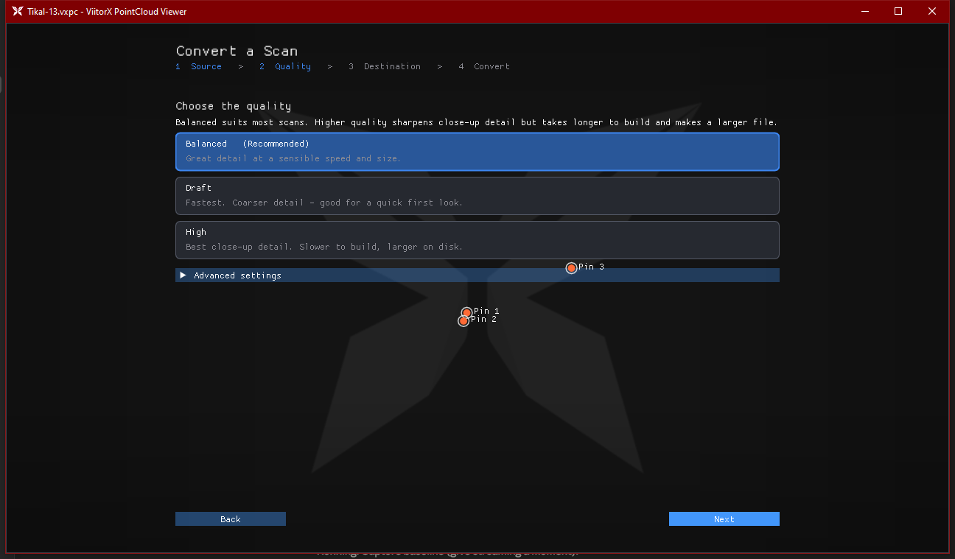
6
CONVERT WIZARD
Importing Scans — 2. Quality
One-click presets
Balanced (recommended) — great detail at a sensible speed & size
Draft — fastest, coarser detail; good for a quick first look
High — best close-up detail; slower to build, larger on disk
Custom — unlocks every parameter under Advanced settings
Higher quality sharpens close-up detail but takes longer and makes a bigger file.
Step 2 — choose a quality preset (or open Advanced settings)

Slide 8
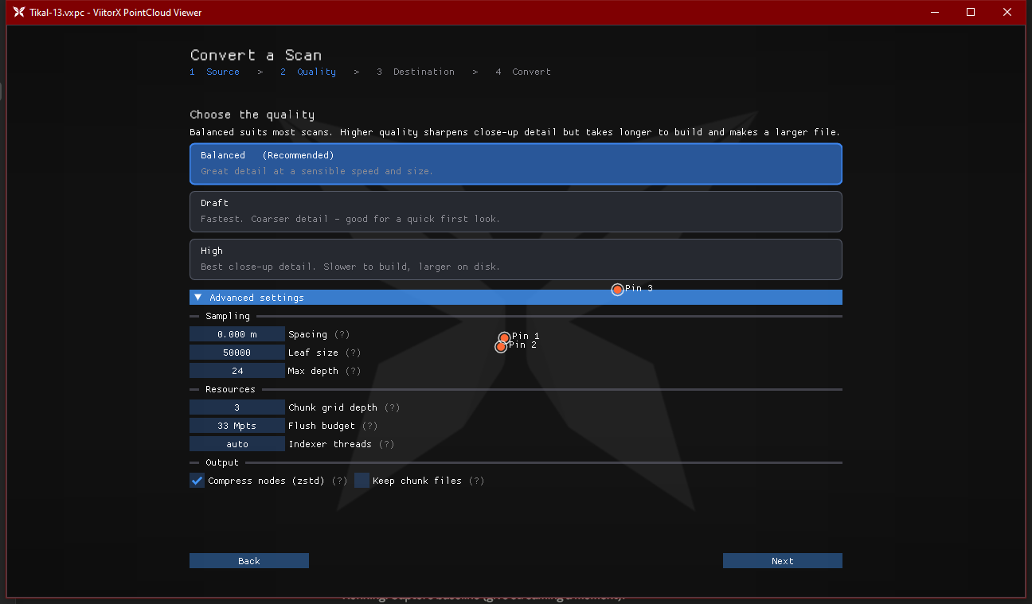
7
CONVERT WIZARD
Importing Scans — 3. Advanced
Fine-grained control
Sampling — Spacing (0 = auto), Leaf size (max pts/node), Max depth
Resources — Chunk grid depth, Flush budget (Mpts), Indexer threads
Output — Compress nodes (zstd) and Keep chunk files (debug)
Editing any value switches the preset to Custom
Destination step then writes a .vxpc (with optional auto-open) — or a folder for batches
Advanced settings — the same knobs as the pfconvert CLI

Slide 9
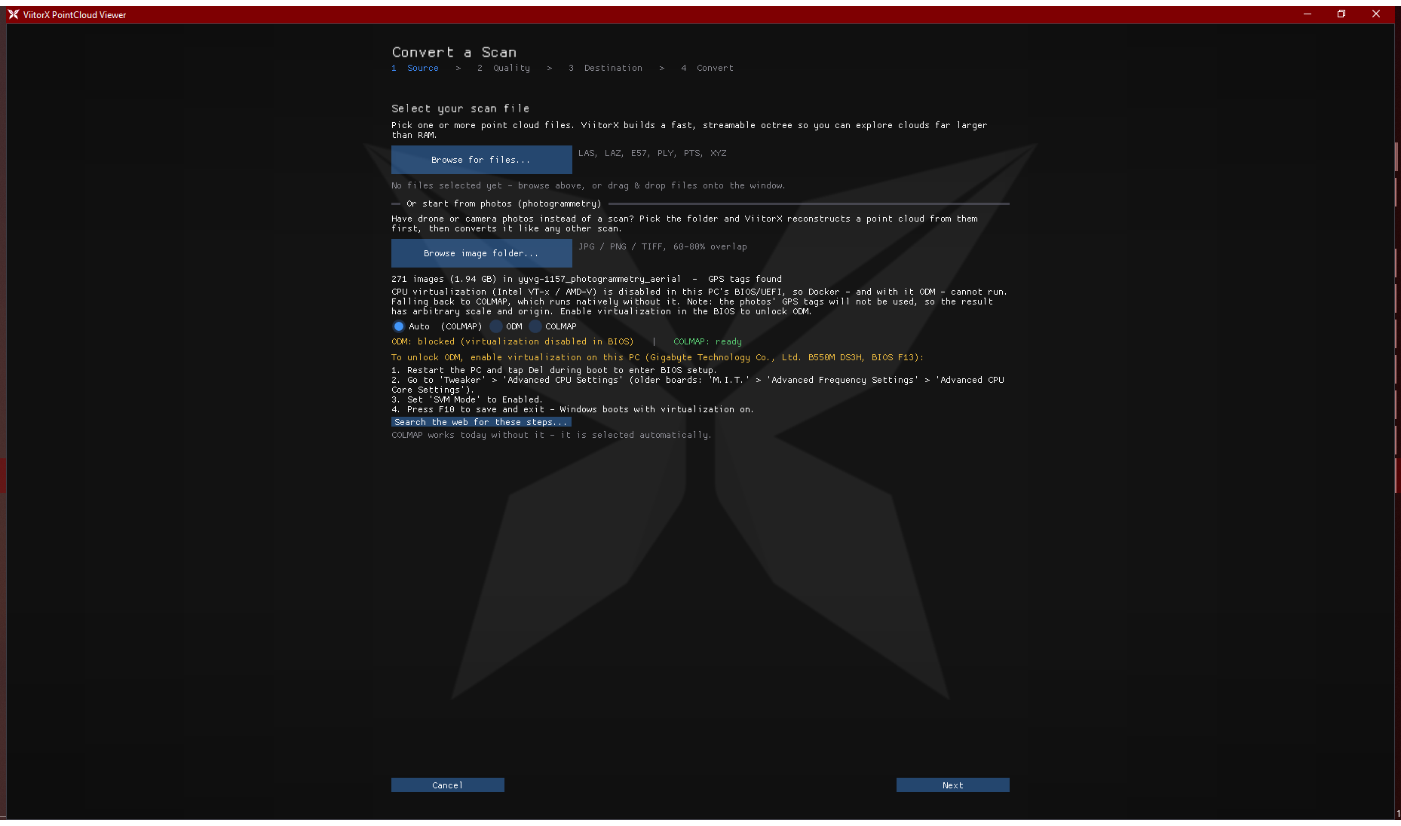
8
CONVERT WIZARD
Importing Photos — Photogrammetry
Photos in, point cloud out
Or start from photos — pick a folder of overlapping drone / camera JPGs, or drag it onto the window
GPS tags found → ODM — georeferenced, metric-scale LAZ (runs via Docker)
No GPS or no NVIDIA GPU → COLMAP — densest native reconstruction
Auto picks the best engine and explains why; override any time
One consent click installs both engines automatically — no manual setup
Cancelable background job: reconstruct, then convert to .vxpc like any scan
Docker blocked? The wizard shows this PC's exact BIOS steps to enable virtualization
271 drone photos scanned — GPS found, engine status, and board-specific BIOS help

Slide 10
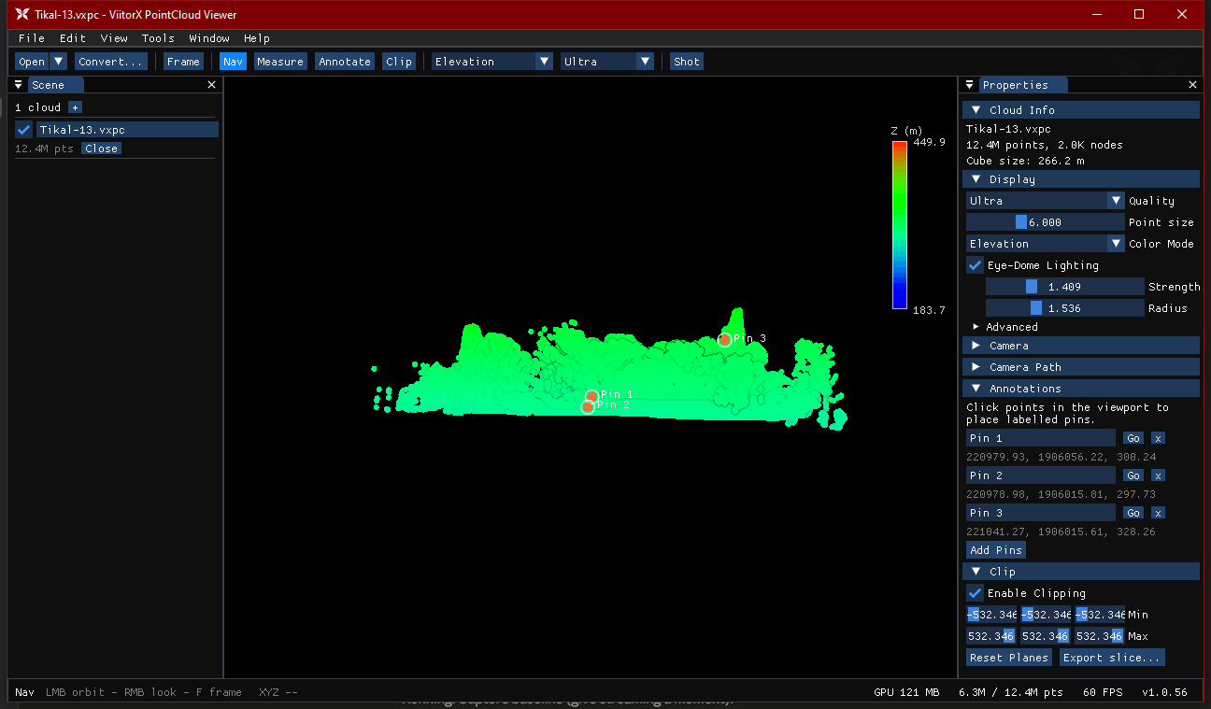
9
RENDERING
Color Modes — True Color & Elevation
True Color — the scan's captured RGB
Elevation — Turbo colormap by height, with a Z(m) legend
How: Toolbar color dropdown, the Properties ▸ Display ▸ Color Mode combo, or View ▸ Color Mode.

Slide 11
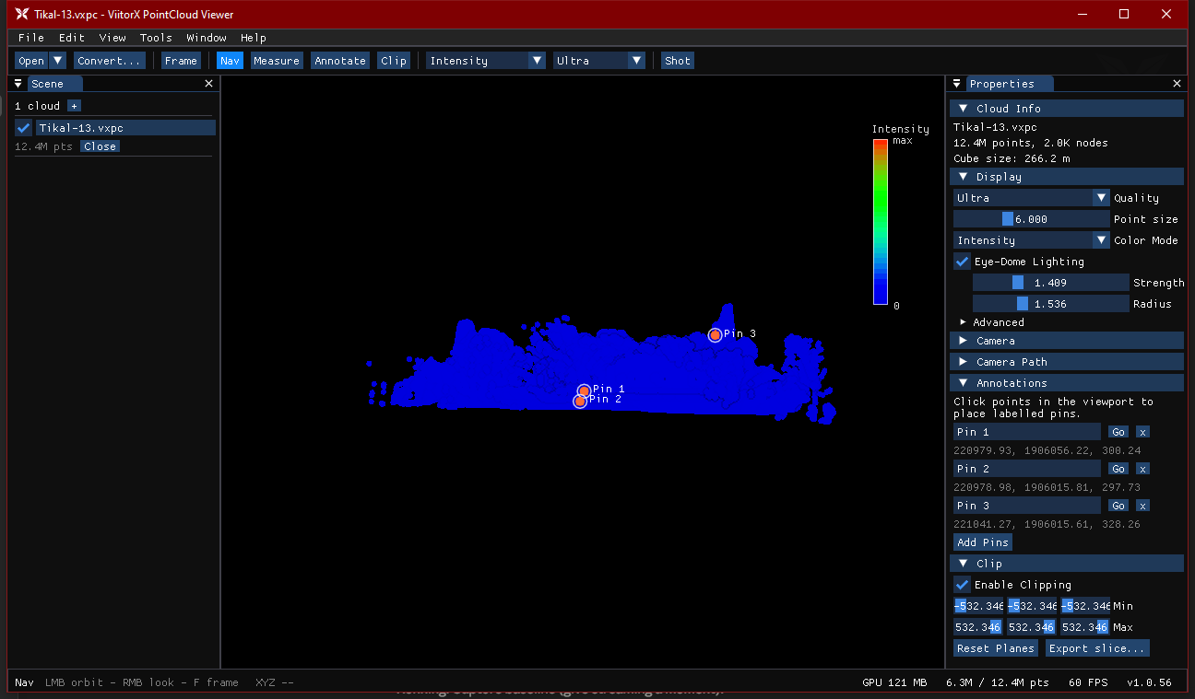
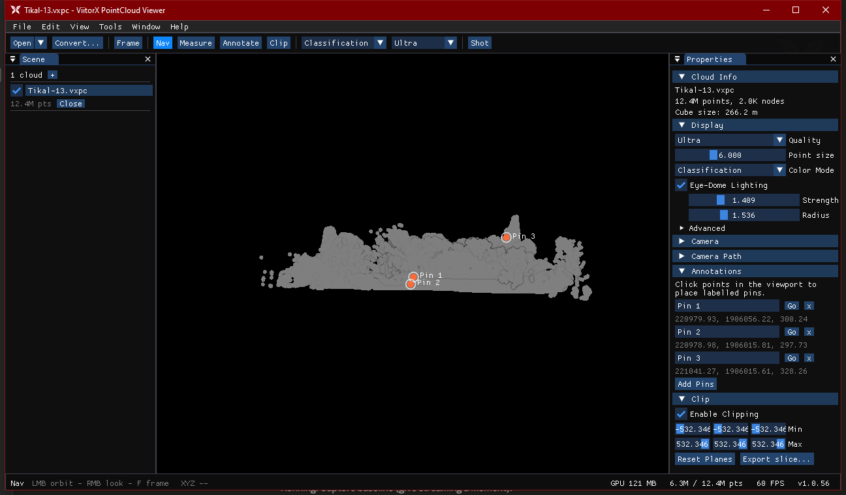
10
RENDERING
Color Modes — Intensity & Classification
Intensity — LiDAR return strength, Turbo legend (auto-scaled)
Classification — per-point class (e.g. ground vs. vegetation)
Also: Solid Color mode paints every point one picked colour — handy against the Elevation/Intensity Turbo legends.

Slide 12
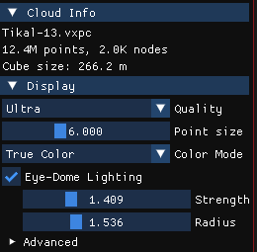
11
RENDERING
Display & Eye-Dome Lighting
Tune how points draw
Quality — Low / Medium / High / Ultra maps to the LOD budget + GPU memory budget
Point size — 1–16 px slider (or Ctrl + mouse-wheel in the viewport)
Eye-Dome Lighting (EDL) — screen-space shading that reveals depth & shape on uncoloured clouds; Strength and Radius sliders
Advanced — LOD budget (screen-space error, px), GPU budget (MB), Uploads/frame, Round points, Attenuate, Background colour
Cloud Info shows point count, node count and cube size for the active cloud
Properties ▸ Display

Slide 13
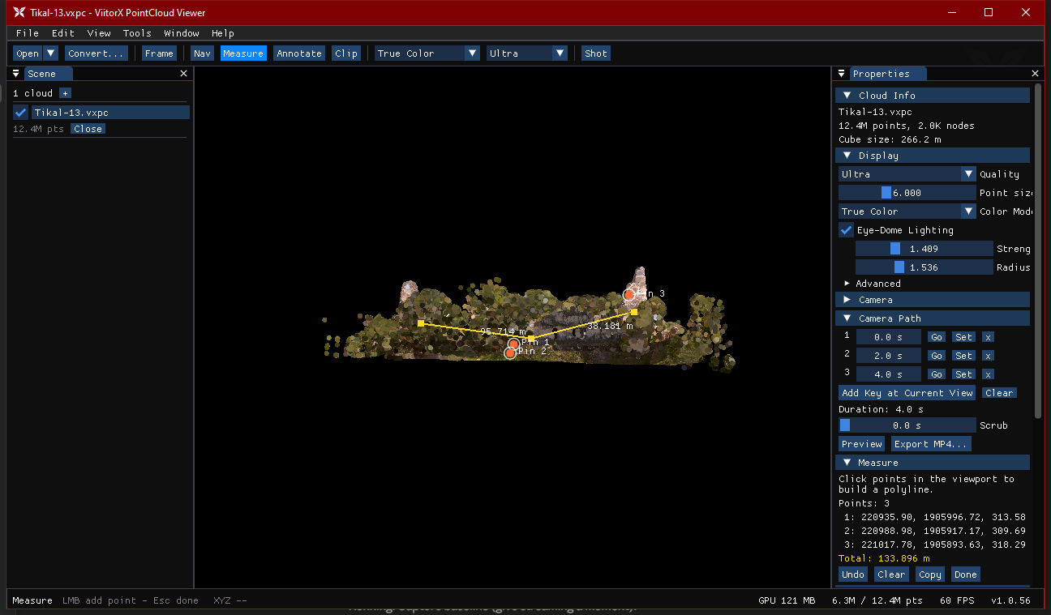
12
TOOLS
Measuring Distances
Measure tool
Activate: toolbar Measure, Tools ▸ Measure, or press M
Left-click points in the viewport to build a polyline
Each segment is labelled; a running Total (m) is shown
Undo / Clear / Copy (points + total to clipboard) / Done
Drawn as real 3D geometry — visible in screenshots & the web stream
Three points — 95.7 m + 38.2 m = 133.9 m total

Slide 14
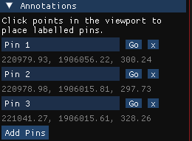
13
TOOLS
Annotations & Bookmarks
Pin points & save views
Annotate tool (toolbar / Tools ▸ Annotate / A) — click points to drop labelled pins
Rename each pin, jump to it with Go, or remove it; coordinates are shown
Bookmarks (Properties ▸ Camera) save named camera poses per cloud
Pins, bookmarks, measurements & camera paths persist — stored beside the octree and embeddable into the .vxpc via File ▸ Save Project Data to Package
Annotations panel

Slide 15
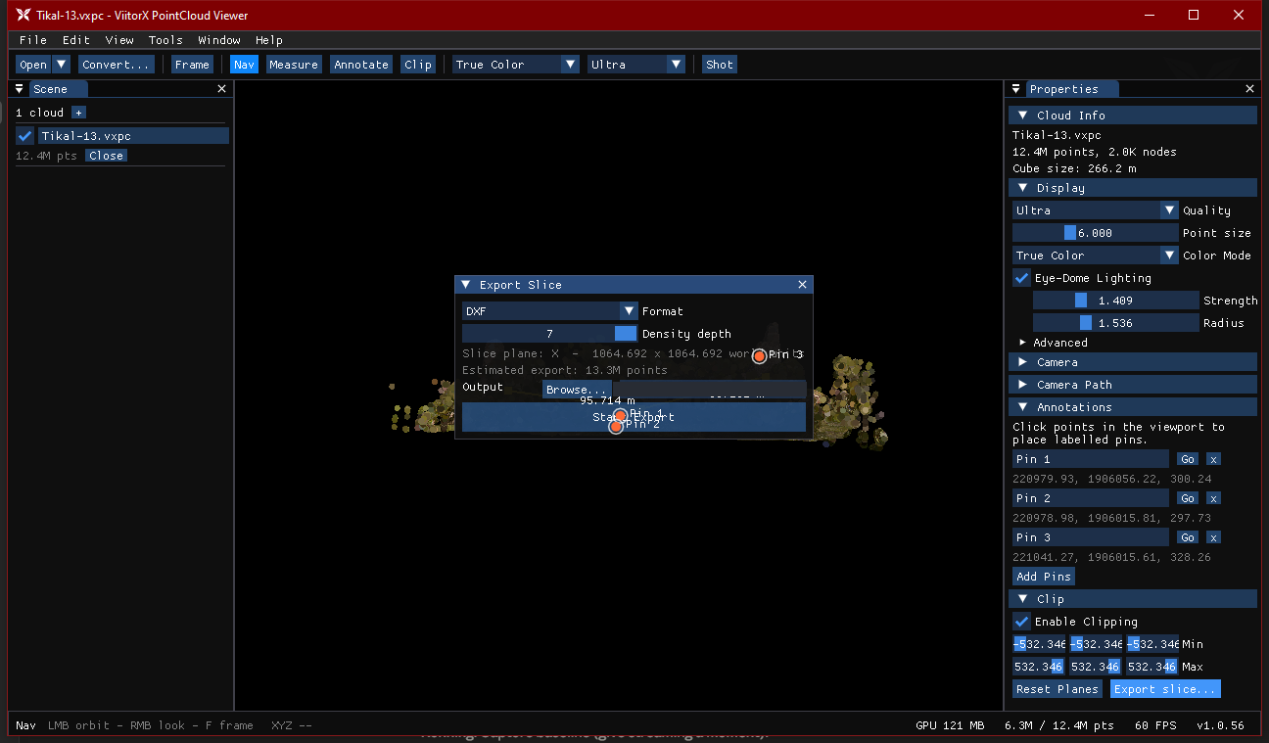
14
TOOLS
Clipping & Slice Export
Cut & export a slice
Clip tool (toolbar / Tools ▸ Clip / C) — enable an axis-aligned clip box
Drag the Min / Max sliders per axis; Reset Planes to clear
Export slice… writes the clipped region to disk
Formats: DXF (CAD lines), PNG (rendered image), CSV (x,y,z,rgb,intensity,class)
An estimated point count warns before very large exports
Slice Export — DXF / PNG / CSV with a live point-count estimate

Slide 16
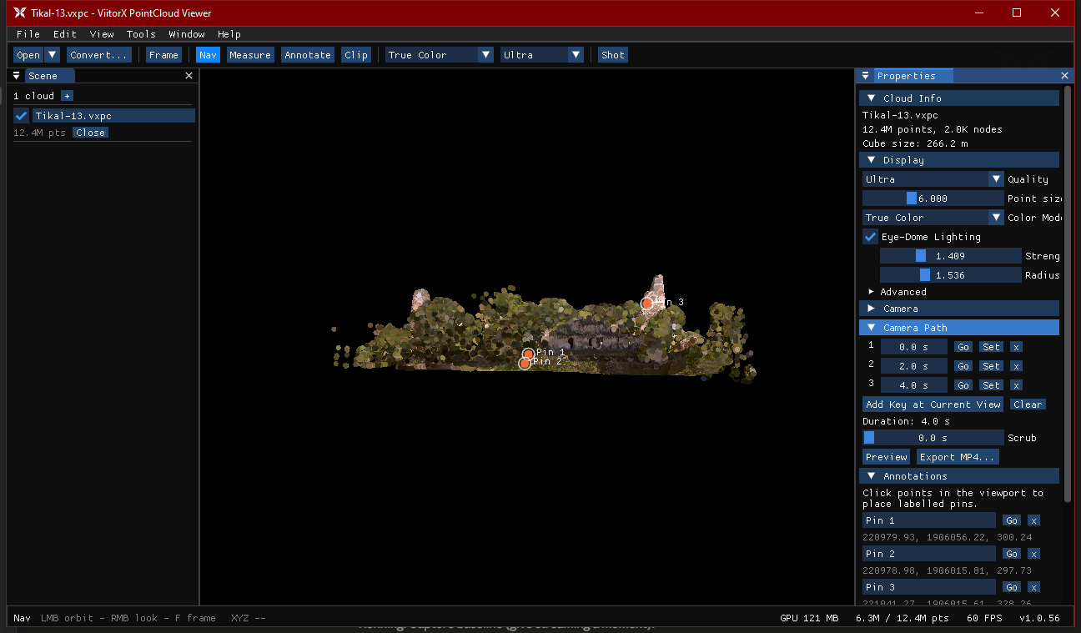
15
ANIMATION
Camera Paths & Video Export
Fly-through animation
Properties ▸ Camera Path — Add Key at Current View to set keyframes
Each key has a time; Go / Set / delete per key; Scrub to preview
Preview plays the interpolated path in the viewport
Export MP4… — resolution (up to 4K), frame rate, H.264 bitrate
Hardware-accelerated (NVENC / QuickSync) via Windows Media Foundation
Three keyframes over 4 s — ready to preview or export

Slide 17
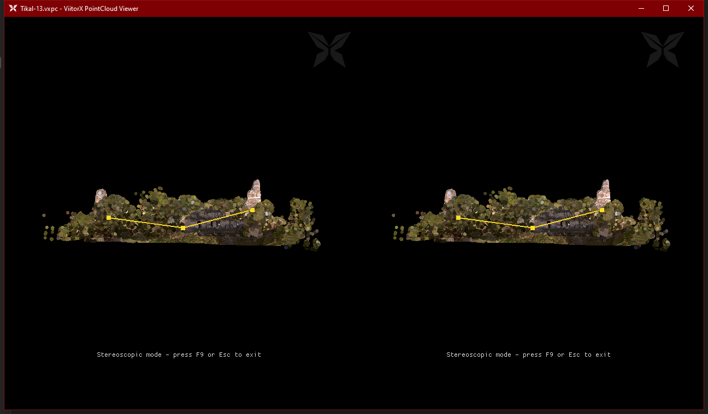
16
IMMERSIVE
Stereoscopic 3D (SBS)
F9 toggles side-by-side stereo — all UI hides so each eye sees only the cloud. Press F9 or Esc to exit. Set eye separation (IPD) & focal distance in Preferences ▸ Display.

Slide 18
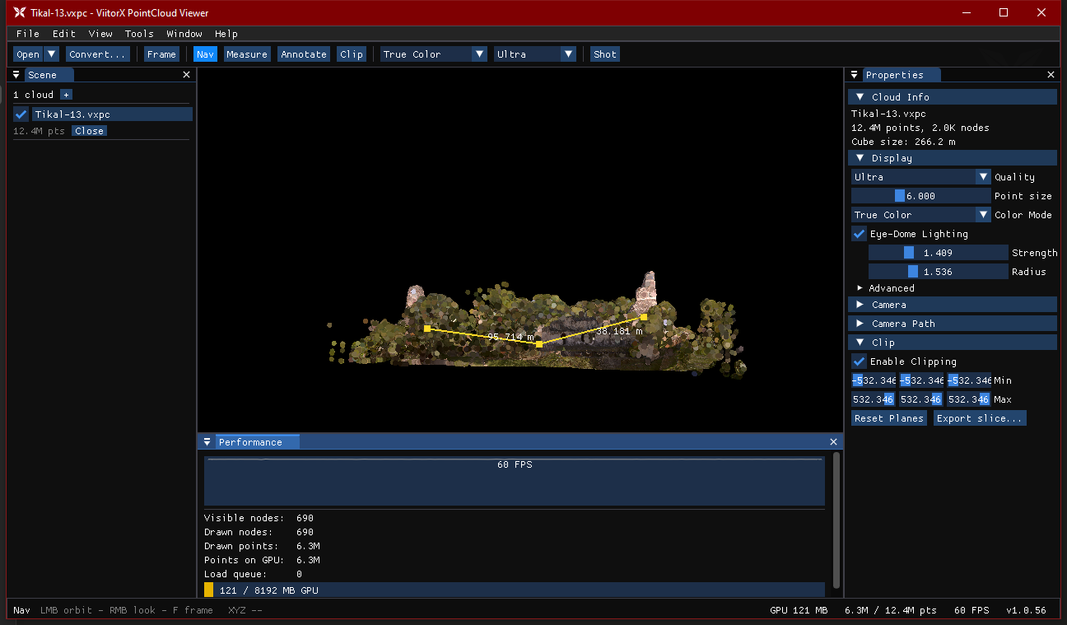
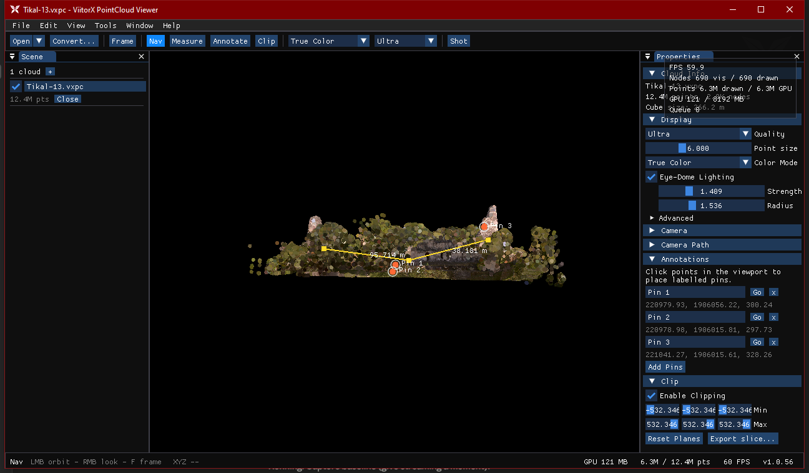
17
DIAGNOSTICS
Performance & Monitoring
Performance panel — FPS plot, node/point counts, GPU budget
Stats overlay (F3) — a live HUD over the viewport
Panels: Window menu toggles Scene, Properties, Jobs, Console and Performance. Conversions run as background Jobs with progress, ETA and a Console log.

Slide 19
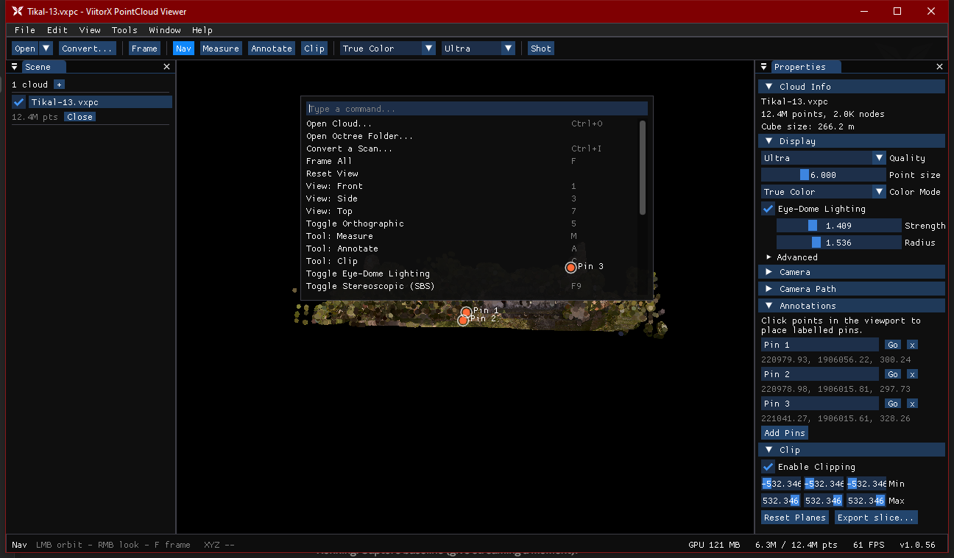
18
PRODUCTIVITY
Command Palette & Navigation
Move & command fast
Ctrl+P — fuzzy Command Palette for every action
LMB drag orbit · double-click to focus · RMB free-look
Wheel zooms to cursor; WASD + Q/E to fly (Shift = 5× fast)
Presets: 1 front · 3 side · 7 top · 5 orthographic · F frame all
F1 shows the full keyboard-shortcut overlay
Command Palette — type to filter, Enter to run

Slide 20
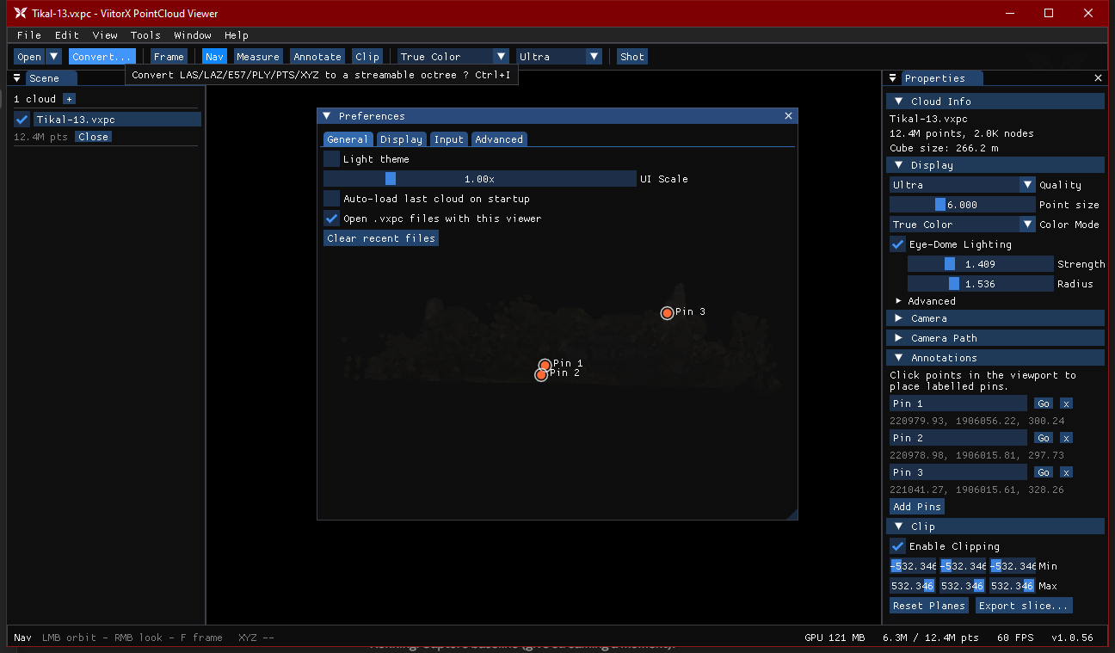
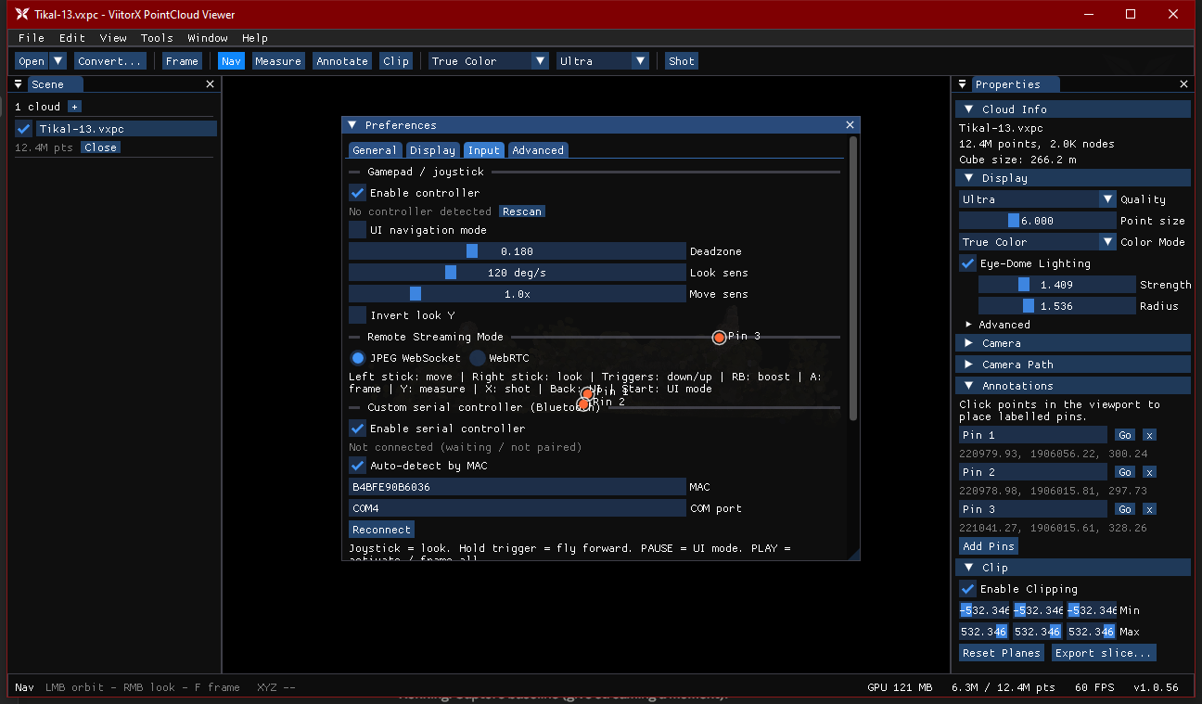
19
SETTINGS
Preferences
General — theme, UI scale, auto-load, .vxpc file association
Input — gamepad sensitivity, deadzone, serial controller
Open: Edit ▸ Preferences… (Ctrl+,). Tabs: General · Display (stereo IPD) · Input · Advanced (reset all). Settings persist between sessions.

Slide 21
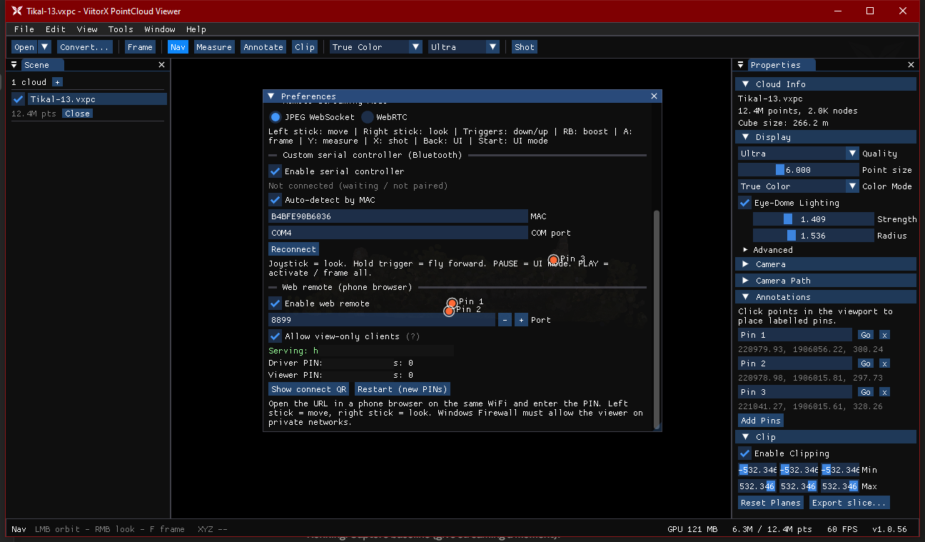
20
CONNECTIVITY
Web Remote & Controllers
Drive from a phone or pad
Web remote — a phone-browser control page on your WiFi (default port 8899)
Two roles: a Driver PIN (full control) and a Viewer PIN (watch-only)
Show connect QR to join instantly; live JPEG/WebRTC viewport streaming
Gamepad — enable & tune deadzone / look / move sensitivity
Serial (Bluetooth) controller — auto-detect by MAC or set the COM port
Preferences ▸ Input — web remote (serving URL & PINs redacted)

Slide 22
21
REFERENCE
Keyboard Shortcuts
Key | Action | Key | Action
Ctrl+O | Open cloud | F | Frame all
Ctrl+I | Convert a scan | 1 / 3 / 7 | Front / side / top
Ctrl+P | Command palette | 5 | Orthographic toggle
Ctrl+, | Preferences | M / A / C | Measure / annotate / clip
F1 | Shortcuts overlay | Esc | Exit tool / popup
F3 | Stats overlay | WASD Q E | Fly (Shift = fast)
F5 / Sh+Spc | Hide UI (zen) | LMB / RMB | Orbit / free-look
F9 | Stereoscopic SBS | 2× LMB | Focus pivot
F11 | Fullscreen | Wheel | Zoom (Ctrl = point size)
F12 | Screenshot | Esc Esc | Quit
Movement keys are ignored while typing in a field. Gamepad & serial-pad mappings are listed in Preferences ▸ Input.

Slide 23
VIITORX POINTCLOUD VIEWER
Convert once, explore anything.
Billion-point clouds, streamed interactively — with measurement, clipping, slice export, camera-path video, stereoscopic 3D and a phone web-remote.
v1.0.61
Download the compiled package
https://github.com/vinayak-vc/ViitorX-PointCloud-Viewer/releases/tag/1.0.61

