Slide 1
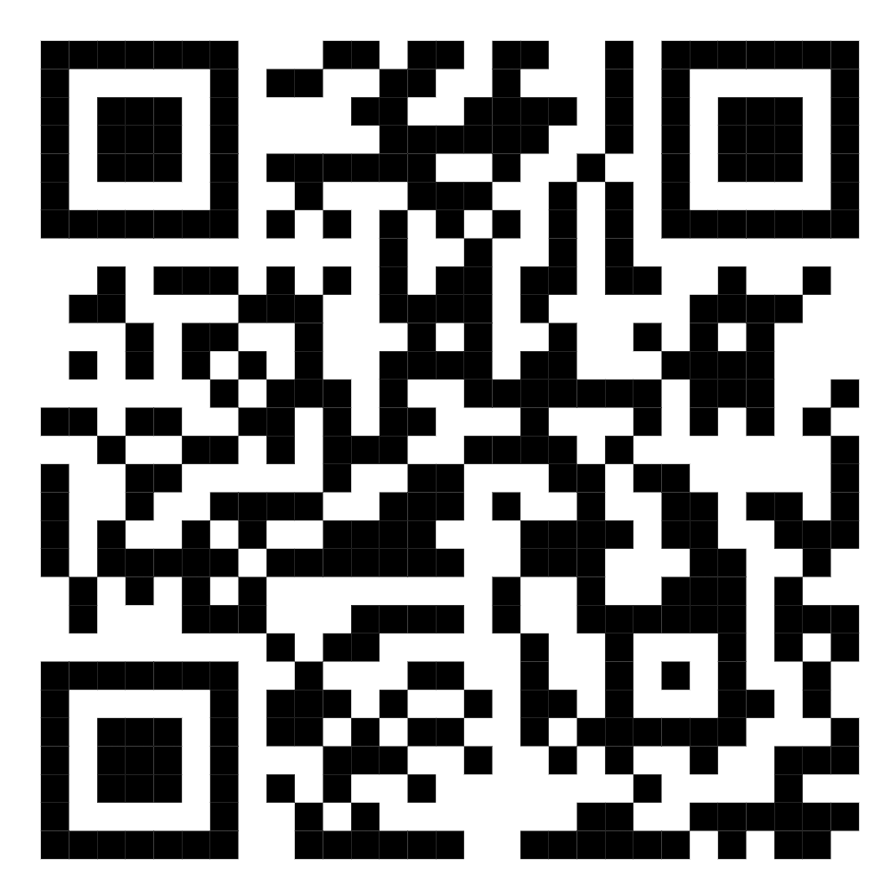
ShopCart
🛒
E-Commerce UX Design Project
COMP3511 – Human Computer Interaction | The University of New South Wales
Personas · Scenarios · Requirements · Prototype · Usability Testing
PROJECT TEAM
K
J
L
P
Kapil
Jonas
Leo
Chuang
Z5646894
z5664497
z5560086
z5622266

Slide 2
Presentation Overview
01
Problem Statement
02
User Personas
Why ShopCart was designed and what problems it solves for online shoppers
4 personas including Emily, Daniel, Sarah & Margaret based on user research
03
Context Scenarios
04
System Requirements
Real-world usage scenarios mapped to each persona's needs and goals
Functional and non-functional requirements derived from research findings
05
Prototype Walkthrough
06
Usability Testing
Key screens: Homepage, Product Page, Cart, Return, Report Issue, Assistive Tools
Test plan, 5 task scenarios, participant findings, and post-test ratings
07
Prototype Improvements
08
Summary & Conclusion
3 major improvements made based on usability test feedback
Key takeaways and what ShopCart achieves for consumer rights

Slide 3
01 Problem Statement
Key Problems Found
ShopCart Solution
1
Refund policies unclear
ShopCart is a modern e-commerce web app that combines online shopping with built-in consumer rights support — designed to be transparent, accessible, and empowering for all users.
Users struggle to find return/refund info before and after purchase
2
Complaint process complex
Multi-step, confusing flows frustrate users trying to report issues
✓
Clear return & refund info on every product page
3
Poor consumer transparency
Platforms fail to explain rights in plain, accessible language
✓
Step-by-step guided complaint & issue reporting
4
Accessibility gaps
✓
Consumer rights explained in plain language
Small text, poor contrast & cluttered pages exclude older users
✓
Accessible design for elderly & low-vision users
5
Support hard to find
Users can't easily locate help channels when problems arise
✓
Visible support channels throughout the platform
Goal: A transparent, accessible, and user-empowering e-commerce experience that puts consumer rights first.

Slide 4
02 User Personas
Frequent Shopper
Value Seeker
Emily Chen
Daniel Wu
P1
P2
University Student
Office Worker
22
Needs: Quick product search, clear refund info before buying
31
Needs: Trustworthy reviews, clear complaint escalation
Pain: Policies buried in pages, slow support
Pain: Incomplete product info, unclear channels
"I want to know my rights before I buy, not after a problem."
"If the process is fair and clear, I'm more likely to trust the platform."
Refund Experience
Accessibility Needs
Sarah Nguyen
Margaret Lee
P3
P4
Retail Assistant
Retired Teacher
27
Needs: Simple Report Issue button, status tracking
62
Needs: Large text, high contrast, plain-language policies
Pain: No clear complaint instructions, too many steps
Pain: Small fonts, cluttered layouts, hidden support
"I don't mind reporting a problem, but I need it to be simple."
"I need the website to guide me clearly, not make me work hard."

Slide 5
03 Context Scenarios
Emily — P1
S1
Checking Refund Rights Before Purchase
Emily wants to buy headphones from ShopCart. Before completing her order, she visits the product page expecting a clear summary of return and refund rights in simple language so she can feel confident buying.
Daniel — P2
S2
Handling a Delayed Order
Daniel's household item is 3 days late. He logs in to check tracking, understand what actions he can take, and find out if he's entitled to compensation, cancellation, or escalation.
Sarah — P3
S3
Reporting a Faulty Product
Sarah receives a damaged item and needs to report it immediately. She expects a clear 'Report Issue' option, guided steps, evidence upload support, and clear outcomes like replacement or refund.
Margaret — P4
S4
Older User Seeking Readable Rights Info
Margaret wants to buy a kitchen appliance but worries about returns. She needs a simple interface with large text, strong contrast, plain-language policy info, and easy-to-find support options.

Slide 6
04 System Requirements
Functional Requirements
Non-Functional Requirements
1
Clear return & refund info on product pages
Usability
Dedicated complaint / issue reporting feature
- Consistent, clear and predictable layout
2
- Minimal steps for all key tasks
3
Step-by-step guidance for returns & complaints
- Intuitive navigation structure throughout
4
Order tracking & complaint status visibility
Accessibility
5
Visible support channels (chat, contact, help)
- Large text options & screen zoom support
6
Full product details incl. seller & delivery info
- High contrast colours for readability
Search & navigation for quick info access
- Clear button labels & icons with text
7
Consumer rights explained in plain language
Performance
8
- Fast page loads on all connections
9
Available actions shown for common problems
- Smooth carousels and transitions
10
Past issue reports saved in user dashboard
Security & Trust
- Secure payment processing
- Transparent, honest information presented

Slide 7
05 Prototype – Homepage & Product Page
Homepage
Product Page
Navigation Bar:
Multi-Image Gallery:
Category, New, Sales, Trending, Fashion, Jewellery, Watch, Gadgets, Home Decor, Foods
3 thumbnail views + 1 large main product image for detailed inspection
Hero Banner:
Color & Size Selector:
Bold promotional banner with 'Make every penny count at best price' CTA
4 colour swatches + 4 size options (Sm, L, XL, 2XL) clearly displayed
Hot Deals Carousel:
Price & Discount:
Scrollable product cards with original & discounted prices and ratings
Sale price $10.99 with 20% discount badge + 6 Pieces Left urgency
Trending Brands:
Add to Cart Button:
Large featured brand sections — e.g. Titan Watch Collections (50+ collections)
Prominent gold CTA button + wishlist heart icon
Popular Items Grid:
Return Policy Badge:
Filterable by All, Cloths, Watch, Bags, Shoes, Decor, Beauty, Skin Care
2 weeks return policy shown prominently below the cart button
Crazy Offers Timer:
Customer Service:
Deal of the Week countdown with up to 70% discount and Check Out button
24/7 online customer service link visible on product page
Footer Links:
Description & Reviews:
Easy Returns, Report an Issue, Assistive Tools — accessible from every page
Full product description, material info, and View Review link

Slide 8
05 Prototype – Cart, Return & Report Issue
Shopping Cart
Easy Return
Report an Issue
All Items view
4-Step Wizard:
4-Step Guided Flow:
Checklist of items with qty +/- controls and size/colour shown
1
2
3
4
1
2
3
4
Order Summary
Select
Reason
Method
Refund
Describe
Photo
Submit
Track
Estimated price panel updates live as items selected
Item selection
Issue details form
Checkout button
Choose item with reason dropdown (Faulty, Wrong item, etc.)
Select item + reason dropdown, phone number add
Gold Check Out CTA with VAT note included
Progress bar
Photo upload step
Payment options
Clear 4-step progress indicator at top of page
Evidence photo upload guided step by step
Card payments + Cash on Delivery (COD) option
Terms sidebar
Complaint T&Cs
Continue Shopping
30-day window, original packaging required, fee note
7-day report window, 48-hour response time shown
Easy link back to browsing without losing cart
Help link
Submit & Track
Recommended section
'Need help? Visit our Return Policy' below Continue btn
Submit report and track progress from dashboard
Personalised product suggestions below cart

Slide 9
05 Prototype – Assistive Tools Page
Designed specifically for Persona 4 (Margaret, 62, Retired Teacher) and all users with visual, physical, or cognitive accessibility needs.
"We're committed to making ShopCart easy and comfortable for everyone."
1
Text Size & Contrast
2
Screen Reader Support
3
Voice Commands
Adjust font size and switch to high-contrast mode for better readability across all pages
Fully compatible with screen readers for smooth, uninterrupted browsing and navigation
Use voice search to find products and navigate the site hands-free with simple speech
4
Keyboard Navigation
5
Color & Theme Options
6
Simplified View
Navigate the entire website easily using only a keyboard — no mouse or touch required
Choose from light, dark, or soft themes to reduce eye strain and improve comfort
Enable a clean, distraction-free layout with only essential features and content shown
Accessibility is always on at ShopCart | These tools help everyone shop with confidence, comfort, and ease.

Slide 10
06 Usability Test Plan
Purpose
5 Task Scenarios
Evaluate whether users can complete core shopping & after-sales tasks efficiently and with minimal confusion or errors
Task 1
Find a casual black T-shirt and open its product details page
Participants
3-5 users for in-class pilot. At least 1 aged 45+, 1 with visual difficulty. General online shoppers
Task 2
Decide to buy the T-shirt and add it to the shopping cart
Method
Task 3
Moderated task-based sessions. Facilitator reads tasks. Think-aloud protocol. No help unless completely stuck
Review cart items and proceed to the checkout payment page
Task 4
Environment
Product arrived differently than expected — initiate a return
Quiet tutorial room. Laptop or desktop. Screen zoom at default. Prototype opened and ready before participant sits
Task 5
Received a damaged item — submit an issue report with evidence

Slide 11
06 Usability Test – Findings & Questionnaire
Post-Test Ease Ratings (Scale 1 = Very Difficult → 5 = Very Easy)
Finding Products
4/5
Product Page Clarity
4/5
Cart & Checkout
3/5
Return Function
3/5
Issue Reporting
3/5
Pre-Test Background (1 Participant)
Post-Test Key Observations
- Often shops online using desktop/laptop
- Purchase flow and Buy button were easiest
- Moderate confidence using shopping websites
- Return policy feature was most confusing area
- Never returned a product or reported an issue
- Felt lost when completing return/report tasks
- Sometimes has difficulty reading small text on websites
- Suggested: clearer return terms + review feedback
- Expects: clear search bar + trustworthy reviews
- Considered usable for elderly with some improvements

Slide 12
07 Prototype Improvements – Overview
Trigger: Usability test revealed 3/5 tasks were rated Neutral or below — Return and Report Issue flows needed redesign.
1
Easy Return Page Redesign
Before (Problem)
After (Improvement)
- No clear step progress indicator
+ 4-step progress wizard at top
- Return T&Cs hidden or missing
+ Return T&Cs sidebar always visible
- Users couldn't find reason options
+ Item + reason dropdown selection
- No visible help or policy link
+ 'Need help? Visit Return Policy' link
2
Report an Issue Redesign
Before (Problem)
After (Improvement)
- No visible 'Report Issue' entry point
+ Clear 4-step guided flow with progress
- No step guidance or flow structure
+ Complaint T&Cs sidebar (7 days, 48hr response)
- No complaint terms shown
+ Photo upload dedicated step
- No photo upload or evidence guidance
+ Contact Customer Care link throughout
3
Assistive Tools Page Added
Before (Problem)
After (Improvement)
- No dedicated accessibility support page
+ 6 accessibility tools on dedicated page
- No font size or contrast controls
+ Text Size & Contrast, Screen Reader
- No voice or keyboard nav support
+ Voice Commands & Keyboard Navigation
- Hard for elderly/low-vision users
+ Simplified View + Color/Theme Options

Slide 13
Summary & Conclusion
4
4
5
3
User Personas
Scenarios
Usability Tasks
Improvements
Student, Worker, Retail & Elderly
Real journeys & pain points mapped
Tested with real participants
Return, Issue Report & Accessibility
ShopCart goes beyond a typical shopping platform. By embedding consumer rights transparency, guided after-sales support, and dedicated accessibility tools directly into the user experience, it empowers all users — from young frequent shoppers to elderly users with visual needs — to shop confidently and claim their rights.
Team: Kapil | Jonas | Leo | Paxon | COMP3511 HCI — UNSW

