Slide 1

Seasonal Agriculture Performance Analysis
Student name - Vinayak Ojha
College name - Chandigarh University
AICTE STU ID : STU685c284f43f901750870095

Slide 2

PROBLEM STATEMENT
(Agricultural activities are influenced by seasonal variations in environmental conditions, farming practices, resource availability and market conditions. As a result, agricultural performance may differ from one season to another. However, raw agricultural data does not clearly explain how agricultural performance changes across seasons or what patterns can be observed in different seasonal conditions. The problem is to analyze the given agricultural dataset and investigate seasonal differences in agricultural performance by identifying meaningful patterns, trends, relationships and variations within the available data.

Slide 3
PROJECT DESCRIPTION
This project analyzes a farm-level agricultural dataset of 4,000 records across 8 Indian states to understand how crop yield, profitability, resource usage (water, fertilizer) and risk vary across the Kharif, Rabi and Zaid seasons. Using Python (Pandas, Matplotlib, Seaborn, SciPy), the data was cleaned, explored and statistically tested (ANOVA) to confirm seasonal differences, and correlation analysis was used to identify the key drivers of yield and profit. The final output is a documented Jupyter Notebook with visualizations and evidence-based recommendations to support seasonal agricultural planning.

Slide 4

WHO ARE THE END USERS?
Farmers planning seasonal crop and irrigation strategy
Agricultural extension officers and state agriculture departments
Agri-business and supply chain planners
Policy makers designing seasonal subsidy/support schemes
Researchers and students studying agricultural data analytics

Slide 5

Technology Used
Python 3
Pandas & NumPy – data cleaning and manipulation
Matplotlib & Seaborn – data visualization
SciPy – statistical testing (ANOVA)
Jupyter Notebook – analysis documentation
GitHub – version control and submission

Slide 6
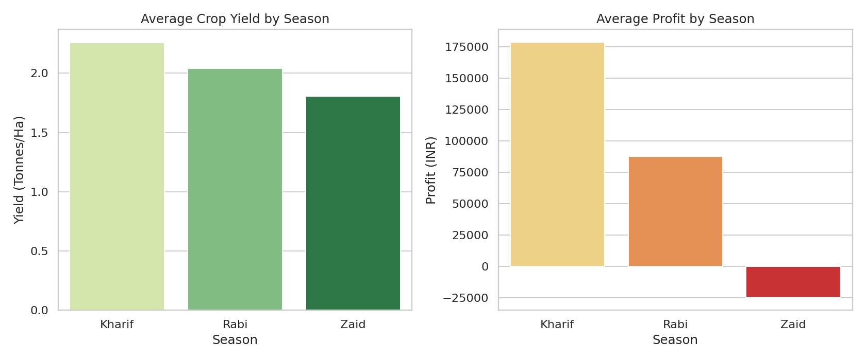
RESULTS
Average Yield & Profit by Season
Kharif shows the highest average yield (2.26 t/ha) and profit (₹1.79L); Zaid records the lowest yield and a negative average profit.

Slide 7
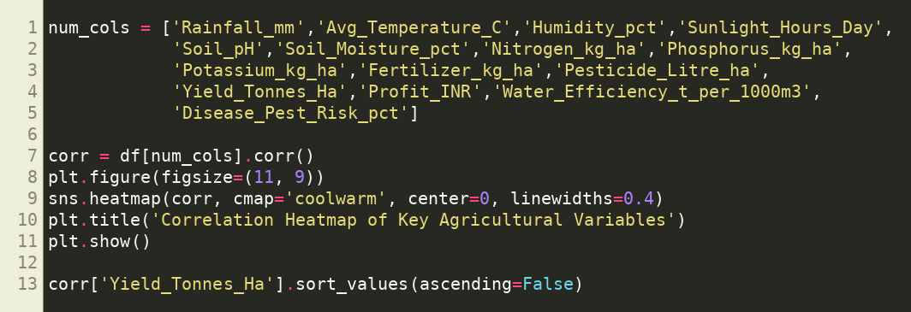
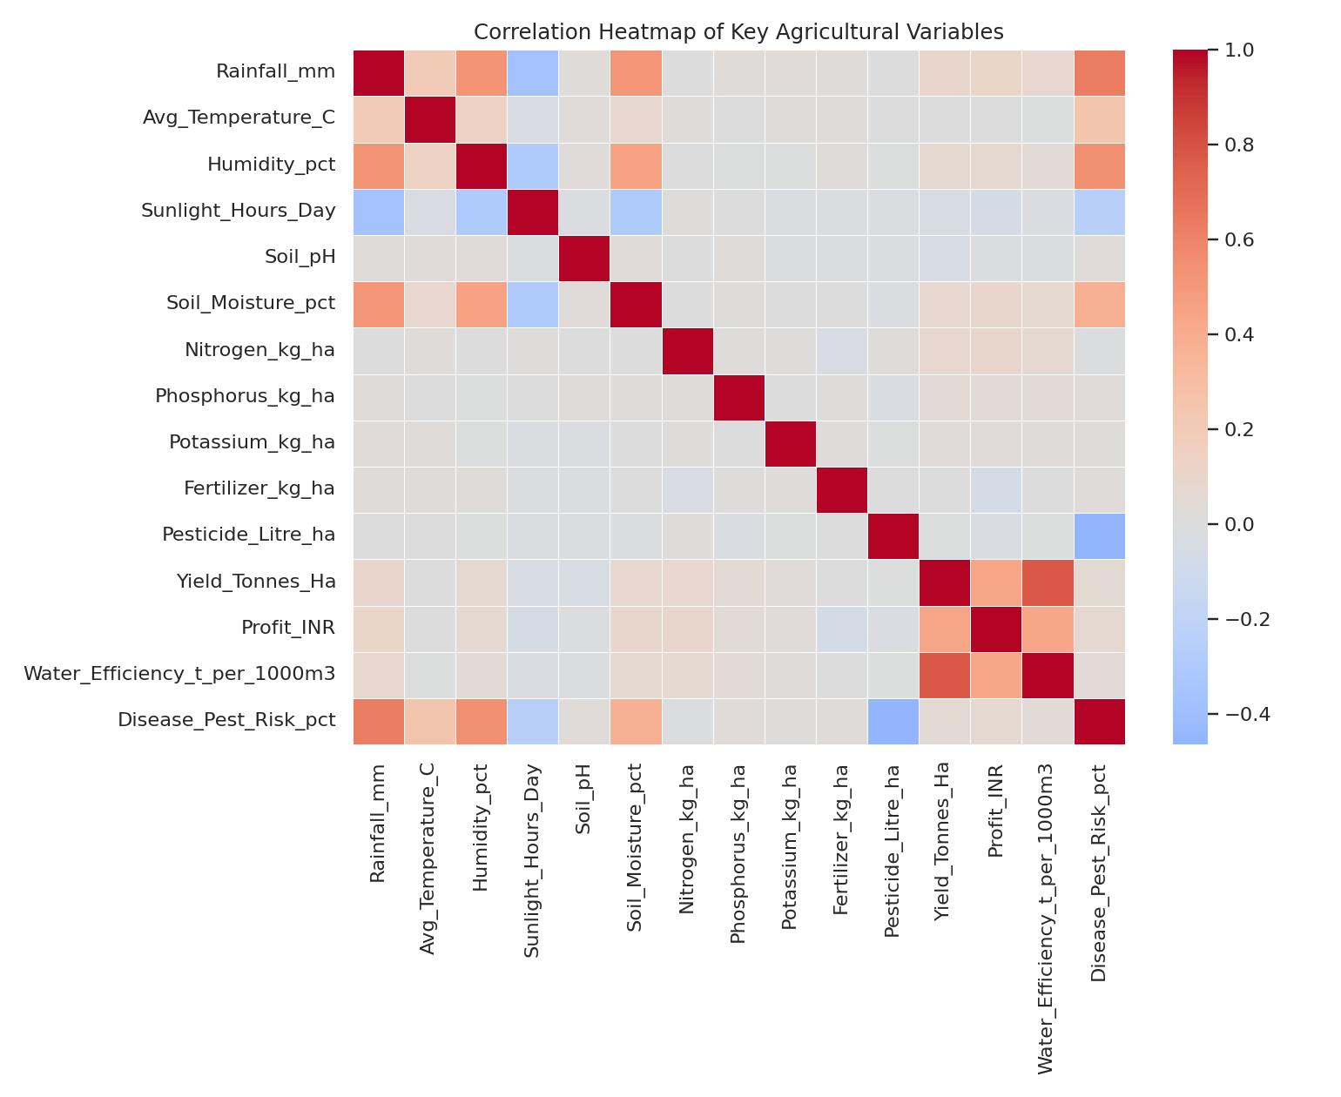
RESULTS
Correlation Between Key Variables
Water efficiency (0.78) is the strongest driver of yield — far more than fertilizer or pesticide volume, which show almost no correlation.

Slide 8
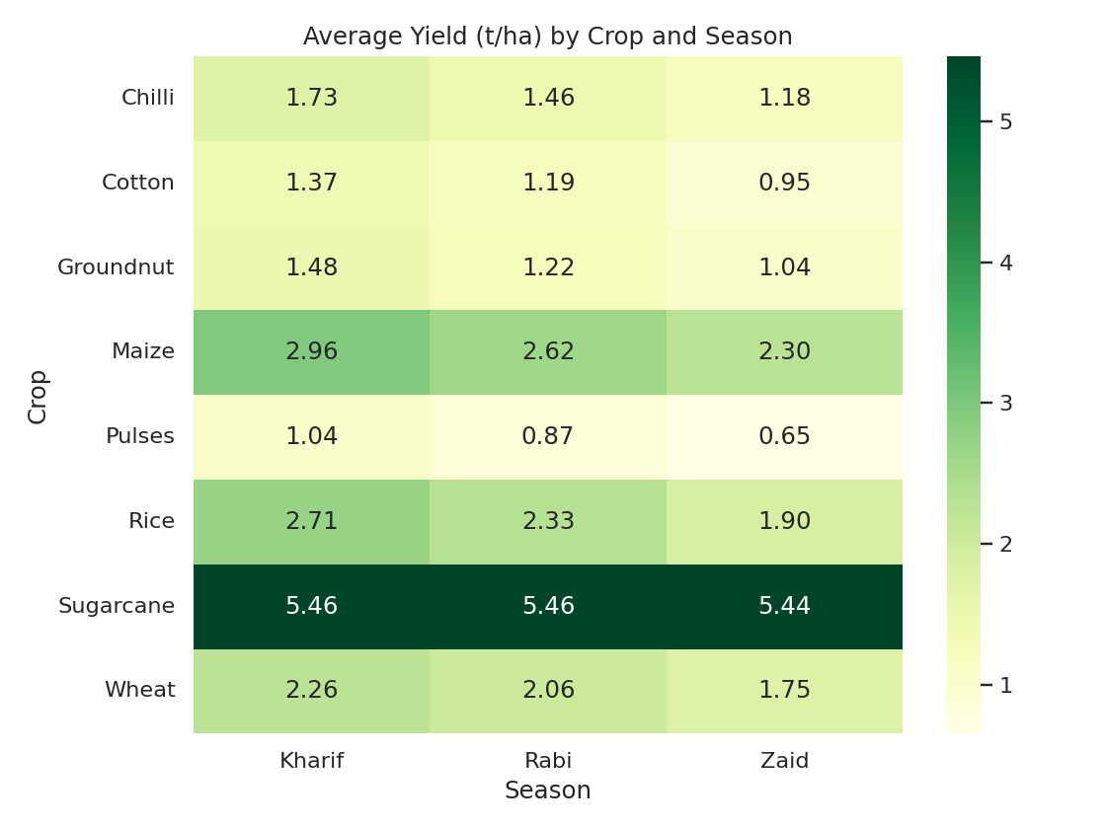
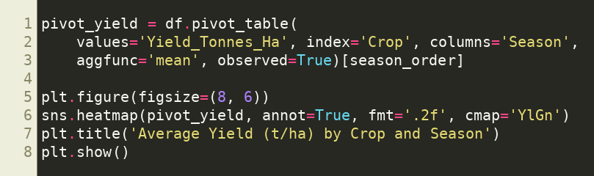
RESULTS
Crop performance is not uniform across seasons — the best/worst crop differs by season, so planning should be crop-specific.
Crop-wise Yield Across Seasons

Slide 9
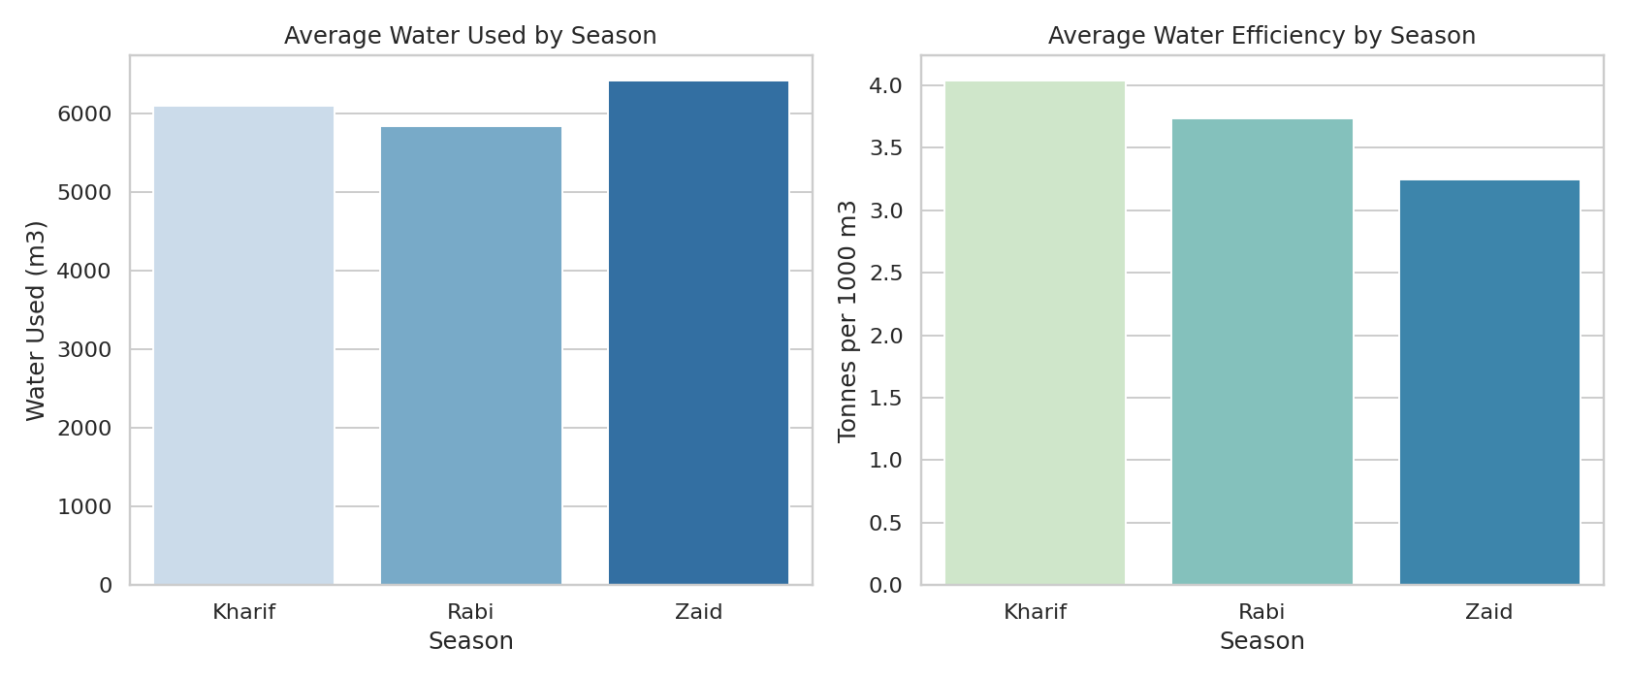
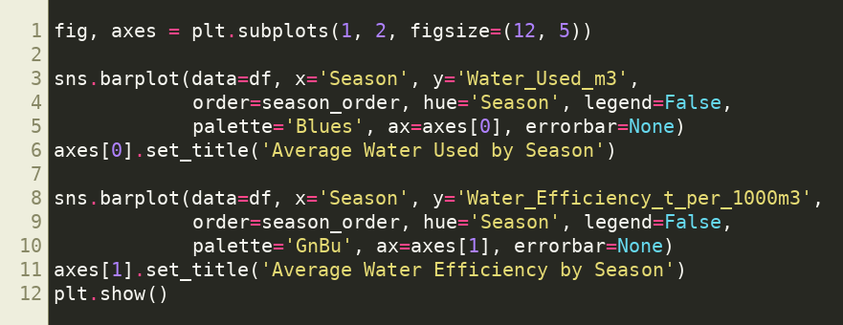
RESULTS
Zaid uses less absolute water but is also the least water-efficient season, contributing to its weaker profitability.
Water Usage & Efficiency by Season

Slide 10
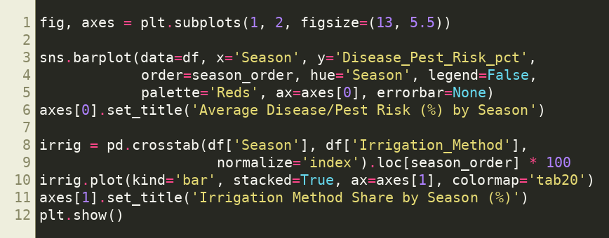
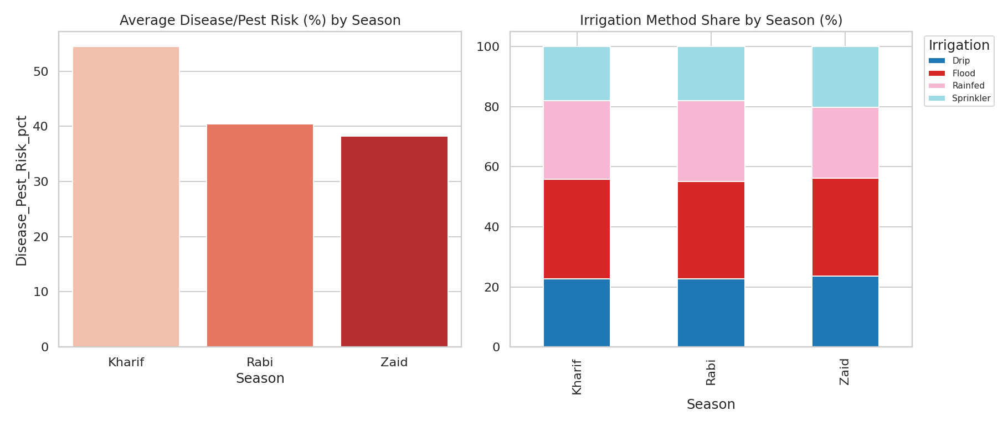
RESULTS
Disease/pest risk stays roughly constant (~45-48%) across seasons — it is not the main driver of Zaid's lower profit; water availability is.
Disease/Pest Risk & Irrigation Method by Season

Slide 11
Future scope
Extend analysis to district/regional level for hyper-local recommendations
Build a predictive ML model to forecast yield/profit by season and crop
Integrate live weather/rainfall APIs for real-time seasonal advisory
Develop an interactive dashboard (Power BI/Streamlit) for farmers
Incorporate market price forecasting to guide crop-season selection
Expand dataset with more seasons/years for trend analysis over time

Slide 12
GitHub Link
https://github.com/SoulKanishk/SeasonalAgriculturePerformanceAnalysis-

Slide 13

VOIS Course completion certificate - Course name- Data Visualization

Slide 14
Thank you
.
.

