Slide 1


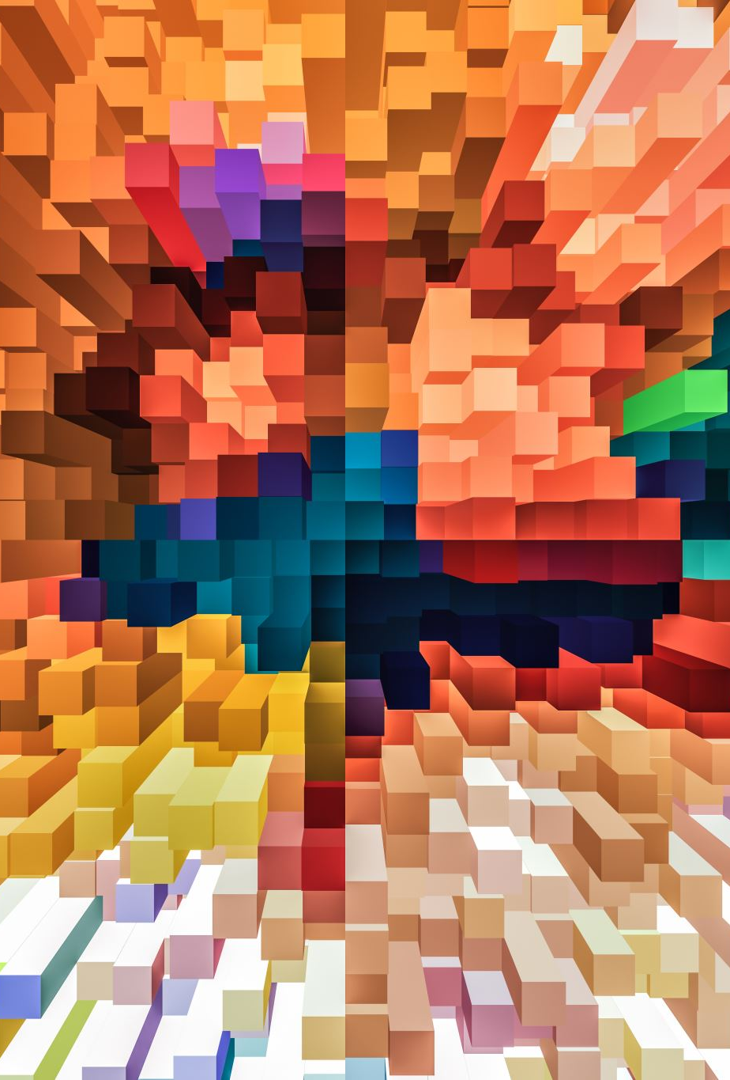
JPEG compression

Slide 2
WHaT IS JPEG
JPEG stands for “Joint Photographic Experts Group”. It’s a standard image format for containing lossy and compressed image data. Despite the huge reduction in file size JPEG images maintain reasonable image quality. This unique compression feature allows JPEG files to be used widely on the Internet, Computers, and Mobile Devices.

Slide 3
Why?
Digital image requires much storage space and compressed data takes less storage space

Slide 4
What is data compression?
It is a process by which the file size is reduced by re-encoding the file data to use fewer bits of storage than original file.

Slide 5
The discrete cosine transform(dct) in image compression
A Discrete cosine transform (DCT) expresses a finite sequence of data points in terms of a sum of cosine functions oscillating at different frequencies.
01
The human eye is most sensitive to low frequencies
02
The image is divided into parts
03
Important lower frequencies are kept
04
Higher ones are discarded (lossy algorithm)
05

Slide 6
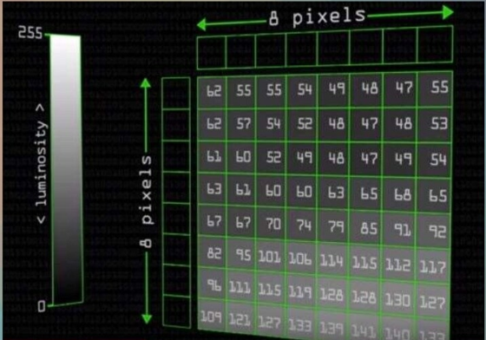
luminosity

Slide 7
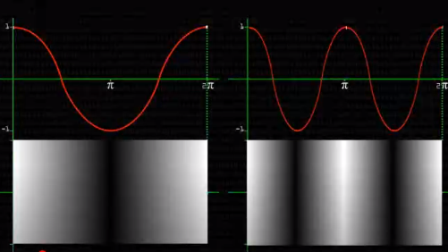
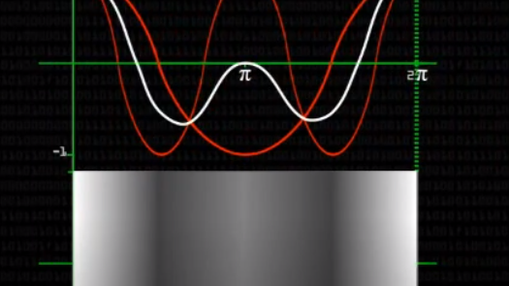
Cosine waves

Slide 8
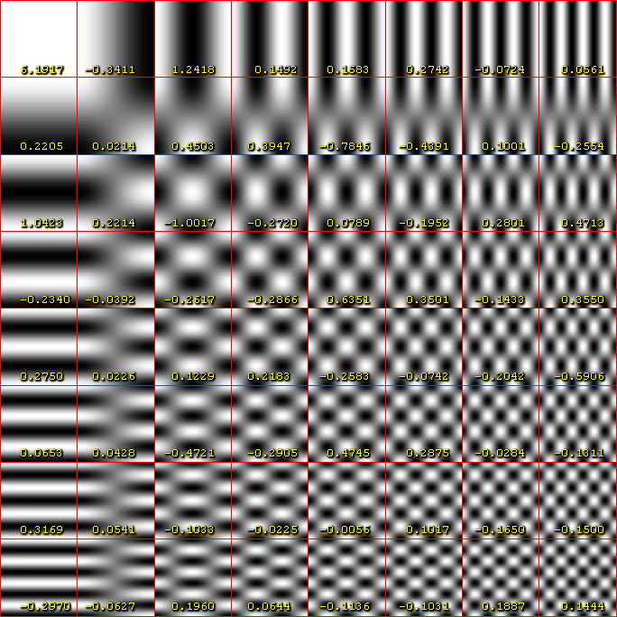
DCT

Slide 9
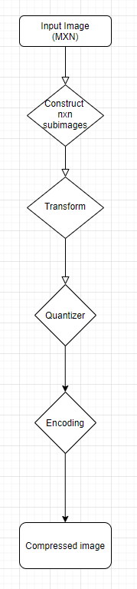
Mechanism

Slide 10
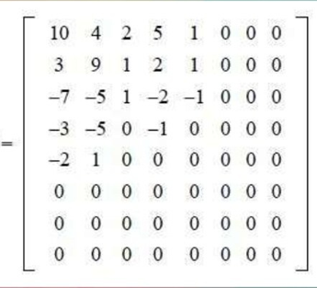
quantization
Removing high frequency data

Slide 11
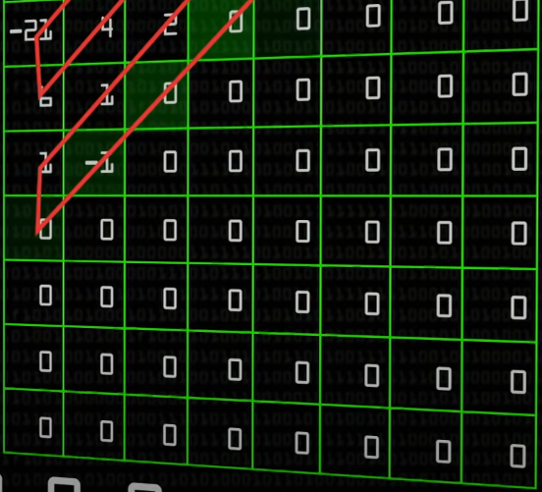
encoding

Slide 12
As we discard part of the original data of the image, this type of compression is considered a lossy compression. Only the non zero coefficients are used to reconstruct are used to reconstruct the image

