Slide 1
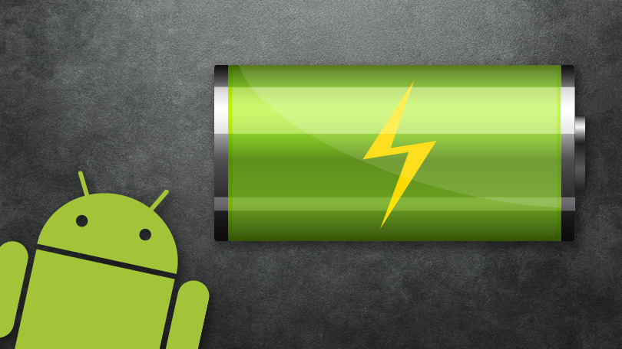
NETWORK AND BATTERY BEST PRACTICES

Slide 2
Network & Battery issues
Optimizing network and battery performance is a huge topic, and as devices and the Android OS change, so do some of the recommendations. The Android team constantly improves the framework and APIs to make it easier for you to write apps that perform well. Battery life is the single most important aspect of the mobile user experience. A device without power offers no functionality at all. For this reason, it is critically important that apps be as respectful of battery life as possible.

Slide 3
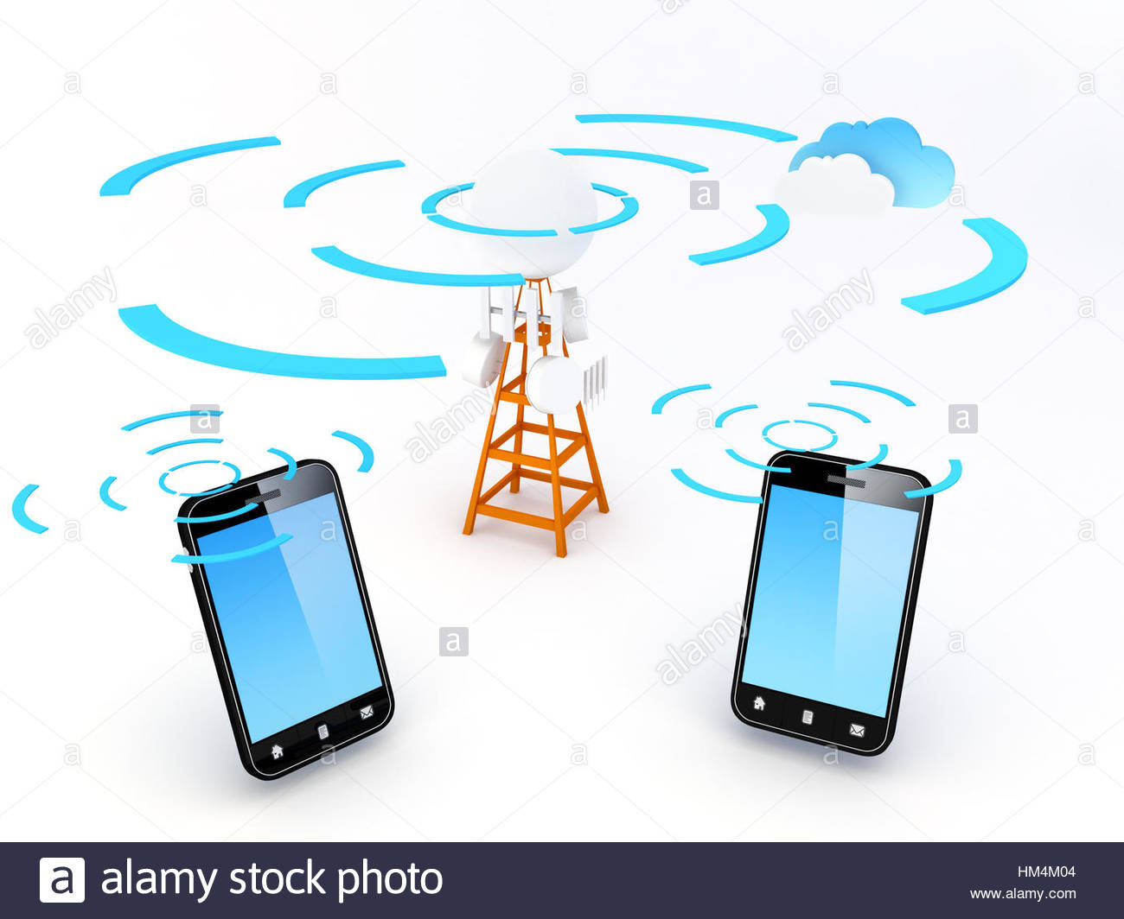
RADIO
Inside your mobile device is a small piece of hardware that's essentially a radio. The purpose of this radio is to communicate with local cell towers and transmit data. However, this radio is not always active and drawing power. It starts in a powered down state, and when the device needs to send data, the radio turns on and transfers the data. After the data packet is sent, the radio stays awake for a while, in case the server sends a response. Eventually, the radio goes back to sleep to save battery.
The exact number of states and amounts of power drawn depend on the device and the Android version. The radio state machine on each device varies based on the mobile radio technology employed—2G, 3G, LTE, etc. This variation is particularly true of the transition delay ("tail time") and startup latency. The device's carrier network defines and configures these attributes.

Slide 4

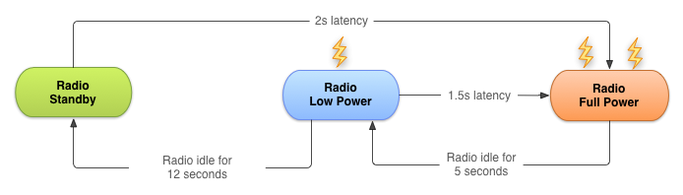
State machine for a typical 3G network radio
Full power: Used when a connection is active, allowing the device to transfer data at its highest possible rate.
Low power: An intermediate state that uses around 50% of the battery power of the full-power state.
Standby: The minimal energy state during which no network connection is active or required.

Slide 5

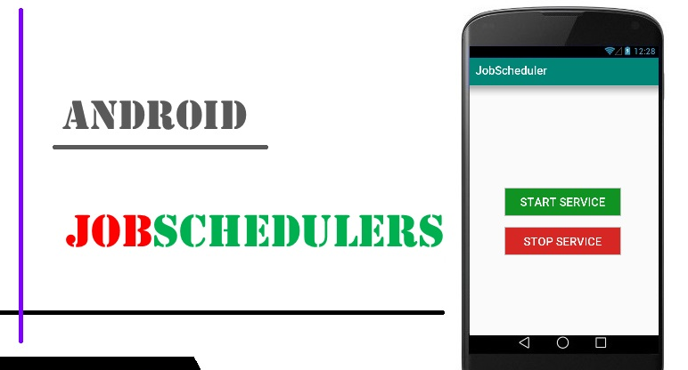

Practices & API’s
You need to minimize the number of times the radio is powered up. Send as much data as you can per cycle, and get a server response before the hardware is turned off. Doing all this requires some timing acrobatics, and there are several APIs, including JobScheduler and FirebaseJobDispatcher, to help you. Even using these APIs, you should follow network and battery best practices.

Slide 6
Types of network requests.
Do now: These networking requests are mostly user-initiated, and the user expects a fast response. As such, there is not much to optimize here. Signing in and requesting a photo are examples of "do now" networking requests.
Server response: The app makes a request to the server, and the server sends a response. To improve resource usage for the request and reduce the size of the request and response, ask only for the data you need, and use compression.
Data push such as uploading analytics, saving state, or syncing: You can optimize the timing of the push and the size of the received data.

Slide 7
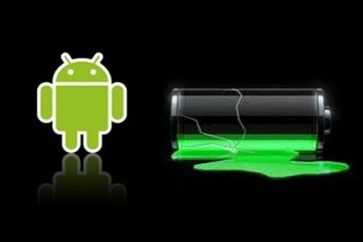
Best practices for reducing network usage and battery consumption
Never poll the server for updates. An app that pings the server every 20 seconds, just to acknowledge that the app is running and visible to the user, keeps the radio powered on indefinitely. Keeping the radio on for this reason results in a significant battery cost for almost no actual data transfer.
Do not oversync. Sync data only as often as you must. And ideally, sync when the phone is on Wi-Fi and plugged in.
Use an (exponential) back-off pattern when you sync or poll. That is, extend the time between subsequent polls, as described in Exponential backoff. A service like Firebase Cloud Messaging will handle this task for your app.

Slide 8
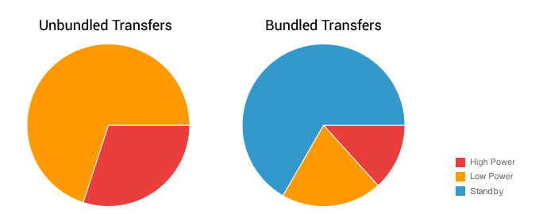
Bundle requests
Instead of sending one request at a time, bundle and send multiple requests together. This optimizes the way your app takes advantage of an active cell radio. Use the JobScheduler API or theFirebase JobDispatcher API.

Slide 9

Managing Network
Prefetch data. Try to predict what the user might need in the next few minutes and download it ahead of time along with requested data. This requires some amount of guessing, but if you predict correctly, you save.
Adapt to what the user is doing.
Fetch text before media. Text requests tend to be smaller and compress better than media requests.
Compress your data. In general, it takes much less battery power for the CPU to compress and decompress data than it takes for the radio to transfer that same data over the network uncompressed.

Slide 10
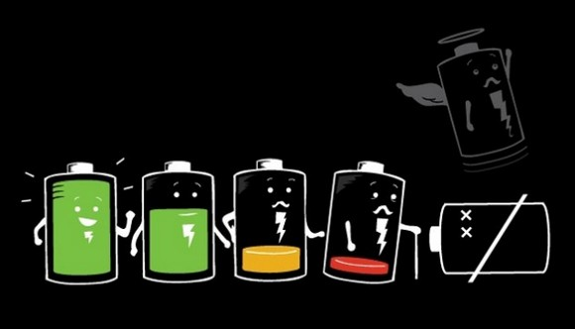
Monitoring the battery level
It is good practice to notice battery level and charging state before performing application update. If the device is charging over AC(wall charger) refresh rate can be maximized without affecting battery life. In case device is unplugged limiting the update rate will help in maximizing battery life.

Slide 11
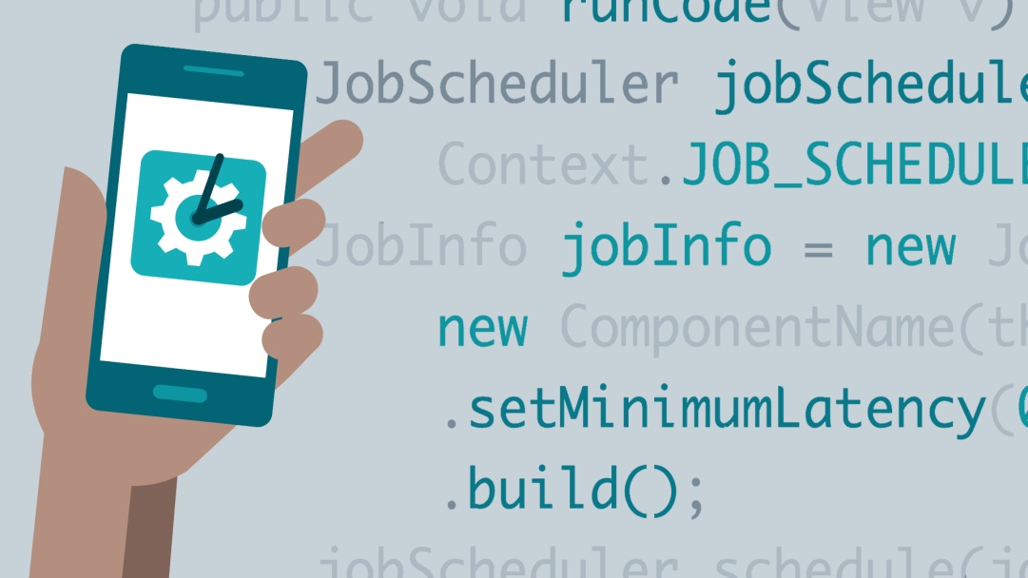
Battery Optimization
Job scheduler api
✓ For efficient use of android resources and smartly handles background tasks in a manner to improve battery life also.
✓ As it operates at the system level hence capable of smartly scheduling background task to run along with jobs from other apps hence minimizes radio usage a major battery drainage issue.
✓ It doesn’t perform task based on time but based on condition.

Slide 12
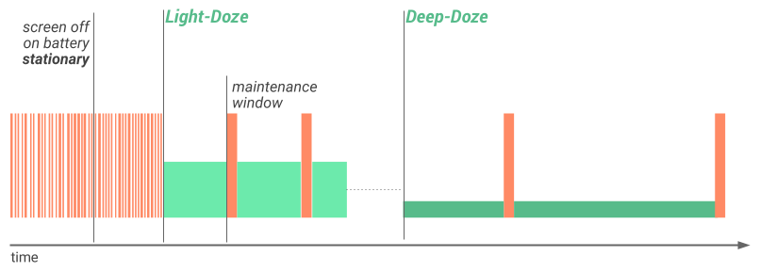
Android Doze
✓ When smartphone is kept idle for hours usually during night with screen off and the device is stationary, this might drain some battery.
✓ Now android doze is triggered and it will defer the background tasks, syncs, alarms and Wi-Fi scan until a maintenance window is scheduled.
✓ Doze will batch all background activities inside a single batch to extend battery life by good margin.

Slide 13
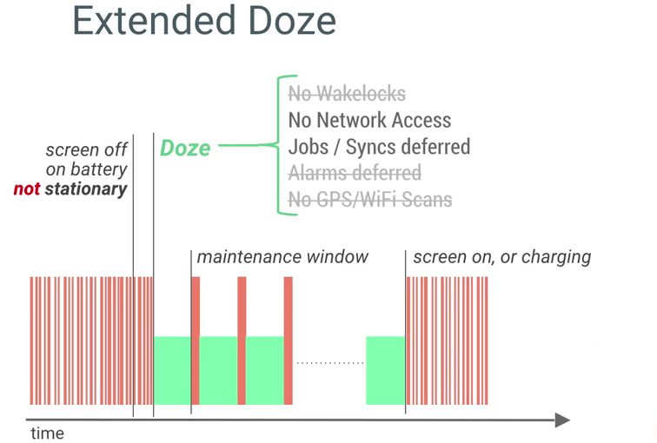
Android Doze Extended
✓ When device is in pocket (not stationary) with screen off.
✓ the lighter doze version will be active and restrict lesser number of background tasks.
✓ During this time there will be regular maintenance windows.

Slide 14
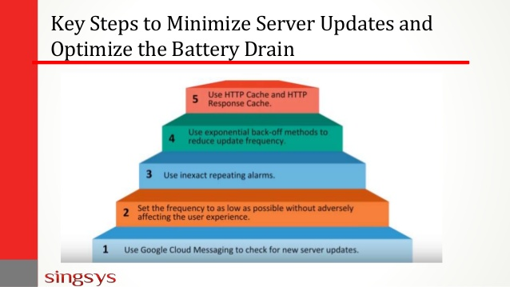
Key Steps to Minimize Server Updates and Optimize the Battery Drain
An Android application needs to activate the wireless radio and create the connection to check the available updates on the server. This will cause unnecessary battery drain.
Once we understand the device state, network connectivity and user behavior then accordingly periodic update can be scheduled.

Slide 15
Make your apps usable offline:
Bundle network requests when users are offline. For example, let users compose messages when offline and send the messages when online.
The best way to save on networking performance is not to download or upload data at all. Apps should cache content that is fetched from the network and likely to be used again. Before making subsequent requests, apps should display locally cached data. This ensures that the app is functional even if the device is offline or on a slow or unreliable network.
Consider an offline-first architecture, which initially tries to fetch data from local storage and, failing that, requests the data from the network. After being retrieved from the network, the data is cached locally for future use. This helps to ensure that network requests for the same piece of data only occur once—with subsequent requests satisfied locally.

Slide 16

Presented by : Vinayak Pahujani
Class : CSE 6A
Roll no : 2K18ECUN02006

