Slide 1


Global Healthcare Data ETL & Analysis CLI
By – Vinayak Choudhary (MS fabrics)

Slide 2
Table of Contents
(1) Project Overview
(2) Objectives
(3) Technology Stack
(4) Project Workflow
(5) ETL Pipeline
(6) Data Loading & CLI
(7) Database Design
(8) Testing & Validation – ETL Pipeline
(9) Sample Queries & Analysis
(10) Conclusion

Slide 3
Project Overview
This project focuses on building a robust command-line application for extracting, transforming, and loading (ETL) healthcare data. It emphasizes data engineering skills, including data ingestion, cleaning, and storage for analytical purposes.
1
2
Data Extraction
Data Transformation
Connect to public APIs and fetch raw healthcare data.
Clean and structure data into a usable format.
3
4
Data Loading
Data Analysis
Load processed data into a MySQL database.
Perform queries and generate reports directly from the CLI.

Slide 4
Objectives
This project offers comprehensive learning across several key areas of data engineering and software development.
API Interaction: Master interacting with RESTful APIs for data extraction.
Data Transformation: Implement robust data cleaning and transformation techniques using Python.
Database Management: Design and manage relational database schemas in MySQL, optimizing data loading performance.
CLI Development: Build a user-friendly and functional command-line interface.
Data Analysis: Perform basic data analysis and reporting using SQL queries.
Robustness: Implement logging and error handling for data pipeline robustness.

Slide 5
Technology Stack
(1) Python Core language for implementing ETL logic, API interaction, and CLI development.
(2) MySQL Relational database used to store transformed healthcare data for analysis.
(3) argparse Python libraries used to build the interactive and user-friendly command-line interface.
(4) Requests For fetching data from public healthcare APIs via HTTP requests.
(5) pandas Used for data cleaning, transformation, and preparation before loading.
(6) Logging Implemented to monitor ETL steps, handle errors, and ensure pipeline reliability.

Slide 6

Project Workflow
This flowchart illustrates the main stages of the Global Healthcare Data ETL & Analysis CLI project, from data ingestion to user interaction.
Data Extraction
Data Transformation
Data Loading
Command-Line Analysis
Each step is crucial for ensuring the integrity and usability of the healthcare data within the system.

Slide 7
ETL Pipeline
The core of this project involves building a robust ETL pipeline with specific functionalities for data handling.
Data Extraction (E)
Data Transformation (T)
Connect to a public healthcare API (e.g., WHO, CDC).
Parse JSON/XML into structured Python format.
Handle API authentication and rate limits.
Perform data cleaning (missing values, types, duplicates, standardization).
Fetch data based on user-defined parameters.
Gracefully handle API errors and network issues.
Apply business logic transformations (e.g., calculating daily new cases).
Define and enforce a target data schema for MySQL.
The pipeline must ensure data integrity and efficient processing from source to destination.

Slide 8
Data Loading & CLI
Beyond ETL, the project requires efficient data loading into MySQL and a user-friendly command-line interface for interaction and analysis.
Data Loading (L)
CLI Interface & Data Analysis
Establish connection to MySQL database.
Develop CLI using argparse or Click.
Create necessary tables with appropriate data types and keys.
Commands for: fetch_data, list_tables, query_data, drop_tables.
Implement efficient batch insertion of transformed data.
Display query results in readable tabular format.
Handle incremental loads (insert new or update existing records).
Implement error handling for database operations.
This ensures the application is both functional and easy to use for data management and reporting.

Slide 9
Database Design
MySQL table, daily_cases illustrate the required schema design for storing healthcare data.
Column Name
Data Type
Constraints
Description
id
INT
PRIMARY KEY, AUTO_INCREMENT
Unique record ID
report_date
DATE
NOT NULL, UNIQUE(country_name, report_date)
Date of the report
country_name
VARCHAR(255)
NOT NULL
Name of the country
total_cases
BIGINT
NULLABLE
Cumulative reported cases
new_cases
INT
NULLABLE
New cases on that date
total_deaths
BIGINT
NULLABLE
Cumulative reported deaths
new_deaths
INT
NULLABLE
New deaths on that date
etl_timestamp
TIMESTAMP
DEFAULT CURRENT_TIMESTAP
When record was loaded
These tables ensure data integrity and efficient querying for analytical purposes.

Slide 10
Testing & Validation – ETL Pipeline
ETL Process Testing
(1) API Client:
Verified data fetching with valid and invalid inputs.
Tested for API downtime, invalid URLs, and rate limiting.
(2) Data Transformation:
Handled missing values, wrong data types, and duplicates.
Ensured data aligned with the defined MySQL schema.
(3) MySQL Data Loading:
Tested initial and incremental data loads.
Verified primary key constraints and timestamp correctness.
Checked for duplicate prevention.

Slide 11
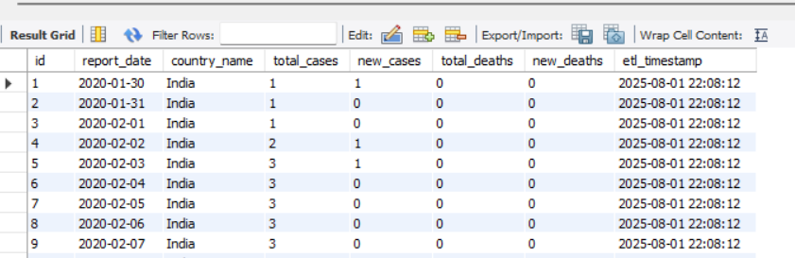

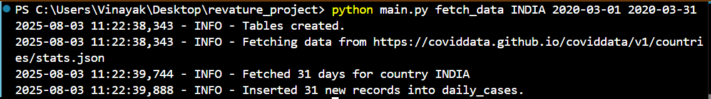
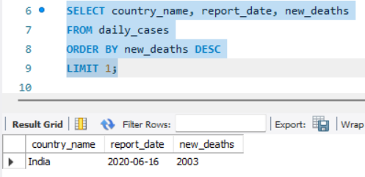
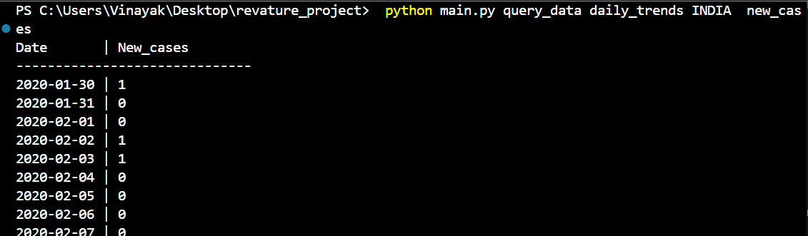
Sample Queries & Analysis
(1) python main.py list_tables
(2) python main.py fetch_data country INDIA 2020-03-01 2020-03-31
(3) python main.py query_data total_cases India
(4) python main.py query_data daily_trends INDIA new_cases

Slide 12
Conclusion
This project successfully demonstrates the end-to-end development of a real-world ETL pipeline using Python. It showcases the ability to extract data from public APIs, transform it for consistency, and load it into a structured MySQL database. The command-line interface adds usability, enabling users to fetch, manage, and analyze data efficiently. Overall, the project reflects practical skills in data engineering, database management, and software development.

Slide 13
Thank You

