Slide 1
Name of project : grow your garden project members: 1. Rutuja patil (210543181084) 2. Satyajit patil (210543181092) 3. Vinayak nikam (210543181054) 4.shital pandhare (210543181058)

Slide 2
Introduction: 1.This project deals with developing Grow Your Garden website for Online Description of Veggies and Selling seeds of that veggies. 2.It provides the user with a catalogue of different category of veggies seeds without any registering in the portal and when user register in portal then they able to buy any product.

Slide 3
Objective: This is a project with the objective to develop a basic website where The Balcony Gardener's uniquely different gardening ideas and for growing their plants, a lack of space won't hold you back; you will soon transform your mini-patch into a fabulous green oasis.

Slide 4
Specification: 1.admin 2.customer

Slide 5
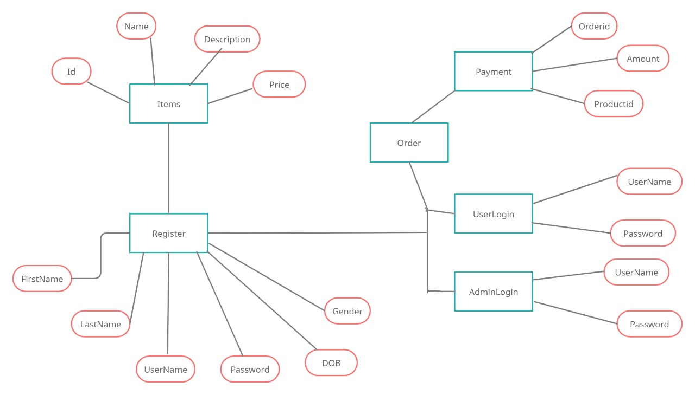
E-r diagram:

Slide 6
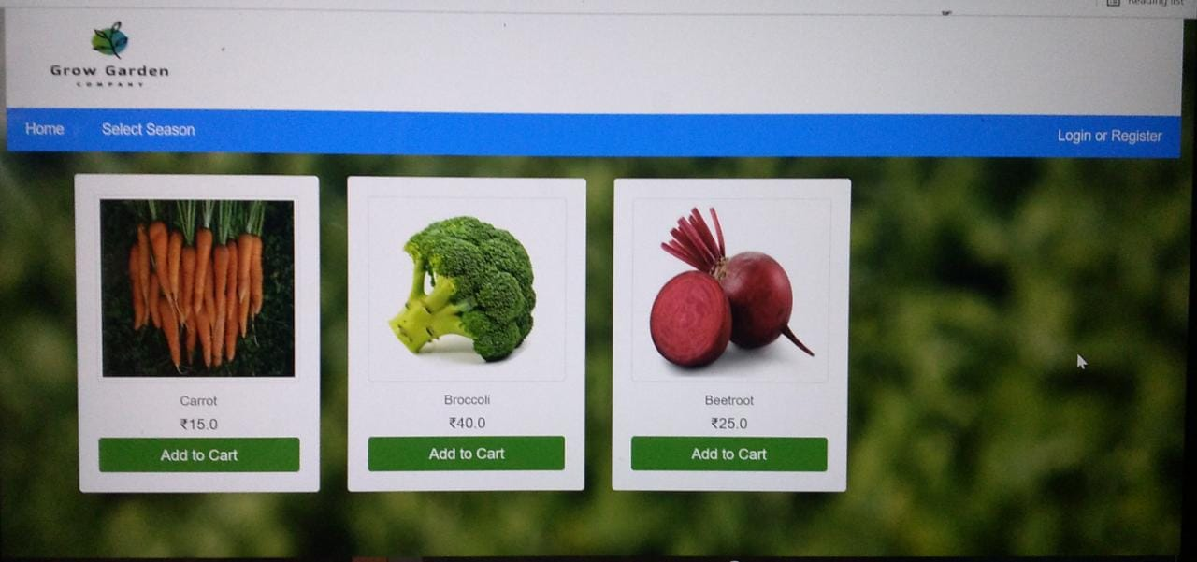

Slide 7
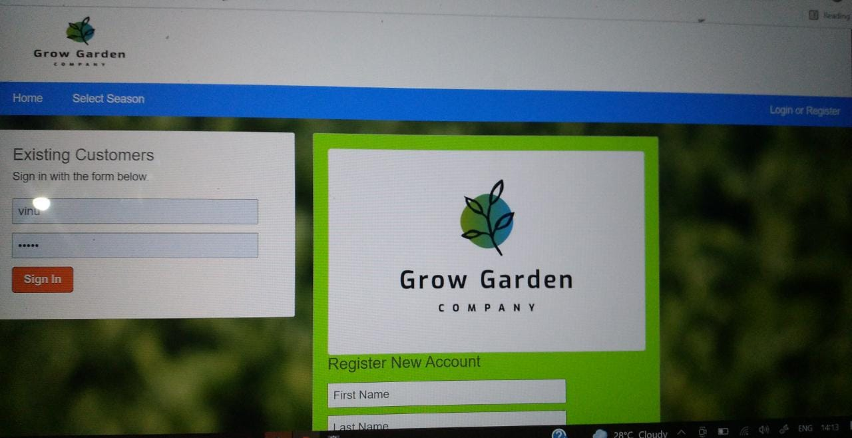

Slide 8
Frontend: Client side language Designing Languages: CSS (cascading style sheet) Designing Framework: bootstrap Browser Scripting Languages (Supporting languages) Java Script

Slide 9
Backend: springboot spring mvc hibernate database(mysql)

Slide 10
Future scope : 1. Vegetable cultivation in the terrace was a sequel to efforts in waste management. 2.after usage of wet garbage it will used for gardening as a fertilizer.

