Slide 1

TRANSFER AGENT DATA FLOW
Front Office, Middle Office & Back Office — Where Every Data Point Moves
Customer onboarding & orders · AML / financial crimes · fund accounting · portfolio management
fund operations & admin · shareholder reporting · taxation · custodian payments · billing · regulatory
[ Presenter Name · Date ]

Slide 2










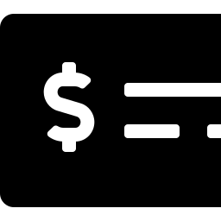




TA OPERATIONS
Transfer Agent Data Flow — Front, Middle & Back Office
Two-way exchange
One-way, TA-originated feed
FRONT OFFICE
MIDDLE & BACK OFFICE
Customer Onboarding
(KYC / CIP)
Fund Accounting
Portfolio Manager
(Orders & Cash Activity)
TRANSFER AGENT
Data Flow Hub
Fund Operations
AML / Financial Crimes
Screening
DATA IN TRANSIT
Fund Administration
Orders
Cash
Shareholder Reporting
Pre-Order Activity
(e.g., Institutional Direct Order)
Customer Info
Taxation
Tax Info
Dividends
Payments
(via Custodian)
Holdings
Corporate Finance
(Billing)
Customer Order Instructions
(Sub / Redeem / Exchange)
Payments
Fund Billing
Regulatory & Compliance
(State / SEC)
Front-office activity flows into the TA, which feeds every middle- and back-office system — several also send data back.
Transfer Agent Data Flow — Front, Middle & Back Office
2

