Slide 1
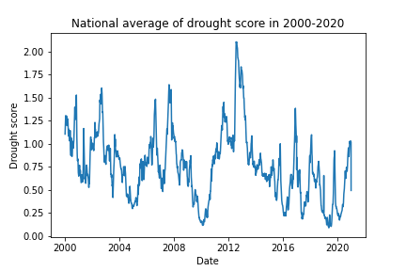
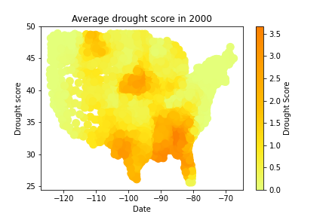
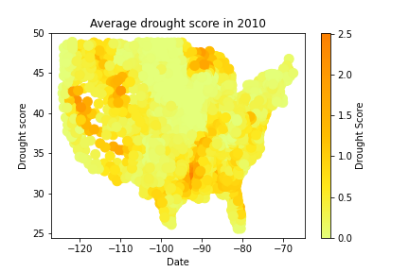
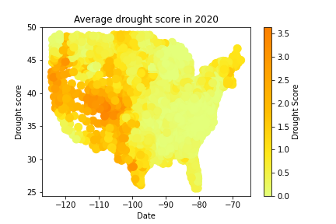
Trends in drought score in USA (Figure 1)
(A)
(B)
(C)
(D)

Slide 2
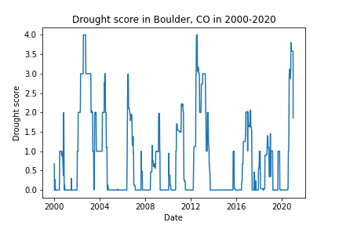
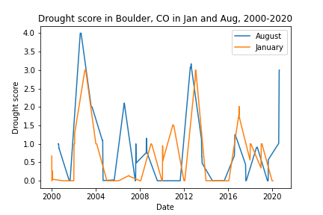
Trends in drought score in Boulder, Colorado (Figure 2)
(A)
(B)

Slide 3
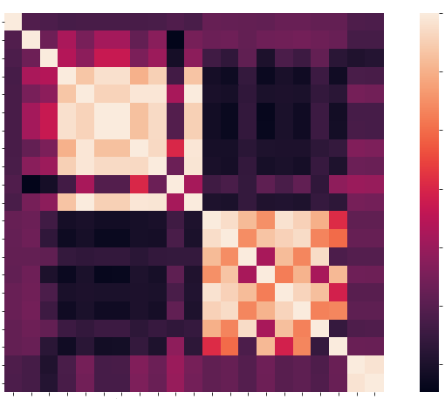
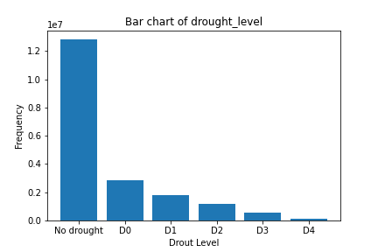
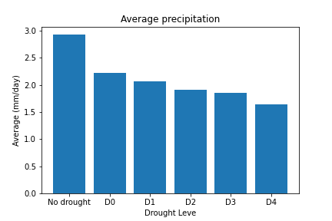
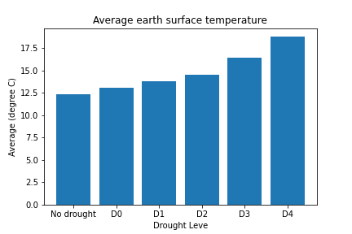
Statistical analysis of correlation (Figure 3)
fips
PROCTPT
PS
QV2M
T2M
T2MDEW
T2MWET
T2M_MAX
T2M_MIN
T2M_RANGE
TS
WS10M
WS10M_MAX
WS10M_MIN
WS10M_RANGE
WS50M
WS50M_MAX
WS50M_MIN
WS50M_RANGE
score
drought_level
1.0
0.8
0.6
0.4
0.2
0.0
-0.2
(A)
(B)
fips
PROCTPT
PS
QV2M
T2M
T2MDEW
T2MWET
T2M_MAX
T2M_MIN
T2M_RANGE
TS
WS10M
WS10M_MAX
WS10M_MIN
WS10M_RANGE
WS50M
WS50M_MAX
WS50M_MIN
WS50M_RANGE
score
drought_level
(C)
(D)

Slide 4
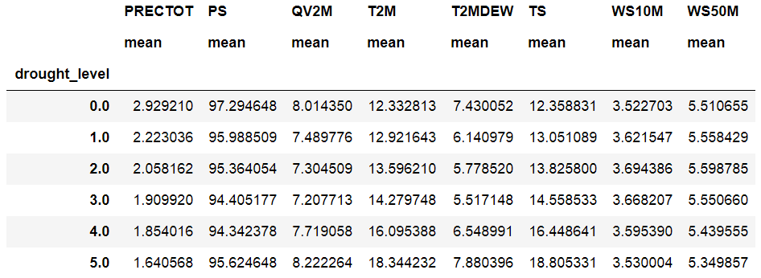
Table 1. Statistical characteristics of the train data set

Slide 5
Table2. Statistical analysis of correlation by Pearson and Spearman methods
feature method 1(correlation, p-value) method 2(correlation, p-value)
PRECTOT Pearsonr (-0.061, 0.0) Speaemanr(-0.083, 0.0)
PS Pearsonr (-0.187, 0.0) Spearmanr(-0.147, 0.0)
QV2M Pearsonr (-0.045, 0.0) Spearmanr(-0.045, 0.0)
T2M Pearsonr ( 0.091, 0.0) Spearmanr( 0.089, 0.0)
TS Pearsonr ( 0.098, 0.0) Spearmanr( 0.096, 0.0)
WS10M Pearsonr ( 0.027, 0.0) Spearmanr( 0.033, 0.0)
WS50M Pearsonr ( 0.003, 2.79e-36) Spearmanr( 0.003, 5.53e-39)

