Slide 1
CAPSTONE PROJECT

Slide 2
New York City’s demographics show that it is a large and ethnically diverse metropolis. It is the largest city in the United States with a long history of international immigration. New York City was home to nearly 8.5 million people in 2014, accounting for over 40% of the population of New York State and a slightly lower percentage of the New York metropolitan area, home to approximately 23.6 million. Over the last decade the city has been growing faster than the region. The New York region continues to be by far the leading metropolitan gateway for legal immigrants admitted into the United States.

Slide 3
Throughout its history, New York City has been a major point of entry for immigrants; the term “melting pot” was coined to describe densely populated immigrant neighbourhoods on the Lower East Side. As many as 800 languages are spoken in New York, making it the most linguistically diverse city in the world. English remains the most widely spoken language, although there are areas in the outer boroughs in which up to 25% of people speak English as an alternate language, and/or have limited or no English language fluency. English is least spoken in neighbourhoods such as Flushing, Sunset Park, and Corona.
With it’s diverse culture , comes diverse food items. There are many restaurants in New York City, each belonging to different categories like Chinese , Indian , French etc.
So as part of this project , we will list and visualise all major parts of New York City that has great Indian restaurants.

Slide 4
Results

Slide 5
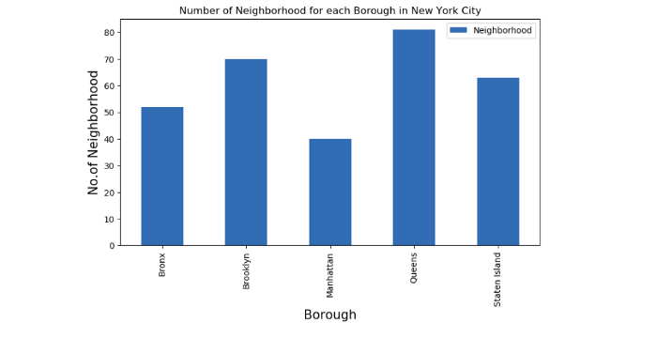
We see that Queens has the highest number of Neighbourhoods.

Slide 6
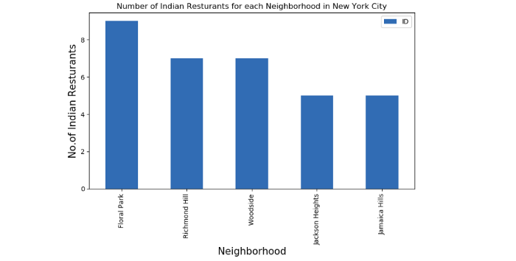
Floral Park in Queens has the highest number of Indian Restaurants with a total count of 9.

Slide 7
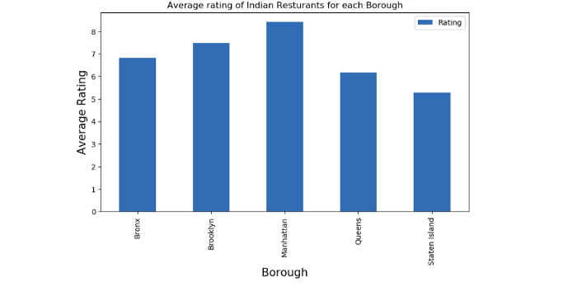
Manhattan has the highest average rating for Indian Restaurants.

Slide 8
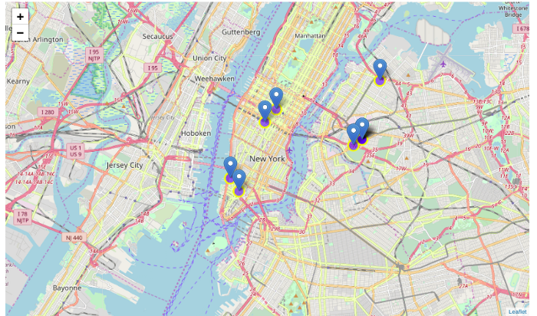
Best neighbourhoods in New York that has highest average rating for Indian Restaurants.

Slide 9
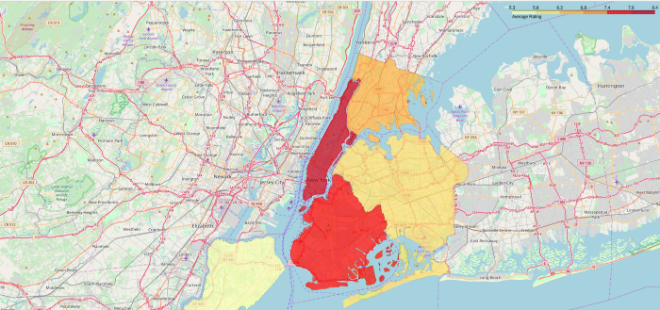
Borough Choropleth map based on average rating of Indian Restaurants.

Slide 10
Conclusion
Astoria(Queens), Blissville(Queens), Civic Center(Manhattan) are some of the best neighborhoods for indian cuisine.
Manhattan have potential Indian Resturant Market/
Staten Island ranks last in average rating of Indian Resturants.
Manhattan is the best place to stay if you prefer Indian Cuisine.
Limitations
The ranking is purely on basis of rating of resturants
The accuracy of data depends purely depends on the data provided by FourSquare

