Slide 1
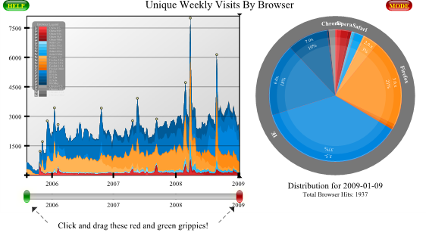
Evaluation only.
Created with Aspose.Slides for .NET 4.0 Client Profile 21.11.
Copyright 2004-2021Aspose Pty Ltd.

